Slide 1


SMART INDIA HACKATHON 2024
TITLE PAGE
Problem Statement ID –1625
Problem Statement Title – Smart Classroom Management software for enhanced learning environments.
Theme – Smart automation
PS Category – Software
Team ID – 62
Team Name (Registered on portal) – Tiny coders

Slide 2
IDEA TITLE
Tiny coders
Proposed Solution
Objective: Create a website where long lecture videos are summarized for quicker review.
Video Summarization: AI shortens 1-hour lectures to 15-20 minute videos.
Text Summarization: AI generates audio and text summaries alongside the video
Quiz Generation: Auto-generated quizzes from lecture keywords.
Discussion Forum: A platform for students and teachers to discuss lectures daily
Benefit: Helps students revise lectures in a shorter time, enhancing learning efficiency.
Tools and Techniques/Algorithms used :-
Lib PySceneDetect :- Automatically splits the videos into various segments/clips.
Lib whisper:- It converts any audio to text.
NLP technique:- To check the link or similarity between segments.
FFmpeg:- Based on time factor the similar videos are merged together.
Rake Lib and spaCy lib:- Extracts the key-words to form the summary.
Hugging face question generation pipeline( From transforms import pipeline):- Returns questions based on key points extracted from summary.
JSON:- Format in which quiz are stored.
Open CV:- To access camera feed.
Tesseract Lib:- Helps in detecting texts in the frame.

Slide 3
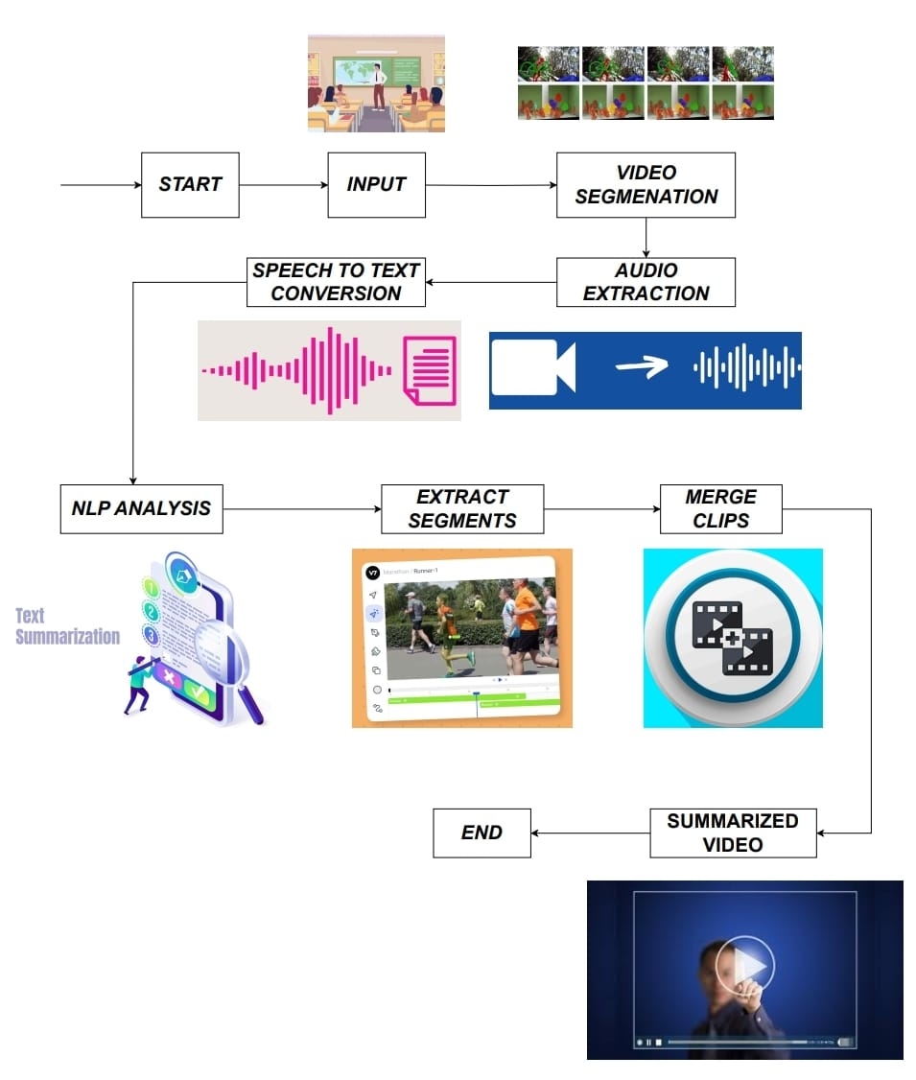
TECHNICAL APPROACH
Tiny coders
Programming language : Python.
(i)For object detection and video processing we use Open CV,CNN,Tesseract libraries.
(ii)To break the video we use Pyscence Detect library.
(iii)To convert segment videos to text and vice versa we use Whipser library.
(iv)To sync the summarized segments we use NLP technique.
(v)To merge the synced we use segments we use Ffmpeg library.
(vi)RAKE and SPACY libraries to extract key points from summary.
(vii)Hugging face quantization to generate quiz questions from the summary.
(viii)JSON for quiz tabs.

Slide 4
FEASIBILITY AND VIABILITY
Tiny coders
Analysis of the feasibility of the idea:
Advancements in AI and ML
Complexity
Cost of Development
Customization
User Integration
Potential challenges and risks:
Accuracy
Real-Time Processing
Strategies for overcoming these challenges:
Improving accuracy:
Multimodal Analysis
Domain-Specific Models
User Feedback and Reinforcement Learning
Improving real time processing:
Edge Computing
Efficient Model Compression
Temporal Segmentation

Slide 5
IMPACT AND BENEFITS
Tiny coders
Time Efficiency
Enhanced Learning and Retention
Personalized Learning
Accessibility and Flexibility
Higher Engagement and Interaction
Scalable and Automated
Improved Assessment and Feedback

Slide 6
RESEARCH AND REFERENCES
Tiny coders
https://scholar.google.com/scholar?hl=en&as_sdt=0%2C5&q=statistical+evaluation+of+video+summarization+models+from+an+empirical+perspective&btnG=
https://scholar.google.com/scholar?hl=en&as_sdt=0%2C5&q=vidsum-+video+summarisation+using+deep+learning&oq=vidsum-+video+summarisation+using+deep.lesrn
https://scholar.google.com/scholar?hl=en&as_sdt=0%2C5&q=multimodal+language+models+for+domain-specific+procedural+video+summarisation+&btnG=
https://dl.acm.org/doi/abs/10.1145/3652920.3652922
https://arxiv.org/abs/2404.12353
https://arxiv.org/abs/2404.04564
https://link.springer.com/article/10.1007/s11042-023-15829-5

Slide 7
IMPORTANT INSTRUCTIONS
Please ensure below pointers are met while submitting the Idea PPT:
Kindly keep the maximum slides limit up to six (6). ( Including the title slide)
Try to avoid paragraphs and post your idea in points /diagrams / Infographics /pictures
Keep your explanation precise and easy to understand
Idea should be unique and novel.
You can only use provided template for making the PPT without changing the idea details pointers (mentioned in previous slides).
You need to save the file in PDF and upload the same on portal. No PPT, Word Doc or any other format will be supported.
Note - You can delete this slide (Important Pointers) when you upload the details of your idea on SIH portal.

