Slide 1

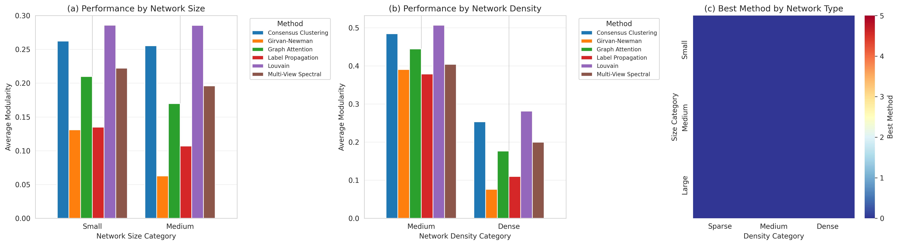
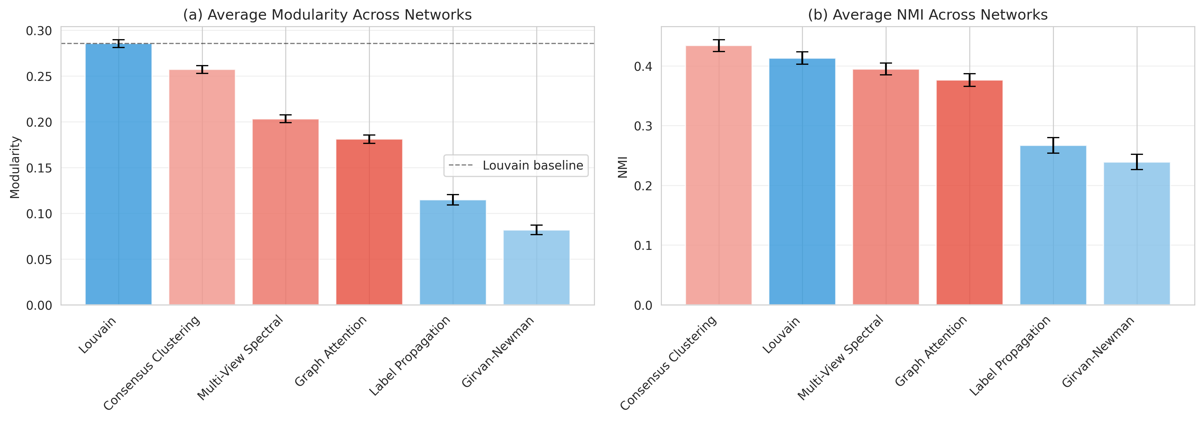
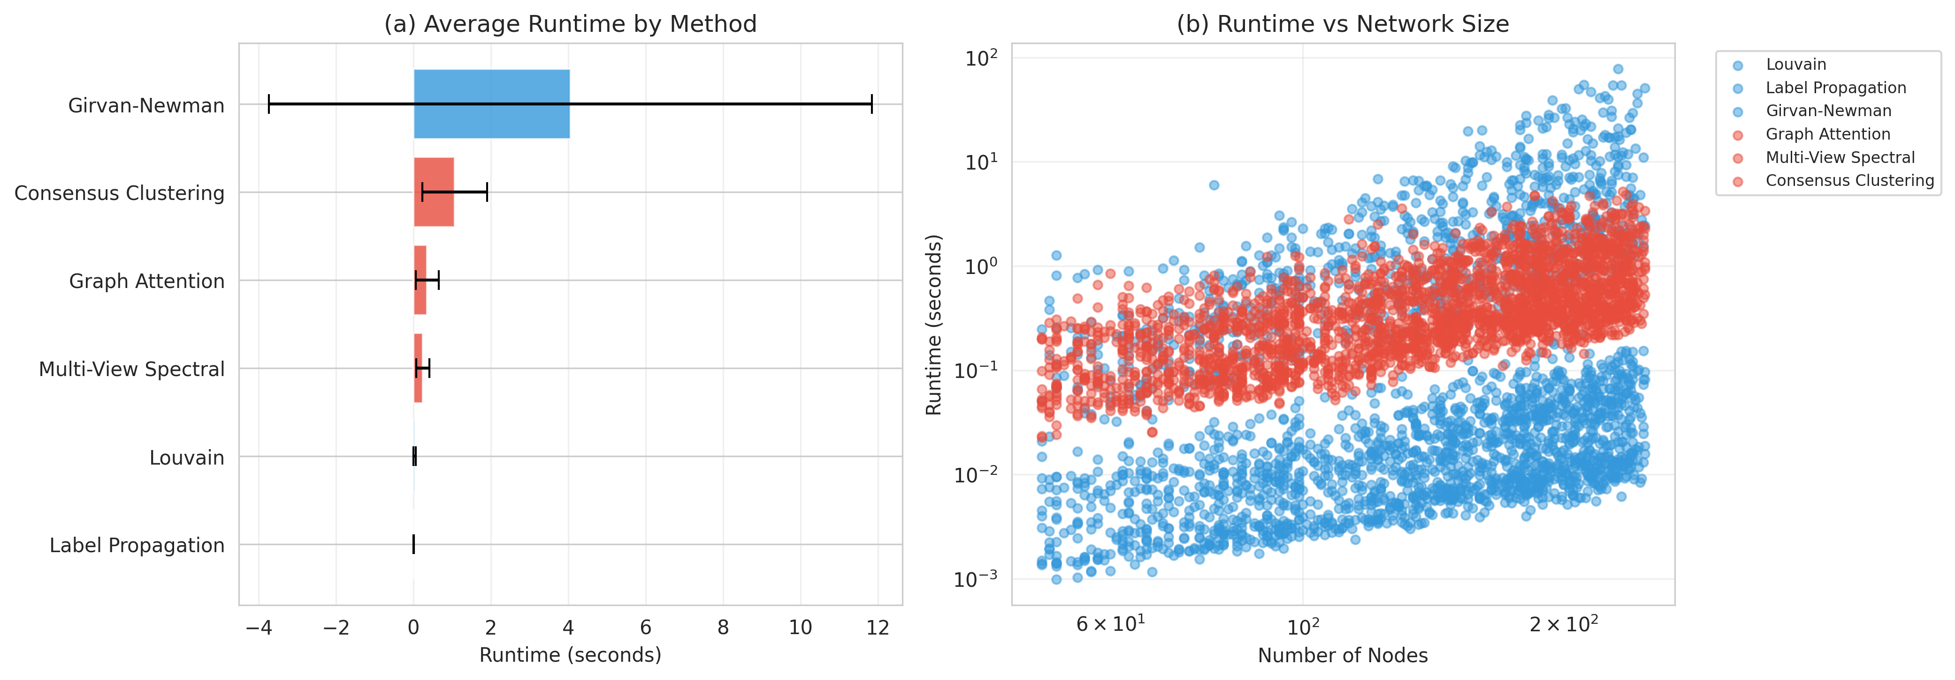
Community Detection in Twitter Ego-Networks: A Large-Scale Comparative Study
Chandana T
Introduction & Motivation
Methodology
Results
Community detection in social networks is fundamental to understanding information diffusion, influence propagation, and social dynamics. While traditional graph-based methods like Louvain and Label Propagation have dominated this space, recent advances in deep learning suggest that attention mechanisms and multi-view learning could capture more nuanced community structures. However, most prior work evaluates these methods on small synthetic datasets or limited real-world networks, leaving a critical question unanswered: Do deep learning-inspired methods actually improve community detection on large-scale real social networks?
This project addresses this gap through a comprehensive evaluation of six community detection methods—three traditional and three deep learning-inspired approaches—on 861 Twitter ego-networks from the SNAP dataset. The central hypothesis is that methods leveraging node attributes through attention mechanisms and multi-view learning will outperform structure-only baselines, particularly in heterogeneous networks with rich feature information. This research is motivated by the practical need to understand when sophisticated deep learning approaches justify their computational overhead versus well-established traditional methods.
Traditional Baselines:
Louvain: Greedy modularity optimization with hierarchical aggregation
Label Propagation: Iterative label diffusion with linear complexity
Girvan-Newman: Edge betweenness-based hierarchical clustering
Deep Learning-Inspired Methods:
Graph Attention: Multi-head attention (4 heads) computing feature-based edge importance, averaged across heads and combined with structure via weighted similarity matrix
Multi-View Spectral: Fuses structural and attribute views with adaptive weighting: α = 1 − homophily, where homophily measures attribute similarity along edges
Consensus Clustering: Ensemble approach running base clustering 20 times with data augmentation (10% edge dropping, 20% feature masking), building a co-occurrence matrix for final clustering
Experimental Setup
Conclusion & Future Work
Network Characteristics
Total networks processed: 861 out of 973
Network size range: 50 to 5,000 nodes
Median network density: 0.008 (highly sparse)
Density stratification:
  Sparse networks (density < 0.01): 68% of the dataset
  Dense networks (density > 0.05): ~10% of the dataset
Hyperparameters
Graph Attention: 4 attention heads
Consensus Clustering: 20 base runs, 10% edge dropping, 20% feature masking
Multi-View Spectral: Adaptive α weighting based on homophily
Traditional methods: Used default hyperparameter-free configurations
Validation Strategy
Performance was validated against ground-truth "circle" annotations provided in the dataset, representing actual social communities identified by Twitter users.
Traditional methods remain dominant: On sparse social networks, Louvain outperforms deep learning-inspired methods in both efficiency (30× faster) and modularity optimization, winning on 65% of networks.
Deep learning adds value conditionally: Deep learning methods excel in specific regimes—dense networks (>0.05 density), high attribute homophily (>0.6), and applications prioritizing stability over modularity.
Future Work
Adaptive hyperparameter optimization: Explore meta-learning approaches to automatically tune hyperparameters based on network characteristics, potentially closing the performance gap
Trainable graph neural networks: Investigate end-to-end learnable architectures with trainable attention mechanisms rather than hand-crafted similarity functions.
Objectives
The primary objectives of this study were:
Benchmark deep learning methods at scale: Conduct the first large-scale evaluation of deep learning-inspired community detection methods on 861 real Twitter networks
Test the attribute-integration hypothesis: Determine whether methods leveraging node attributes through attention mechanisms and multi-view learning outperform structure-only baselines on networks with rich feature information
Identify performance regimes: Quantify specific network characteristics (density, homophily, size) where deep learning methods justify their computational overhead
References
[1] J. McAuley and J. Leskovec, “Learning to discover social circles in ego networks,” NIPS, 2012.
[2] V. Blondel et al., “Fast unfolding of communities in large networks,” J. Statistical Mechanics,2008.
[3] M. Girvan and M. E. J. Newman. Community structure in social and biological networks. Proceedings of the National Academy of Sciences (PNAS), 2002.

