Slide 1


Healthcare Fund Allocation Portal
University BDT College of Engineering, Davangere
Blockchain-Powered Transparent Healthcare Claims System
- Chandana T

Slide 2
Under the guidance of:
Prof. Mohamed Rafi ME, Phd.
Chairman & Guide
DOS of Computer Science & Engineering
University BDT College of Engineering
Davangere - 577004

Slide 3
Introduction
• Ayushman Bharat (PM-JAY): ₹5 Lakh/family/year with 100M+ beneficiaries and is Aadhaar-based
• Arogya Karnataka (AB-ArK): Blends national and state schemes providing
Free treatment, with no upfront payment
• Claims delayed: Weeks to months
• Only ~66% budget was utilized
• Paperwork, fraud, duplicate claims
• Rural hospitals suffer cash flow
• No real-time visibility

Slide 4
Literature Survey
GLOBAL RESEARCH (2016–2023)
• 2019 MDPI Review (Hasselgren et al.): 60+ studies
EHR security, Drug traceability, Clinical trials
Benefits: Tamper-proof, No middlemen, Transparent
Gap: Mostly theoretical, Few real deployments
• 2021 PLOS One (Hussien et al.): 51 studies
Patientory: Patient-controlled health data
Challenges: High cost, Slow speed

Slide 5
Literature Survey
• NITI Aayog (2020): Blockchain: The India Strategy,
Pilots: Fertilizer | Apollo Hospitals (drug supply chain),
WHO: 1 in 5 drugs in India = fake
Goal: End-to-end pill tracking
Gaps: Only 10,000 blockchain experts globally
• 2022 Hindawi (Kumar & Tripathi
Blockchain for EHR sharing | Vaccine certificates
Barriers: Poor internet | Low digital literacy | High cost

Slide 6
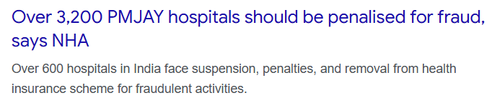
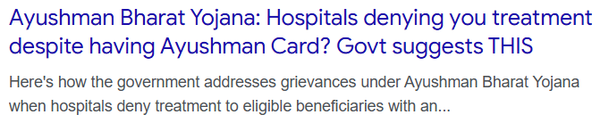
Motivation
Enhancing Transparency and Trust
Preventing Fraud
Social Impact

Slide 7
Problem Statement
Manual claim processing causes delays and errors
High risk of fraud and duplicate claims
No transparency in fund allocation
Difficulty tracking family-wise annual limits

Slide 8
Solution Overview
Web-based portal with role-based access
Blockchain for immutable claim logging
Auto-generated PDF certificates with QR verification
Bulk citizen data upload via XLSX

Slide 9
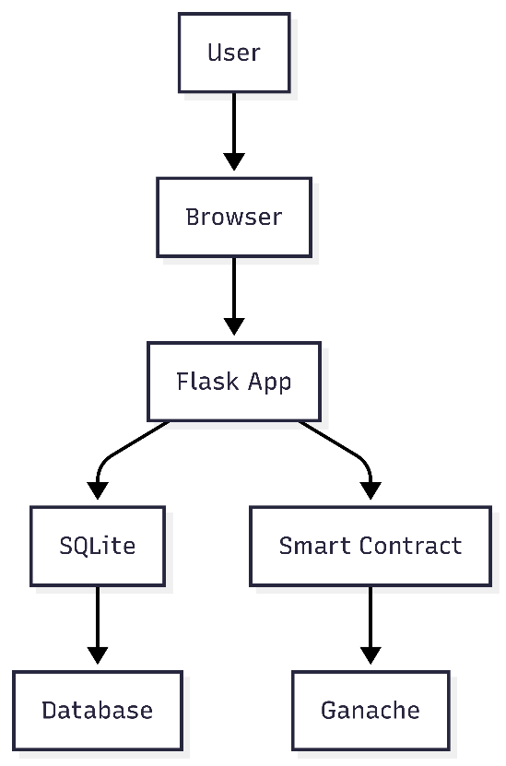
System Architecture
Frontend: Flask + HTML/Jinja2
Backend: SQLite (thread-safe)
Blockchain: Ethereum (Ganache local chain)
Web3.py for smart contract interaction
ReportLab for PDF generation
QR codes for certificate verification

Slide 10
User Roles
District Admin → Creates Socio-Economic & Treasurer accounts
Socio-Economic Admin → Manages citizen data & news
Treasurer → Registers hospitals, approves/rejects claims
Hospital Staff → Submits claims with bill PDFs

Slide 11
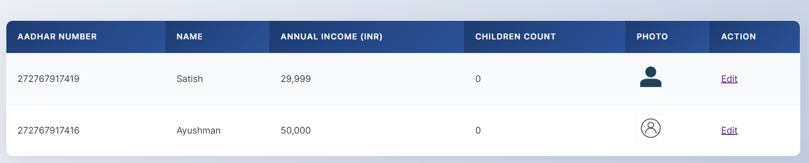
Socio-Economic Admin
Add/edit citizen: Aadhaar, name, income, family
Upload photo (JPG/PNG/PDF)
Bulk upload via XLSX with validation
View all registered citizens

Slide 12
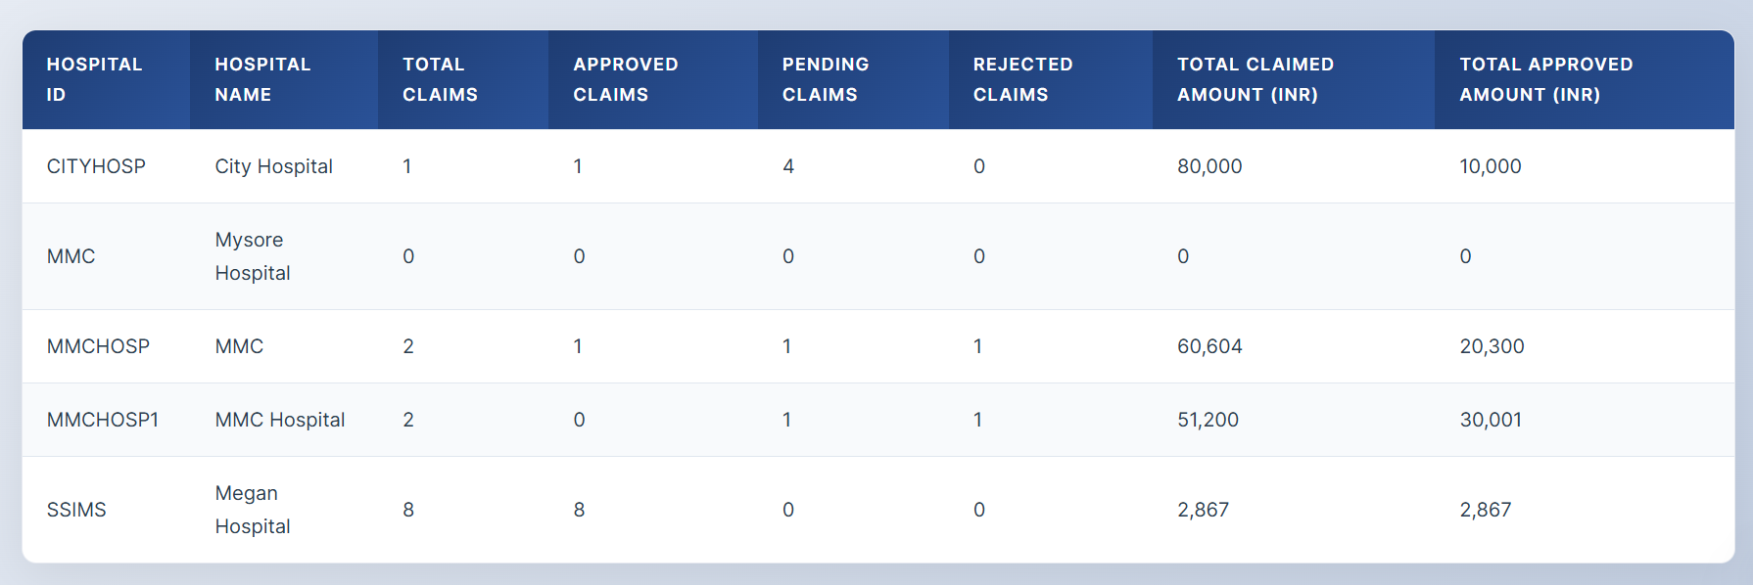
Treasurer Dashboard
Register hospitals with public/private keys
View pending claims with bill PDFs
Approve/Reject with reason
View hospital-wise and overall stats

Slide 13
Hospital Staff Workflow
Enter patient ID, Aadhaar, operation, amount, place
Upload bill PDF
System checks family annual limit (₹5 Lakh)
Submit → recorded on blockchain

Slide 14
Blockchain Integration
Smart Contract Functions:
• registerHospital(address)
• submitClaim(hospital, amount)
• approveClaim(claimId)
• rejectClaim(claimId)
Event: ClaimSubmitted(claimId, hospital, amount)

Slide 15
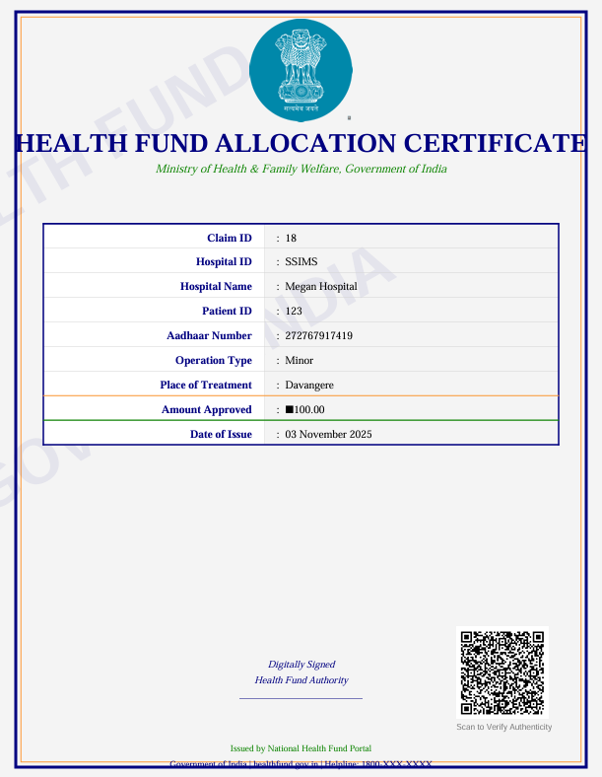
PDF Certificate Generation
Generated automatically on approval
Includes: Claim ID, Amount, Hospital, QR Code
Watermark: 'Health Portal'
Emblem of India + border
Downloadable by Treasurer & Hospital

Slide 16
Security Features
Password hashing (Werkzeug)
Session: HttpOnly, SameSite=Lax, 1-hour expiry
File upload validation (extensions, secure_filename)
Input sanitization & logging
Thread-local SQLite connections

Slide 17
Key Features
Indian number formatting (Jinja filter)
XLSX bulk import with Aadhaar validation
Family-wise claim limit enforcement
Comprehensive logging

Slide 18
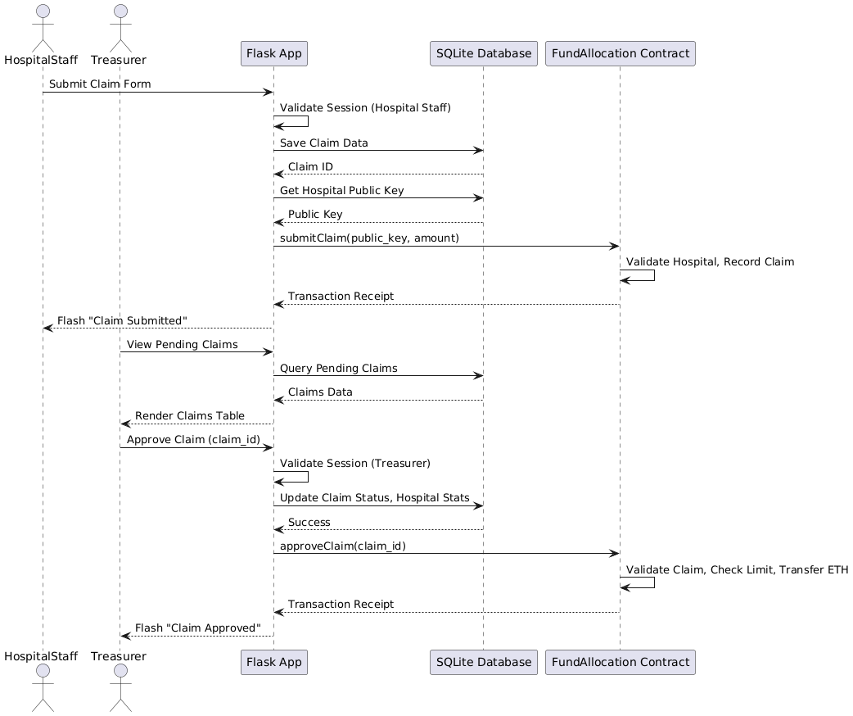
Demo Flow
1. Login as Hospital → Submit Claim
2. Treasurer → Review & Approve
3. Certificate Generated → Download
4. Scan QR → Verify on Blockchain

Slide 19
Future Enhancements
Public claim verification portal
SMS/Email alerts on status change
IPFS storage for bill PDFs
Digital signature on certificates
Mobile app for hospital staff

Slide 20
Thank You!
Project by: Chandana T
GitHub: github.com/Chandanat14/health-fund-portal

