Slide 1

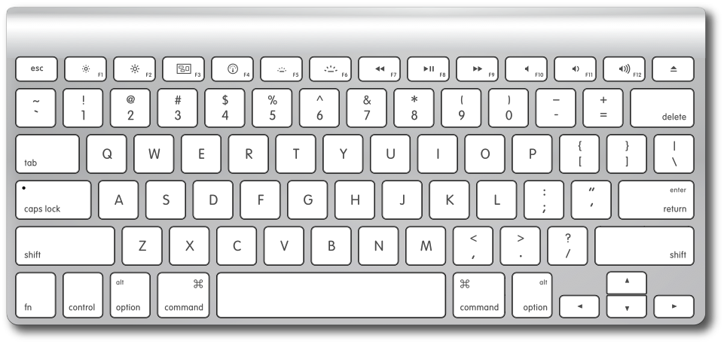
CONTROLLER TO SELECT OPTION
CONTROLLER TO SELECT POSITON OF GUN TO SHOOT
SHOOT

