Slide 1
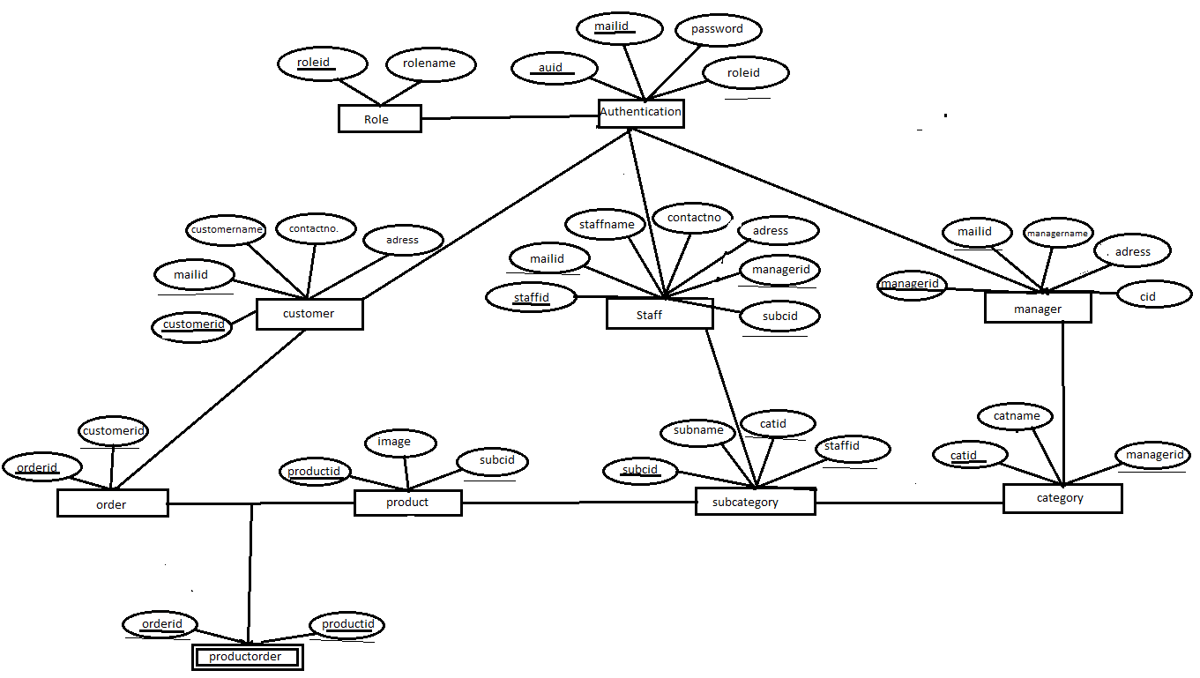
1
n
require
1
1
requires
requires
requires
1
1
1
1
1
manages
manages
gives
1
1
n
has
has
has
n
1
n
1
n
1

