Slide 1
OBE Implementation
Module-7:Courses
Submitted By
JavaBeans
G .Sai Chandhan [AP22110010343]
E .Likhith [AP22110010386]
N .Mahimanth [AP22110010329]
K .Nehar [AP22110010381]
K .Deepika [AP22110010423]

Slide 2
Introduction to Project
Our University (herewith considered as SRM-AP) is going to implement OBE(Outcome Based Education) in their university and you are assigned in the project to develop a CURD(Create,Update,Retrieve and Delete) windows and mobile application using JAVA programming and Android studio for the same.

Slide 3
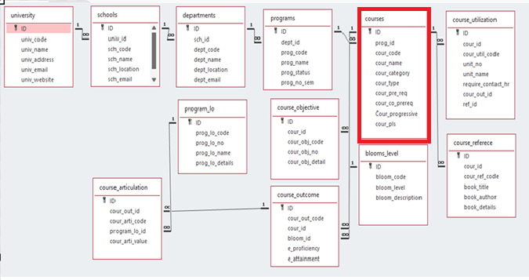
Architecture Diagram

Slide 4
Module Description : University Setting
This module is used to create,Update,Retrieve,Delete(hereafter known as CURD) details of the module and storing the details in the mysql table.

Slide 5
Courses:Field/table details
Field Name | Datatype
id | String
program_id | String
code | String
name | String
category | String
type | String
prereq | String
coreq | String
progression | String
course_plan | String

Slide 6
University Setting:Programming Details
File name: JavaBeans_courses
Function/method name
Create: JavaBeans_courses_create
Update: JavaBeans_courses_update
Retrieve: JavaBeans_courses _retrive
Delete: JavaBeans_courses _delete

Slide 7
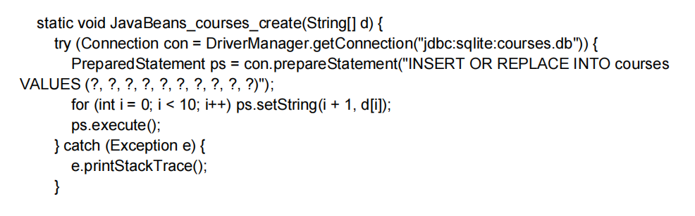
Sample Source Code
a.] Create:

Slide 8
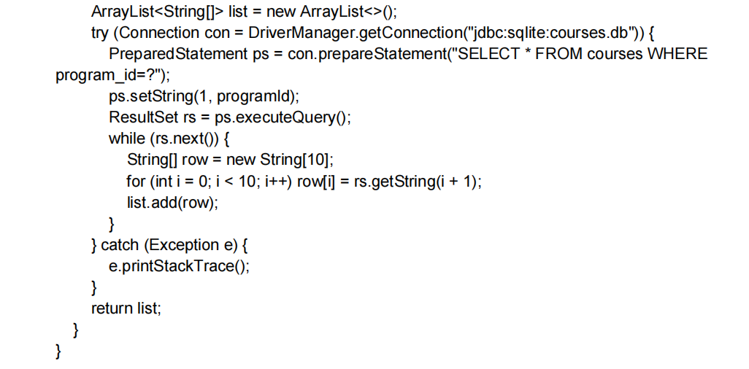
b.] Retrieve:

Slide 9
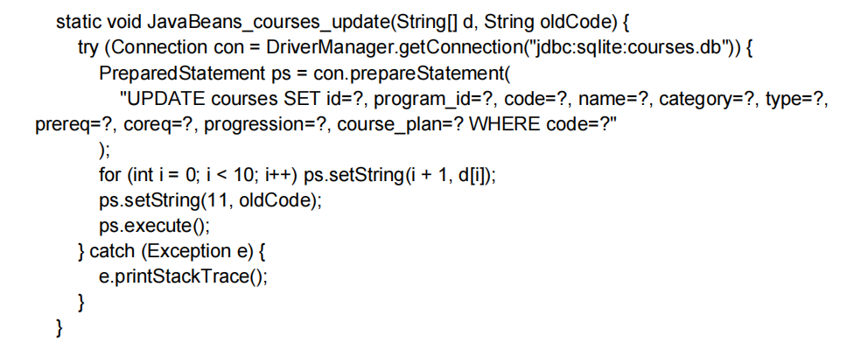
c.] Update:

Slide 10
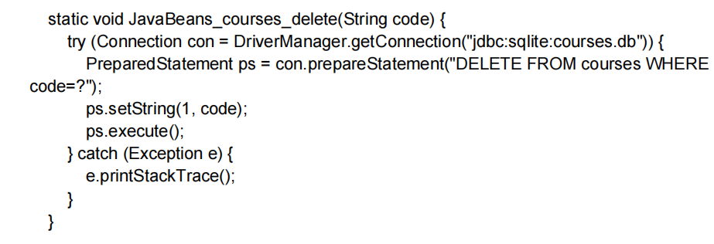
d.] Delete:

Slide 11
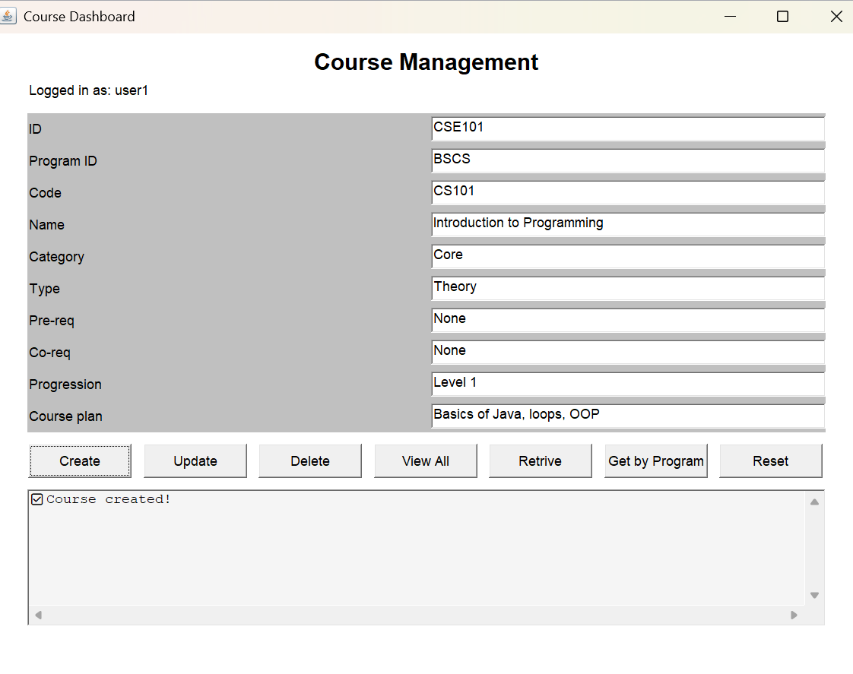
Sample Screen Shots
Create:

Slide 12
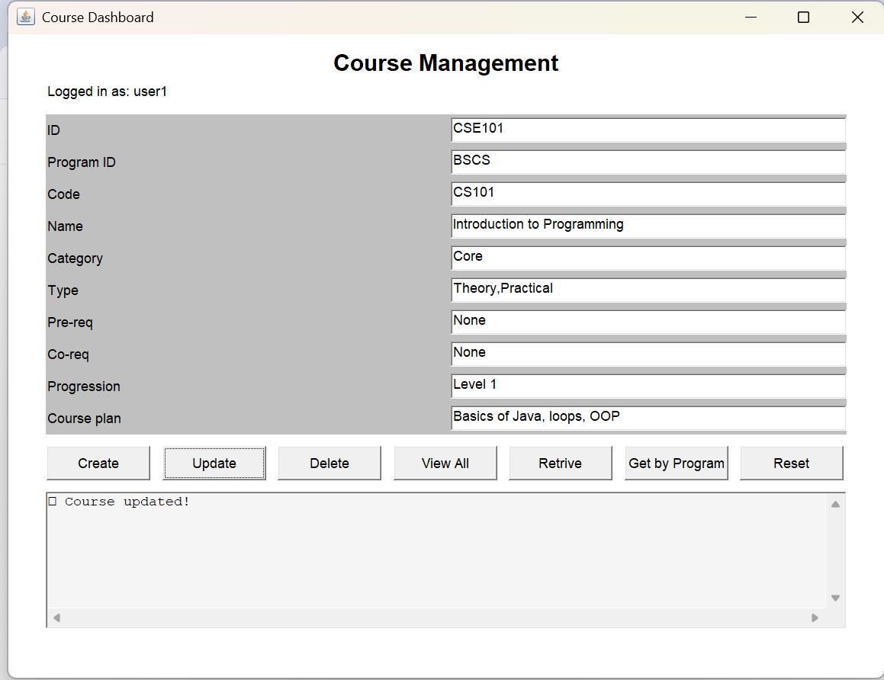
Sample Screen Shots
Update:

Slide 13
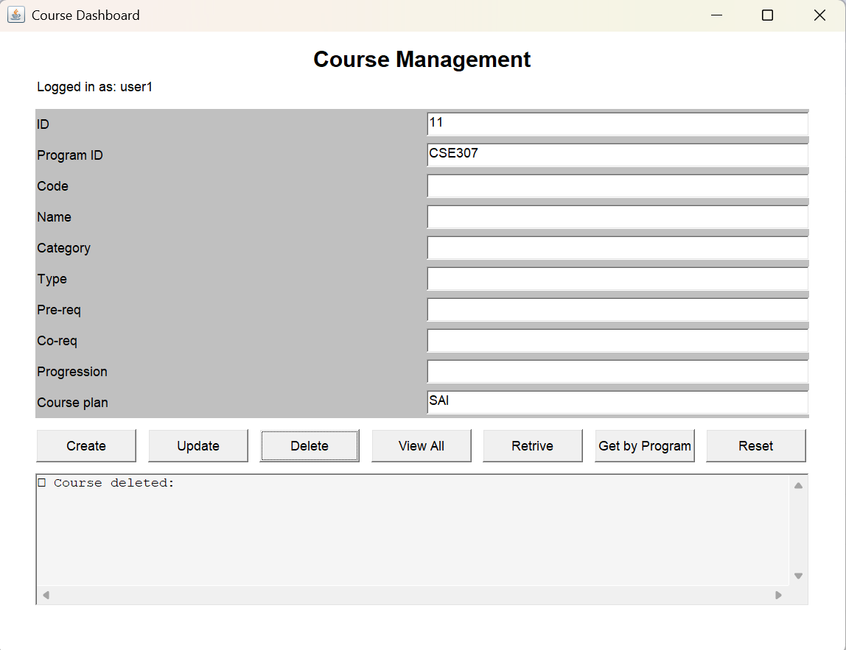
Sample Screen Shots
Delete:

Slide 14
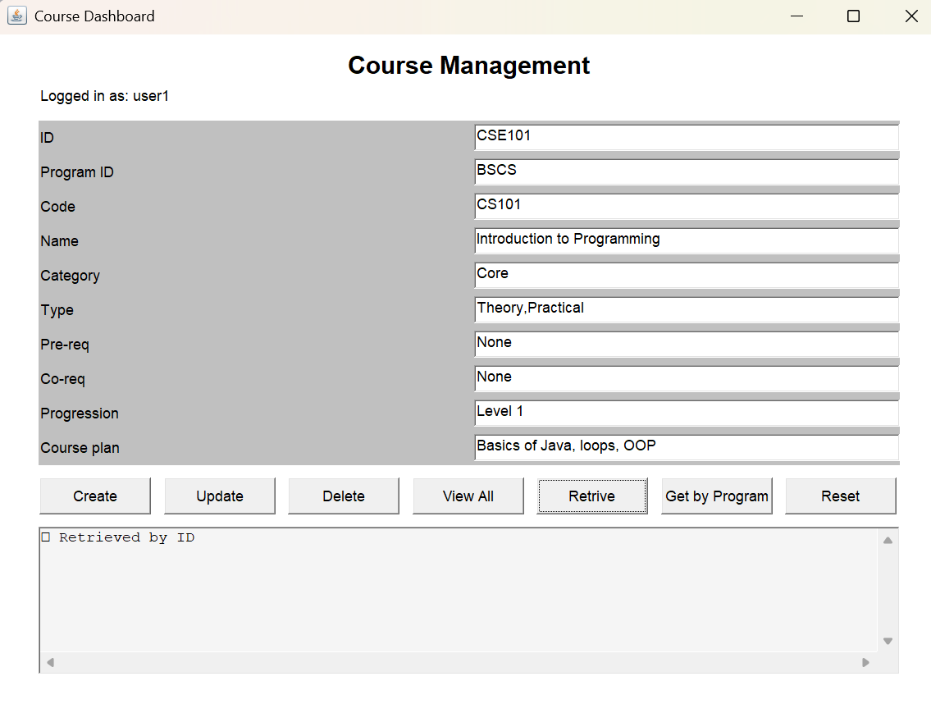
Sample Screen Shots
Retrive:

Slide 15
Conclusion
This project effectively demonstrates the implementation of a full-fledged Java AWT-based GUI application integrated with SQLite for managing course data. It supports complete CRUD (Create, Read, Update, Delete) operations, allowing users to register, log in, and manage course records such as course codes, program IDs, prerequisites, and more through an intuitive and interactive interface.The structure combines clean form-based input with functional logic, using Java’s Frame, TextField, and Button components. The integration of JDBC with SQLite ensures reliable data persistence, while features like login authentication, course retrieval by ID or Program ID, and form reset add usability and depth.
The separation of GUI and database logic via the CourseOperations class keeps the project modular and maintainable. Future enhancements can include features such as:Input validation,Enhanced UI with Swing or JavaFX,User roles (e.g., admin vs student).Overall, this project lays a solid foundation for educational course management systems in Java.

Slide 16
Thank You

