Slide 1
Methods of BUS ARBITRATION

Slide 2
INTRODUCTION
In a computer system, a bus serves as a common communication pathway connecting various devices such as the CPU, memory, and I/O controllers.
Multiple devices may need to access the bus to transfer data simultaneously, leading to potential conflicts and complications.
Bus arbitration is the process designed to resolve conflicts that arise when multiple devices attempt to access the bus concurrently.
The primary goal of bus arbitration is to ensure that only one device has access to the bus at any given time, promoting a systematic and controlled data transfer process within the computer system.

Slide 3
Types of Bus arbitration
There are two approaches to bus arbitration:
Centralized bus arbitration : – A single bus arbiter performs the required arbitration.
Distributed bus arbitration : – All devices participating in the selection of the next bus master.

Slide 4
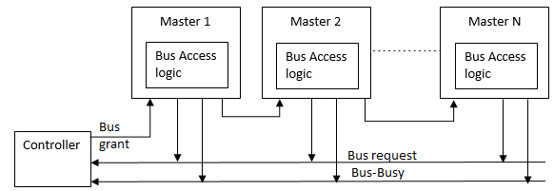
Methods of centralized bus arbitration
1) Daisy Chain bus arbitration :

Slide 5
Advantages & Disadvantages of daisy chain method
Advantages:
Simplicity and Scalability.
The user can add more devices anywhere along the chain, up to a certain maximum value.
Disadvantages:
The value of priority assigned to a device depends on the position of the master bus.
Propagation delay arises in this method.
If one device fails then the entire system will stop working.

Slide 6
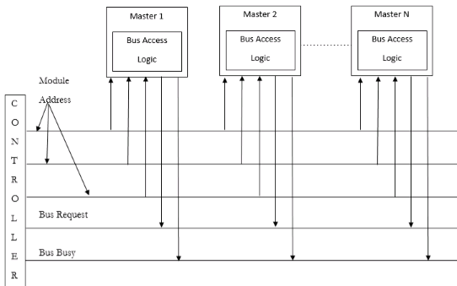
2) Polling or rotating priority method

Slide 7
Advantages & disadvantages of rotating bus arbitration
Advantages : –
This method does not favour any particular device and processor.
The method is also quite simple.
Disadvantages : –
Adding bus masters is difficult as increases the number of address lines of the circuit.
If one device fails then the entire system will not stop working.

Slide 8
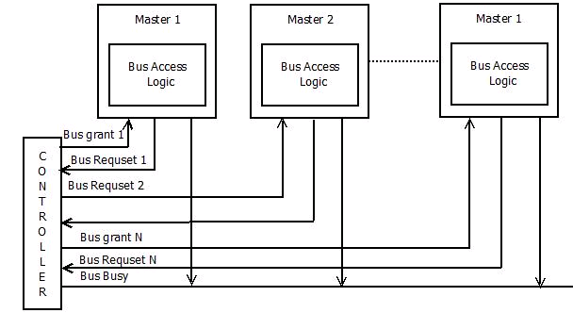
3). Fixed priority or independent request method

Slide 9
Advantages & disadvantages of fixed priority method
Advantages –
This method generates a fast response.
Disadvantages –
Hardware cost is high as a large no. of control lines is required.

Slide 10
Distributed Bus Arbitration
Here, all the devices participate in the selection of the next bus master.
Each device on the bus is assigned a4 bit identification number.
When one or more devices request control of the bus, they assert the start arbitration signal and place their 4-bit identification numbers on arbitration lines through ARB3.
Each device compares the code and changes its bit position accordingly.
It does so by placing a 0 at the input of their drive.
The distributed arbitration is highly reliable because the bus operations are not dependant on devices.

Slide 11
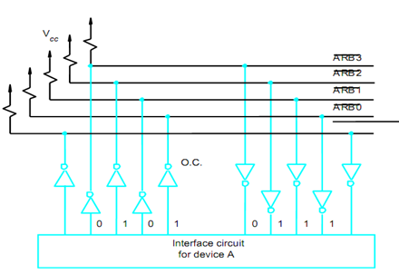

Slide 12


