Slide 1


Revolutionizing Interaction: Unveiling the Potential of Si Sense Technology

Slide 2
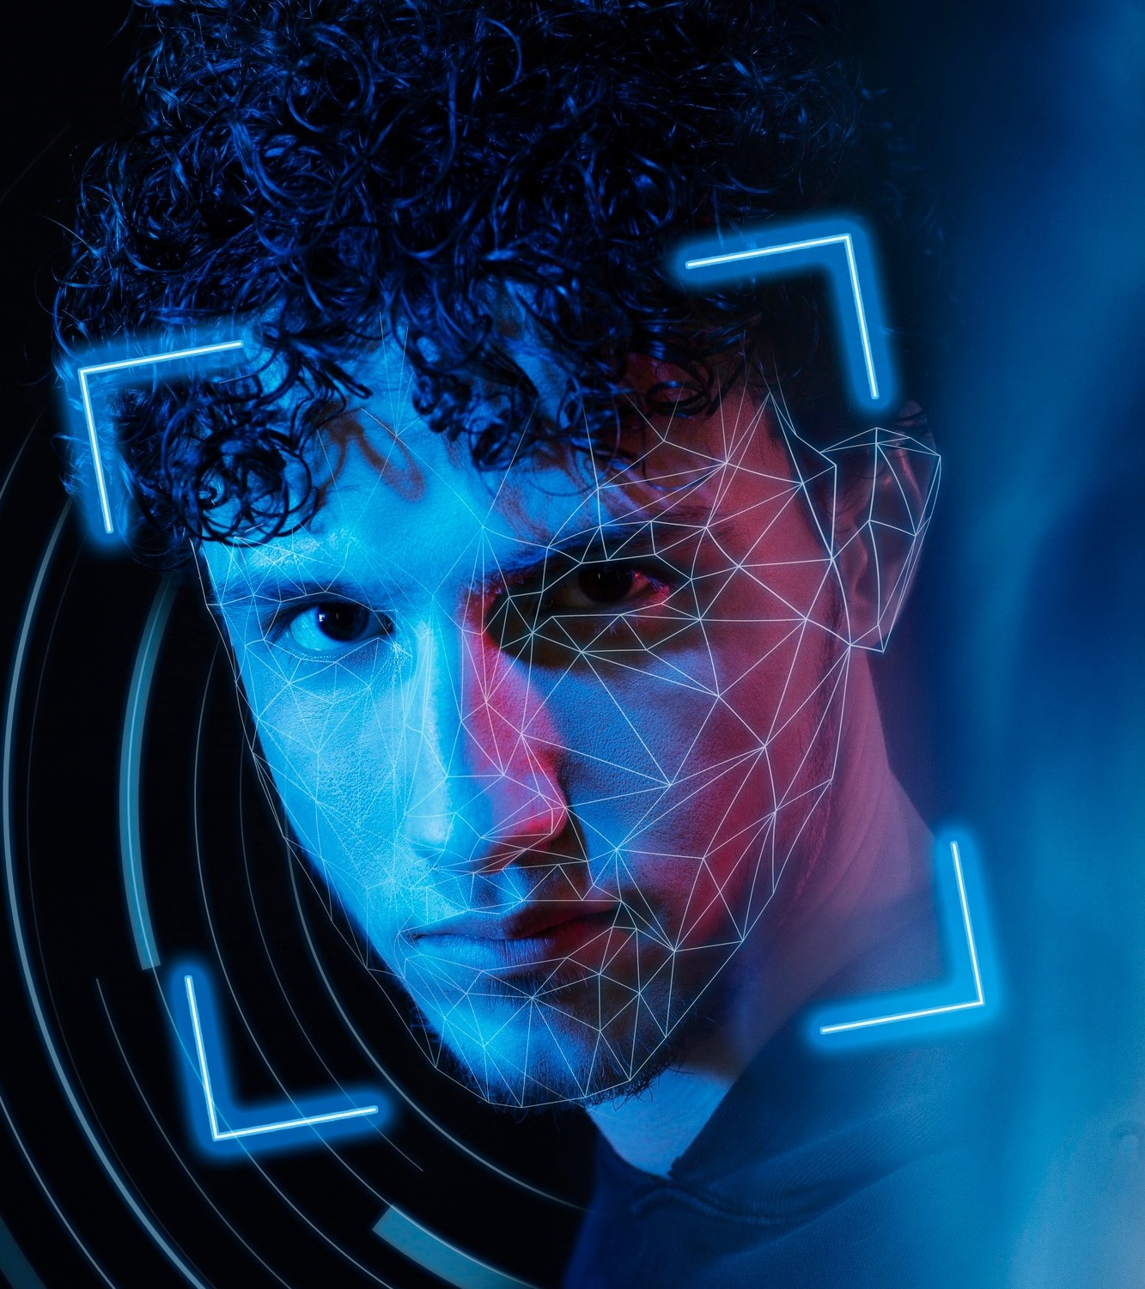
Introduction
Welcome to the presentation on Revolutionizing Interaction with Six Sense Technology. Today, we will explore the incredible potential of this groundbreaking technology and its impact on various industries.

Slide 3

Understanding Si Sense
Six Sense is a cutting-edge technology that enables users to interact with digital information in the physical world. It leverages gestures and motion tracking to create a seamless interface between humans and technology.

Slide 4


Applications in Healthcare
In the healthcare sector, Six Sense Technology has the potential to revolutionize patient care by enabling hands-free access to medical records and real-time data. It also facilitates virtual consultations and surgical simulations.

Slide 5

Enhancing Education
Six Sense Technology can transform education by offering immersive learning experiences through augmented reality. It enables students to interact with digital content in the physical classroom, making learning more engaging and interactive.

Slide 6


Empowering Retail E periences
Retailers can leverage Six Sense to provide personalized shopping experiences through virtual try-ons and interactive product displays. This technology enhances customer engagement and facilitates seamless omnichannel interactions.

Slide 7
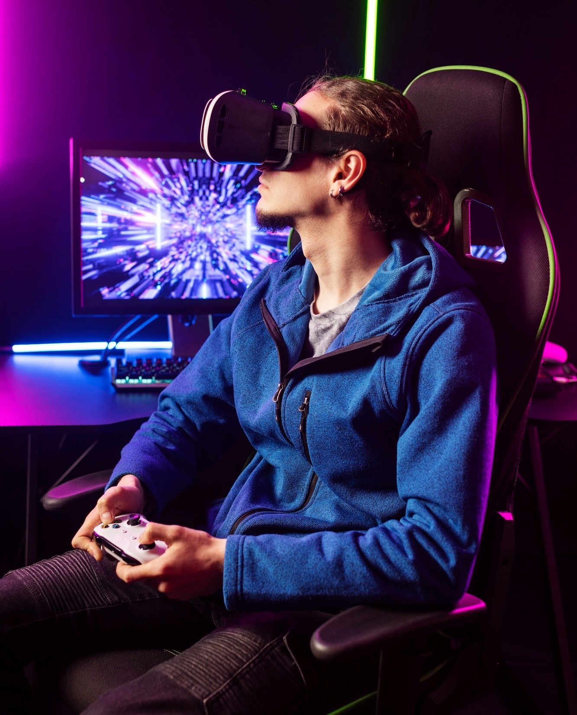
Revolutionizing Entertainment
Six Sense Technology offers a new dimension to entertainment with immersive gaming experiences and interactive storytelling. It enables users to engage with content in a way that blurs the line between the digital and physical worlds.

Slide 8
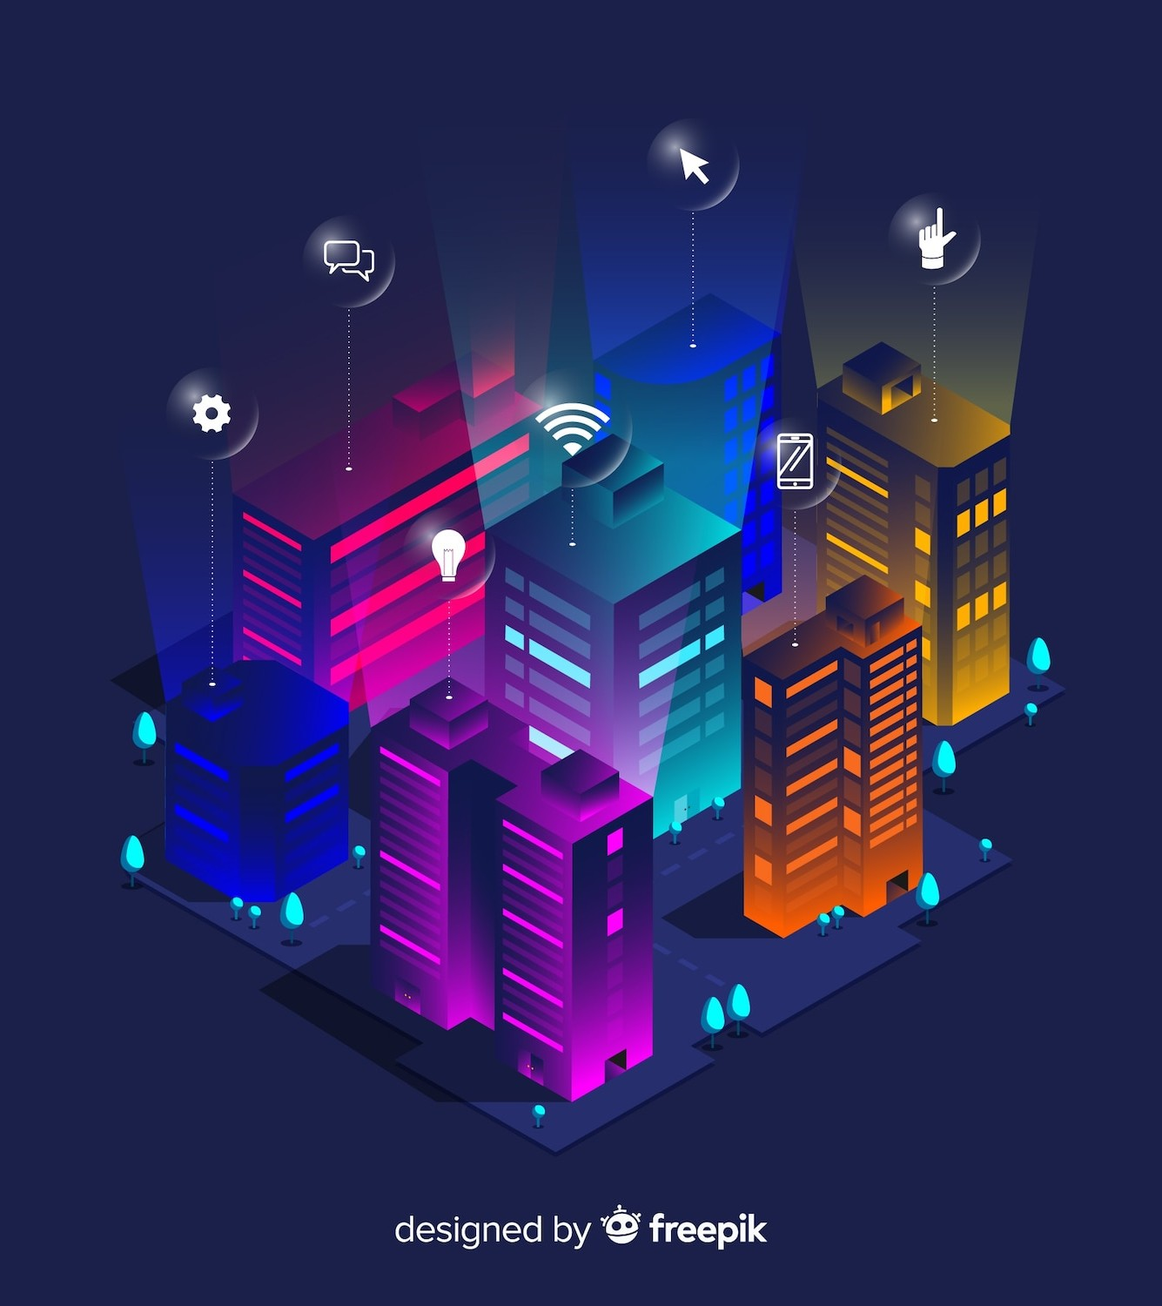

Future Innovations
The future of Six Sense Technology holds immense potential for smart cities, industrial automation, and enhanced communication. As advancements continue, we can expect to see even more innovative applications across various domains.

Slide 9
Conclusion
In conclusion, Six Sense Technology has the power to revolutionize the way we interact with digital information, opening up new possibilities across industries. Its seamless integration of the digital and physical realms marks a signiﬁcant leap in human-computer interaction.

Slide 10



Thanks!
Do you have any questions? youremail@email.com
+91 620 421 838
www.yourwebsite.com @yourusername

