Slide 1


Revolutionizing Interaction: Unveiling the Power of Sixth Sense Technology

Slide 2
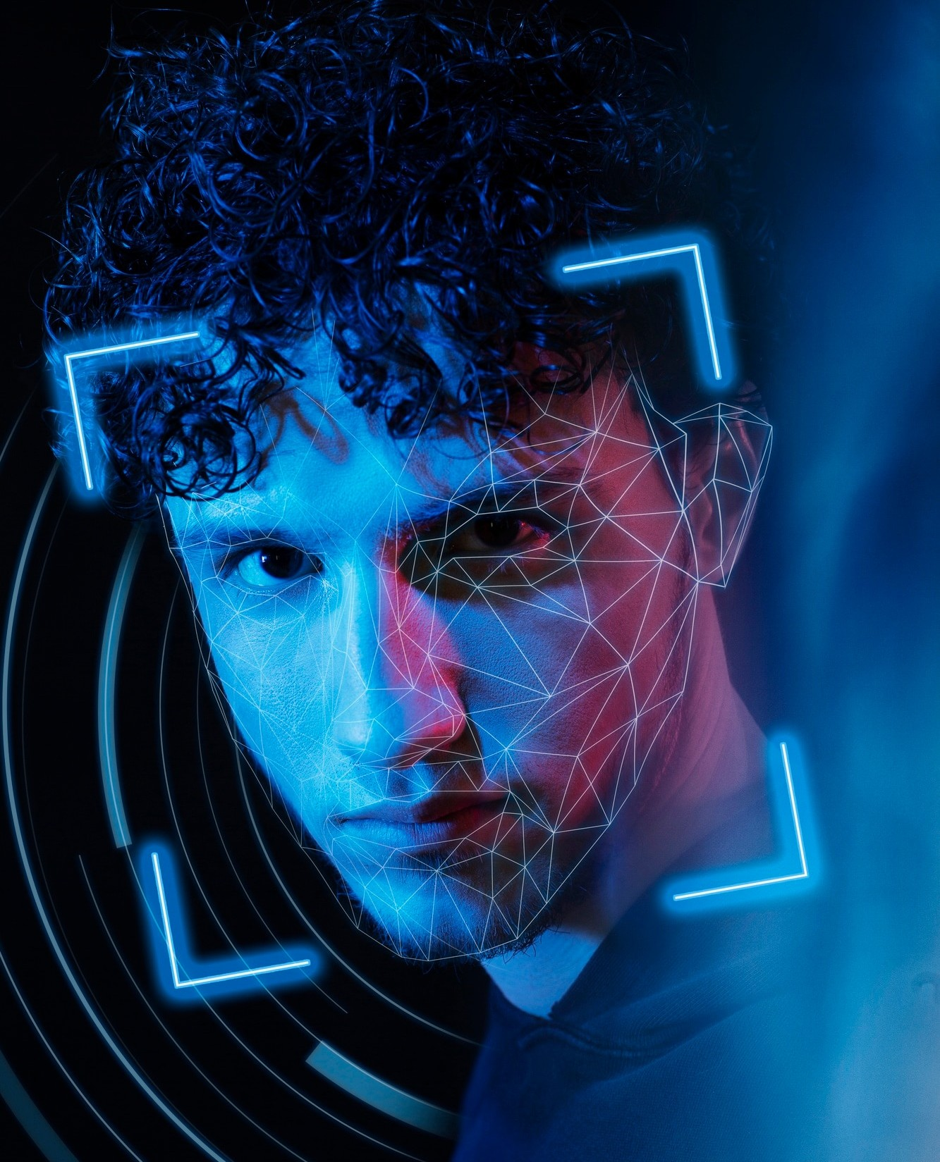
Introduction
Welcome to the world of Sixth Sense Technology, a revolutionary concept that brings together the physical and digital worlds. This presentation will explore the potential impact of this groundbreaking technology on various industries and everyday life.

Slide 3

Understanding Si th Sense
The concept of Sixth Sense involves augmenting human senses with digital information, creating a seamless interaction between the physical and digital worlds. This technology has the potential to transform how we perceive and interact with our environment, making it more intuitive and interconnected.

Slide 4

Applications in Healthcare
In the healthcare industry, Sixth Sense Technology has the potential to revolutionize patient care and medical diagnostics. From real- time access to patient data to augmented reality surgical assistance, this technology can enhance medical professionals' capabilities and improve patient outcomes.

Slide 5

Enhancing Education
The integration of Sixth Sense Technology in education can transform traditional learning methods by providing immersive and interactive experiences. From virtual ﬁeld trips to interactive learning materials, this technology has the potential to engage students in new and innovative ways, enhancing their overall learning experience.

Slide 6

Impact on Retail
In the retail sector, Sixth Sense Technology can redeﬁne the customer shopping experience by offering personalized recommendations, interactive product displays, and seamless digital integration. This technology has the potential to create a more engaging and tailored shopping experience for consumers, revolutionizing the retail industry.

Slide 7
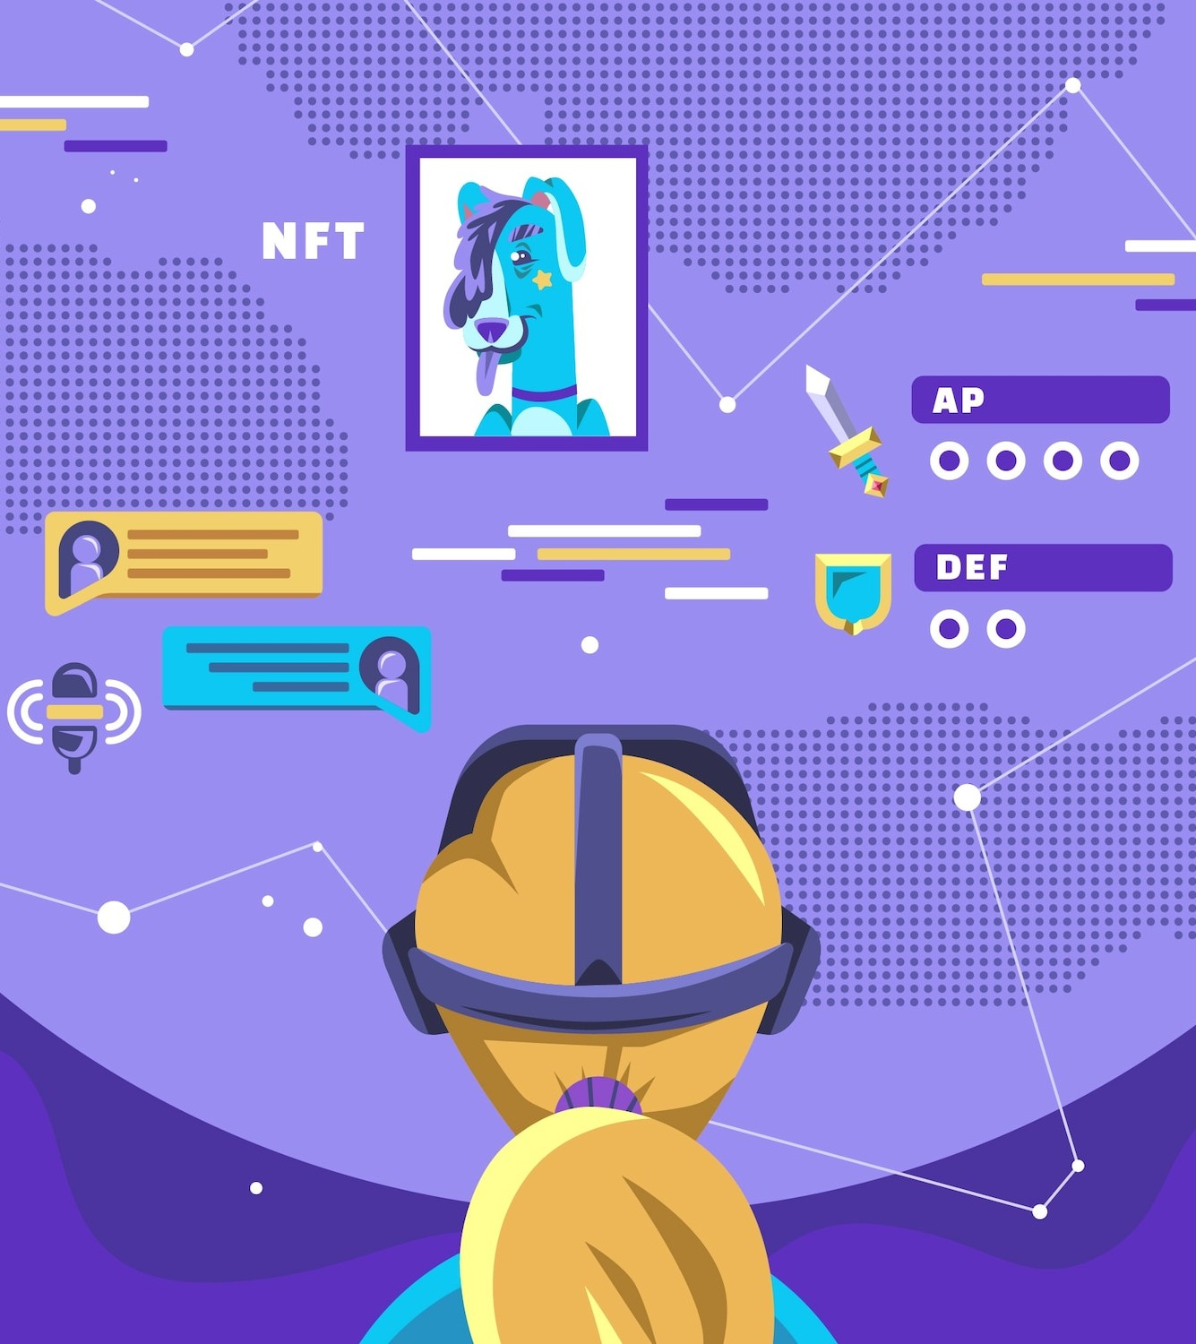
Advancements in Entertainment
From interactive gaming experiences to immersive storytelling, Sixth Sense Technology can elevate entertainment to new heights. By blending the physical and digital worlds, this technology offers endless possibilities for creating captivating and interactive entertainment experiences that engage audiences in unprecedented
ways.

Slide 8

Challenges and Considerations
While the potential of Sixth Sense Technology is vast, its widespread adoption raises ethical, privacy, and security concerns. Addressing these challenges and ensuring responsible use of this technology will be crucial for its successful integration into various industries and everyday life.

Slide 9
Conclusion
As we conclude our exploration of Sixth Sense Technology, it's evident that this innovative concept has the power to revolutionize interaction across industries and everyday life.
Embracing the potential of this technology while addressing its challenges will shape a future where seamless digital integration enhances our experiences and interactions.

Slide 10



Thanks!
Do you have any questions? varshneyanurag691@email.com
+91 7310522500
www.yourwebsite.com @yourusername

