Slide 1
Climate Variability and Crop Production Stability
Is increasing temperature and precipitation variability associated with
greater year-to-year instability in crop production?

Slide 2
Problem Statement
Is increasing temperature and precipitation variability associated with greater year-to-year instability in crop production?
Climate is one driver of yield swings that affect crop production
How climate varies from year to year may matter as much as its long-term average
We compare contrasting crops and agro-climatic regions to find the crops most sensitive to climatic variability
Outcome: crop yield (kg/ha), because production also reflects harvested-area changes driven by prices and policy

Slide 3
Objectives
Build validated annual temperature and precipitation series (2000-2023) for five countries
Quantify climate variability and yield instability for 15 country-crop series
Methodology 1: test the overall association between the two(climate variability and yield instability)
Methodology 2: compare crop-specific sensitivity to climate anomalies
Methodology 3: check whether variability changed over time (10-year rolling windows)
Why these countries and crops?
India, China, USA, Brazil and Australia are major producers with complete data and very different climates (dry and variable, tropical, monsoon, temperate).
Rice, wheat and maize are the main staple cereals and differ in season and water needs, so they may respond differently to the same climate swings.

Slide 4
Data Used
Dataset | Content | Coverage | Role
FAOSTAT | Yield (kg/ha): maize, rice, wheat | National, annual, 2000-2023 | Crop data
ERA5-Land | 2 m temperature, total precipitation | Monthly, 0.1 degree grid | Climate data
CHIRPS | Precipitation | Annual, India only | Validation
5 countries x 3 crops x 24 years = 360 yield observations
5 countries x 24 years = 120 country-year climate observations

Slide 5
Methodology: Measuring Instability and Variability
Common first step for all three analyses
Yield instability
ln(Yield) = a + b x year + residual
Instability = standard deviation of the residual. A residual of -0.15 means about 15% below trend.
Climate variability
Temperature: SD of detrended annual mean (degrees C)
Precipitation: coefficient of variation, 100 x SD / mean (%)
Anomalies are standardised per country (z-scores).
Yields rise with technology, so the trend is removed first; logs make shocks comparable across countries
Warming trend is removed from temperature; rainfall uses CV because its spread scales with its mean

Slide 6
Climate Contrast Between the Five Countries
Country-level ERA5-Land summary, 2000-2023
Country | Mean T (C) | Temp SD (C) | Trend (C/decade) | Mean P (mm) | Precip CV (%)
Australia | 22.39 | 0.482 | 0.324 | 450.4 | 21.68
Brazil | 24.82 | 0.252 | 0.348 | 1752.2 | 6.64
China | 16.96 | 0.295 | 0.359 | 788.0 | 5.40
India | 23.53 | 0.254 | 0.021 | 1266.0 | 7.68
United States | 12.05 | 0.485 | 0.315 | 797.5 | 6.86
Australia is the driest and by far the most variable in rainfall (CV 21.7% vs 5.4-7.7%)
Detrended temperature variability is small everywhere (about 0.25-0.49 C)

Slide 7
Yield Instability by Country and Crop
SD of detrended log-yield residuals (higher = less stable)
Country | Maize | Rice | Wheat
Australia | 0.132 | 0.101 | 0.264
Brazil | 0.104 | 0.043 | 0.149
China | 0.024 | 0.012 | 0.031
India | 0.054 | 0.033 | 0.047
United States | 0.071 | 0.030 | 0.063
Ranges from 0.012 (China rice) to 0.264 (Australia wheat)
China is the most stable for all crops; Australia the least
Rice is the most stable crop in every country
Wheat is most unstable in Australia, Brazil, China; maize in India and USA
Ranking holds with a second measure (year-over-year change, Spearman about 0.96)

Slide 8
Methodology 1: Climate Variability vs Yield Instability
Does more variable climate go with more unstable yield?
Unit of analysis: 15 country-crop series (5 countries x 3 crops)
Each series gets its country's precipitation CV and temperature SD
Compared with yield instability using Pearson r (linear) and Spearman rho (rank-based)
Repeated without Australia and within each crop
The 3 crops of a country share one climate value, so the 15 points are not independent

Slide 9
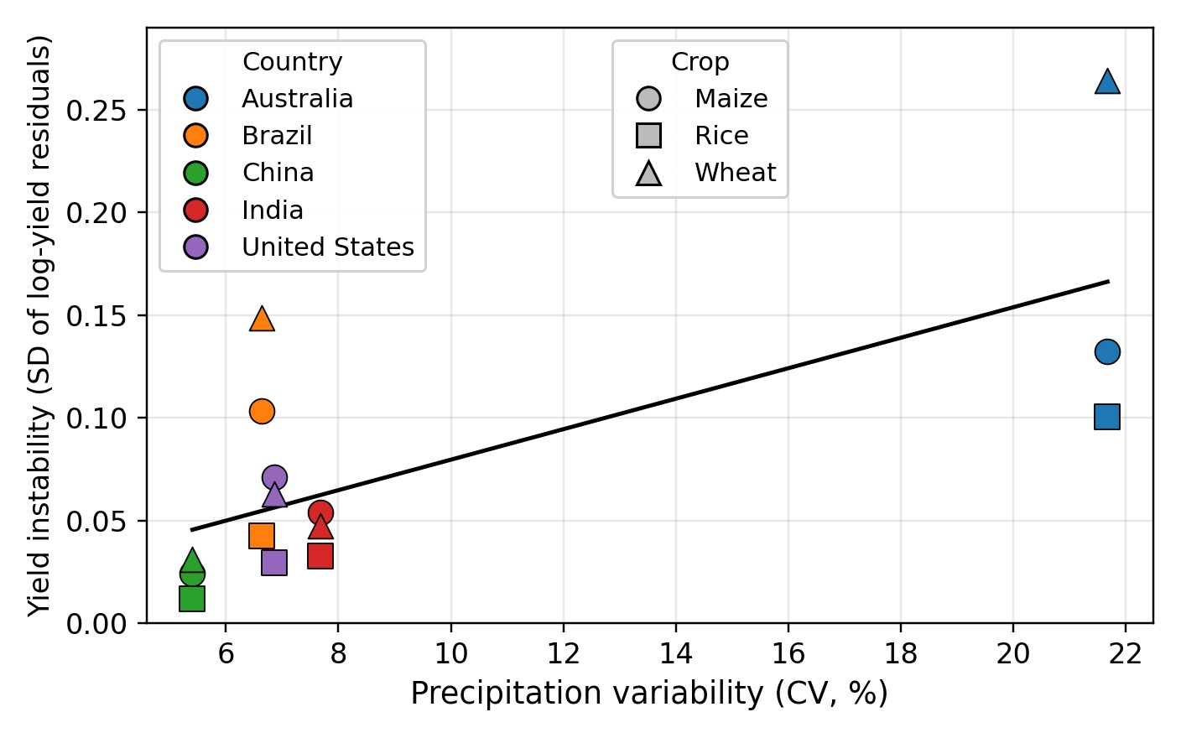
Methodology 1: Precipitation Variability
Pearson r = 0.71
Spearman rho = 0.57
More variable rainfall tends to coincide with less stable yields.
Australia (CV about 22%) drives the pattern; without it r = 0.24.

Slide 10
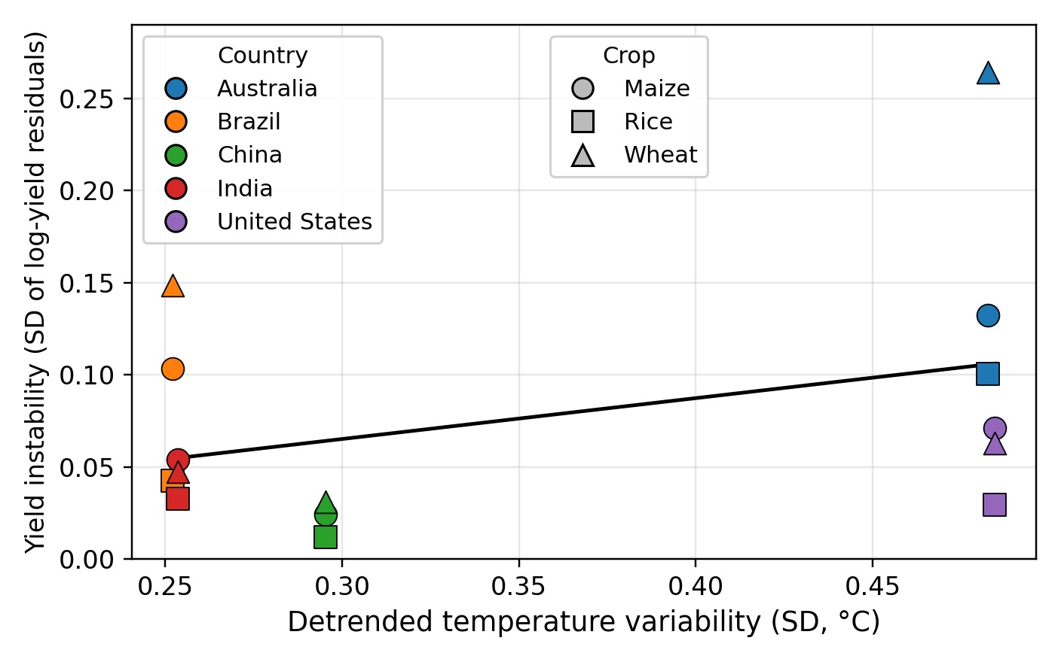
Methodology 1: Temperature Variability
Pearson r = 0.37
Spearman rho = -0.01
Weaker and less consistent than precipitation.
Pearson is positive but Spearman is about zero, so country ordering does not match.

Slide 11
Methodology 1: Correlation Summary and Robustness
Subset | n | Precip Pearson | Precip Spearman | Temp Pearson | Temp Spearman
All series | 15 | 0.707 | 0.567 | 0.374 | -0.011
Excluding Australia | 12 | 0.244 | 0.345 | -0.108 | -0.367
Maize only | 5 | 0.763 | 0.600 | 0.446 | 0.100
Rice only | 5 | 0.965 | 0.700 | 0.527 | -0.200
Wheat only | 5 | 0.886 | 0.600 | 0.445 | 0.100
Precipitation variability has the clearest association with yield instability, but the result is better described as "Australia versus the rest" than as a graded relationship. Temperature variability shows no consistent relationship. These are associations, not causal effects.

Slide 12
Methodology 2: Crop-Specific Climate Sensitivity
Which crop responds most strongly to climate anomalies?
Model for each crop (all 5 countries, 120 country-years):
yield residual = country effect + bT x temperature anomaly + bP x precipitation anomaly + error
Anomalies are standardised per country, so each coefficient is the effect of a 1-SD anomaly
bT < 0: warmer-than-normal years have lower detrended yield
bP > 0: wetter-than-normal years have higher detrended yield
Larger absolute coefficient = stronger sensitivity
Country fixed effects and HC3 robust standard errors; exploratory models

Slide 13
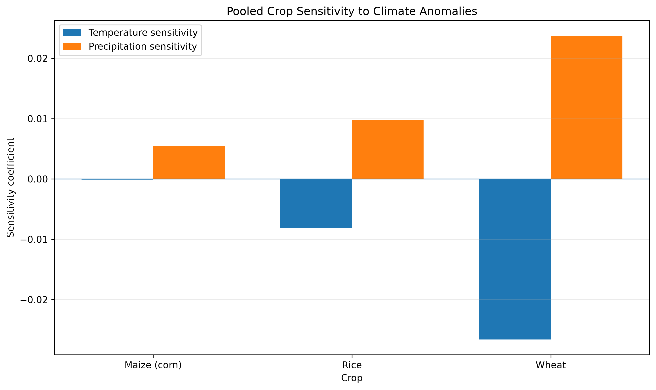
Methodology 2: Results
Wheat: strongest response (about 2.7% lower yield per +1 SD temperature; 2.4% higher per +1 SD rainfall)
Rice: mainly precipitation
Maize: little association
Climate explains a modest share (R2 at most 0.093)
Crop | Temperature coef | Precipitation coef | R2
Wheat | -0.0266 | +0.0238 | 0.093
Rice | -0.0081 | +0.0098 | 0.083
Maize | -0.0001 | +0.0055 | 0.004

Slide 14
Methodology 2: Climate-Attributable Variability by Series
Series | Instability | Climate SD
Australia wheat | 0.264 | 0.149
Australia rice | 0.101 | 0.041
United States maize | 0.071 | 0.038
Brazil wheat | 0.149 | 0.037
India maize | 0.054 | 0.027
Australia maize | 0.132 | 0.023
India rice | 0.033 | 0.017
China rice | 0.012 | 0.005
Australia wheat has the highest yield instability and the highest climate-related SD.
Australia rice has moderate yield instability, with a smaller climate-related component.
Brazil wheat has high yield instability, but its climate-related SD is relatively low.
Australia maize is quite unstable, but its climate-related SD is much lower than its overall instability.
India and China rice have low yield instability and also relatively low climate-related SD.
Overall, higher yield instability does not always mean stronger climate sensitivity.
Instability is not the same as sensitivity: Australia maize is very unstable but only 3.1% of its variance is climate-related
India rice and China rice are stable but have 26.8% and 19.2% climate-related variance
Suggests non-climatic factors or a growing-season mismatch

Slide 15
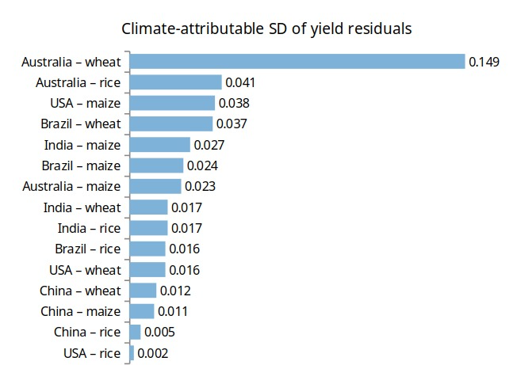

Slide 16
Methodology 3: 10-Year Rolling Windows
Did climate variability and yield instability change during 2000-2023?
Window of 10 years moved forward one year at a time: 2000-2009, 2001-2010, ... 2014-2023 (15 windows)
Climate: temperature SD and precipitation CV in each window, for each country
Yield: SD of detrended log-yield residuals in each window, for each country-crop
Early (2000-2011) vs late (2012-2023) halves compared

Slide 17
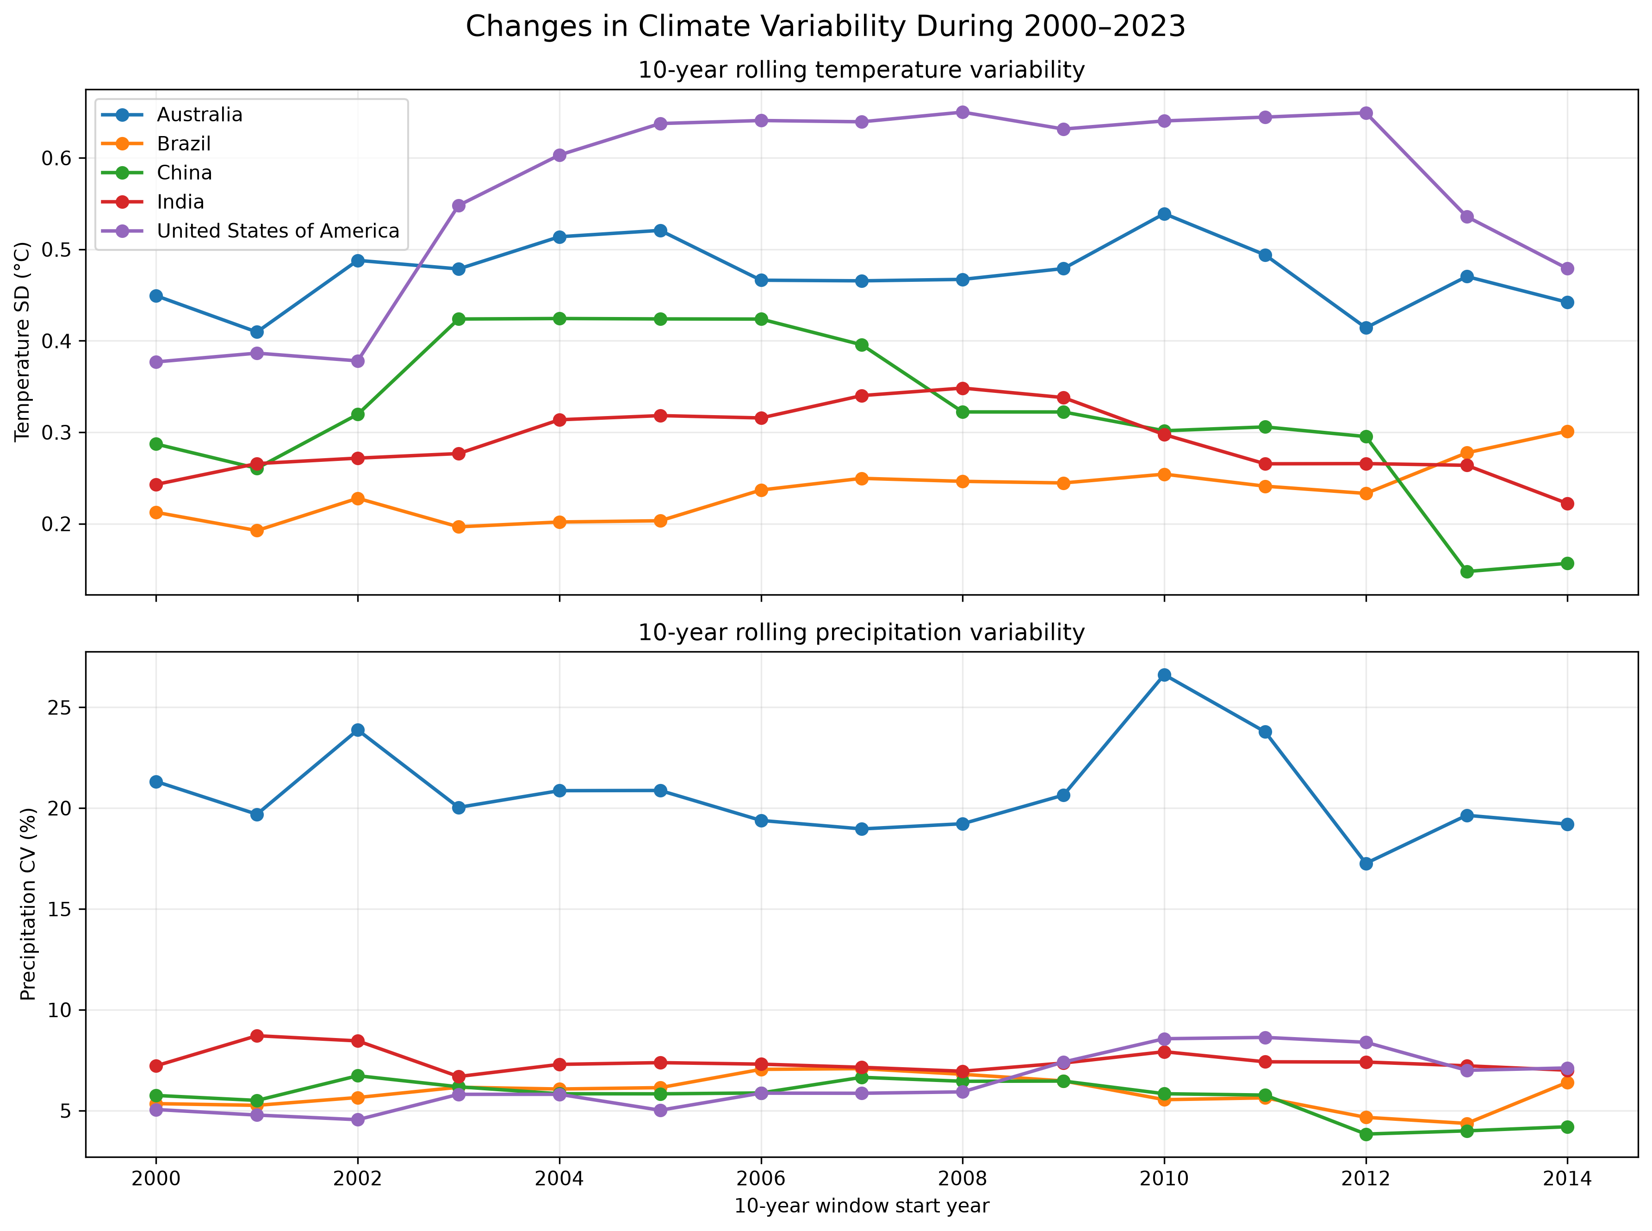
Methodology 3: Climate Variability Over Time
Country | Temp SD (C) | Precip CV (%)
Australia | 0.521 to 0.455 | 24.0 to 17.7
Brazil | 0.231 to 0.282 | 5.5 to 6.6
China | 0.312 to 0.284 | 6.6 to 4.0
India | 0.270 to 0.242 | 8.3 to 7.0
United States | 0.352 to 0.601 | 4.6 to 8.1
Values shown: early (2000-2011) to late (2012-2023). Down in Australia, China, India; up in Brazil and USA. Change is not uniform.

Slide 18
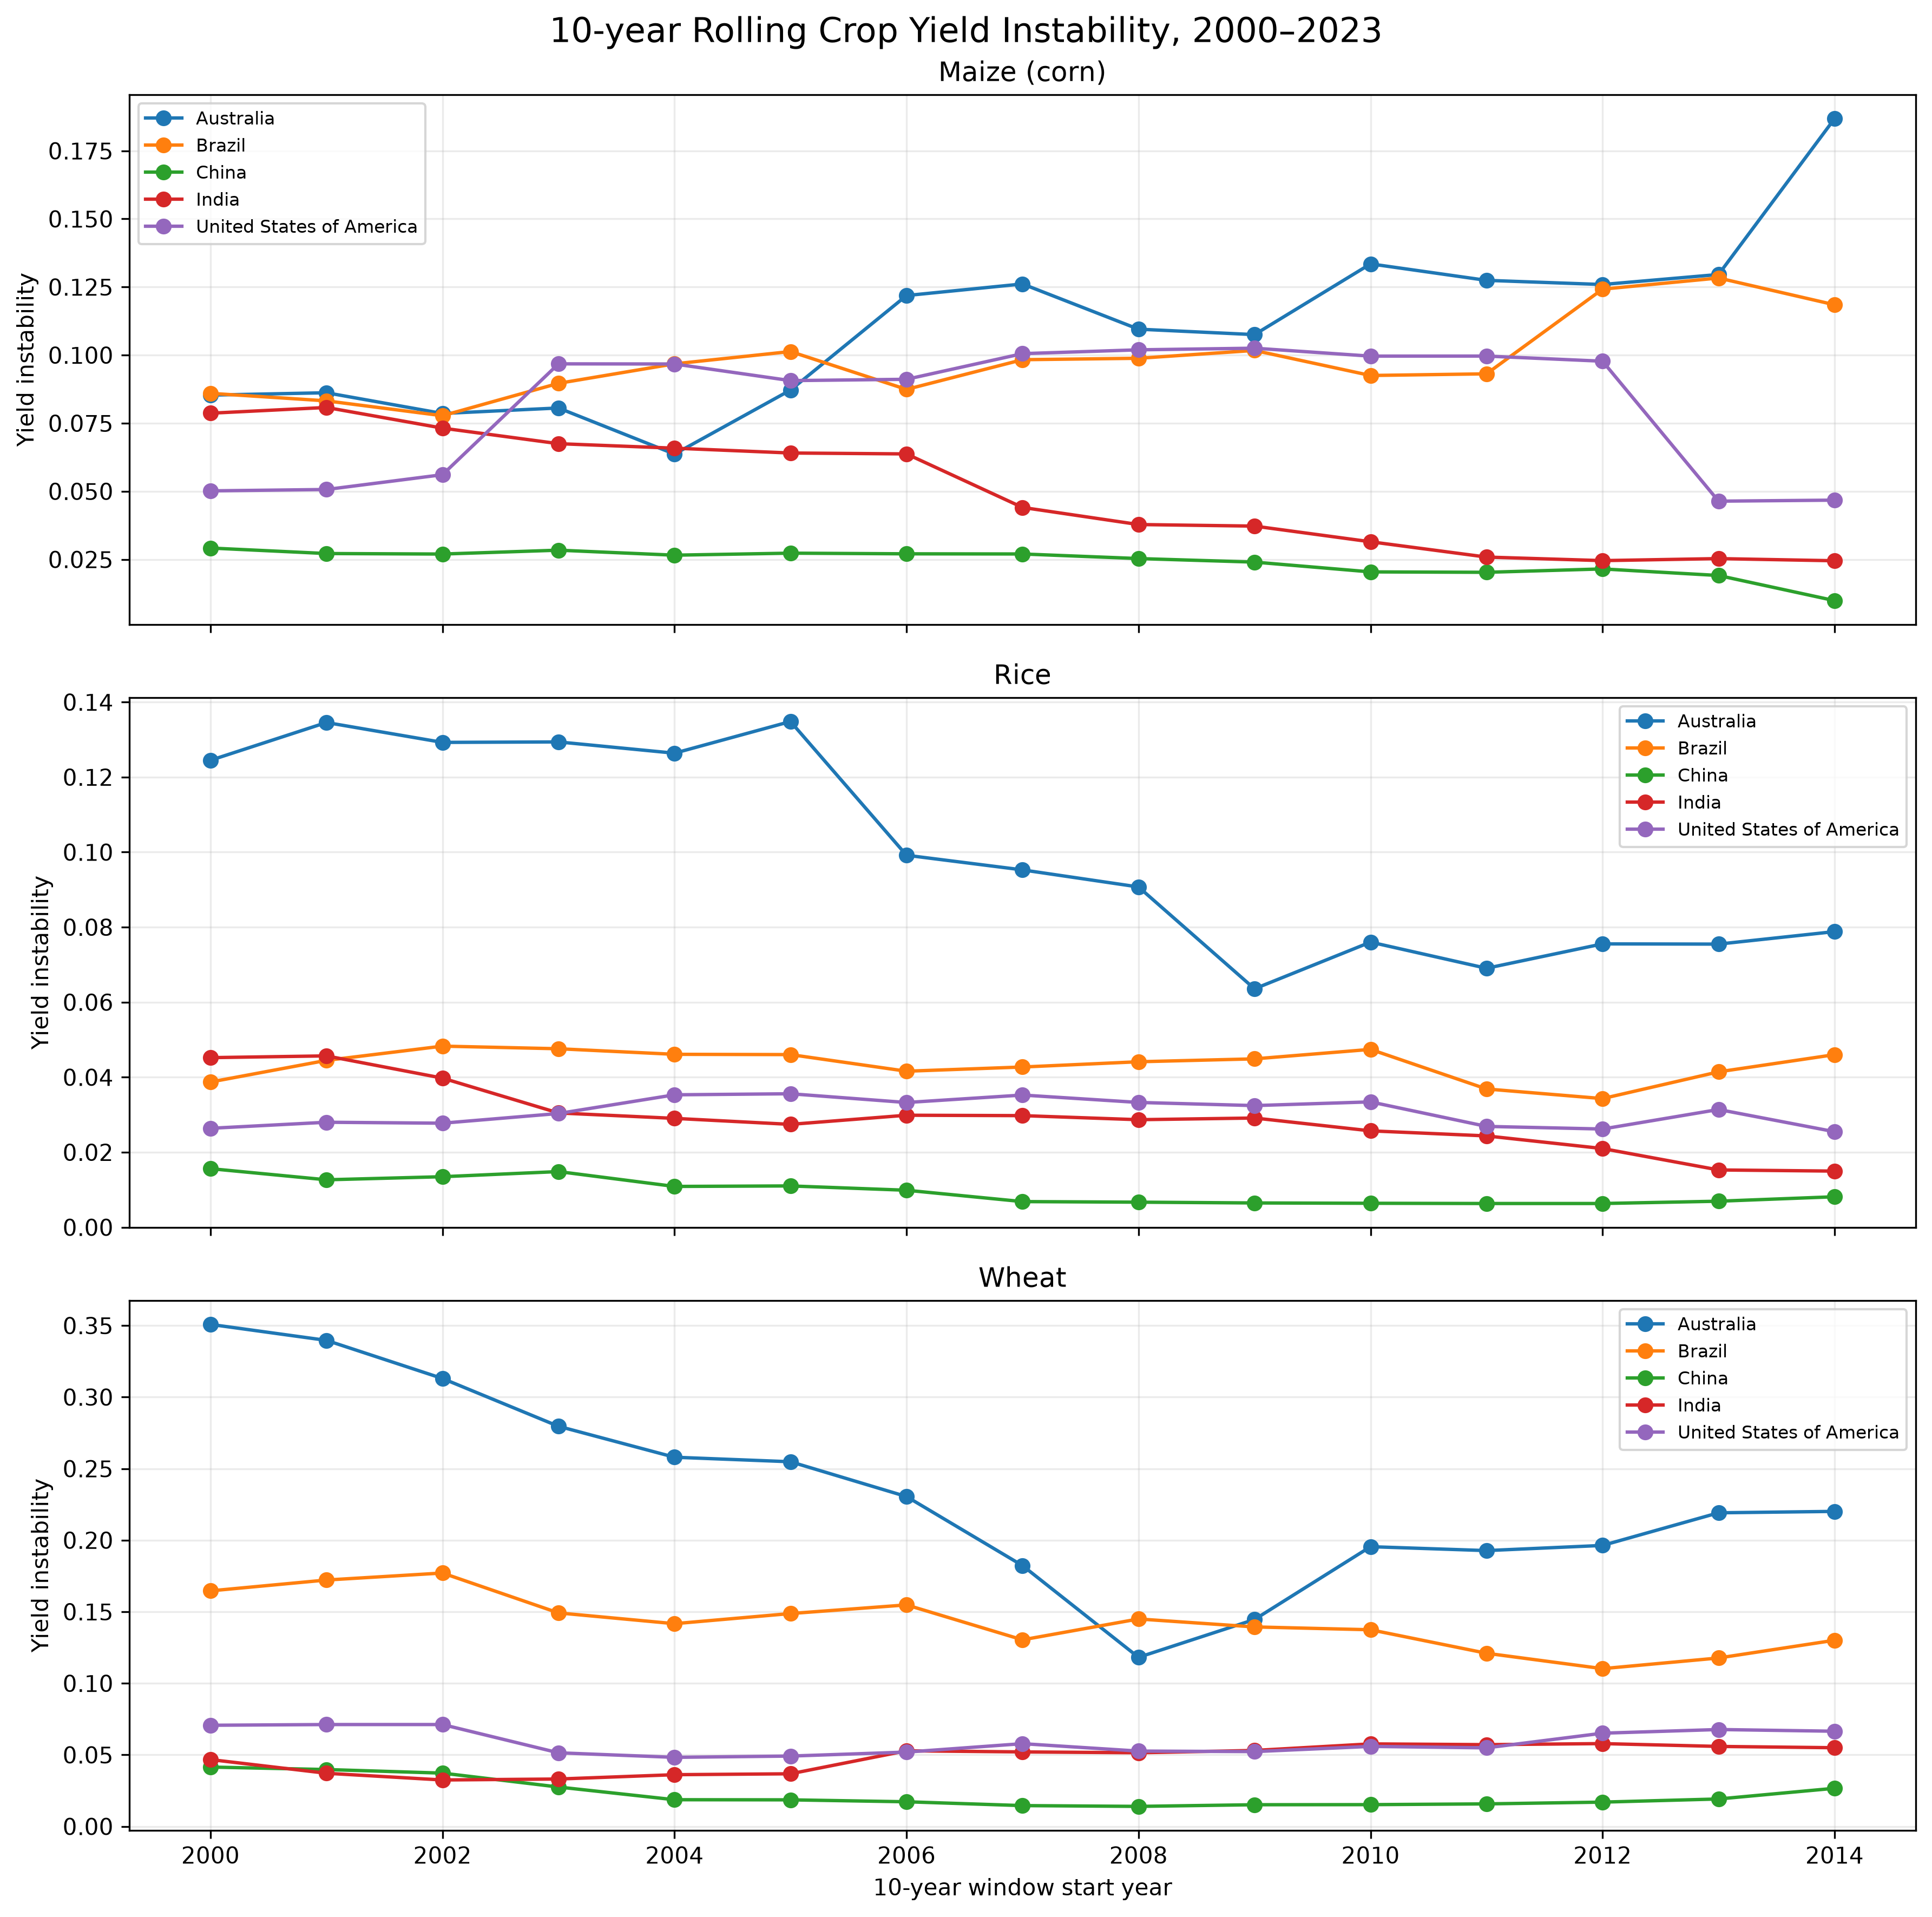
Methodology 3: Yield Instability Over Time
Instability fell in 10 of 15 series and rose in 5 (Australia maize, Brazil maize, India wheat, USA maize, USA rice)
Single extreme years drive jumps, e.g. USA maize 2012 (7727 kg/ha) and Australia wheat 2002 and 2006

Slide 19
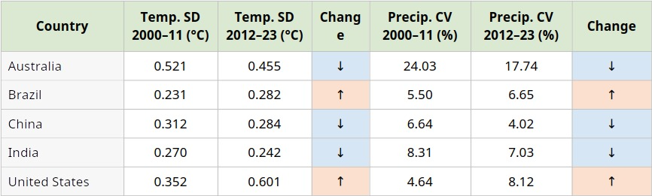
Within each country, temperature SD and precipitation CV moved in the same direction: both decreased in Australia, China and India, and both increased in Brazil and the United States. Changes are heterogeneous, with no uniform increase.

Slide 20
Key Observations
Instability differs strongly: China is the most stable and Australia the least; rice is the most stable crop everywhere
Rainfall variability has the clearest link with instability (r = 0.71), but it depends on Australia (r = 0.24 without it)
Temperature variability shows no consistent relationship (Spearman about 0)
Wheat is the most climate-sensitive crop; rice responds mainly to rainfall; maize shows little response
Climate anomalies explain only a modest share of yield variation (R2 at most 0.093)

Slide 21
Conclusion
Is climate variability linked to yield instability? Partly. Precipitation variability is positively associated (r = 0.71), largely because of Australia. Temperature variability shows no consistent relationship.
Which crop is most sensitive? Wheat. Warmer years go with lower wheat yield and wetter years with higher yield. Rice responds mainly to precipitation; maize shows little response.
Overall: climate variability matters, but climate anomalies explain only a modest share of yield instability. These are exploratory associations, not causal effects.

Slide 22
Future Work
.1. Use crop-specific growing-season climate variables
2. Consider additional crops
3. Use longer historical periods where data permit
4. Add drought or moisture indices as climate indicators
5. Study country- and crop-specific effects in more depth
6. Run robustness checks, such as leave-one-country-out models and a joint panel model

