Slide 1
Securing Smart Sensing Production System using Deep Neural Network Model
Presented by:
S. Chandini (19RH1A05K2)
U. Mounika (19RH1A05M8)
V. Akshaya (19RH1A05N3)

Slide 2
ABSTRACT
Internet of Things (IoT) enabled cyber physical systems such as Industrial equipment’s and operational IT to send and receive data over internet. This equipment’s will have sensors to sense equipment condition and report to centralized server using internet connection. Sometime some malicious users may attack or hack such sensors and then alter their data and this false data will be report to centralized server and false action will be taken. Due to false data many countries equipment and production system got failed and many algorithms was developed to detect attack, but all these algorithms suffer from data imbalance (one class my contains huge records (for example NORMAL records and other class like attack may contains few records which lead to imbalance problem and detection algorithms may failed to predict accurately). To deal with data imbalance, existing algorithms were using OVER and UNDER sampling which will generate new records for FEWER class only. To overcome from this issue, we are introducing novel technique without using any under or oversampling algorithms.

Slide 3
INTRODUCTION
Sensors are most commonly used in numerous applications ranging from body-parameters’ measurement to automated driving. Moreover, sensors play a key role in performing detection- and vision-related tasks in all the modern applications of science, engineering and technology where the computer vision is dominating. An interesting emerging domain that employs the smart sensors is the Internet of Things (IoT) dealing with wireless networks and sensors distributed to sense data in real time and producing specific outcomes of interest through suitable processing. In IoT-based devices, sensors and artificial intelligence (AI) are the most important elements which make these devices sensible and intelligent. In fact, due to the role of AI, the sensors act as smart sensors and find an efficient usage for a variety of applications, such as general environmental monitoring; monitoring a certain number of environmental factors; weather forecasting; satellite imaging and its use; remote sensing based applications; hazard events’ monitoring such as landslide detection; self-driving cars; healthcare and so on. In reference to this latter sector, recently the usage of smart devices has been hugely increased in hospitals and diagnostic center’s for evaluating and monitoring various health conditions of affected patients, remotely as well as physically.

Slide 4
EXISTING SYSTEM
Auto encoder: It will get trained on imbalanced dataset and then extract features from it and these extracted features will get trained with DECISION TREE algorithm to predict label for known or unknown attacks. Decision tree get trained on reduced number of features obtained from PCA (principal component analysis) algorithm.
Deep Neural Network (DNN): In this level, DNN algorithm get trained on known and unknown attacks. If any records contain attack signature, then DNN will identify attack label or class and attribute them.

Slide 5
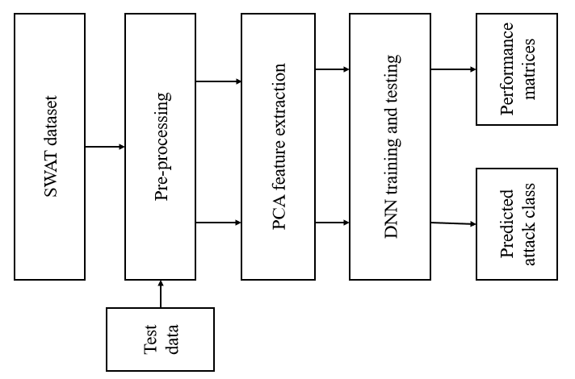
SYSTEM ARCHITECTURE

Slide 6
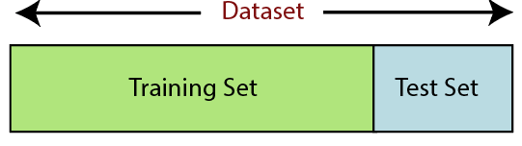
PROPOSED SYSTEM
Data Pre-processing:
Getting the dataset
Importing libraries
Importing datasets
Finding Missing Data
Encoding Categorical Data
Splitting dataset into training and test set
Feature scaling
Splitting the Dataset into the Training set and Test set:

Slide 7
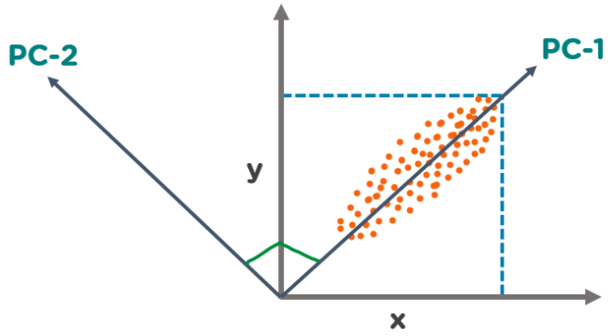
PCA FEATURE REDUCTION
The Principal Component Analysis is a popular unsupervised learning technique for reducing the dimensionality of data. It increases interpretability yet, at the same time, it minimizes information loss. It helps to find the most significant features in a dataset and makes the data easy for plotting in 2D and 3D. PCA helps in finding a sequence of linear combinations of variables.
PCA Analysis

Slide 8
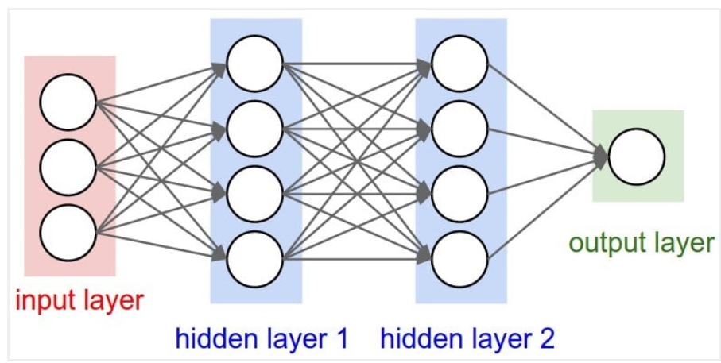
DEEP NEURAL NETWORK
The learning portion of creating models spawned the development of artificial neural networks. ANNs utilize the hidden layer as a place to store and evaluate how significant one of the inputs is to the output. The hidden layer stores information regarding the input’s importance, and it also makes associations between the importance of combinations of inputs.
Deep neural nets, then, capitalize on the ANN component. They say, if that works so well at improving a model—because each node in the hidden layer makes both associations and grades importance of the input to determining the output—then why not stack more and more of these upon each other and benefit even more from the hidden layer. So, the deep net has multiple hidden layers. ‘Deep’ refers to a model’s layers being multiple layers deep.

Slide 9
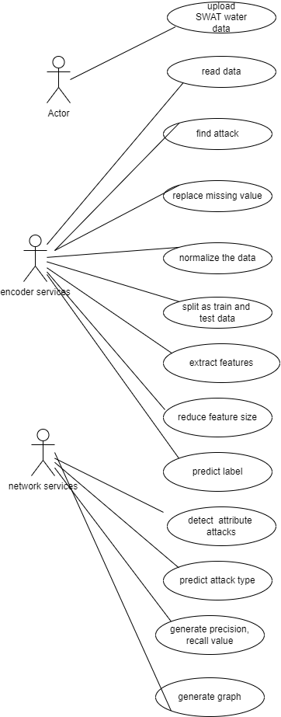
UML DIAGRAMS
1 Use Case Diagram

Slide 10
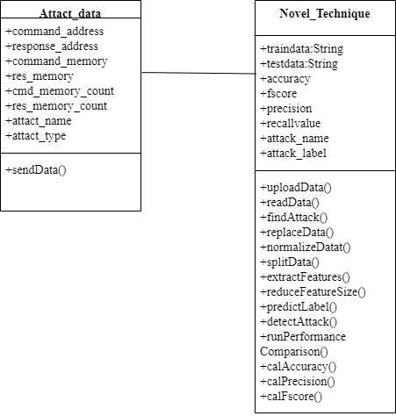
2 Class Diagram

Slide 11
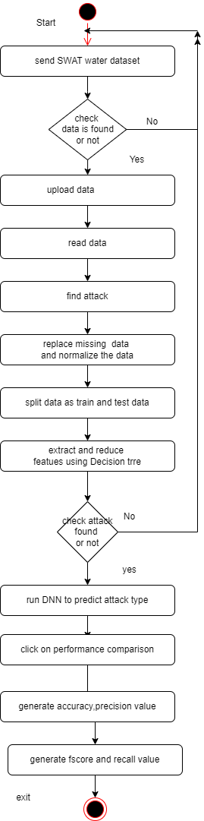
3 Activity Diagram

Slide 12
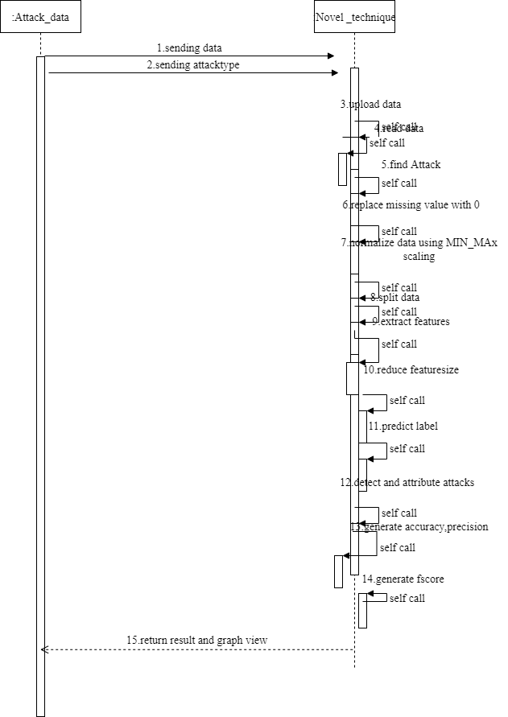
4 Sequence Diagram

Slide 13
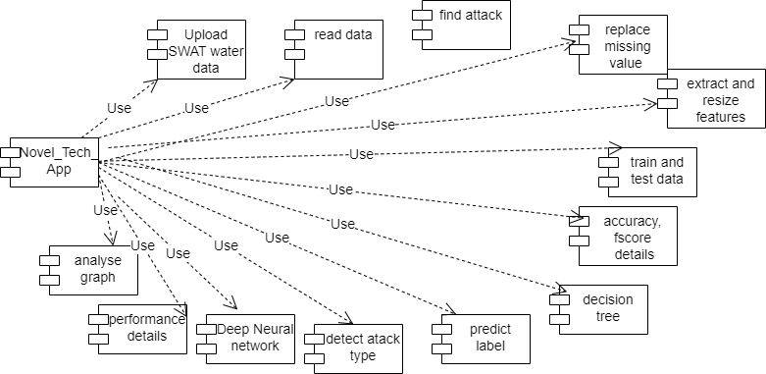
5 Component Diagram

Slide 14
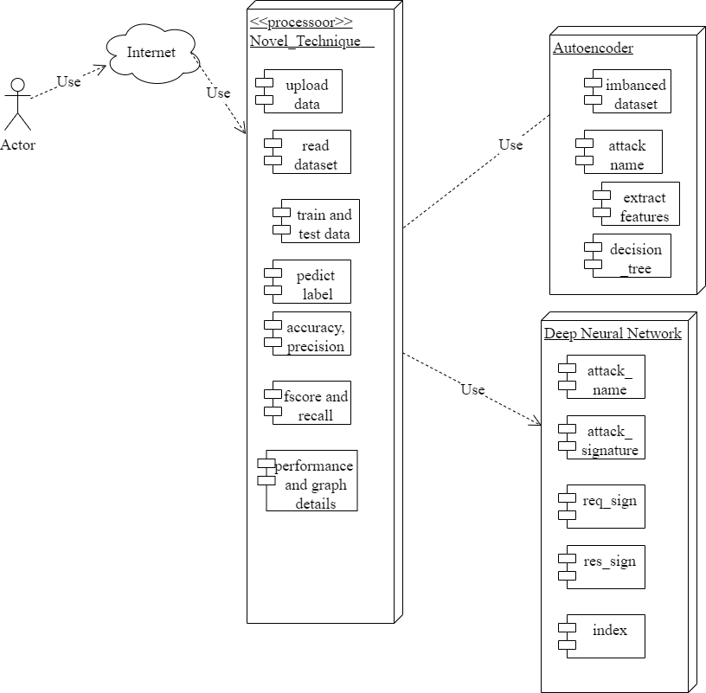
6 Deployment Diagram

Slide 15
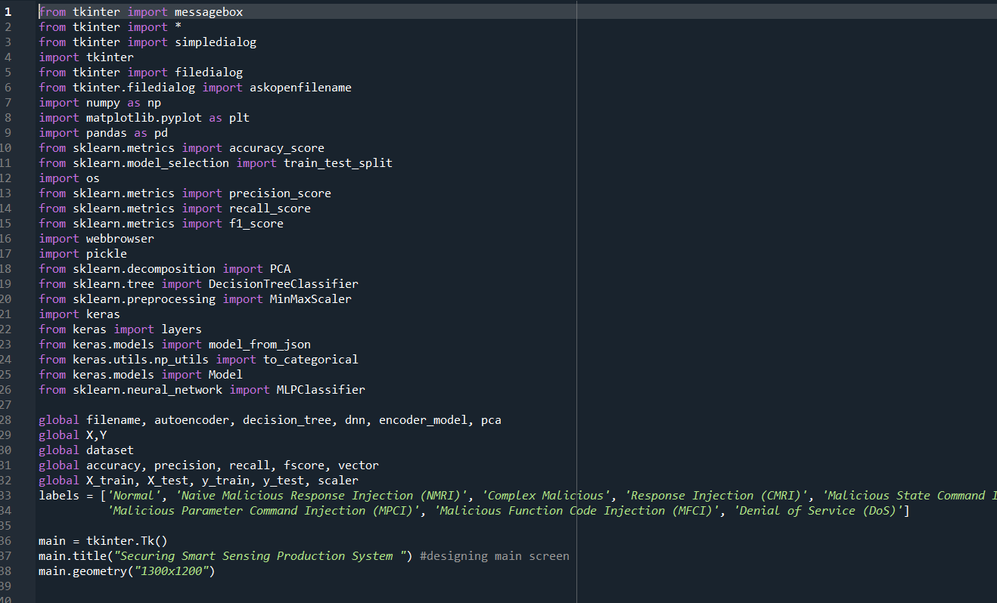
SOURCE CODE

Slide 16
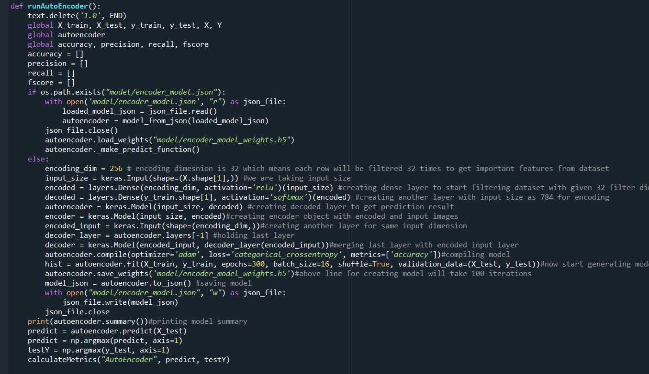

Slide 17
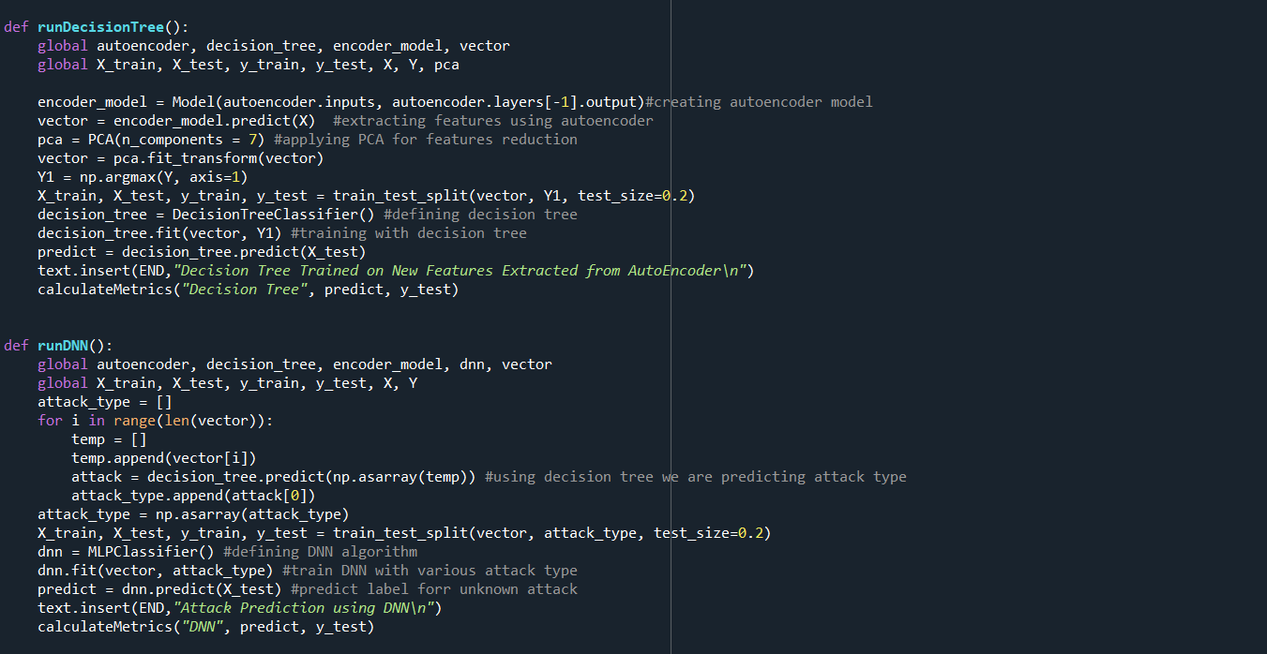

Slide 18
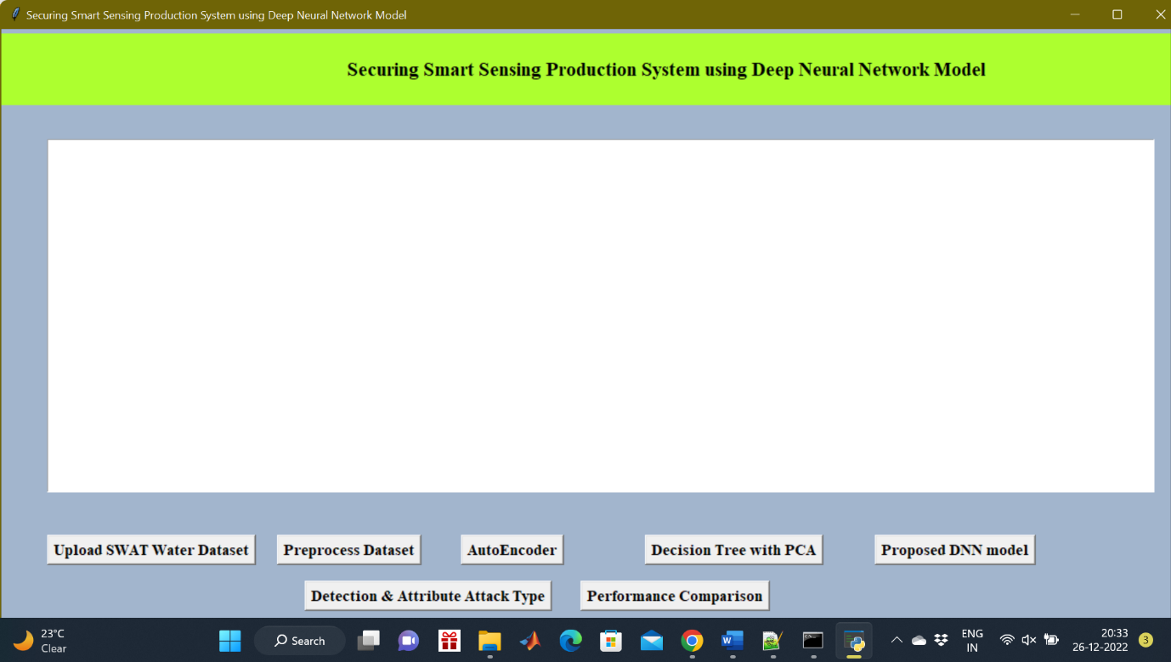
RESULTS

Slide 19
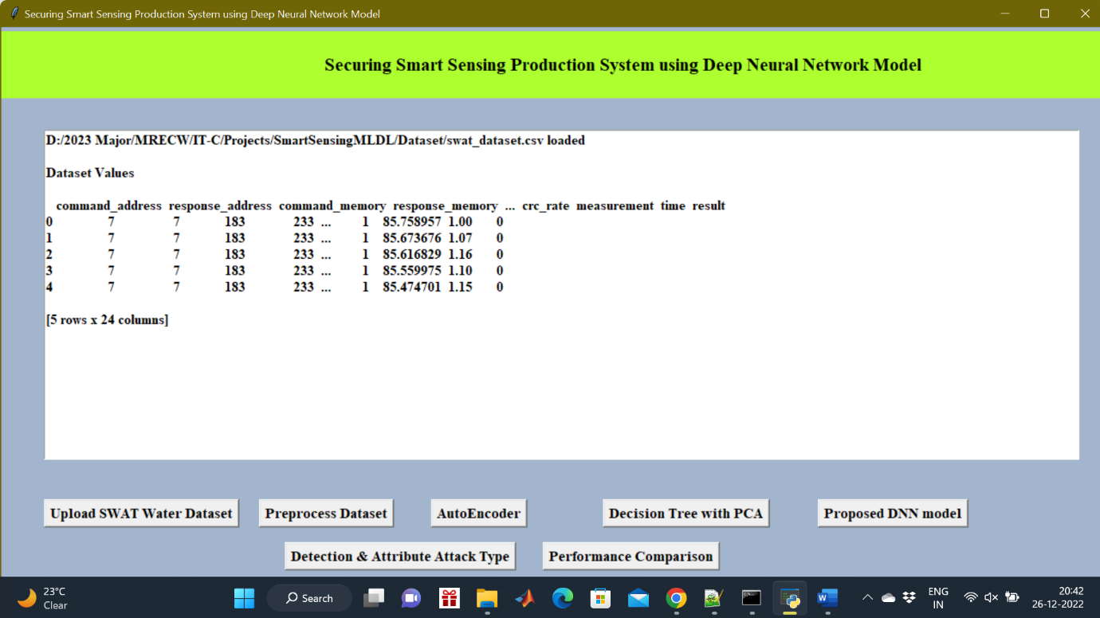
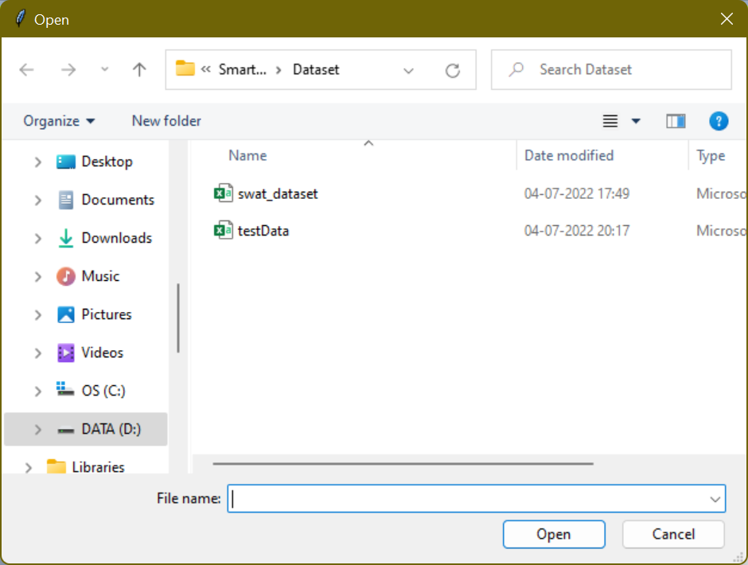

Slide 20
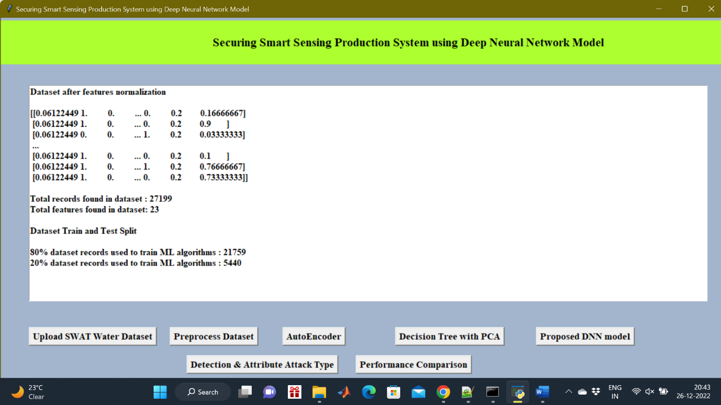

Slide 21
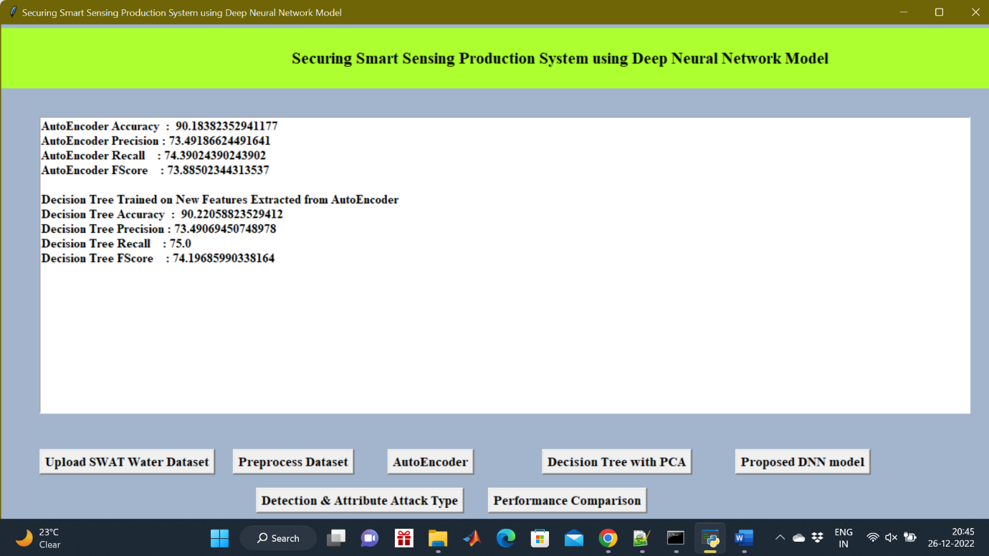

Slide 22
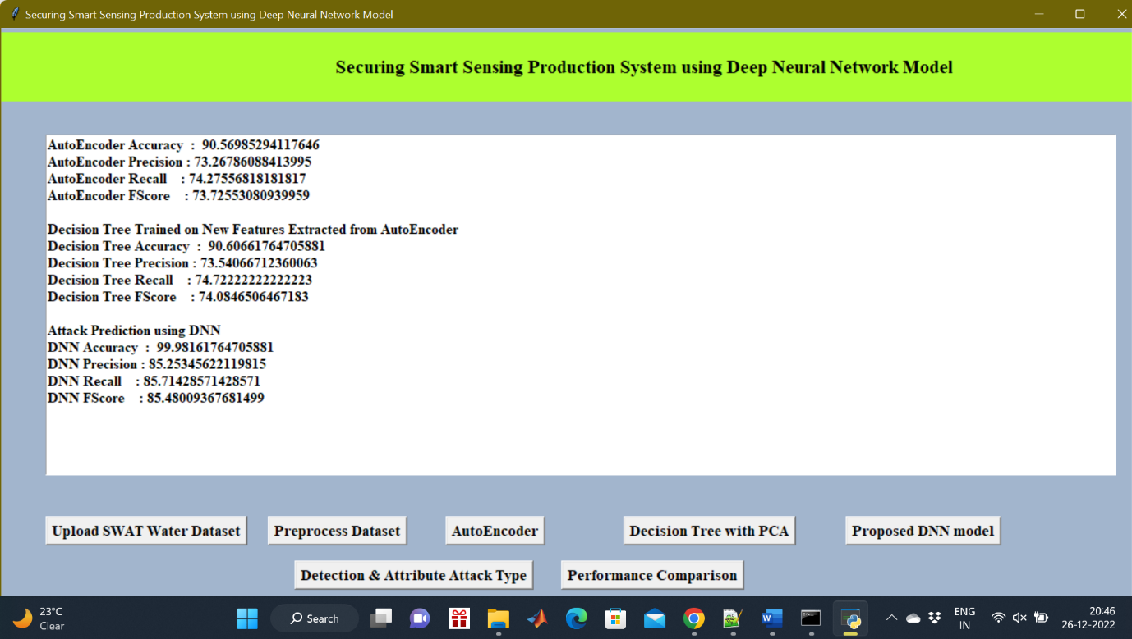

Slide 23
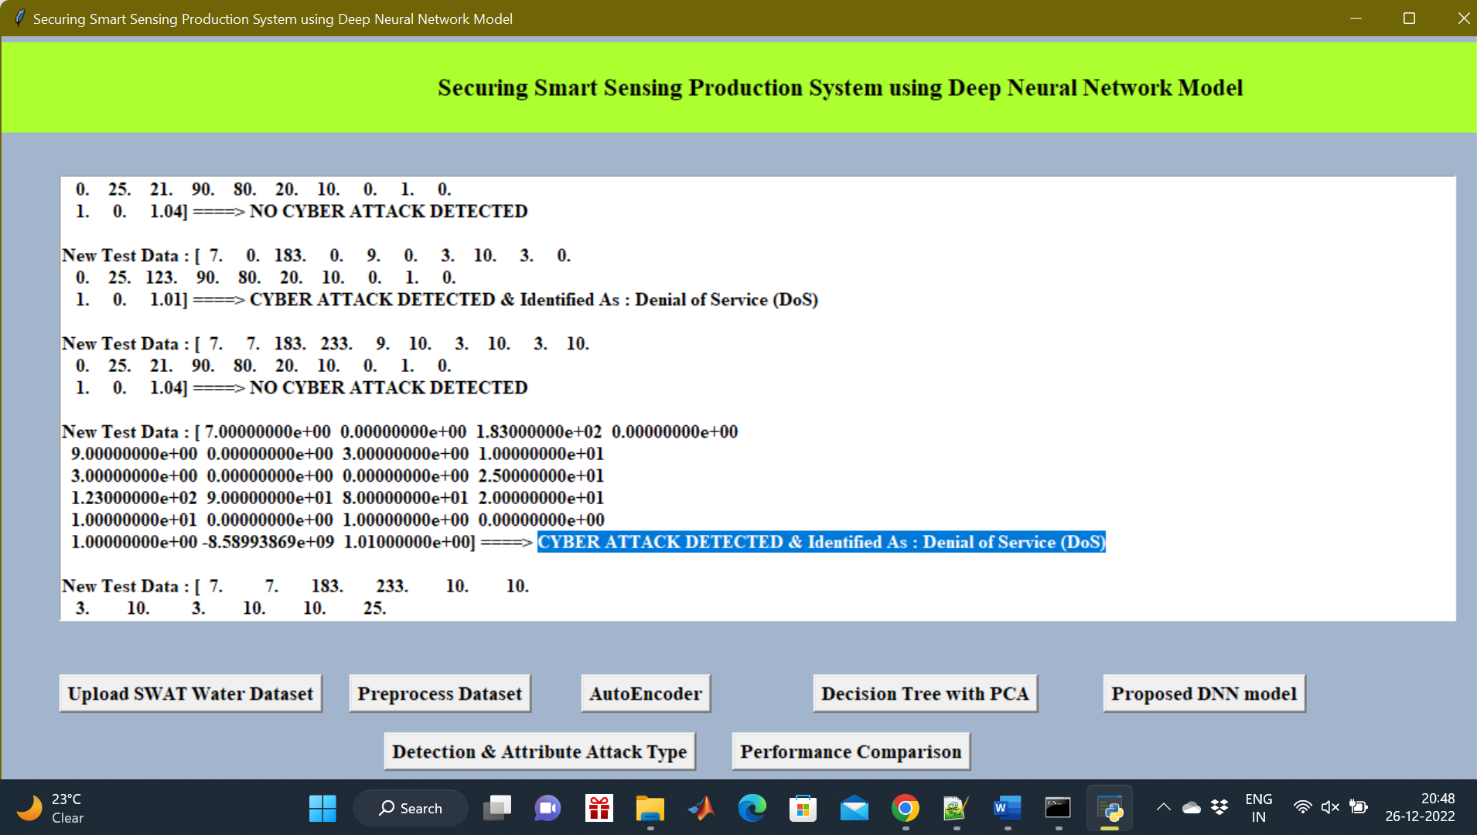
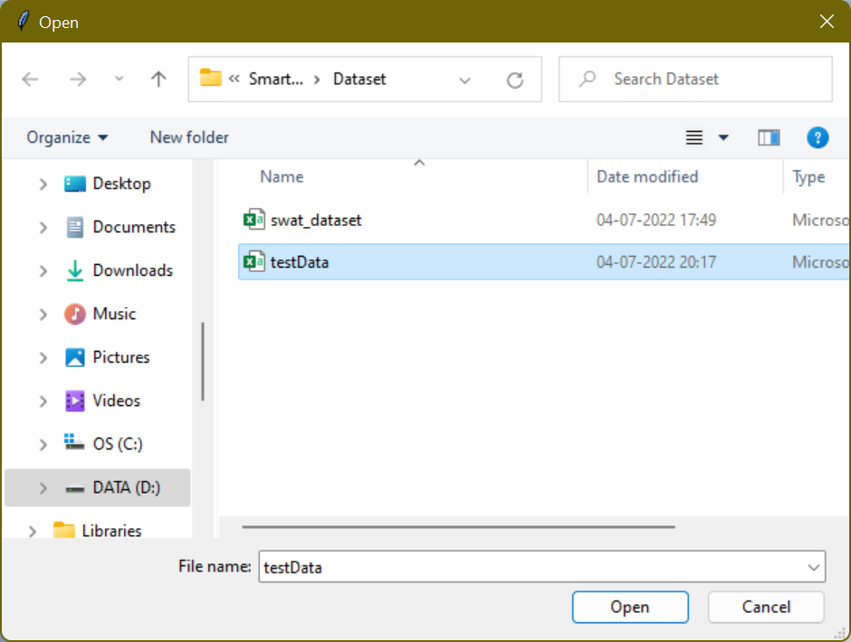

Slide 24
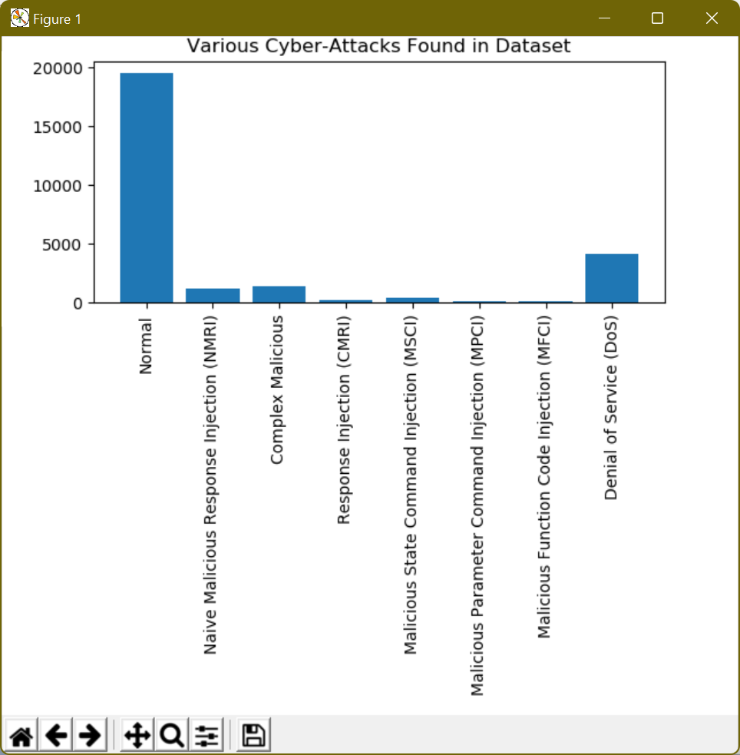
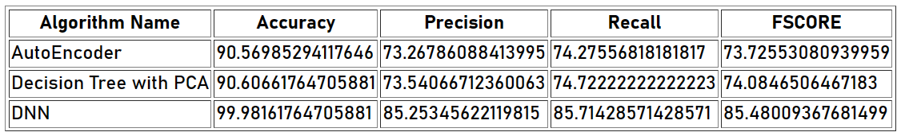

Slide 25
CONCLUSION
Internet of Things enabled cyber physical systems such as Industrial equipment’s and operational IT to send and receive data over internet. This equipment’s will have sensors to sense equipment condition and report to centralized server using internet connection. Sometime some malicious users may attack or hack such sensors and then alter their data and this false data will be report to centralized server and false action will be taken. Due to false data many countries equipment and production system got failed and many algorithms was developed to detect attack, but all these algorithms suffer from data imbalance. To deal with data imbalance existing algorithms were using OVER and UNDER sampling which will generate new records for FEWER class, but this technique improve accuracy but not up to the mark. Therefore, to overcome from this issue, this project introduced an efficient deep learning model without using any under or oversampling algorithms with the usage of auto encoder, decision tree with PCA, and DNN for identifying the attack and classify the type of attack. In addition, the performance evaluation of three models also compared and proven that proposed DNN obtained enhanced accuracy 99.98%.

Slide 26
REFERENCES
Kayad, A.; Paraforos, D.; Marinello, F.; Fountas, S. Latest advances in sensor applications in agriculture. Agriculture 2020, 10, 362.
Elahi, H.; Munir, K.; Eugeni, M.; Atek, S.; Gaudenzi, P. Energy harvesting towards self-powered IoT devices. Energies 2020, 13, 5528.
Ullo, S.L.; Sinha, G.R. Advances in smart environment monitoring systems using IoT and sensors. Sensors 2020, 20, 3113.
Carminati, M.; Sinha, G.R.; Mohdiwale, S.; Ullo, S.L. Miniaturized pervasive sensors for indoor health monitoring in smart cities. Smart Cities 2021, 4, 146–155.
Ullo, S.L.; Addabbo, P.; Di Martire, D.; Sica, S.; Fiscante, N.; Cicala, L.; Angelino, C.V. Application of DInSAR technique to high coherence Sentinel-1 images for dam monitoring and result validation through in situ measurements. IEEE J. Sel. Top. Appl. Earth Obs. Remote. Sens. 2019, 12, 875–890.
Ullo, S.L. and Sinha, G.R., 2021. Advances in IoT and smart sensors for remote sensing and agriculture applications. Remote Sensing, 13(13), p.2585.
Sivasuriyan, A., Vijayan, D.S., LeemaRose, A., Revathy, J., Gayathri Monicka, S., Adithya, U.R. and Jebasingh Daniel, J., 2021. Development of smart sensing technology approaches in structural health monitoring of bridge structures. Advances in Materials Science and Engineering, 2021.
Dazhe Zhao, Kaijun Zhang, Yan Meng, Zhaoyang Li, Yucong Pi, Yujun Shi, Jiacheng You, Renkun Wang, Ziyi Dai, Bingpu Zhou, Junwen Zhong, Untethered triboelectric patch for wearable smart sensing and energy harvesting, Nano Energy, Volume 100, 2022, 107500, ISSN 2211-2855, https://doi.org/10.1016/j.nanoen.2022.107500.

