Slide 1
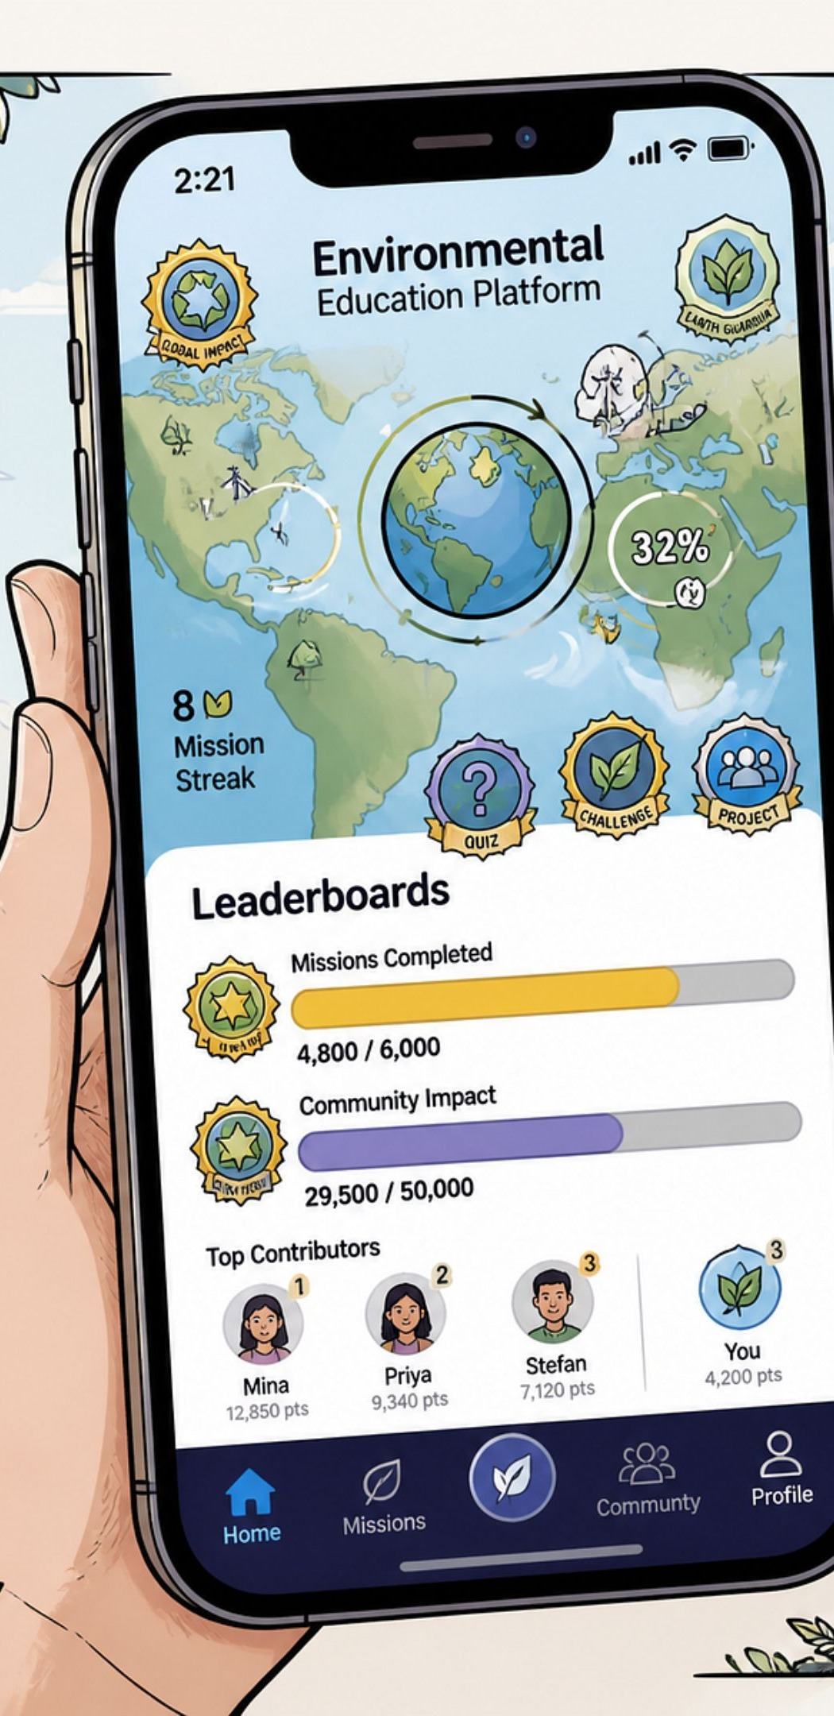
GenGreen
Gamified Environmental Education Platform
Team 4Bugs — Sustainability Track
Tagline: Turning environmental awareness into real-world sustainable action.

Slide 2
Problem — Theory without practice
Textbook-Driven Learning
Environmental learning in many Indian schools remains textbook-driven and theoretical. NEP 2020 calls for experiential, competency-based learning, but the classroom-to-community gap persists.
Current state
Consequence
Textbook learning → low engagement → passive understanding
Limited habit formation: waste disposal, water use, biodiversity care
Low Engagement
Passive understanding
Opportunity
NEP 2020 alignment: Use technology & missions to make learning active

Slide 3

Solution — The GenGreen Loop
Learn & Practice
Complete Mission
Earn & Compete
AI Verify
A closed learning loop that converts concepts into verified real-world action and measurable outcomes.

Slide 4
Product Experience — Roles & Dashboards
S
T
O
Student
Teacher
Organizer
Learn modules • Quizzes & Eco Crossword • AI Eco Mentor • Missions • Badges & Leaderboard
Assign missions • Track progress • Verify evidence • AI-generated class insights
Run competitions • School-level analytics • Incentivize community campaigns

Slide 5
Key Features — Built & Ready
IBM Bob — AI Eco Mentor
Deterministic Verification
Teacher Class Insights
Personalized next-topic & mission recommendations with concise reasons tied to student data.
Prototype verifies mission evidence deterministically; IBM Bob produces plain-language explanations for auditability.
Short prioritized action lists generated by IBM Bob for targeted remediation.
Active Learning Tools
Gamified Progress
Scenario-based quizzes and Eco Crossword to practice application and reasoning.
Leaderboards, badges, streaks, and a Green Score to motivate sustained participation.

Slide 6
Technical Architecture (Prototype)
UI
Client & Frontend
React + Vite UI, connected via Socket.io for real-time updates
GenGreen Platform
API
AI
API Server
AI & Reasoning
Express.js REST endpoints for core resources
FastAPI AI service → IBM Bob reasoning layer
Tech Stack
JavaScript
Python
React
Vite
Tailwind CSS
Express.js
FastAPI
IBM Bob
Prototype components include:
AI service endpoints
REST endpoints for users, missions, tasks, submissions, analytics, leaderboards
Socket.io for real-time notifications & leaderboard updates
Mock/in-memory DB for fast iteration during hackathon
POST /personalize-learning
POST /verify-image
GET /class-insights/{class_id}

Slide 7

IBM Technologies — The Bob Reasoner
Personalize
1. Personalized learning
1
Uses topic scores, completed lessons, mission activity to recommend next topics and missions with traceable reasoning.
Bob
Data
Verify
2. Mission verification explanation
2
Deterministic verification for evidence + Bob-generated student/teacher explanations for clarity and audit logs.
Insights
3. Teacher insights
3
Converts class analytics into prioritized, actionable recommendations for remediation and enrichment.

Slide 8
Impact, Limitations & Team
Impact
Boosts engagement — turns passive learning into verified action
Builds sustainable habits through short missions and streaks
Helps teachers identify and remediate weak topics (e.g., water conservation)
Enables schools/organizers to run measurable green competitions
Team 4Bugs
Hima Mehta
Kairavi Padhariya
Akshara Pandya
Known limitations
Gamification alone doesn't guarantee long-term behavior change
Offline-first features are limited in the prototype
Regional environmental priorities vary — content localization required
Large-scale ERP/LMS integration will be needed for broad adoption
Chandni Kothari

