Slide 1
Chat based news assistant
Cs691 : Chandni shah, Guannan zou, Kinnari Jasoliya, Longyuan chu, Pradeep Prakash, Wahidur rahman

Slide 2
1. introduction
Since past few years News consumption has shifted from traditional mediums like Newspapers, TV broadcasts, radio etc. to digital mediums like websites, smartphone apps, podcasts etc.
These mediums were one-directional
Nowadays, the average smartphone users frequently use on an average maximum of 3-4 apps on a daily basis. App fatigue has set in.
Instead, users spend most of their time on smartphone using instant messaging/social apps like WhatsApp, WeChat, Facebook Messenger etc.
Due to changing user consumption habits, Instant messaging apps have thus become the next big platforms.

Slide 3
2. OBJECTIVE
With increasing convenience & simplicity offered by virtual assistants like Google Assistant, Apple Siri , Amazon Alexa etc. , have started popping up everywhere from smartphones, laptops to Internet connected devices like smart speakers, smart appliances etc.
We wanted to design a News Assistant Chatbot that combines the convenience of virtual assistants with the interactivity of chatting with a friend via instant messaging services.

Slide 4


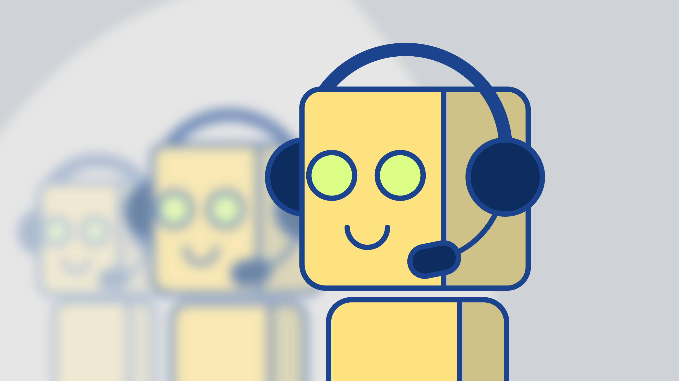
3. Project description
Web based news application with conversational UI
Chatbot to provide personalized news, recommendations according to users’ preferences
Supports both web and mobile platforms
Provide daily news briefings to the user while avoiding frequent push notifications that can be distracting

Slide 5
3.1 What is a chatbot?
A Chabot is a service, that communicates with you, most commonly using a text/voice interface and uses artificial intelligence techniques like NLP/Machine Learning to understand & respond to user queries
The service could be any number of things, ranging from functional to fun, and it could live inside any major messaging product (like Facebook messenger, slack, telegram, text messages, etc.).

Slide 6
4. architecture
4.1 Software Design Pattern:
Single Page Application (SPA)
Model View Control (MVC)

Slide 7
4.2 tools used
UX Design: Axure RP and Visio
Testing: QTP & Load Runner, python unit tests
Project Monitoring: MS Project
Code Repository: GitHub

Slide 8
4.3 Back end (Model)
Using MySQL database for storage
Parameter passing and receiving from Databases
Handle registered user, news preferences data
Handle data required for language processing in training bot

Slide 9
4.4 Front end (view)
Responsive Web Design
Using Bootstrap component library to create responsive websites for different screen sizes in HTML/CSS
React JS : JavaScript library for building UI
Python flask: Web server to deploy the python app on the web
Chatbot UI box: To display the chat responses

Slide 10
4.5 Business Logic (control)
Implementation of the Chatbot:
Chatterbot : A python library to generate automated responses to user’s input
Training the bot to give required responses
Using stored chats
Using Machine Learning models for NLP etc.

Slide 11
4.5 business logic (continued)
Controller:
It will handle UI and Backend two-way bindings
Push Notifications
Communicate with web services
Communicate to Model and View
Keep XML Data up to date
Machine Learning/NLP:
Front end: Keras high-level neural networks API
Back end: Tensorflow open-source ML framework

Slide 12
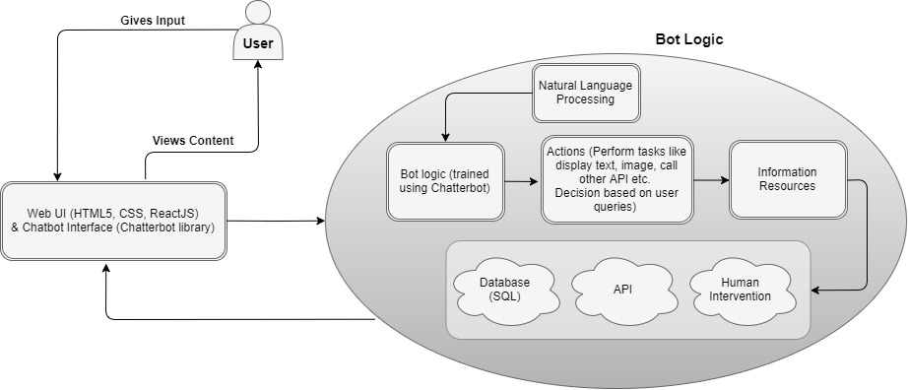
4.6 Architectural Flow chart

Slide 13
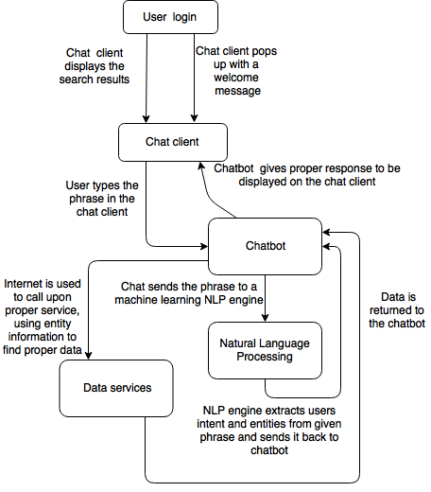
4.7 User flow chart

Slide 14
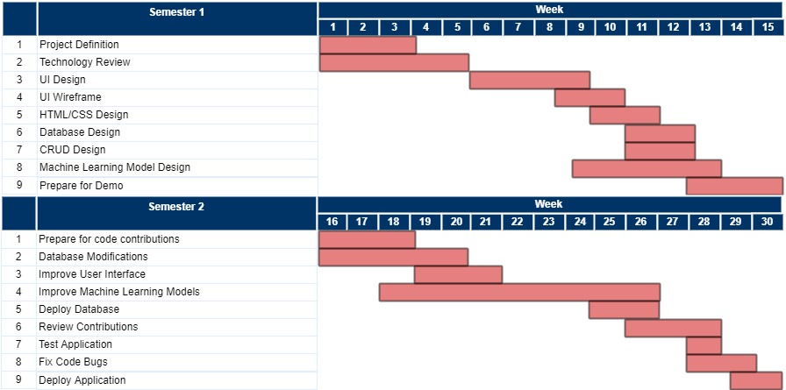
5. workflow:

Slide 15
6. Future scope
Ability to provide suggestions based on Contextual Awareness of location, time of day, trending stories on Twitter etc.
Ability to recognize people using image recognition
Adding Augmented Reality features with layers showing content like social media profiles, news/tweets relevant to context etc. overlaid on the entities captured using smartphone camera

Slide 16
GitHub Team wiki
https://github.com/paceuniversityCS691TeamB

Slide 17
Thank you

