Slide 1
Chat Based News Assistant
Sprint 4 Status Presentation
Chandni Shah, Kinnari Jasoliya, Pradeep Prakash, Guannan Zou & Longyuan Chu
Guided by: Professor Henry Wong

Slide 2
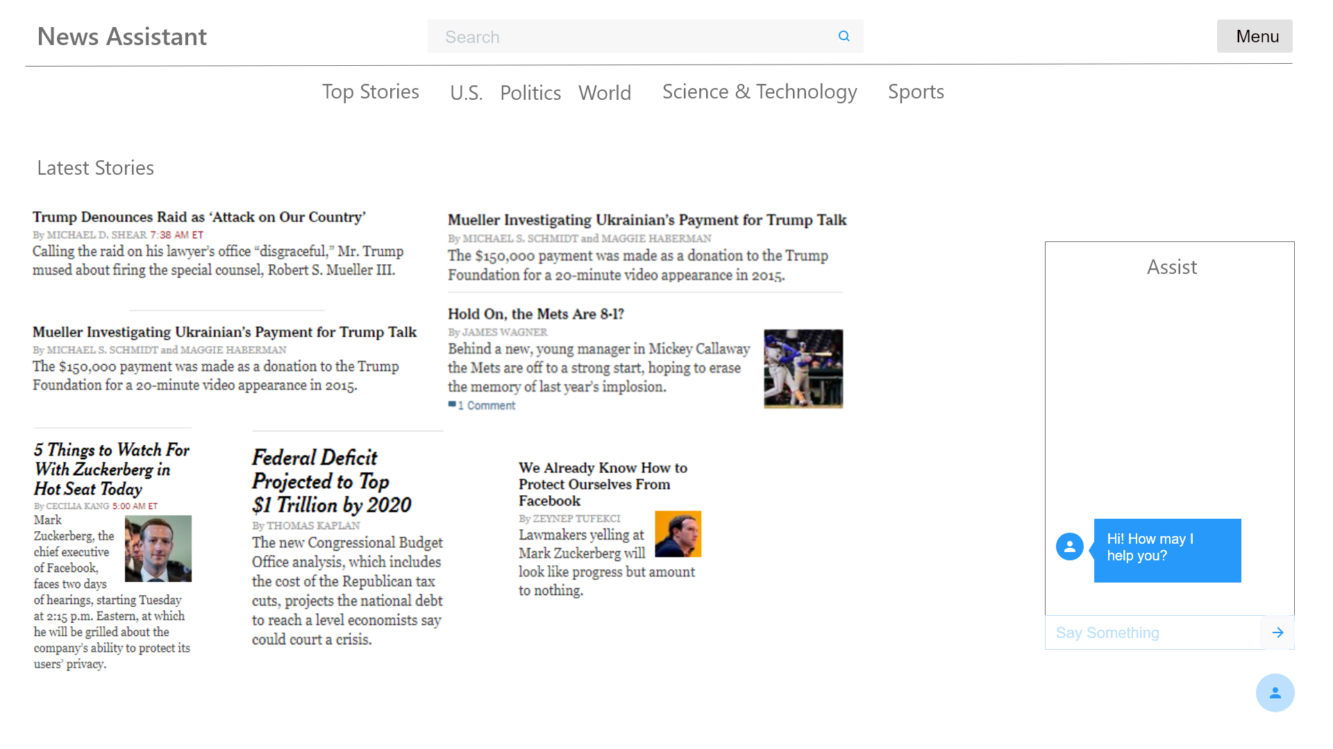
Project Objectives
To design a web application that combines functionality of:
Providing News content aggregated from various sources
Interactivity of communicating with virtual agent via Chatbot interface

Slide 3
Components
Aggregate news from
different news sites
Floating Window with
chatbot integration
Web based news application

Slide 4
Sprint 4 Changes
Improved chatbot training
Added category-based and custom topic news search to chatbot
Worked on deploying the web application to Heroku cloud

Slide 5
CS 692 Sprints Overview
Static news articles displayed from the database
Redesigned basic UI
Designed database structure
SPRINT 1
User registration implemented with database
RSS feed gathered from different websites
Worked on improvising UI pages
SPRINT 2

Slide 6
CS 692 Sprints Overview
Dynamic news feed using NewsAPI.org
Improved UI pages
Integrated chatbot UI with frontend pages
SPRINT 3
Deploying WebApp on Heroku
Worked on Chatbot training
Tried to deploy chatbot backend on cloud
SPRINT 4

Slide 7
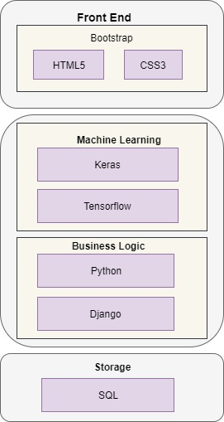
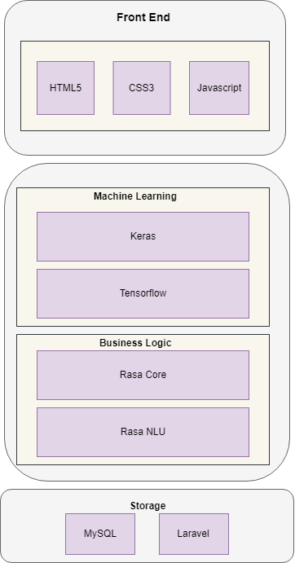
CS 692 Changes
CS 691
CS 692

Slide 8
Architectural changes
Business Logic Framework:
From Django(Python) to Laravel(PHP) – Due to difficulties in working with Django template and routing UI pages
Chatbot Framework Logic:
From Chatterbot to Rasa – for more robust machine learning training and custom response templating
Database:
From PostgreSQL to MySQL – for better compatibility with Laravel

Slide 9




Technical Details
Front End:
HTML, CSS & Javascript
Business Logic:
Chatbot:
RASA NLU & RASA Core
Machine Learning:
Keras
Tensorflow
News:
NewsAPI.org
Back End:
Laravel Framework
MySQL database

Slide 10
Future Scope
Ability to provide suggestions based on Contextual Awareness of location, time of day, trending stories on social media.
Suggest news based on user preferences like topics of interest
Desktop notifications – alert user whenever trending news is found from user-preferred categories & topics
Voice Input via speech recognition and chatbot responses using Text to Speech

Slide 11
Project Links
Github code: http://bit.ly/newsassistant
Github wiki: http://bit.ly/newsassistantwiki
Cloud-hosted app link: http://newsassistant.herokuapp.com/

Slide 12
Thank You

