Slide 2

UNIVERSITY OF PETROLEUM AND ENERGY STUDIES DEHRADUN
END TERM PRESENTATION ON
Comparative Study and Analysis of CPU Scheduling
UNDER THE GUIDANCE OF:-
Dr. Kingshuk Srivastava
Assistant. Prof, Department of Informatics
BY:-
Prashant Chandra Tiwari(R970218038)
Mansi Gupta(R970218032)
Chandranath Hazra(R970218015)

Slide 3
Contents
1.) Abstract
2.) Introduction
3.) Problem Statement
4.) Objectives
5.) Methodology
6.) Related Studies
7.) Algorithm
8.) Code Screen Shots

Slide 4
ABSTRACT
This project proposes a new scheduling algorithm which can be used to solve real world problems like smart grocery store. The methodology is to maximize the profits by avoiding the loss of higher profit yielding customers and to minimize the starvation of lower profit yielding customers.
Keywords: CPU Scheduling, Throughput, Waiting time (WT), Turnaround time (TAT), Response time (RT).

Slide 5
INTRODUCTION Scheduling is a fundamental operating system property which allots a particular process to the CPU for execution while the other processes are in the ready queue. First come first serve(FCFS) is the simplest of all scheduling algorithms. In this the process that requests CPU first, is allocated the CPU first. The implementation of FCFS is managed by FIFO queue. Shortest job first(SJF) is very advantageous because of its simplicity and simultaneously it also reduces the average amount of time that each process has to wait until its execution is complete. Priority Algorithm includes a certain priority number (in integer) associated with each process and then the CPU is given a highest priority process. And if a case occurs where the priority of two or more processes is same then the processes are scheduled in FCFS order.

Slide 6
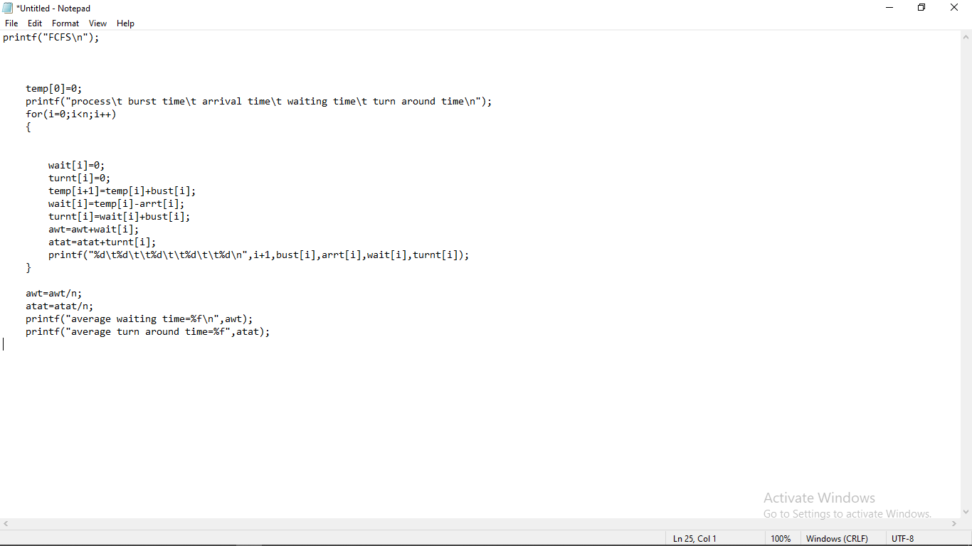

Slide 7
PROBLEM STATEMENT
Scheduling of processes is carried out to finish the work on time. The project deals with the comparative study of different CPU scheduling algorithms and their implementation on the working of smart grocery store.
The problem that arises in scheduling the tasks is utmost waiting time, If any Customer is there with one product still he/she may have to wait for other Customers to finish up Billing Process . How can we implement any algorithm which can solve real world problems like smart grocery store efficiently?

Slide 8
OBJECTIVES
To reduce the waiting time for arrived process/customer and to complete the task in minimum time and to achieve this objective various algorithms are implemented-
First come first serve (FCFS)
Shortest Job First (SJF)
Priority Algorithm

Slide 9
Methodology
The challenge is to make the overall system efficient and fair as much as possible, giving respected priority on the basis of weight of product, type of item required , cost and number of products.
The overall solving process includes:
Step 1: Detailed Study about different CPU scheduling algorithms.
Step 2: Understanding the basic concept and problems of scheduling.
Step 3: Identifying the algorithms which will be best implemented.
Step 4: Selection of algorithms which can solve the billing queue problem in most optimized way.
Step 5: Designing Flowcharts and algorithms of these optimization algorithms.
Step 6: Coding -Build the entire schedule by writing code using the C language.
Step 7: Testing-Test the developed algorithm by giving different inputs and if it gives correct output for different inputs, go to implementation phase.
Step 8: Implementation of these algorithms in different Environments.
Step 9: Comparative Study.
Step 10: Report.

Slide 10
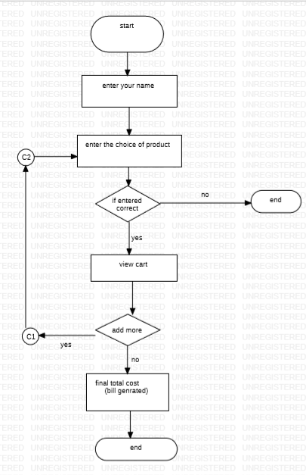
Methodology

Slide 11
Related Studies
The other research paper ‘Billing queue scheduling’ by Nikita Parmar and Aastha Joshi (2018) shows the application of these CPU scheduling algorithms, making billing in a grocery store an easier task. The Shortest job first algorithm and priority algorithm are best for the billing option, coming across these research paper, it encouraged the smart grocery store idea of this minor project.

Slide 12
Algorithm
Start
Enter No. of Customers
Enter your name
Enter the choice of product
Confirm the product and if wish to add more products to cart , go to step 4 again.
Increase/Decrease Quantity of product or Add/delete product .
Generate final bill of customer .
Add No. of item in Customer’s Cart to Burst time Array.
Assign priority for Customer by finding Cost per item for every customer.
Repeat Step 3 to Step 9 for every Customer .
Now , Select from available options of CPU Scheduling Algorithms( FCFS, SJF, Priority, Proposed Algo ) .
Average Waiting Time and Turn around time will be shown for respective algorithm.
Compare Waiting time for all algorithms and least WT algorithm will be the best for increasing efficiency in Billing problem .

Slide 13
Proposed Algorithm
Start
Store total cost for each customer and no. of item for each customer in array.
Find the average Cost of customers .
Divide customers in 2 queues as one with cost > avg(cost) as High Queue and other as cost <avg(cost) as Low Queue.
Sort both queues w.r.t no. of item .
Now , we will schedule CPU such that one process chosen from high queue and other from low queue in an alternate pattern .
This way we will maximize Shop’s profit by scheduling high profit customers and minimize starvation for lower profit customers by scheduling them after every High queue.
Compute Avg waiting , turn around time .
End.

Slide 14
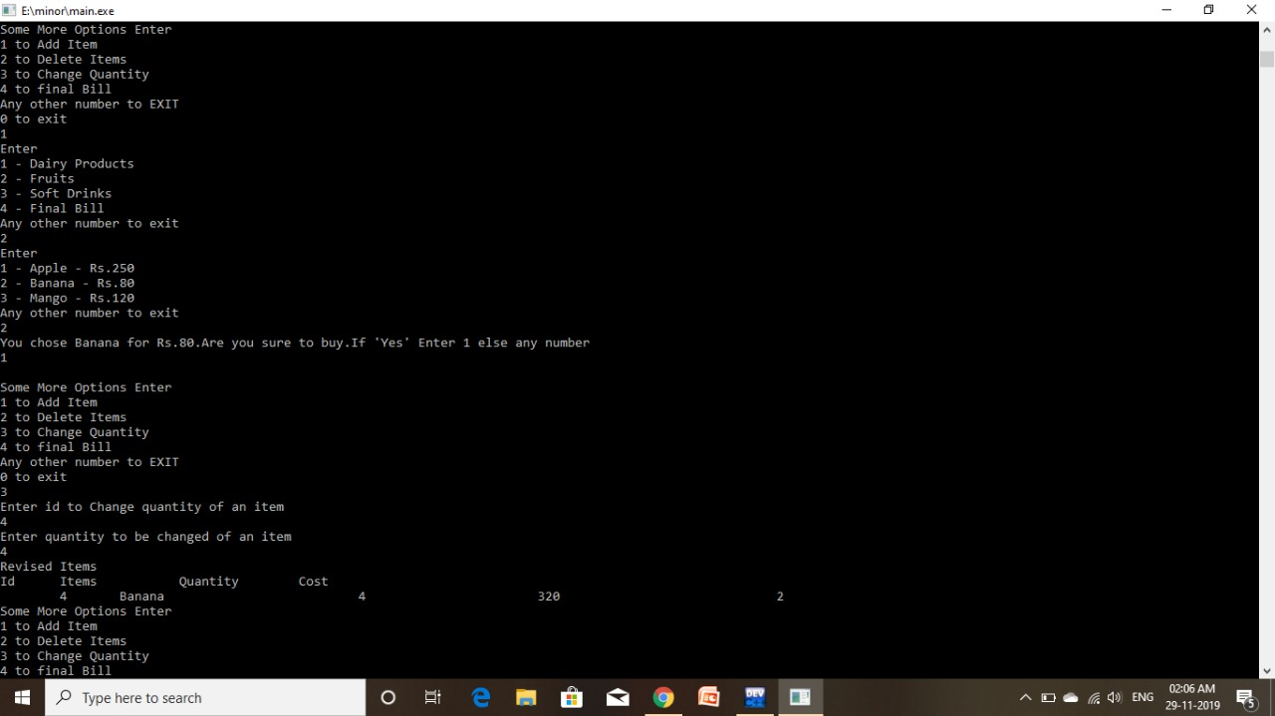

Slide 15
