Slide 1
GymHub Gym Management System
Akhilesh Singh (1002106742)
Alma Babydasan (1002168004)
Gayathri Reddy Dendi (1002182864)
Chandra Vamsi Krishna Alla (1002170054)

Slide 2
AGENDA
Introduction
Planning
Methodology
Design
Implementation
Testing
Maintenance
Future Scope
Demo

Slide 3
INTRODUCTION

Slide 4
ABSTRACT
The “GymHub” is a web-based application which helps the user to keep track of their health, view various exercises and select membership plans much more efficiently by providing features such as tracking heart rate, calories burned, cardio workouts and viewing exercises .
User Registration
User Dashboard - user details, viewing workouts, membership details and about us.
Admin Registration
Admin Dashboard – add/delete members, trainers, gyms.

Slide 5
Functionalities
Admin Registration: Members should be able to register using personal information such as name, email, and contact number. The registration process must include setting up a secure password.
User Registration: Similar to the admin, the user should be able to register using name, email and contact number.
Admin Login: Admin should be able to login using email and password.
User Login: User should be able to login using email and password.
Adding or deleting a member for admin: Admin should be able to add a new member, edit his/her info, and delete a member completely.
Adding and viewing gyms across various locations: Admin should be able to add and view gyms across different locations.
Adding and viewing trainers: Admin should be able to add and view gym trainers.

Slide 6
SDLC Model - Scrum
Scrum (a subset of agile) Model is the most suitable model for our project since the requirements might change over time and are not fully defined at the start of the project.
Since this model supports iterative development process, it allows flexible and rapid adaptation to changing needs.
Essential for dynamic environment like gym where changing requirements like new membership plans or fitness tracking features and user feedback can influence software functionality.

Slide 7
PLANNING

Slide 8
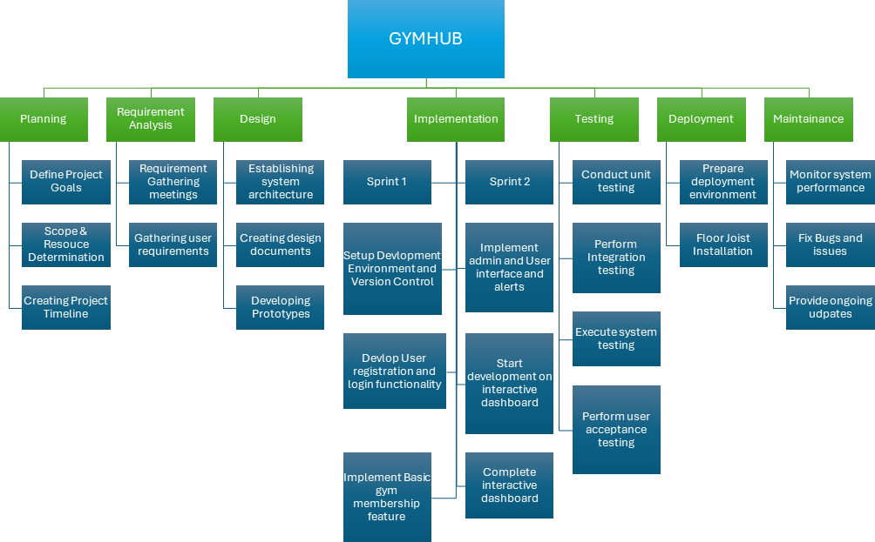
WORK BREAKDOWN STRUCTURE

Slide 9
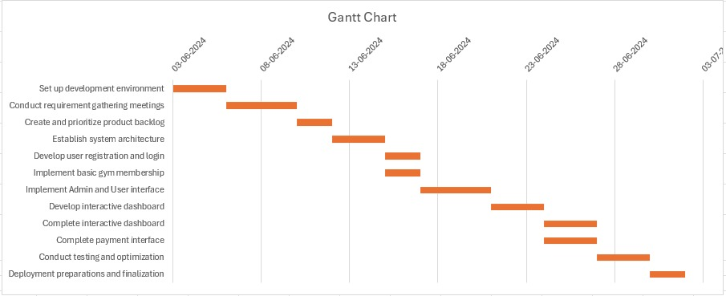
GANTT CHART

Slide 10
TASK ALLOCATION
SPRINT | MEMBER | ROLES and RESPONSIBILTY
Sprint 1 (WEEK 1 - 2) | Akhilesh Singh | Frontend Developer. Responsible for developing the Data Dictionary aligned with project specifications. Developed UI pages for User, Admin and integrated each of them with styling.
Sprint 1 (WEEK 1 - 2) | Chandra Vamsi Krishna Alla | Backend Developer. Tasked with designing the database architecture and creating tables. Implemented authentication and authorization functionalities. Reviewed and revised the Data Dictionary as required by evolving project needs.
Sprint 1 (WEEK 1 - 2) | Gayathri Reddy Dendi | Scrum Master. Handled the presentation of data including names, descriptions, categories, and pricing. Conducted data verification and validation. Checking of product backlog and creating database connections for all functionalities involved.
Sprint 1 (WEEK 1 - 2) | Alma Babydasan | Backend Developer. Developed the structural framework for project operations. Created User and Admin interfaces after completion of login page creation for User and Admin.

Slide 11
Sprint 2 (WEEK 3 - 4) | Alma Babydasan | Project Manager. Completed the integration of interactive dashboard with the login page and added some more valuable contents to help user decide on the Gym membership. Conducted Integration testing for user login, admin login and user sign up pages.
Sprint 2 (WEEK 3 - 4) | Gayathri Reddy Dendi | Test Engineer. Created payment page after selecting the membership deal and
 |  | integrated with interactive dashboard page. In database also payment records updated after completing transaction. Conducted manual testing and unit testing for user login, admin login and suer sign up page. Created all the diagrams needed for final document.
Sprint 2 (WEEK 3 - 4) | Chandra Vamsi Krishna Alla | Backend Developer. Integrating User and Admin interfaces with database and establishing connection between all of functions. Conducted testing of the MySQL database functionality and also tested the connections between the pages and the database with updating values.
Sprint 2 (WEEK 3 - 4) | Akhilesh Singh | Test Engineer. Developed an Interactive dashboard for User’s where they can check their Plan, different types of exercises, update profile picture, etc. Conducted Integration testing for the user login, admin login and user signup page. Conducted manual and user acceptance testing to validate product features and user interfaces.

Slide 12
COST ESTIMATION
We are using the LOC to estimate project cost
Lines of Code (LOC) Estimation:
Given:
Total Lines of Code (LOC): 4,000
Number of Developers: 2
Project Completion: 4 weeks (20 working days)
Average productivity rate: 200 lines of code per person-day
Effort Estimation:
Total Effort in Person-Days = Total LOC / (Productivity Rate × Number of Developers)
Total Effort in Person-Days = 4,000 LOC / (200 LOC/person-day × 2 developers)
Total Effort in Person-Days = 10 person-days
Timeline Estimation:
Total Effort in Person-Days / Number of Developers = Total Days
10 person-days / 2 developers = 5 working days
Cost Estimation:
Cost per person-month: $5,000 (approximate average cost for a mid-level developer)
Total Effort in Person-Months = Total Effort in Person-Days / 20 days per month
Total Effort in Person-Months = 10 person-days / 20 days per month = 0.5 person months
Cost = Total Effort in Person-Months × Cost per Person-Month × Number of Developers
Cost = 0.5 person-months × $5,000 per person-month × 2 developers
Cost = $5,000
Based on the Lines of Code (LOC) estimation, with 2 developers and a 4-week timeline, the estimated cost for the project is $5,000.

Slide 13
RISK FACTORS
Risks Involved:
Technical Risks | Organizational Risks | External Risks
Integration Task Risk: Some tasks may take longer than usual leading to slower integration of two parts of the project. | Team Availability: All team members are only available from Friday to Sunday, which might delay completion and slow development. | Poor Communication: Miscommunication among team members leads to poor communication.
Software Issues: Software issues (like lower disk space), and internet connectivity issues. | Team Health: Team health issues.
Quality Risk: Limited testing leading to bugs in the system. | Poor Communication: Miscommunication among team members leads to poor communication.
Finishing Touches: Not using standard coding rules may lead to more time for beautification/formatting of the code.

Slide 14
RISK MITIGATION
Risk Mitigation:
Technical Risk Mitigations | Organizational Risk Mitigations | External Risk Mitigations
Testing after every sprint and maintaining communication among team members. | Regular meetings can be held. | Prioritize bigger tasks first and also schedule extra hours to finish the tasks taken up.
Make sure backup is kept after every commit. | Prioritize bigger tasks first and schedule extra hours to finish the tasks taken up.
Implementation needs to be completed faster, so we have enough time for thorough testing. Also, keep testing after every requirement is completed. | Having meetings and communicating early so the tasks can be divided among others.
Using standard coding practices, so later beautification work can be avoided. | Regular meetings and proper documentation of tasks and code.

Slide 15
RISK ASSESSMENT
 | Risk | Probability (%) | Impact ($) | Total ($)
1 | Requirement Changes | 20 | 1000 | 200
2 | Team Availability | 30 | 500 | 150
3 | Integration Task Risk | 10 | 2700 | 270
4 | Software Issues | 5 | 700 | 35
5 | Team Health | 20 | 200 | 40
6 | Quality Risk | 20 | 800 | 160
7 | Poor Communication | 30 | 600 | 180
8 | Finishing Touches | 10 | 200 | 20

Slide 16
METHODOLOGY

Slide 17




SCRUM TASKS
SPRINT 1
SPRINT 1
SPRINT 2
SPRINT 2
Task 1: Set up development environment and version control.
Task 2: Conduct requirement gathering meetings.
Task 3: Create and prioritize product backlog.
Task 4: Establish system architecture.
Task 5: Develop user registration and login functionality.
Task 6:Implement basic gym membership feature
Task 7: Implement Admin and User interface and alerts.
Task 8: Start development on the interactive dashboard and payment interface.
Task 9: Complete the interactive dashboard.
Task 10: Complete the payment interface.
Task 11: Conduct extensive testing and optimization.
Task 12: Deployment preparations and finalization.

Slide 18
DESIGN

Slide 19
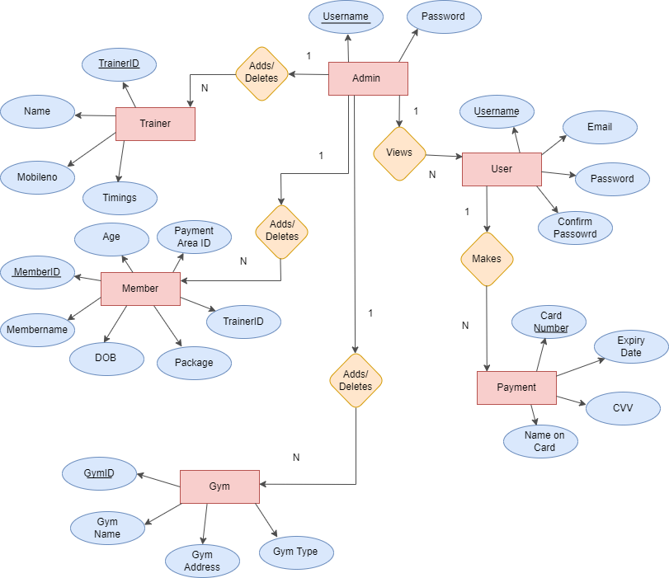
UML DESIGN

Slide 20
IMPLEMENTATION

Slide 21




Implementation
(IDEs): Visual Studio Code, Notepad++.
FRONTEND: HTML, CSS, PHP
BACKEND: phpMyAdmin, MySQL
WEB SERVERS: Apache HTTP Server
TESTING: Selenium
WEB BROWSERS: Google Chrome, Mozilla Firefox, Microsoft Edge

Slide 22
TESTING

Slide 23
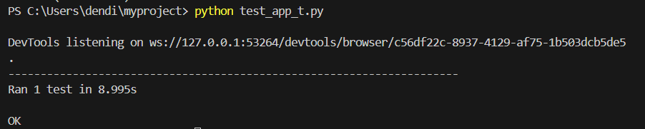
Automation Testing
Selenium is a popular testing framework designed to simplify a broad range of testing needs, from unit testing to integration testing.
Test 1: User Login
Test 2: User Signup Test 3: Admin Login
Login selenium
Unit:

Slide 24
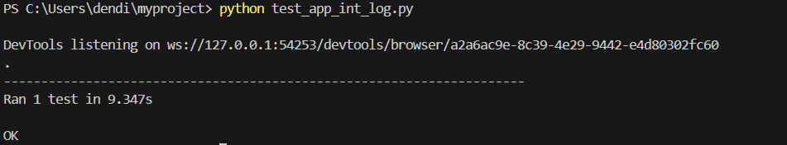
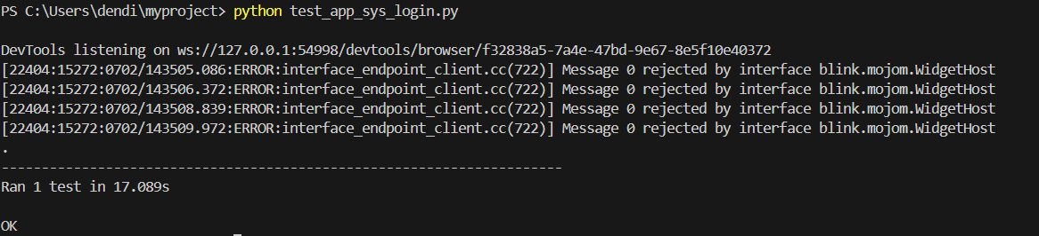
Automation Testing Integration:
System:

Slide 25
Manual Testing
Unit Testing:
Test Case # | Functionality | I/P and Action | Expected Result | Actual Result | Status
UT001 | User Signup | Adding all the details with valid inputs and clicks on SignUp. | Smooth transition to the Login page. | Successfully moving to Login page. | Pass
UT002 | User Login | Giving valid credentials and clicks on Login. | A successful Login message is displayed and redirected to Particular User’s Dashboard. | A successful Login message is displayed and redirected to Particular User’s Dashboard. | Pass
UT003 | Verify an Error msg is displayed for invalid or empty field During user signUp | User click on with an empty fields. Should give error for input validation indication fields req. | User should gets an error msg for field/s req. | User gets a Msg to fill Empty field/s | Pass

Slide 26
Manual Testing
Unit Testing:
UT004 | Error msg for login for invalid Credentials | User enters invalid Credentials at Login time. | User should not be able to login he/she will get a Msg on the screen saying Invalid Credentials | User Gets a Msg of error saying Invalid Credentials | Pass
UT005 | Success msg for new user registration | User entering all valid data at time of Signup | User should get the Msg for successful Registration. | User gets the Msg for successful Registration and also receives an email. | Pass

Slide 27
Manual Testing
Integration Testing:
Test Case # | Functionality | I/P and Action | Expected Result | Actual Result | Status
IT001 | User Signup | User signs up and we check if it goes to user login and it contains the word “GymHub”. | User should signup successfully and it goes to login page which contains the word “GymHub” | Successfully navigating to login page and login page contains “GymHub” | Pass
IT002 | User Login | User logs in and we check if it goes to user dashboard and it contains the word “Gym Hub”. | User should login successfully and it goes to user dashboard which contains the word “Gym Hub” | Successfully navigating to user dashboard page and the dashboard contains “Gym Hub” | Pass
IT003 | Admin Login | Admin logs in and we check if it navigates to Admin dashboard with word “GymHub”. | Admin should log in successfully and we check if it navigates to Admin dashboard with word “GymHub”. | Admin sucessfully logs in and is able to navigates to Admin dashboard with word “GymHub”. | Pass

Slide 28
Manual Testing
User Acceptance Testing:
Test Case # | Functionality | I/P and Action | Expected Result | Actual Result | Status
AT001 | Test User Login and Registration | User will give inputs and login/ register | On successful login/registration user is redirected to Dashboard | On successful login/registration user is redirected to Dashboard | Pass
AT002 | Navigation | User Will be navigating through these pages and using the functionalities | User should be able to navigates where they clicks. | User should be able to navigates where they clicks. | Pass
AT003 | Dashboard updating on profile, check exercises and apply for a membership. | User checking links to exercises, updating profile and applying for membership and logging out successfully. | On updating profile dashboard is updated, videos are streamed and log out successfully. | Successfully updated profile dashboard, streamed desired exercise videos and logged out successfully. | Pass

Slide 29
MAINTENANCE/FUTURE SCOPE

Slide 30
Maintenance
Routine Maintenance Tasks:
Performance and Security Audits: Regularly check and improve system performance and security.
Data Backups: Frequently back up the database to protect data.
Log Management: Consistently clear logs and temporary files to avoid storage overflow and keep the system efficient.
Preventive Maintenance:
System Health Checks: Routinely monitor server, database, application, and user interface performance.
Database Maintenance: Regularly optimize the database for faster responses
and efficient storage.
Code Quality Assurance: Use tools to check the code for errors or inefficiencies.

Slide 31
Maintenance
Update and Patch Management:
Regular Updates: Update all software components and libraries to the newest versions.
Security Patching: Apply security patches swiftly to fix vulnerabilities, especially urgent ones for critical issues.
Monitoring and Alerts:
Performance Monitoring: Use tools to continuously monitor system performance and spot any irregularities.
Alert Systems: Set up alerts for important budget thresholds to manage finances better.

Slide 32
Maintenance
Corrective Maintenance:
Issue Resolution: Quickly fix any reported system bugs or problems.
Post-Incident Analysis: Review what caused issues and learn from them to improve the system.
Performance Optimization: Regularly enhance the system’s performance, focusing on processing and data retrieval speeds.
Management of Updates, Patches, and Bug Fixes:
Version Control: Use a robust system to manage changes and enable easy reversions if needed.
Staging Environment: Test new updates thoroughly in a staging environment before full deployment.
Release Schedule: Keep a regular update schedule for routine patches and have a system for urgent updates.

Slide 33
Maintenance
Scalability and Futureproofing:
Scalability Planning: Design the system to easily handle more users or increased activity.
Modular Design: Keep the system flexible to update easily or add new features.
Technological Updates: Stay current with new technologies and trends to keep the system innovative.
Continuous User Feedback: Regularly gather and use user feedback to continually refine and improve the system.

Slide 34
Future Scope
Payment Gateway can be added by integrating API.
Admin and User Dashboard pages can be improved by adding a few more attributed making it more personal for the user.
Timings of various exercises can also be updated on the website.
Mobile Optimization: Developing a dedicated mobile app or enhancing the mobile. responsiveness of the web interface to improve accessibility and user engagement.
Feature Expansion: Adding features such as personalized workout plans, user progress tracking, and interactive elements like forums or chat services for better user interaction.
Advanced Analytics: Integrating more advanced analytics features for admins to help track gym.

Slide 35
References
Text Editors / Integrated Development Environments (IDEs):
Visual Studio Code(https://visualstudio.microsoft.com/)
PHPStorm:(https://www.jetbrains.com/phpstorm/)
Notepad++: (https://notepad-plus-plus.org/)
Web Servers:
Apache HTTP Server: .(https://httpd.apache.org/)
Database Management:
phpMyAdmin:(https://www.phpmyadmin.net/)
MySQL : (https://www.mysql.com/products/workbench/)
Local Development Environment:
XAMPP: (https://www.apachefriends.org/download.html)

Slide 36
References
Front-End Frameworks and Libraries:
CSS
HTML
Web Browsers:
Google Chrome:(https://www.google.com/chrome/)
Mozilla Firefox:(https://www.mozilla.org/en-US/firefox/new/)
Microsoft Edge: (https://www.microsoft.com/)
Testing:
Selenium: .(https://www.selenium.dev/)

Slide 37
Thank you!!!

