Slide 1

Class Diagram and Sequence Diagram
Group-7

Slide 2
UML(Unified Modelling Language)
Unified Modeling Language (UML) is a standardized modeling language used in software engineering. UML helps visualize, specify, construct, and document the artifacts of a software system.
Types of UML Diagrams
Structural Diagrams: Focus on the static aspects of the system. Examples include Class Diagrams and Component Diagrams.
Behavioral Diagrams: Focus on the dynamic aspects of the system. Examples include Sequence Diagrams and Use Case Diagrams.

Slide 3
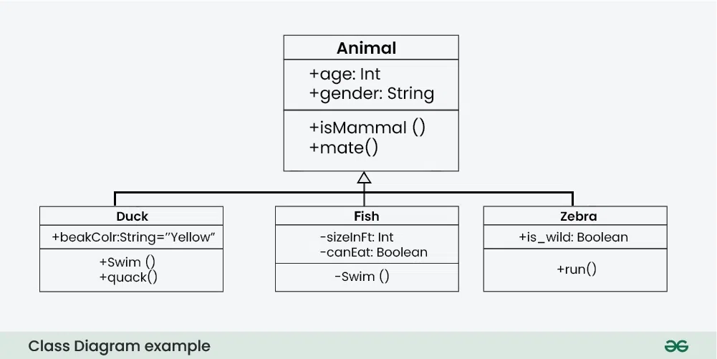
What is a Class Diagram?
In object-oriented programming (OOP), a class is a blueprint or template for creating objects. Class Diagram/notation is a graphical representation used to depict classes and their relationships in object-oriented modeling.

Slide 4
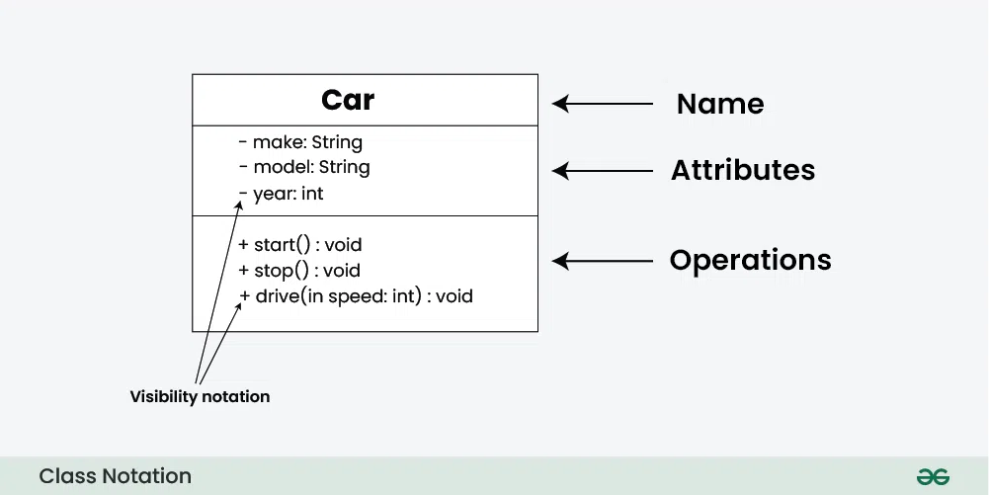
Class Notation
Visibility Notation:
Visibility notations indicate the access level of attributes and methods. Common visibility notations include:
+ for public (visible to all classes)
- for private (visible only within the class)
# for protected (visible to subclasses)
~ for package or default visibility (visible to classes in the same package)

Slide 5
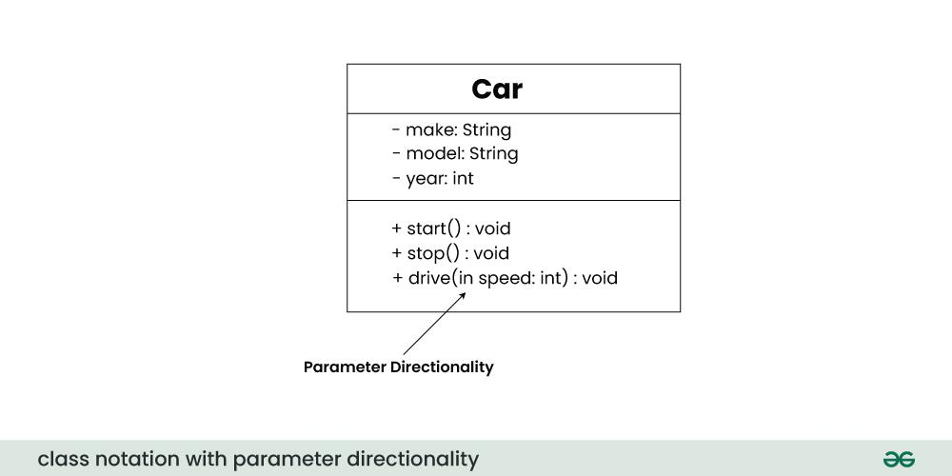
Parameter Directionality
In class diagrams, parameter directionality refers to the indication of the flow of information between classes through method parameters. It helps to specify whether a parameter is an input, an output, or both. This information is crucial for understanding how data is passed between objects during method calls.

Slide 6
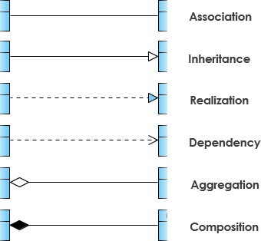
Relationships between classes
Association: A bidirectional or unidirectional connection indicating that instances of one class are related to instances of another class.
Inheritance: Represents an "is-a" relationship where a subclass inherits attributes and behaviors from a superclass.
Realization: It indicates that a class implements the features of an interface. It is often used in cases where a class realizes the operations defined by an interface.
Dependency: Indicates that one class relies on another for its implementation or functionality, typically through method parameters or return types.
Aggregation: A "whole-part" relationship where one class represents a whole and the other represents a part, but parts can exist independently of the whole.
Composition: A strong "whole-part" relationship where parts cannot exist independently of the whole and are created and destroyed with it.

Slide 7
How to draw Class Diagrams and uses
Identify Classes
List Attributes and Methods
Identify Relationships
Create Class Boxes
Add Attributes and Methods
Draw Relationships
Label Relationships
Review and Refine
Uses:
System Design
Communication and Collaboration
Code Generation

Slide 8
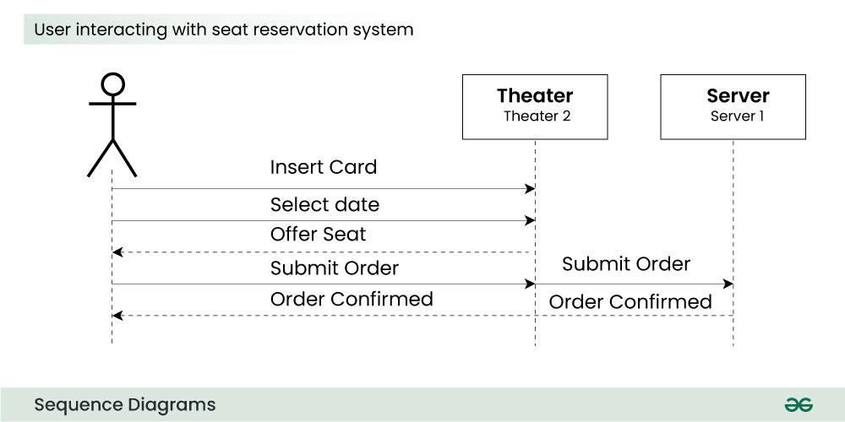
What is a Sequence Diagram?
A sequence diagram simply depicts the interaction between the objects in a sequential order i.e. the order in which these interactions occur. Sequence diagrams describe how and in what order the objects in a system function. These diagrams are widely used by businessmen and software developers to document and understand requirements for new and existing systems.

Slide 9
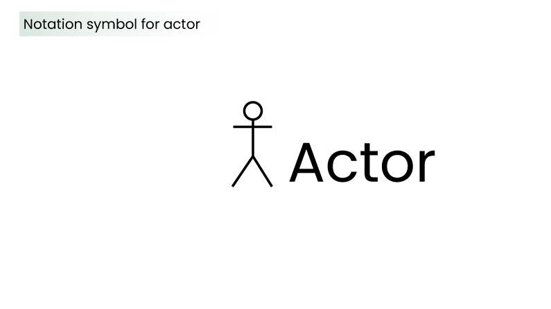
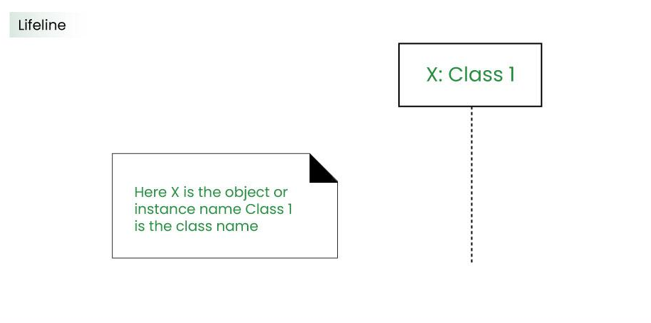
Sequence Diagram Notations
Actor:
An actor in a UML diagram represents a type of role where it interacts with the system and its objects.
Lifelines:
A lifeline is a named element which depicts an individual participant in a sequence diagram.
So basically, each instance in a sequence diagram is represented by a lifeline. Lifeline elements are located at the top in a sequence diagram.

Slide 10
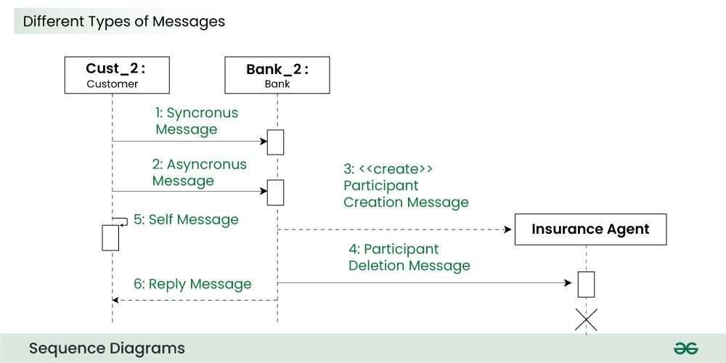
Messages
Communication between objects is depicted using messages. The messages appear in a sequential order on the lifeline. We represent messages using arrows. Lifelines and messages form the core of a sequence diagram.
Messages can be broadly classified into the following categories:
Synchronous messages
Asynchronous Messages
Create message
Delete Message
Reply Message
Self Message

Slide 11
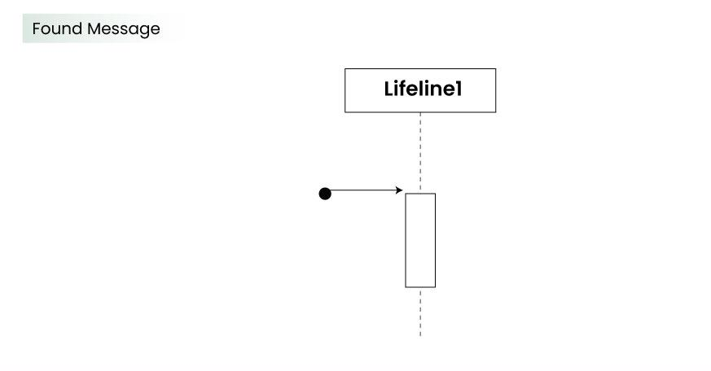
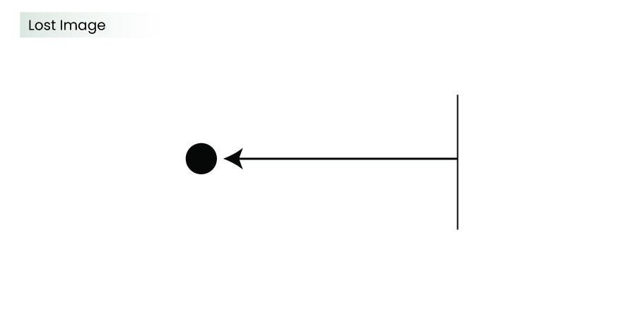
Messages
Found Message:
A Found message is used to represent a scenario where an unknown source sends the message. It can be due to multiple reasons, and we are not certain as to what caused the failure.
Lost Message:
A Lost message is used to represent a scenario where the recipient is not known to the system. The warning might be generated for the user or other software/object that the lifeline is interacting with. Since the destination is not known before hand, we use the Lost Message symbol.

Slide 12
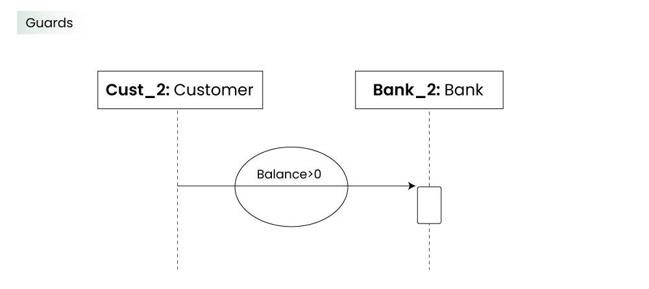
Guards
They are used when we need to restrict the flow of messages on the pretext of a condition being met. Guards play an important role in letting software developers know the constraints attached to a system or a particular process.

Slide 13
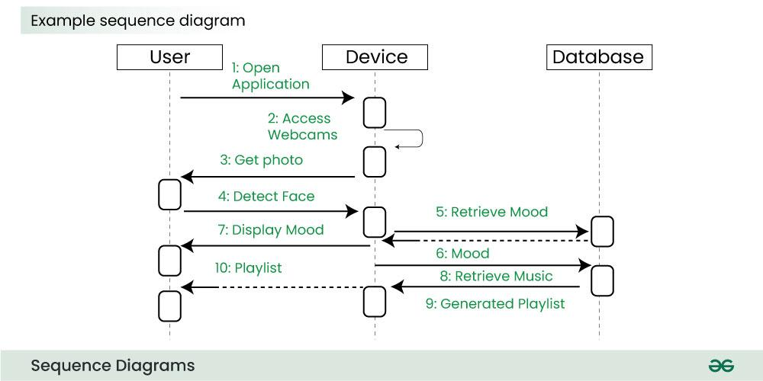
Example: Emotion based music player:
Firstly the application is opened by the user.
The device then gets access to the web cam.
The webcam captures the image of the user.
The device uses algorithms to detect the face and predict the mood.
It then requests database for dictionary of possible moods.
The mood is retrieved from the database.
The mood is displayed to the user.
The music is requested from the database.
The playlist is generated and finally shown to the user.

Slide 14
Uses of Sequence Diagram
System Design and Architecture
System Behaviour and Visualization
Communication and Collaboration
Requirements Clarification and debugging

Slide 15

Thank you

