Slide 1
Campaign for selling personal loans -By Chandra

Slide 2

Inferences
Here are the inference generated during the Exploratory data analysis-
Only 9.6% of the customers in the data file has Personal Loan compared to 90.4% of customers without the Personal loan(0). This clearly shows we do not have enough data for the model to learn more about customers accepted the personal loans. Model will learn and predict customers without personal loans more accurately compared to customers with personal loans.
Real time scenario, we need to request the bank to include equal proportions of the data for each class in the target column. In this case, we will be exploring other options like Up sampling the minority data to feed the model with equal proportions of data.

Slide 3

Key features
I have identified below features are driving the customers from accepting the personal loan offers -
1. Customers accepting the personal loan offer having average income of 144K compared to 66K of customers without the personal loan
2. CCAvg is 3.9k for the Customers accepting the personal loan offer compared to 1.7k of customers without the personal loan.
3. Educating level is more 2.2 for customers with personal loan compared to 1.8 of customers without the personal loan
4. Mortgage balance is 100K for customers with personal loan compared to 51k compared to customers without accepting the Personal Loan

Slide 4
Key features
5. It looks like age and Experience are correlated i.e. work experience is increasing with increase in age. But no clear difference in age and experience of the customers accepted the personal loans in the previous campaign. Dropped those features from the analysis.
6. Other features dropped during the EDA was ID, Zip codes features. Both are not having any significant effect on the customers accepting the personal loans.

Slide 5
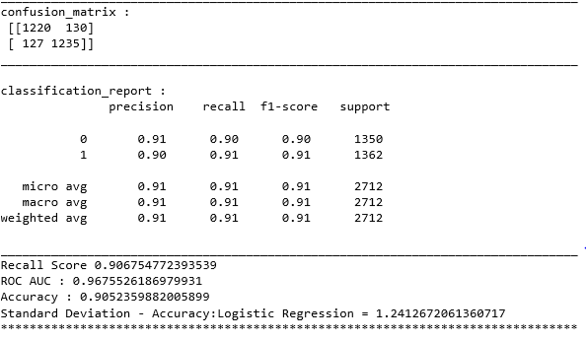
Champion Model
Model Results :
Number of models are built to classify the customers with personal loan and without personal. After carefully reviewing the results it looks like logistic regression model with equal proportions of data both the classes(Personal Loan=0 and Personal Loan=1) is performing better compared to the other models.

Slide 6
Model Results
Accuracy value of 90.5% means that 1 of every 10 labels is incorrect, and 9 is correct. Model can classify true customers accepted personal loans and without personal loans 90.5% of the time.
Precision value 91% means on average, 1 out of every 10 customers labeled as personal loan by our model is doesn’t have personal loan, and 9 are having personal loan. If we use this Bank may end up sending personal offers to the wrong customers and draining the marketing spending on wrong customers. We may need to tie this model with some other targeting attributes explored during data exploration while applying the targeting criteria for the campaign.
Recall value is 91% means that 1 of every 10 customers are missed by our model and 9 labeled as customers with personal loan product. Bank may miss targeting the right customers in every 1 in 10 cases. Missing right customers means missing loan balances as well.
F1 score value is 91% i.e. harmonic mean of Precision and Recall. Identifying personal loan customers as personal loan and without personal loan 91% accurately is a very good model.
ROC AUC curve is 0.967 of the area is under the curve meaning True positive rate close to 1.

Slide 7
Targeting Criteria - Recommendation
I would recommend bank to use the below targeting criteria along with scoring data through model to identify the targeting universe for the campaign and to increase response rate from the campaign –
Targeting criteria :
1. Customers with income > = 100k
2. Customers with 3 or 4 people in the family
3. Customers with credit card average balance of 1.8k or more
4. Customers with higher education levels 2 and 3
5. Customers without online account activated
6. Customers with mortgage balance $0
8. Utilize the model scores

Slide 8

Thanks

