Slide 1
Bivariate Relationships
Presented By:
Chandra Prakash
Guneet Singh Bajaj
Hemlata Saraswat

Slide 2
Objective:
Our objectives is to find the relationship between the home runs and the batting average of a baseball player.

Slide 3


TOOLS USED
1. Programming Language :- R
2. Libraries :- ggplot2, caTools, Publish
3.IDE :- RStudio

Slide 4
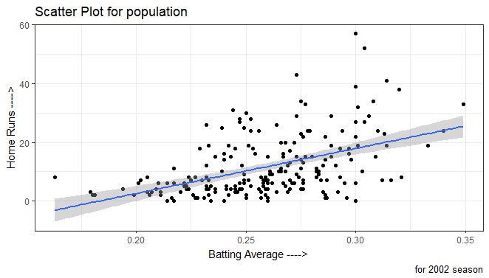
1. Scatter Plot

Slide 5
Evidence for relationship and Variability
Yes, there is a positive linear relationship.
The variability of number of home runs is greater for those with higher batting averages.

Slide 6
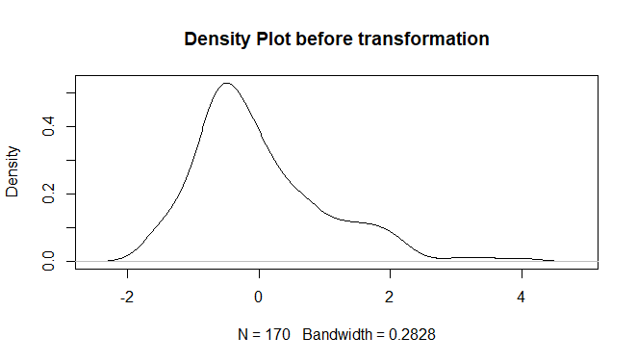
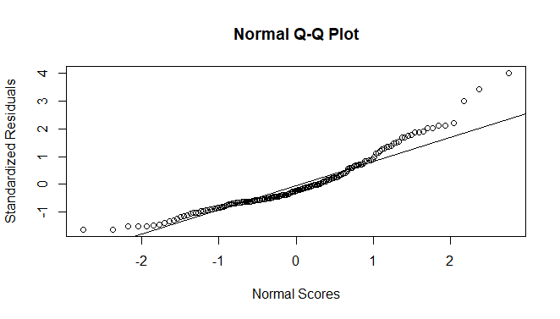
Skewness and Normality

Slide 7
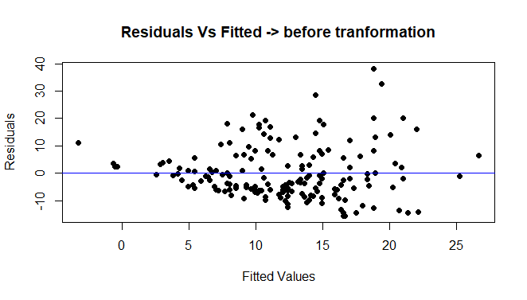
Fitted vs Residuals

Slide 8
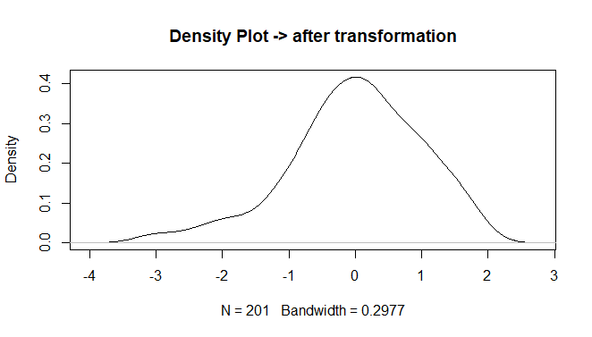
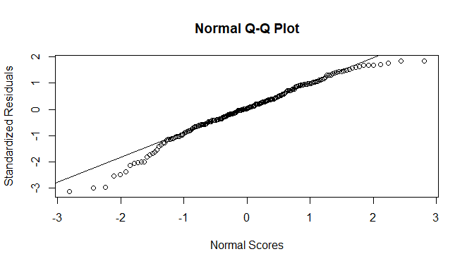
Skewness and Normality after transformation

Slide 9
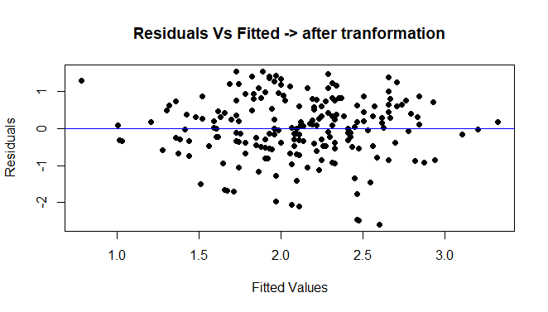
Fitted vs Residuals after transformation

Slide 10
Equation of population regression
Recall equations of line :
Algebra Line: y = mx + c
Statistics Line: y = 𝛃o + 𝛃1x , where
𝛃o = y-intercept ⇒ -28.149
𝛃1 = slope of the line ⇒ 153.551
R square = 0.2305

Slide 11
Equation of population regression
Statistics Line: y = bo + b1x , where
bo = y-intercept ⇒ -1.4346
b1 = slope of the line ⇒ 13.6375
R square = 0.2189

