Slide 1
Bivariate Relationships
17.871

Slide 2
Testing associations (not causation!)
Continuous data
  Scatter plot (always use first!)
  (Pearson) correlation coefficient (rare, should be rarer!)
  (Spearman) rank-order correlation coefficient (rare)
  Regression coefficient (common)
Discrete data
  Cross tabulations
  Differences in means, box plots
  χ²
  Gamma, Beta, etc.

Slide 3
Continuous DV, continuous EV
Dependent Variable: DV
Explanatory (or independent) Variable: EV
Example: What is the relationship between Black percent in state legislatures and black percent in state populations

Slide 4
Regression interpretation
Three key things to learn (today)
Where does regression come from
To interpret the regression coefficient
To interpret the confidence interval
  We will learn how to calculate confidence intervals in a couple of weeks

Slide 5
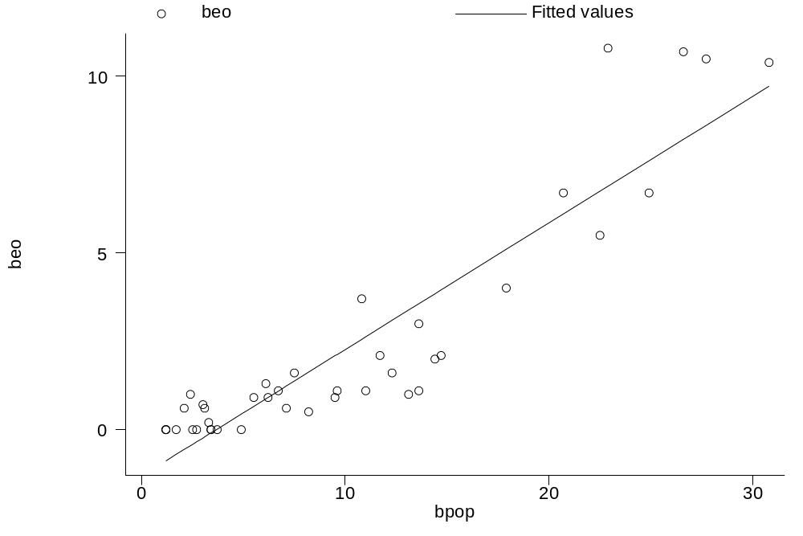
Linear Relationship between African American Population & Black Legislators
Black % in state legislatures
Black % in state population

Slide 6
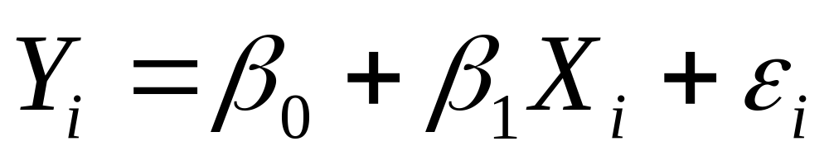
The linear relationship between two variables
Regression quantifies how one variable can be
described in terms of another

Slide 7
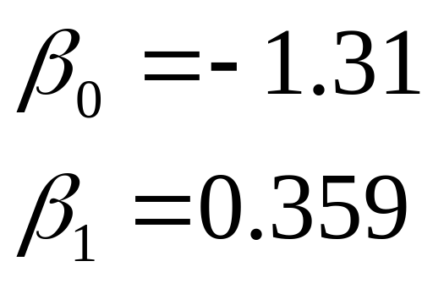
Linear Relationship between African American Population & Black Legislators
Black % in state legislatures
^
^
Black % in state population

Slide 8
How did we get that line?
1. Pick a value of Y_{i}
Y_{i}
Black % in state legis.
Black % in state population

Slide 9
How did we get that line?
2. Decompose Y_{i} into two parts
Black % in state legis.
Black % in state population

Slide 10
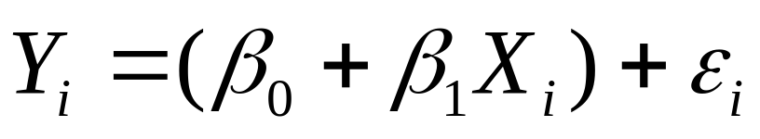
How did we get that line?
3. Label the points
Y_{i}
^
ε_{i}
Y_{i}-Y_{i}
“residual”
^
Y_{i}
Black % in state legis.
Black % in state population

Slide 11
What is ε_{i}? (sometimes ui)
Wrong functional form
Measurement error
Stochastic component in Y

Slide 12

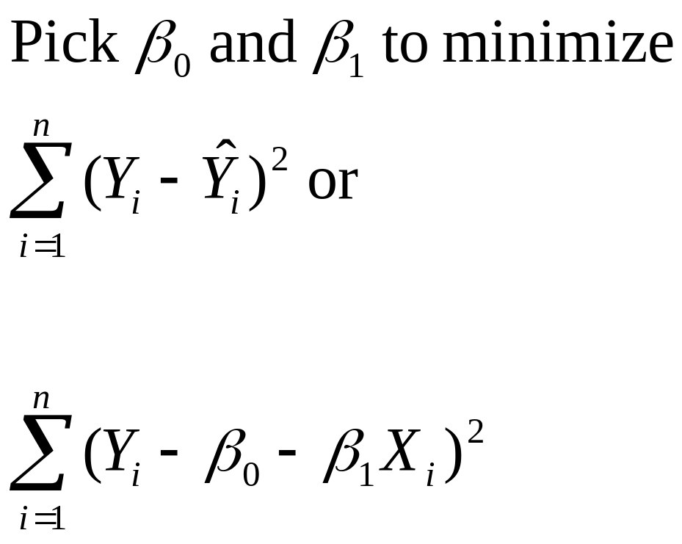
The Method of Least Squares
Y_{i}
ε_{i}
^
Y_{i}-Y_{i}
^
Y_{i}

Slide 13
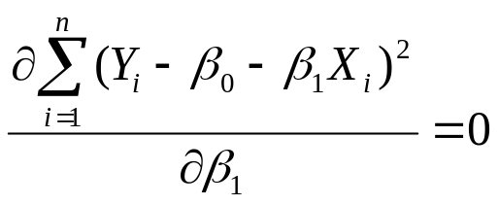
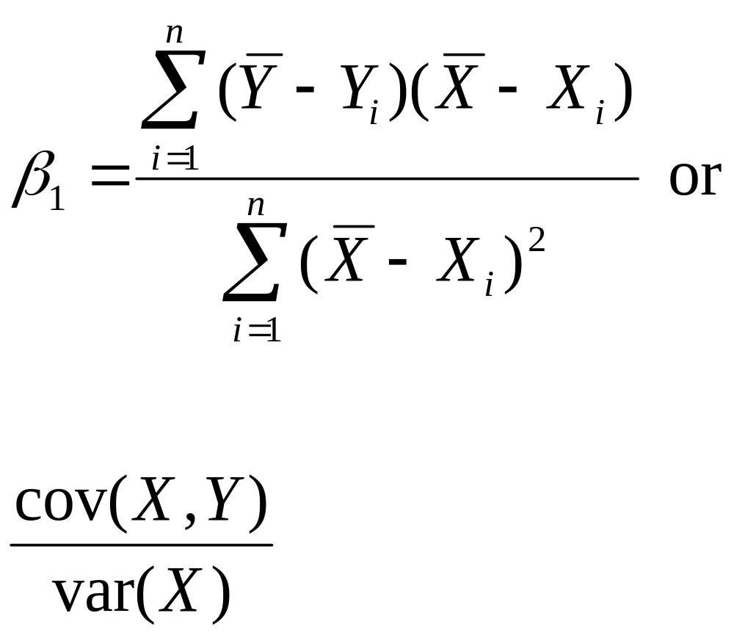
Solve for
^
Remember this for the problem set!
Notes:
(Tufte,p. 68)

Slide 14
Regression commands in STATA
reg depvar expvars
  E.g., reg y x
  E.g., reg beo bpop
Making predictions from regression lines
  predict newvar
  predict newvar, resid
    newvar will now equal ε_{i}

Slide 15
Black elected officials example
. reg beo bpop
Source | SS df MS Number of obs = 41
-------------+------------------------------ F( 1, 39) = 202.56
Model | 351.26542 1 351.26542 Prob > F = 0.0000
Residual | 67.6326195 39 1.73416973 R-squared = 0.8385
-------------+------------------------------ Adj R-squared = 0.8344
Total | 418.898039 40 10.472451 Root MSE = 1.3169
------------------------------------------------------------------------------
beo | Coef. Std. Err. t P>|t| [95% Conf. Interval]
-------------+----------------------------------------------------------------
bpop | .3586751 .0251876 14.23 0.000 .3075284 .4094219
_cons | -1.314892 .3277508 -4.01 0.000 -1.977831 -.6519535
------------------------------------------------------------------------------
Always include interpretation in your presentations and papers
Interpretation: a one percentage point increase in black population leads to a .36 increase in black percentage in the legislature
Notes:
-trick: ignore most of the output

Slide 16
The Linear Relationship between African American Population & Black Legislators
Black % in state legislatures
(Y)
Black % in state population (X)

Slide 17
More regression examples

Slide 18
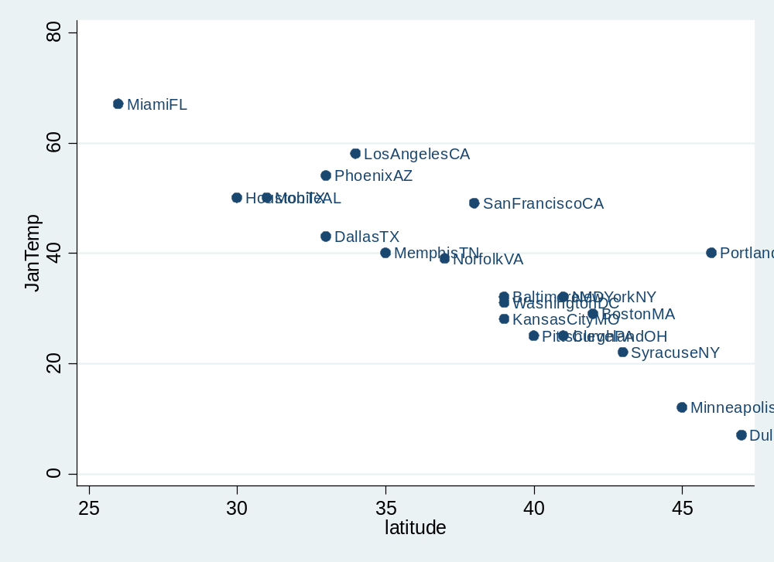
Temperature and Latitude
scatter JanTemp latitude, mlabel(city)

Slide 19
. reg jantemp latitude
Source | SS df MS Number of obs = 20
-------------+------------------------------ F( 1, 18) = 49.34
Model | 3250.72219 1 3250.72219 Prob > F = 0.0000
Residual | 1185.82781 18 65.8793228 R-squared = 0.7327
-------------+------------------------------ Adj R-squared = 0.7179
Total | 4436.55 19 233.502632 Root MSE = 8.1166
------------------------------------------------------------------------------
jantemp | Coef. Std. Err. t P>|t| [95% Conf. Interval]
-------------+----------------------------------------------------------------
latitude | -2.341428 .3333232 -7.02 0.000 -3.041714 -1.641142
_cons | 125.5072 12.77915 9.82 0.000 98.65921 152.3552
------------------------------------------------------------------------------
Interpretation: a one point increase in latitude is associated with a 2.3 decrease in average temperature (in Fahrenheit).

Slide 20
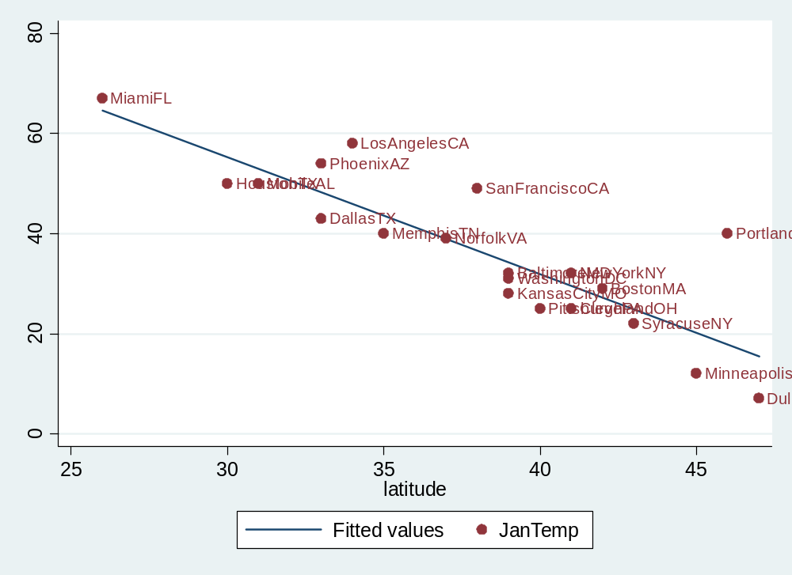
How to add a regression line:
Stata command: lfit
scatter JanTemp latitude, mlabel(city) || lfit JanTemp latitude
or often better
scatter JanTemp latitude, mlabel(city) m(i) || lfit JanTemp latitude

Slide 21
Presenting regression results
Brief aside
First, show scatter plot
  Label data points (if possible)
  Include best-fit line
Second, show regression table
  Assess statistical significance with confidence interval or p-value
  Assess robustness to control variables (internal validity: nonrandom selection)

Slide 22
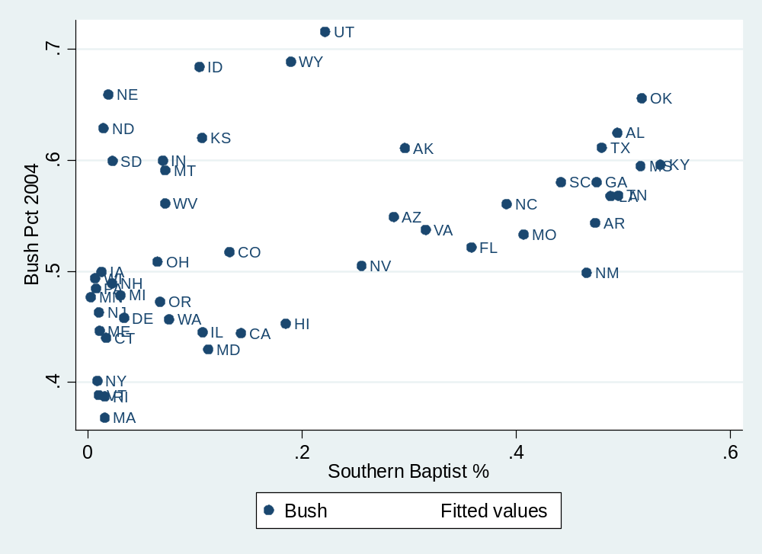
Bush vote and Southern Baptists

Slide 23
. reg bush sbc_mpct [aw=votes]
(sum of wgt is 1.2207e+08)
Source | SS df MS Number of obs = 50
-------------+------------------------------ F( 1, 48) = 40.18
Model | .118925068 1 .118925068 Prob > F = 0.0000
Residual | .142084951 48 .002960103 R-squared = 0.4556
-------------+------------------------------ Adj R-squared = 0.4443
Total | .261010018 49 .005326735 Root MSE = .05441
------------------------------------------------------------------------------
bush | Coef. Std. Err. t P>|t| [95% Conf. Interval]
-------------+----------------------------------------------------------------
sbc_mpct | .261779 .0413001 6.34 0.000 .1787395 .3448185
_cons | .4563507 .0112155 40.69 0.000 .4338004 .4789011
------------------------------------------------------------------------------
Coefficient interpretation:
A one percentage point increase in Baptist percentage is associated with a .26 increase in Bush vote share at the state level.

Slide 24
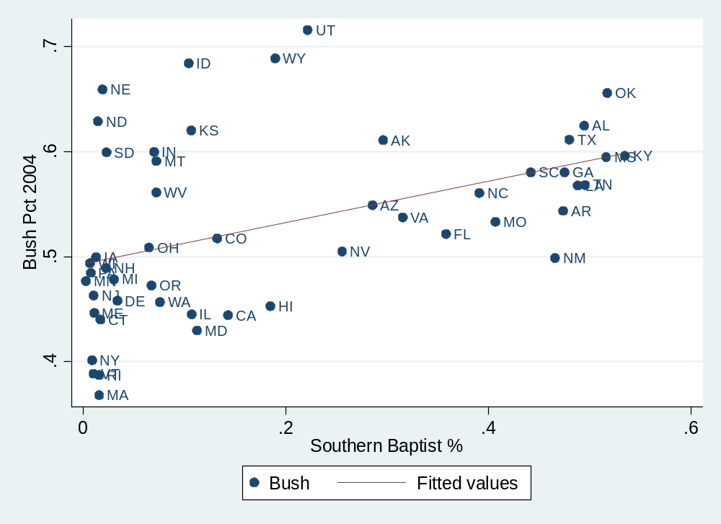

Slide 25
Interpreting confidence interval
. reg bush sbc_mpct [aw=votes]
(sum of wgt is 1.2207e+08)
Source | SS df MS Number of obs = 50
-------------+------------------------------ F( 1, 48) = 40.18
Model | .118925068 1 .118925068 Prob > F = 0.0000
Residual | .142084951 48 .002960103 R-squared = 0.4556
-------------+------------------------------ Adj R-squared = 0.4443
Total | .261010018 49 .005326735 Root MSE = .05441
------------------------------------------------------------------------------
bush | Coef. Std. Err. t P>|t| [95% Conf. Interval]
-------------+----------------------------------------------------------------
sbc_mpct | .261779 .0413001 6.34 0.000 .1787395 .3448185
_cons | .4563507 .0112155 40.69 0.000 .4338004 .4789011
------------------------------------------------------------------------------
Coefficient interpretation:
A one percentage point increase in Baptist percentage is associated with a .26 increase in Bush vote share at the state level.
Confidence interval interpretation
The 95% confidence interval lies between .18 and .34.

Slide 26
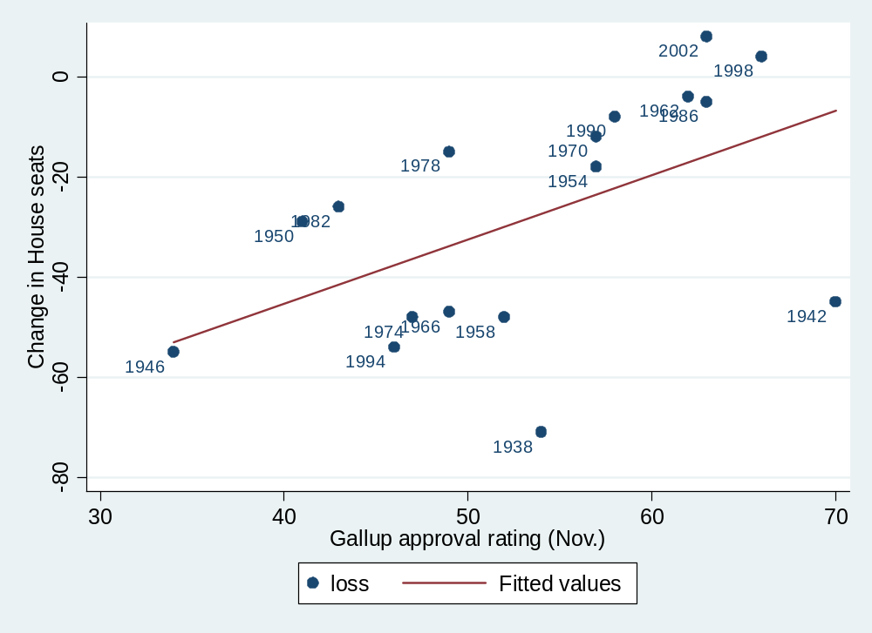

Slide 27
. reg loss gallup
Source | SS df MS Number of obs = 17
-------------+------------------------------ F( 1, 15) = 5.70
Model | 2493.96962 1 2493.96962 Prob > F = 0.0306
Residual | 6564.50097 15 437.633398 R-squared = 0.2753
-------------+------------------------------ Adj R-squared = 0.2270
Total | 9058.47059 16 566.154412 Root MSE = 20.92
------------------------------------------------------------------------------
Seats | Coef. Std. Err. t P>|t| [95% Conf. Interval]
-------------+----------------------------------------------------------------
gallup | 1.283411 .53762 2.39 0.031 .1375011 2.429321
_cons | -96.59926 29.25347 -3.30 0.005 -158.9516 -34.24697
------------------------------------------------------------------------------
Coefficient interpretation:
A one percentage point increase in presidential approval is associated with an average of 1.28 more seats won by the president’s party.
Confidence interval interpretation
The 95% confidence interval lies between .14 and 2.43.

Slide 28
Additional regression in bivariate relationship topics
Residuals
Comparing coefficients
Functional form
Goodness of fit (R² and SER)
Correlation
Discrete DV, discrete EV
Using the appropriate graph/table

Slide 29
Residuals

Slide 30
Residuals
e_{i} = Y_{i} – B₀ – B₁X_{i}

Slide 31
One important numerical property of residuals
The sum of the residuals is zero

Slide 32
Generating predictions and residuals
. reg jantemp latitude
Source | SS df MS Number of obs = 20
-------------+------------------------------ F( 1, 18) = 49.34
Model | 3250.72219 1 3250.72219 Prob > F = 0.0000
Residual | 1185.82781 18 65.8793228 R-squared = 0.7327
-------------+------------------------------ Adj R-squared = 0.7179
Total | 4436.55 19 233.502632 Root MSE = 8.1166
------------------------------------------------------------------------------
jantemp | Coef. Std. Err. t P>|t| [95% Conf. Interval]
-------------+----------------------------------------------------------------
latitude | -2.341428 .3333232 -7.02 0.000 -3.041714 -1.641142
_cons | 125.5072 12.77915 9.82 0.000 98.65921 152.3552
------------------------------------------------------------------------------
. predict py
(option xb assumed; fitted values)
. predict ry, resid

Slide 33
gsort -ry
. list city jantemp py ry
+-------------------------------------------------+
| city jantemp py ry |
|-------------------------------------------------|
1. | PortlandOR 40 17.8015 22.1985 |
2. | SanFranciscoCA 49 36.53293 12.46707 |
3. | LosAngelesCA 58 45.89864 12.10136 |
4. | PhoenixAZ 54 48.24007 5.759929 |
5. | NewYorkNY 32 29.50864 2.491357 |
|-------------------------------------------------|
6. | MiamiFL 67 64.63007 2.36993 |
7. | BostonMA 29 27.16722 1.832785 |
8. | NorfolkVA 39 38.87436 .125643 |
9. | BaltimoreMD 32 34.1915 -2.1915 |
10. | SyracuseNY 22 24.82579 -2.825786 |
|-------------------------------------------------|
11. | MobileAL 50 52.92293 -2.922928 |
12. | WashingtonDC 31 34.1915 -3.1915 |
13. | MemphisTN 40 43.55721 -3.557214 |
14. | ClevelandOH 25 29.50864 -4.508643 |
15. | DallasTX 43 48.24007 -5.240071 |
|-------------------------------------------------|
16. | HoustonTX 50 55.26435 -5.264356 |
17. | KansasCityMO 28 34.1915 -6.1915 |
18. | PittsburghPA 25 31.85007 -6.850072 |
19. | MinneapolisMN 12 20.14293 -8.142929 |
20. | DuluthMN 7 15.46007 -8.460073 |
+-------------------------------------------------+

Slide 35
Use residuals to diagnose potential problems
Notes:
-polling improved after 1946, 1938-1946 were unusual years, followed big Democratic gains, war, depression

Slide 36
. reg loss gallup
Source | SS df MS Number of obs = 17
-------------+------------------------------ F( 1, 15) = 5.70
Model | 2493.96962 1 2493.96962 Prob > F = 0.0306
Residual | 6564.50097 15 437.633398 R-squared = 0.2753
-------------+------------------------------ Adj R-squared = 0.2270
Total | 9058.47059 16 566.154412 Root MSE = 20.92
------------------------------------------------------------------------------
Seats | Coef. Std. Err. t P>|t| [95% Conf. Interval]
-------------+----------------------------------------------------------------
gallup | 1.283411 .53762 2.39 0.031 .1375011 2.429321
_cons | -96.59926 29.25347 -3.30 0.005 -158.9516 -34.24697
------------------------------------------------------------------------------
. reg loss gallup if year>1946
Source | SS df MS Number of obs = 14
-------------+------------------------------ F( 1, 12) = 17.53
Model | 3332.58872 1 3332.58872 Prob > F = 0.0013
Residual | 2280.83985 12 190.069988 R-squared = 0.5937
-------------+------------------------------ Adj R-squared = 0.5598
Total | 5613.42857 13 431.802198 Root MSE = 13.787
------------------------------------------------------------------------------
seats | Coef. Std. Err. t P>|t| [95% Conf. Interval]
-------------+----------------------------------------------------------------
gallup | 1.96812 .4700211 4.19 0.001 .9440315 2.992208
_cons | -127.4281 25.54753 -4.99 0.000 -183.0914 -71.76486
------------------------------------------------------------------------------

Slide 37
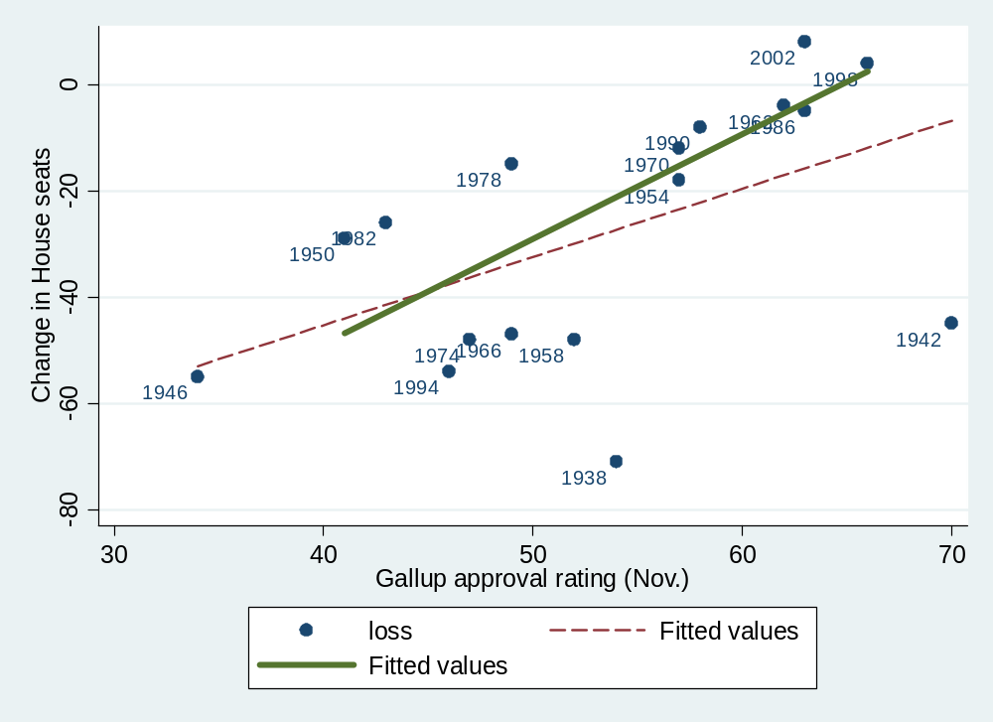
scatter loss gallup, mlabel(year) || lfit loss gallup || lfit loss gallup if year >1946

Slide 38
Comparing regression coefficients
As a general rule:
  Code all your variables to vary between 0 and 1
    That is, minimum = 0, maximum = 1
  Regression coefficients then represent the effect of shifting from the minimum to the maximum.
  This allows you to more easily compare the relative importance of coefficients.

Slide 39
How to recode variables to 0-1 scale
Party ID example: pid7 (on pset)
  Usually varies from
    1 (strong Republican)
    to 8 (strong Democrat)
    sometimes 0 needs to be recoded to missing (“.”).
Stata code?
  replace pid7 = ?
  replace pid7 = (pid7-1)/7

Slide 40
Regression interpretation with 0-1 scale
Continue with pid7 example
  regress natlecon pid7 (both recoded to 0-1 scales)
  pid7 coefficient: b = -.46 (CCES data from 2006)
  Interpretation?
    Shifting from being a strong Republican to a strong Democrat corresponds with a .46 drop in evaluations of the national economy (on the one-point national economy scale)

Slide 41
Functional Form

Slide 42
About the Functional Form
Linear in the variables vs. linear in the parameters
  Y = a + bX + e (linear in both)
  Y = a + bX + cX² + e (linear in parms.)
  Y = a + X^{b} + e (linear in variables, not parms.)
Regression must be linear in parameters

Slide 43
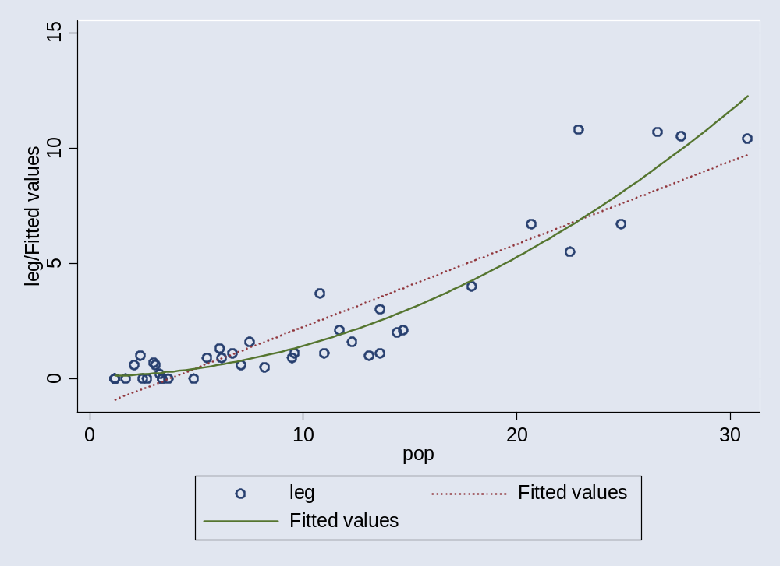
The Linear and Curvilinear Relationship between African American Population & Black Legislators
scatter beo pop || qfit beo pop

Slide 44
Log transformations
Y = a + bX + e | b = dY/dX, or b = the unit change in Y given a unit change in X | Typical case
Y = a + b lnX + e | b = dY/(dX/X), or b = the unit change in Y given a % change in X | Log explanatory variable
ln Y = a + bX + e | b = (dY/Y)/dX, or b = the % change in Y given a unit change in X | Log dependent variable
ln Y = a + b ln X + e | b = (dY/Y)/(dX/X), or b = the % change in Y given a % change in X (elasticity) | Economic production

Slide 45
Goodness of regression fit

Slide 46
How “good” is the fitted line?
Goodness-of-fit is often not relevant to research
Goodness-of-fit receives too much emphasis
Focus on
  Substantive interpretation of coefficients (most important)
  Statistical significance of coefficients (less important)
    Confidence interval
    Standard error of a coefficient
    t-statistic: coeff./s.e.
Nevertheless, you should know about
  Standard Error of the Regression (SER)
    Standard Error of the Estimate (SEE)
    Also called Regrettably called Root Mean Squared Error (Rout MSE) in Stata
  R-squared (R²)
    Often not informative, use sparingly

Slide 47
Standard Error of the Regression picture
Y_{i}
^
ε_{i}
Y_{i}-Y_{i}
^
Y_{i}
Add these up after squaring

Slide 48
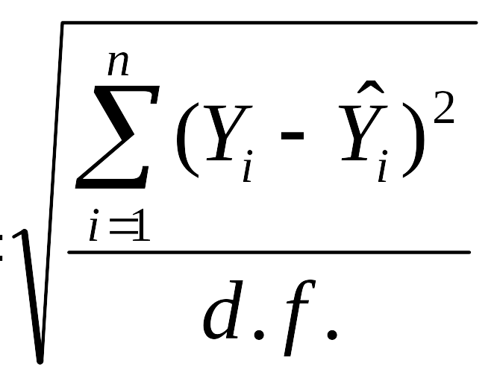
Standard Error of the Regression (SER)
or Standard Error of the Estimate
or Root Mean Squared Error (Root MSE)
d.f. equals n minus the number of estimate coefficients (Bs).
In bivariate regression case, d.f. = n-2.

Slide 49
SER interpretation called “Root MSE” in Stata
On average, in-sample predictions will be off the mark by about one standard error of the regression
. reg beo bpop
Source | SS df MS Number of obs = 41
-------------+------------------------------ F( 1, 39) = 202.56
Model | 351.26542 1 351.26542 Prob > F = 0.0000
Residual | 67.6326195 39 1.73416973 R-squared = 0.8385
-------------+------------------------------ Adj R-squared = 0.8344
Total | 418.898039 40 10.472451 Root MSE = 1.3169
------------------------------------------------------------------------------
beo | Coef. Std. Err. t P>|t| [95% Conf. Interval]
-------------+----------------------------------------------------------------
bpop | .3586751 .0251876 14.23 0.000 .3075284 .4094219
_cons | -1.314892 .3277508 -4.01 0.000 -1.977831 -.6519535
------------------------------------------------------------------------------

Slide 50
R²: A less useful measure of fit
beo
Fitted values
10
10.8
^
(Y_{i}-Y_{i})
^
(Y_{i}-Y)
(Y_{i}-Y)
beo
_
Y
0
-.884722
1.2
30.8
bpop

Slide 51
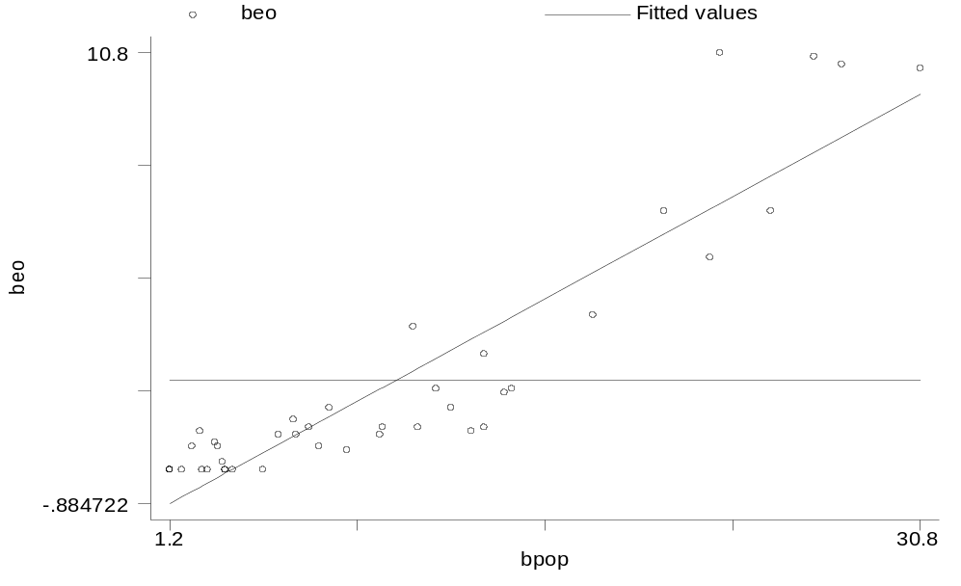
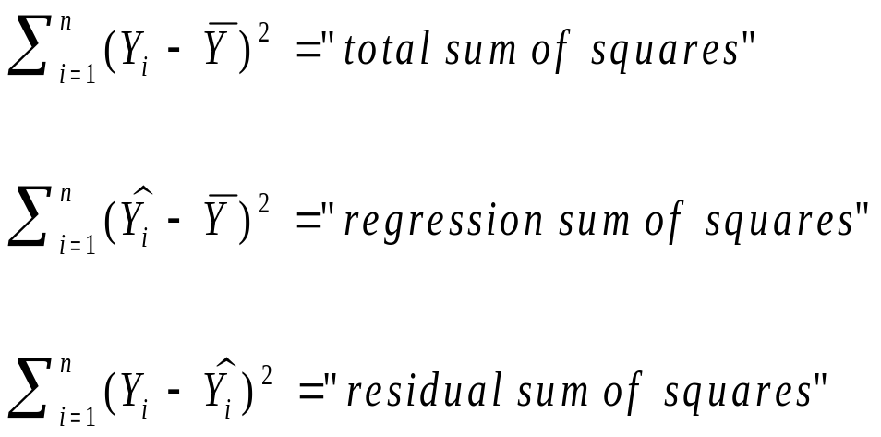
R²: A less useful measure of fit
10
^
(Y_{i}-Y_{i})
^
_
_
(Y_{i}-Y)
(Y_{i}-Y)
_
Y
0

Slide 52
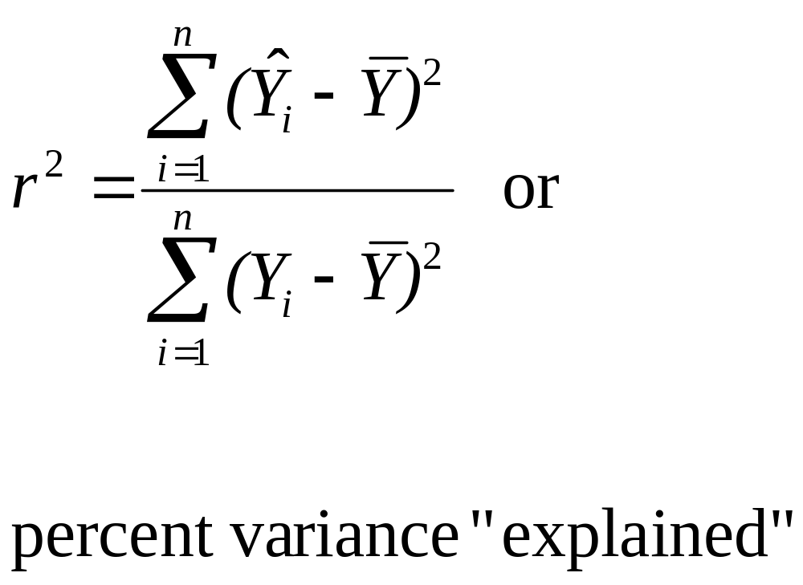
R-squared
Also called “coefficient of determination”

Slide 53
Interpreting SER (Root MSE) and R²
. reg bush sbc_mpct
Source | SS df MS Number of obs = 50
-------------+------------------------------ F( 1, 48) = 11.83
Model | .069183833 1 .069183833 Prob > F = 0.0012
Residual | .280630922 48 .005846478 R-squared = 0.1978
-------------+------------------------------ Adj R-squared = 0.1811
Total | .349814756 49 .007139077 Root MSE = .07646
------------------------------------------------------------------------------
bush | Coef. Std. Err. t P>|t| [95% Conf. Interval]
-------------+----------------------------------------------------------------
sbc_mpct | .196814 .0572138 3.44 0.001 .0817779 .3118501
_cons | .4931758 .0155007 31.82 0.000 .4620095 .524342
------------------------------------------------------------------------------
Interpreting SER (Root MSE):
On average, in-sample predictions about Bush’s vote share will be off the mark by about 7.6%
Interpreting R²
Regression model explains about 19.8% of the variation in Bush vote.

Slide 55
Correlation

Slide 56
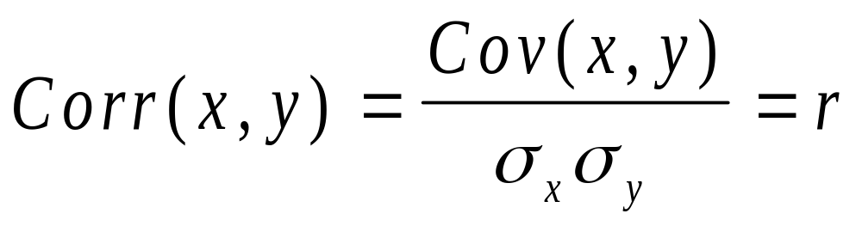
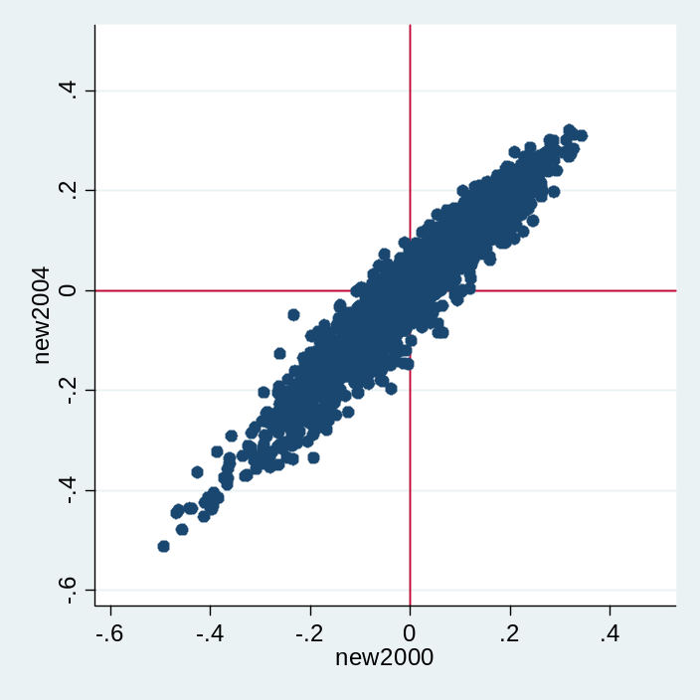
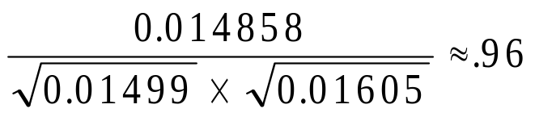
Correlation
Corr(BushPct₀₀,BushPct₀₄) =0.96 =
Measures how closely data points fall along the line
Varies between -1 and 1
(compare with Tufte p. 102)

Slide 57
Warning: Don’t correlate often!
Correlation only measures linear relationship
Correlation is sensitive to variance
Correlation usually doesn’t measure a theoretically interesting quantity
Same criticisms apply to R², which is the squared correlation between predictions and data points.
Instead, focus on regression coefficients (slopes)

Slide 58
Discrete DV, discrete EV
Crosstabs
χ²
Gamma, Beta, etc.

Slide 59
Example
What is the relationship between abortion sentiments and vote choice?
The abortion scale:
  1. BY LAW, ABORTION SHOULD NEVER BE PERMITTED.
  2. THE LAW SHOULD PERMIT ABORTION ONLY IN CASE OF RAPE, INCEST, OR WHEN THE WOMAN'S LIFE IS IN DANGER.
  3. THE LAW SHOULD PERMIT ABORTION FOR REASONS OTHER THAN RAPE, INCEST, OR DANGER TO THE WOMAN'S LIFE, BUT ONLY AFTER THE NEED FOR THE ABORTION HAS BEEN CLEARLY ESTABLISHED.
  4. BY LAW, A WOMAN SHOULD ALWAYS BE ABLE TO OBTAIN AN ABORTION AS A MATTER OF PERSONAL CHOICE.

Slide 60
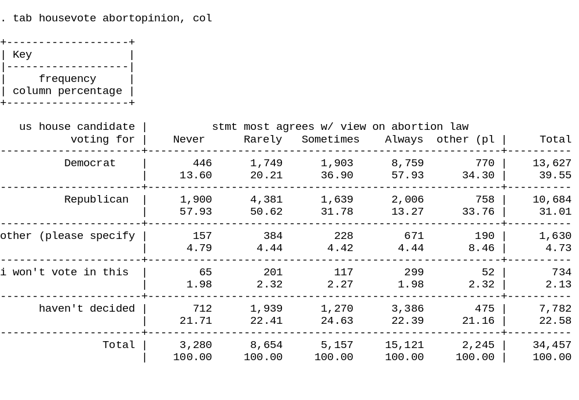
Abortion and vote choice in 2006

Slide 61
Use the appropriate graph/table
Continuous DV, continuous EV
  E.g., vote share by income growth
  Use scatter plot
Continuous DV, discrete and unordered EV
  E.g., vote share by religion or by union membership
  Box plot, dot plot
Discrete DV, discrete EV
  No graph: Use crosstabs (tabulate)

Slide 62
Additional slides

Slide 63
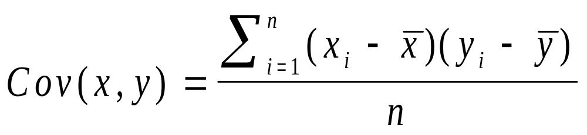
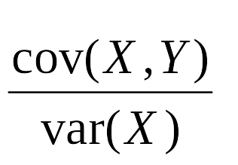
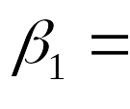
Intuition behind regression Covariance
x’=0.588-x
y’=0.609-y
Cov(BushPct₀₀,BushPct₀₄) =0.014858

