Slide 1
Addressing Alternative Explanations:
Multiple Regression
17.871

Slide 2
Did Clinton hurt Gore example
Did Clinton hurt Gore in the 2000 election?
  Treatment is not liking Bill Clinton
How would you test this?

Slide 3
Bivariate regression of Gore thermometer on Clinton thermometer
C
l
i
n
t
o
n
t
h
e
r
m
o
m
e
t
e
r

Slide 4
Did Clinton hurt Gore example
What alternative explanations would you need to address?
Nonrandom selection into the treatment group (disliking Clinton) from many sources
Let’s address one source: party identification
How could we do this?
  Matching: compare Democrats who like or don’t like Clinton; do the same for Republicans and independents
  Multivariate regression: control for partisanship statistically
    Also called multiple regression, Ordinary Least Squares (OLS)
    Presentation below is intuitive

Slide 5
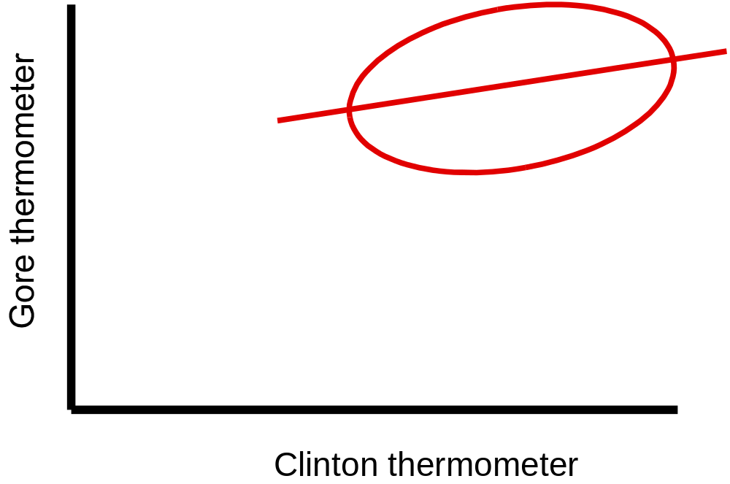
Democratic picture

Slide 6
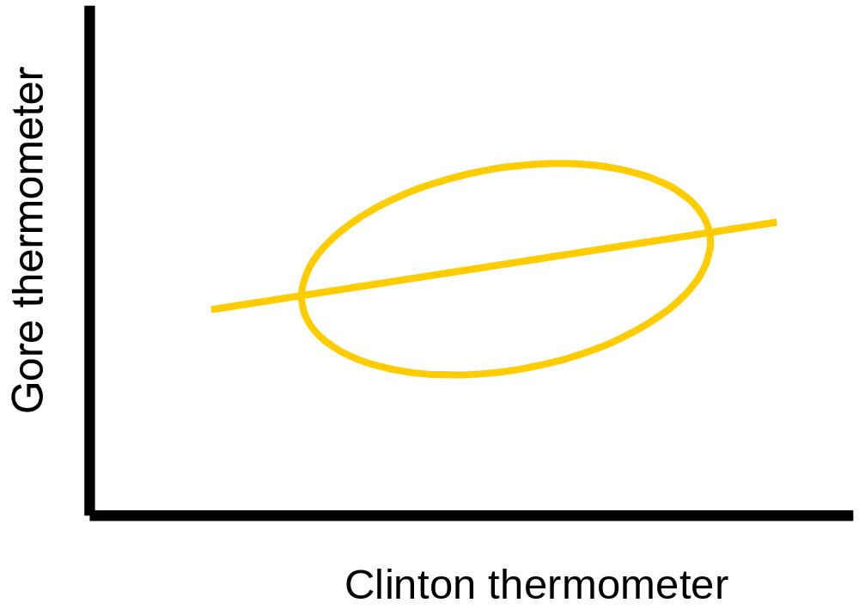
Independent picture

Slide 7
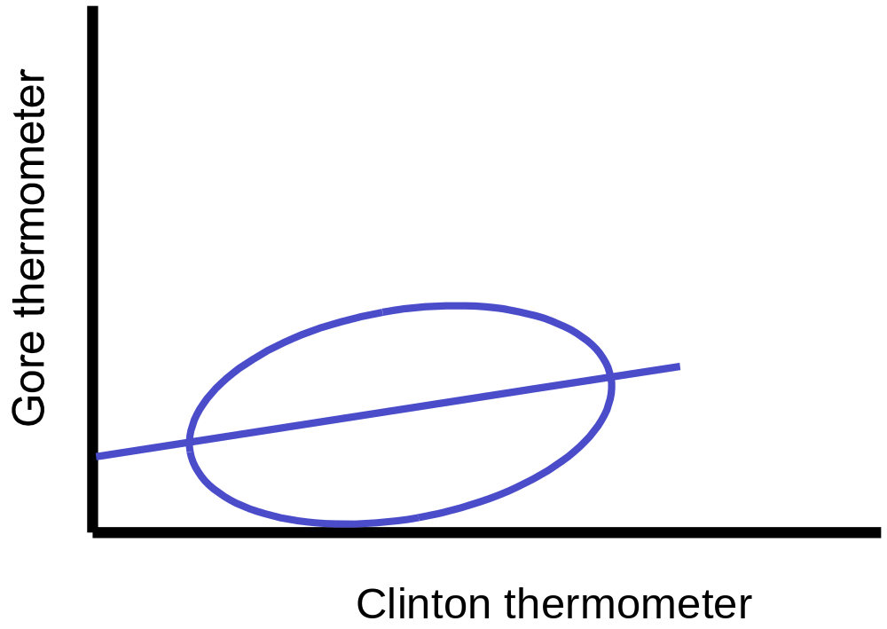
Republican picture

Slide 8
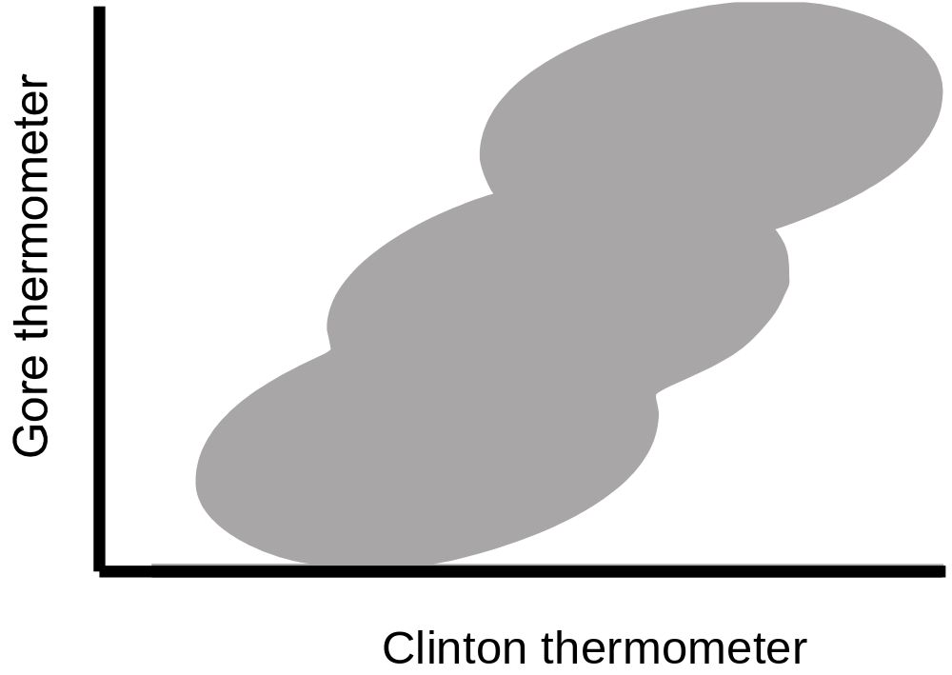
Combined data picture

Slide 9
Combined data picture with regression: bias!
C
l
i
n
t
o
n
t
h
e
r
m
o
m
e
t
e
r

Slide 10
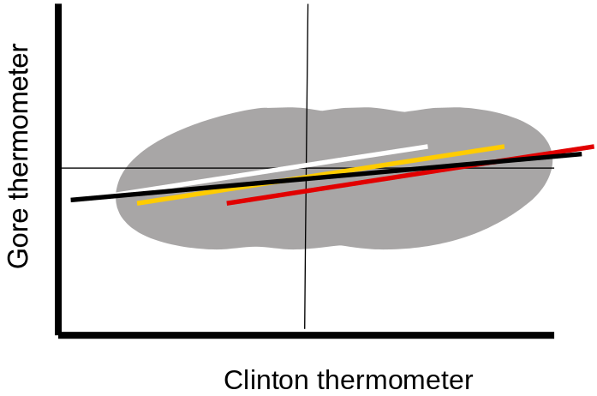
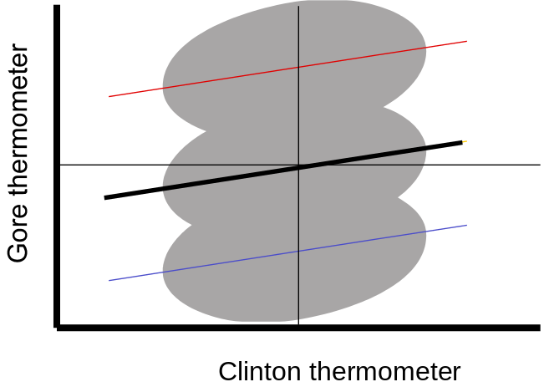
Tempting yet wrong normalizations
Subtract the Gore
therm. from the
avg. Gore therm.
score
Subtract the Clinton
therm. from the
avg. Clinton therm.
score

Slide 11
Combined data picture with “true” regression lines overlaid
C
l
i
n
t
o
n
t
h
e
r
m
o
m
e
t
e
r

Slide 12
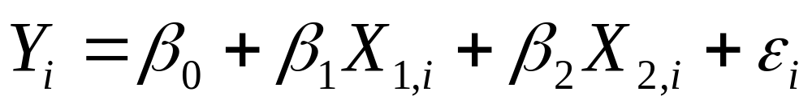
The Linear Relationship between Three Variables
Gore
thermometer
Clinton thermometer
Party ID
STATA:
reg y x1 x2
reg gore clinton party3

Slide 13
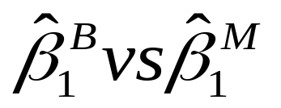
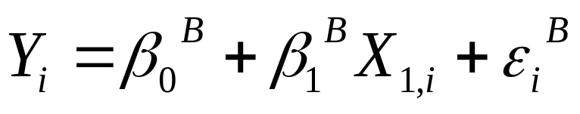
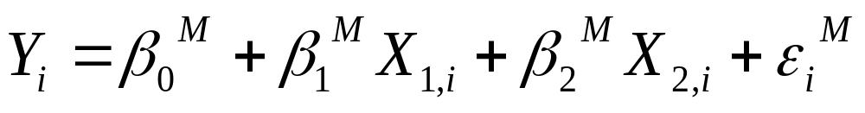
Gore thermometer
Clinton thermometer
Y
X₁
Party ID
Gore
Clinton
X₂
Gore
Clinton
Party ID

Slide 14
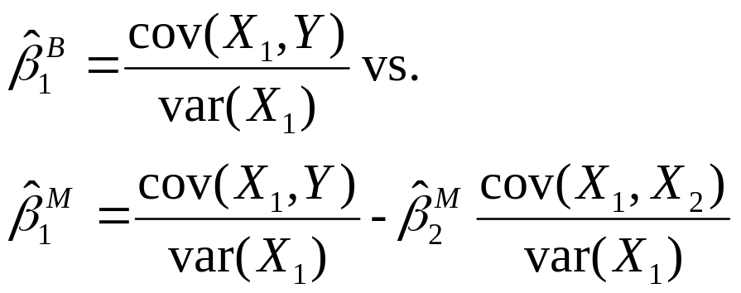
Multivariate slope coefficients
Clinton effect (on Gore) in bivariate (B) regression
Are Gore and Party ID related?
Bivariate estimate:
Multivariate estimate:
Are Clinton and Party ID related?
Clinton effect (on Gore) in multivariate (M) regression
Gore
Clinton
Party ID

Slide 15
Gore thermometer
Clinton thermometer
Y
X₁
Party ID
X₂
Gore
Clinton
Party ID

Slide 16
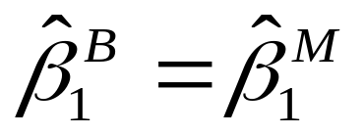
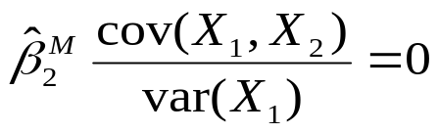
Gore thermometer
Clinton thermometer
Y
X₁
Party ID
X₂
When does
Obviously, when

Slide 17
Lung cancer
Y
Smoking
X₁
Genetic predisposition
X₂

Slide 18
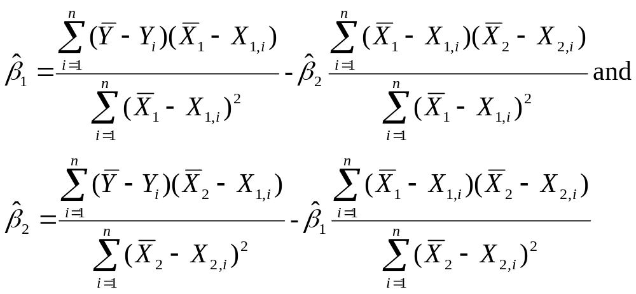
The Slope Coefficients
X₁ is Clinton thermometer, X₂ is PID, and Y is Gore thermometer

Slide 19
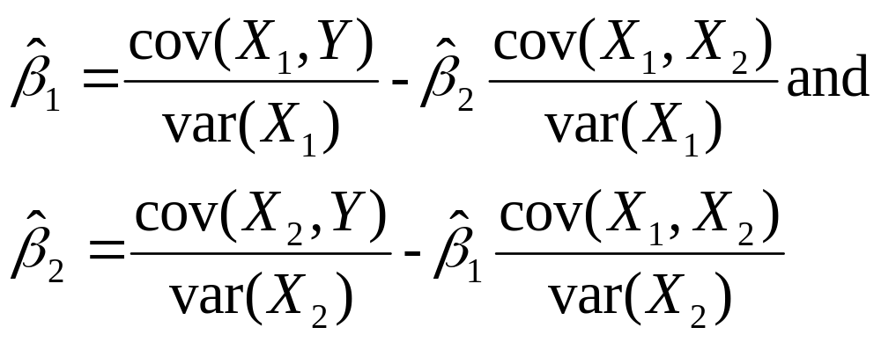
The Slope Coefficients More Simply
X₁ is Clinton thermometer, X₂ is PID, and Y is Gore thermometer

Slide 20
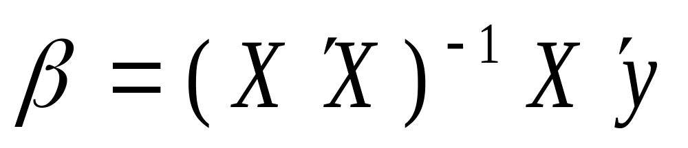
The Matrix form
y₁
y₂
…
y_{n}
1 | x_{1,1} | x_{2,1} | … | x_{k,1}
1 | x_{1,2} | x_{2,2} | … | x_{k,2}
1 | … | … | … | …
1 | x_{1,n} | x_{2,n} | … | x_{k,n}

Slide 21
The Output
. reg gore clinton party3
Source | SS df MS Number of obs = 1745
-------------+------------------------------ F( 2, 1742) = 1048.04
Model | 629261.91 2 314630.955 Prob > F = 0.0000
Residual | 522964.934 1742 300.209492 R-squared = 0.5461
-------------+------------------------------ Adj R-squared = 0.5456
Total | 1152226.84 1744 660.68053 Root MSE = 17.327
------------------------------------------------------------------------------
gore | Coef. Std. Err. t P>|t| [95% Conf. Interval]
-------------+----------------------------------------------------------------
clinton | .5122875 .0175952 29.12 0.000 .4777776 .5467975
party3 | 5.770523 .5594846 10.31 0.000 4.673191 6.867856
_cons | 28.6299 1.025472 27.92 0.000 26.61862 30.64119
------------------------------------------------------------------------------
Interpretation of clinton effect: Holding constant party identification, a one-point increase in the Clinton feeling thermometer is associated with a .51 increase in the Gore thermometer.

Slide 22
Separate regressions
Each column shows the coefficients for a separate regression
 | DV: Gore thermometer
 | (1) | (2) | (3)
Intercept | 23.1 | 55.9 | 28.6
Clinton | 0.62 | -- | 0.51
Party3 | -- | 15.7 | 5.8
N | 1745 | 1745 | 1745

Slide 23
Is the Clinton effect causal?
That is, should we be convinced that negative feelings about Clinton really hurt Gore?
No!
  The regression analysis has only ruled out linear nonrandom selection on party ID.
  Nonrandom selection into the treatment could occur from
    Variables other than party ID, or
    Reverse causation, that is, feelings about Gore influencing feelings about Clinton.
  Additionally, the regression analysis may not have entirely ruled out nonrandom selection even on party ID because it may have assumed the wrong functional form.
    E.g., what if nonrandom selection on strong Republican/strong Democrat, but not on weak partisans

Slide 24
Other approaches to addressing confounding effects?
Experiments
Matching
Difference-in-differences designs
Others?

Slide 25
Summary: Why we control
Address alternative explanations by removing confounding effects
Improve efficiency

Slide 26
Why did the Clinton Coefficient change from 0.62 to 0.51
. corr gore clinton party, cov
(obs=1745)
| gore clinton party3
-------------+---------------------------
gore | 660.681
clinton | 549.993 883.182
party3 | 13.7008 16.905 .8735

Slide 27
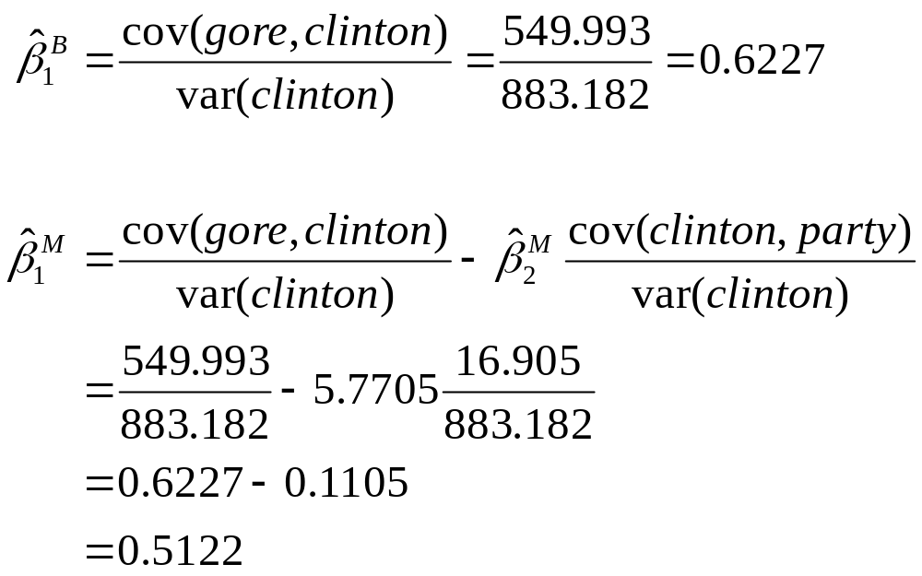
The Calculations
. corr gore clinton party,cov
(obs=1745)
| gore clinton party3
-------------+---------------------------
gore | 660.681
clinton | 549.993 883.182
party3 | 13.7008 16.905 .8735

Slide 28
Drinking and Greek Life Example
Why is there a correlation between living in a fraternity/sorority house and drinking?
  Greek organizations often emphasize social gatherings that have alcohol. The effect is being in the Greek organization itself, not the house.
  There’s something about the House environment itself.
Example of indicator or dummy variables

Slide 29


Dependent variable: Times Drinking in Past 30 Days

Slide 30
. infix age 10-11 residence 16 greek 24 screen 102 timespast30 103 howmuchpast30 104 gpa 278-279 studying 281 timeshs 325 howmuchhs 326 socializing 283 stwgt_99 475-493
weight99 494-512 using da3818.dat,clear
(14138 observations read)
. recode timespast30 timeshs (1=0) (2=1.5) (3=4) (4=7.5) (5=14.5) (6=29.5) (7=45)
(timespast30: 6571 changes made)
(timeshs: 10272 changes made)
. replace timespast30=0 if screen<=3
(4631 real changes made)

Slide 31
. tab timespast30
timespast30 | Freq. Percent Cum.
------------+-----------------------------------
0 | 4,652 33.37 33.37
1.5 | 2,737 19.64 53.01
4 | 2,653 19.03 72.04
7.5 | 1,854 13.30 85.34
14.5 | 1,648 11.82 97.17
29.5 | 350 2.51 99.68
45 | 45 0.32 100.00
------------+-----------------------------------
Total | 13,939 100.00

Slide 32
Key explanatory variables
(indicator variables or dummy variables)
Live in fraternity/sorority house
  Indicator variable (dummy variable)
  Coded 1 if live in, 0 otherwise
Member of fraternity/sorority
  Indicator variable (dummy variable)
  Coded 1 if member, 0 otherwise

Slide 33
Three Regressions
Dependent variable: number of times drinking in past 30 days
Live in frat/sor house (indicator variable) | 4.44 (0.35) | --- | 2.26 (0.38)
Member of frat/sor (indicator variable) | --- | 2.88 (0.16) | 2.44 (0.18)
Intercept | 4.54 (0.56) | 4.27 (0.059) | 4.27 (0.059)
R2 | .011 | .023 | .025
N | 13,876 | 13,876 | 13,876
Note: Standard errors in parentheses. Corr. Between living in frat/sor house and being a member of a Greek organization is .42

Slide 34
Interpreting indicator variables
Dependent variable: number of times drinking in past 30 days
Live in frat/sor house (indicator variable) | 4.44 (0.35) | --- | 2.26 (0.38)
Member of frat/sor (indicator variable) | --- | 2.88 (0.16) | 2.44 (0.18)
Intercept | 4.54 (0.56) | 4.27 (0.059) | 4.27 (0.059)
R2 | .011 | .023 | .025
N | 13,876 | 13,876 | 13,876
Col 1
  Live in frat/sor house increases number of times drinking in past 30 days by 4.4
  Compare to constant: Live in frat/sor house increases number of times drinking from 4.54 to (4.54+ 4.44=) 8.98
Col 3
  Holding constant membership, live in frat/sor house increases number of times drinking by 2.26

Slide 35
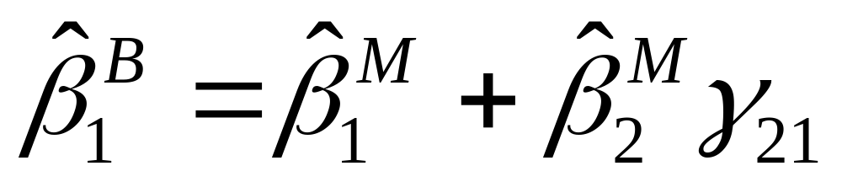
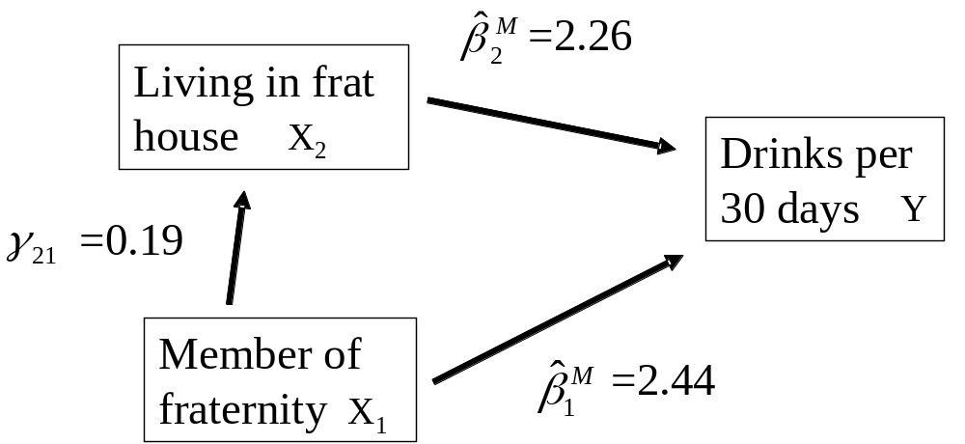
Accounting for the total effect
Total effect = Direct effect + indirect effect

Slide 36
Accounting for the effects of frat house living and Greek membership on drinking
Effect | Total | Direct | Indirect
Member of Greek org. | 2.88 | 2.44 (85%) | 0.44 (15%)
Live in frat/ sor. house | 4.44 | 2.26 (51%) | 2.18 (49%)

