Slide 1
Regression and Correlation
Dr. M. H. Rahbar
Professor of Biostatistics
Department of Epidemiology
Director, Data Coordinating Center
College of Human Medicine
Michigan State University

Slide 2
How do we measure association between two variables?
1. For categorical E and D variables
Odds Ratio (OR)
Relative Risk (RR)
Risk Difference
2. For continuous E & D variables
Correlation Coefficient R
Coefficient of Determination (R-Square)

Slide 3
Example
A researcher believes that there is a linear relationship between BMI (Kg/m²) of pregnant mothers and the birth-weight (BW in Kg) of their newborn
The following data set provide information on 15 pregnant mothers who were contacted for this study

Slide 4
BMI (Kg/m²)
Birth-weight (Kg)
20
2.7
30
2.9
50
3.4
45
3.0
10
2.2
30
3.1
40
3.3
25
2.3
50
3.5
20
2.5
10
1.5
55
3.8
60
3.7
50
3.1
35
2.8

Slide 5
Scatter Diagram
Scatter diagram is a graphical method to display the relationship between two variables
Scatter diagram plots pairs of bivariate observations (x, y) on the X-Y plane
Y is called the dependent variable
X is called an independent variable

Slide 6
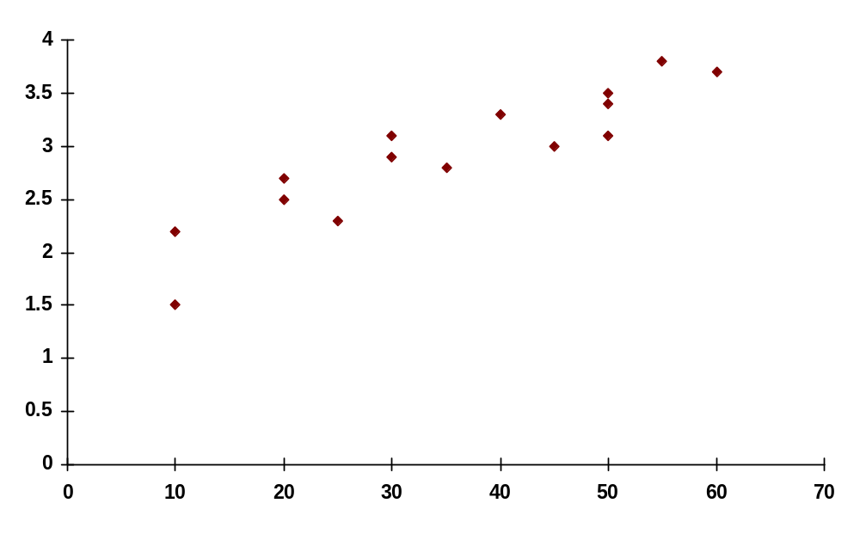
Scatter diagram of BMI and Birthweight

Slide 7
Is there a linear relationship between BMI and BW?
Scatter diagrams are important for initial exploration of the relationship between two quantitative variables
In the above example, we may wish to summarize this relationship by a straight line drawn through the scatter of points

Slide 8
Simple Linear Regression
Although we could fit a line "by eye" e.g. using a transparent ruler, this would be a subjective approach and therefore unsatisfactory.
An objective, and therefore better, way of determining the position of a straight line is to use the method of least squares.
Using this method, we choose a line such that the sum of squares of vertical distances of all points from the line is minimized.

Slide 9
Least-squares or regression line
These vertical distances, i.e., the distance between y values and their corresponding estimated values on the line are called residuals
The line which fits the best is called the regression line or, sometimes, the least-squares line
The line always passes through the point defined by the mean of Y and the mean of X

Slide 10
Linear Regression Model
The method of least-squares is available in most of the statistical packages (and also on some calculators) and is usually referred to as linear regression
Y is also known as an outcome variable
X is also called as a predictor

Slide 11
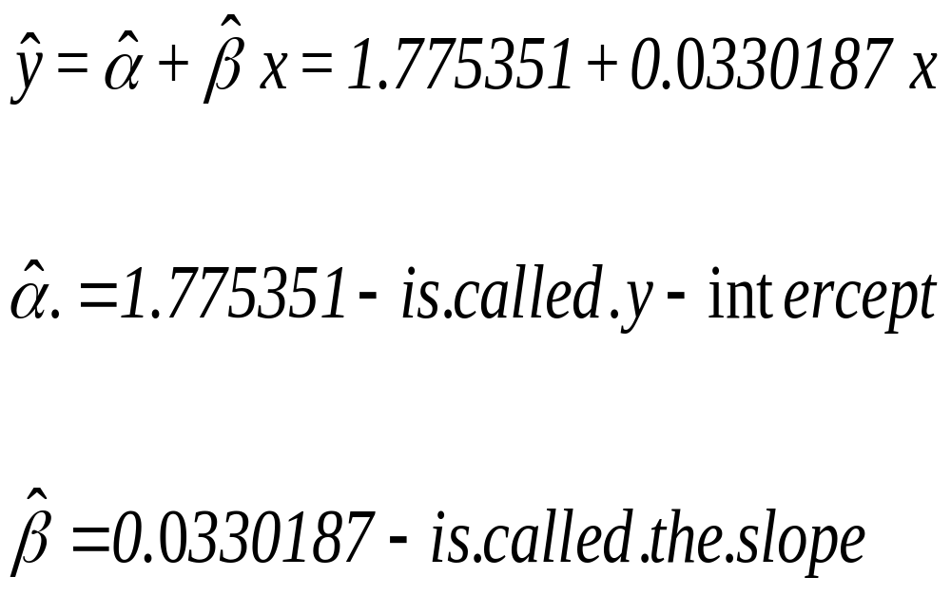
Estimated Regression Line

Slide 12
Application of Regression Line
This equation allows you to estimate BW of other newborns when the BMI is given.
e.g., for a mother who has BMI=40, i.e. X = 40 we predict BW to be

Slide 13
Correlation Coefficient, R
R is a measure of strength of the linear association between two variables, x and y.
Most statistical packages and some hand calculators can calculate R
For the data in our Example R=0.94
R has some unique characteristics

Slide 14
Correlation Coefficient, R
R takes values between -1 and +1
R=0 represents no linear relationship between the two variables
R>0 implies a direct linear relationship
R<0 implies an inverse linear relationship
The closer R comes to either +1 or -1, the stronger is the linear relationship

Slide 15
Coefficient of Determination
R² is another important measure of linear association between x and y (0 ≤ R² ≤ 1)
R² measures the proportion of the total variation in y which is explained by x
For example r² = 0.8751, indicates that 87.51% of the variation in BW is explained by the independent variable x (BMI).

Slide 16
Difference between Correlation and Regression
Correlation Coefficient, R, measures the strength of bivariate association
The regression line is a prediction equation that estimates the values of y for any given x

Slide 17
Limitations of the correlation coefficient
Though R measures how closely the two variables approximate a straight line, it does not validly measures the strength of nonlinear relationship
When the sample size, n, is small we also have to be careful with the reliability of the correlation
Outliers could have a marked effect on R
Causal Linear Relationship

Slide 18
The following data consists of age (in years) and presence or absence of evidence of significant coronary heart disease (CHD) in 100 persons.
Code sheet for the data is given as follows:
Serial No.
Variable name
Variable description
Codes/values
1.
2.
3.
4.
ID
AGRP
AGE
CHD
Identification no.
Age Group
Actual age (in years)
Presence or absence of CHD
ID number (unique)
1 = 20-29;
2 = 30-34;
3 = 35-39;
4 = 40-44;
5 = 45-49;
6 = 50-54;
7 = 55-59;
8 = 60-69
in years
0 = Absent;
1 = Present

Slide 19
ID
AGRP
AGE
CHD
1
1
20
0
2
1
23
0
3
1
24
0
4
1
25
0
5
1
25
1
6
1
26
0
7
1
26
0
8
1
28
0
…
99
8
65
1
100
8
69
1

Slide 20
Is there any association between age and CHD?
By categorizing the age variable we will be able to answer the above question the Chi-Square test of independence
Age Group by CHD
Age Group
Coronary Heart Disease (CHD)
Total
Present
Absent
≤ 40 years
7
32
39
>40 years
36
25
61
Total
43
57
100

Slide 21
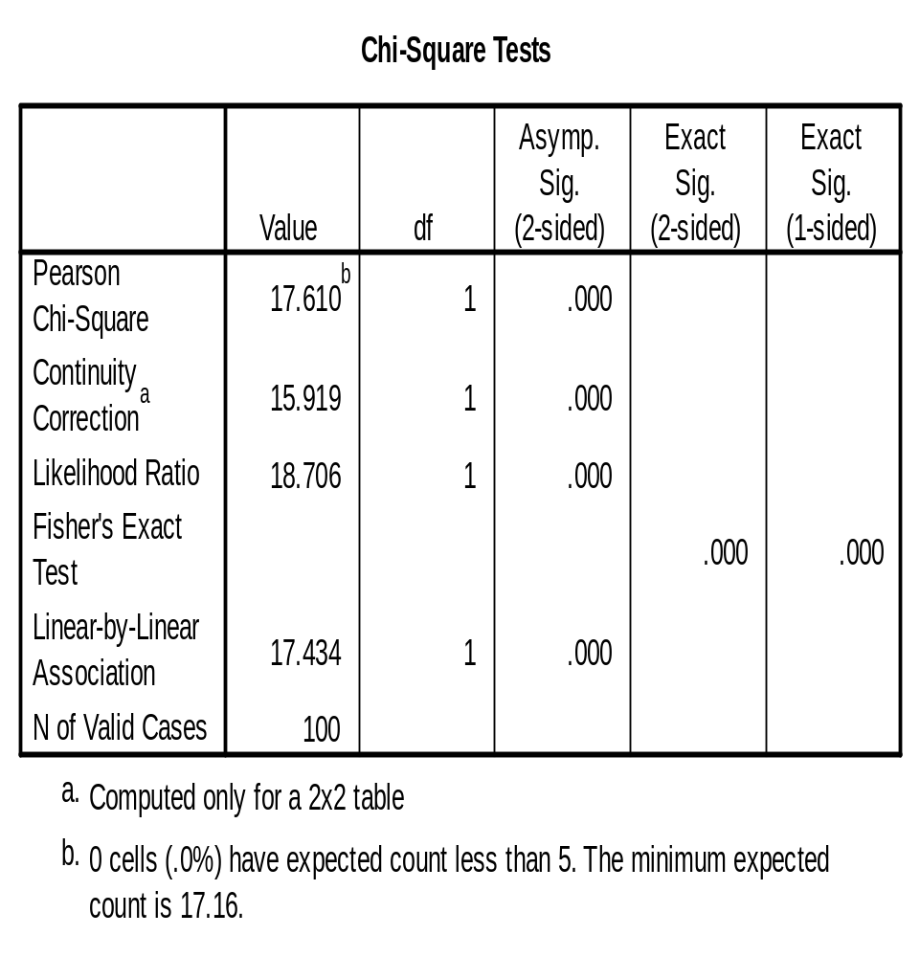
Odds Ratio = 0.14 with 95% confidence interval (0.05,0.41)
Relative Risk = 0.30 with 95% confidence interval (0.15,0.60)

Slide 22
What about a situation that you do not want to categorize the age?
PLOT OF CHD by AGE
1.2
1.0
.8
.6
Presence of Coronary Heart Disease (CHD)
.4
.2
0.0
-.2
10
20
30
40
50
60
70
Actual age (in years)

Slide 23
Actually, we are interested in knowing whether the probability of having CHD increases by age.
How do you do this?
Frequency Table of Age Group by CHD
Mid point
CHD
Mean (proportion) =
Age Group
of age
n
Absent
Present
{(Present)/n}
20-29
30-34
35-39
40-44
45-49
50-54
55-59
60-69
25
32.5
37.5
42.5
47.5
52.5
57.5
65
10
15
12
15
13
08
17
10
09
13
09
10
07
03
04
02
01
02
03
05
06
05
13
08
(01/10) = 0.10
(02/15) = 0.13
(03/12) = 0.25
(05/15) = 0.33
(06/13) = 0.46
(05/08) = 0.63
(13/17) = 0.76
(08/10) = 0.80
Total
100
57
43
(43/100) = 0.43

Slide 24
Logistic Regression
Logistic Regression is used when the outcome variable is categorical
The independent variables could be either categorical or continuous
The slope coefficient in the Logistic Regression Model has a relationship with the OR
Multiple Logistic Regression model can be used to adjust for the effect of other variables when assessing the association between E & D variables

