Slide 1
Bivariate Regression
Presented By:
Chandra Prakash
Guneet Singh Bajaj
Hemlata Saraswat

Slide 2
Objective:
Our objectives is to find the relationship between the home runs and the batting average of a baseball player.

Slide 3
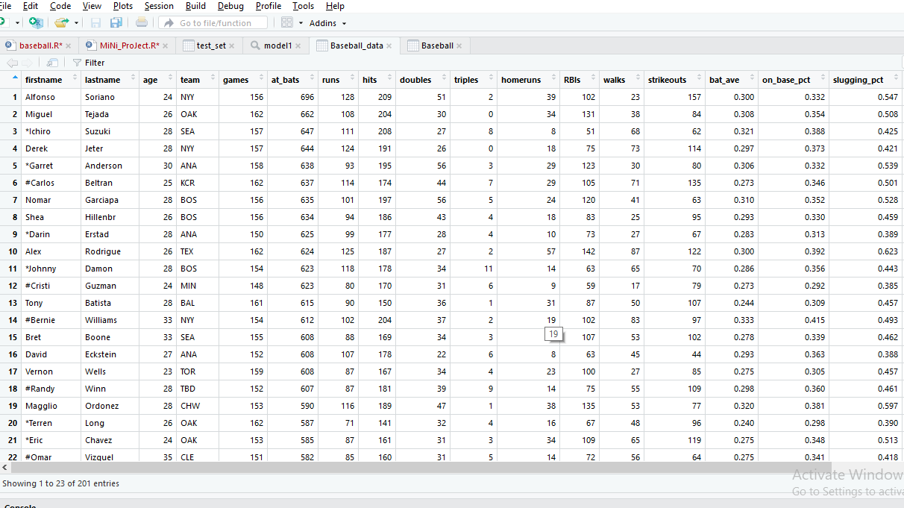
DATASET - BASEBALL DATA

Slide 4


TOOLS and LIBRARIES USED
1. Programming Language :- R
2. Libraries :- ggplot2, caTools, Publish
3. IDE :- RStudio

Slide 5
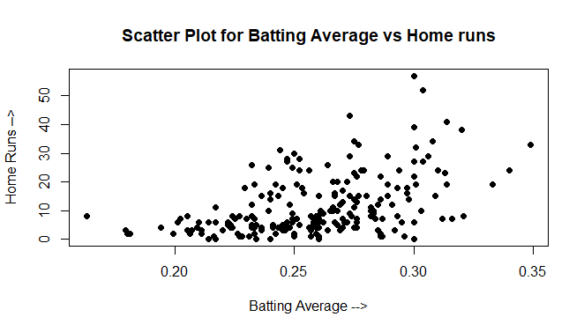
1. Scatter Plot

Slide 6
Evidence for relationship and Variability
Yes, there is a positive linear relationship.
The variability of number of home runs is greater for those with higher batting averages.

Slide 7
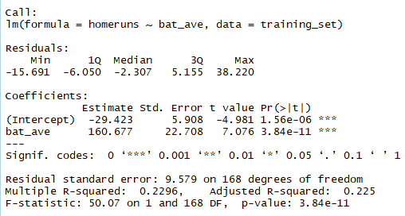
Algorithm Used
Bivariate Regression:
It is regression performed between two variables one predictor variable (X) other is response variable (Y).
Summary of our model:

Slide 8
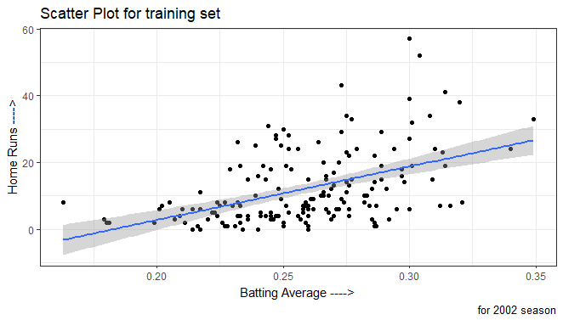
Visualization

Slide 9
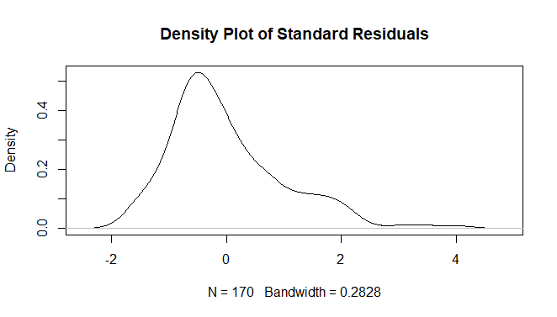
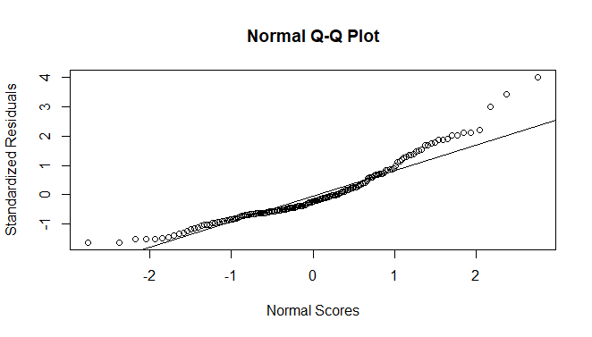
Skewness and Normality Check

Slide 10
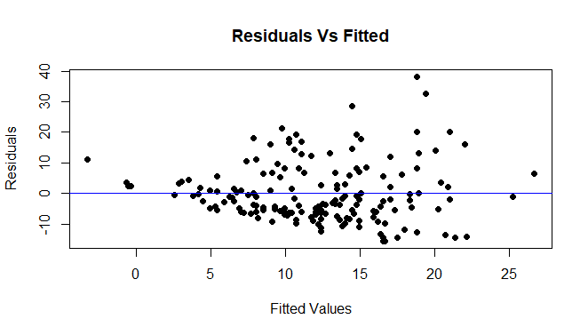
Fitted vs Residuals

Slide 11
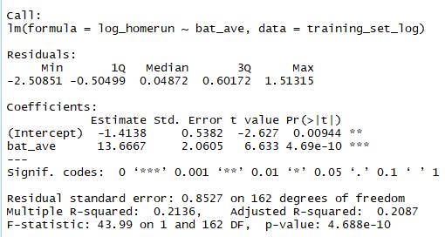
Transformation of home runs
Log transformation:
We performed log transformation on home runs feature to normalize it.
Summary after transformation:

Slide 12
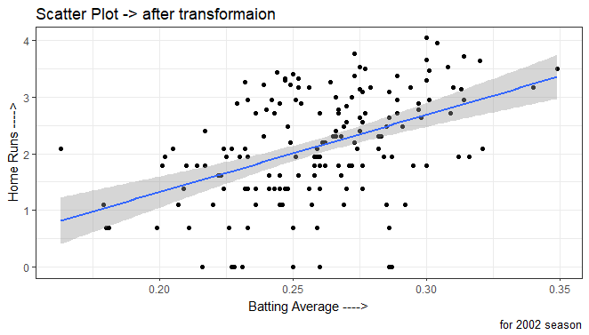
Visualization

Slide 13
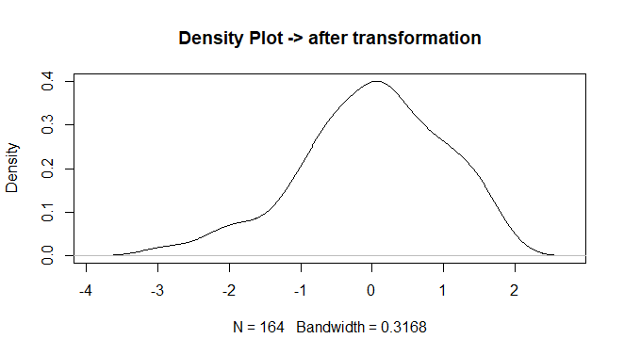
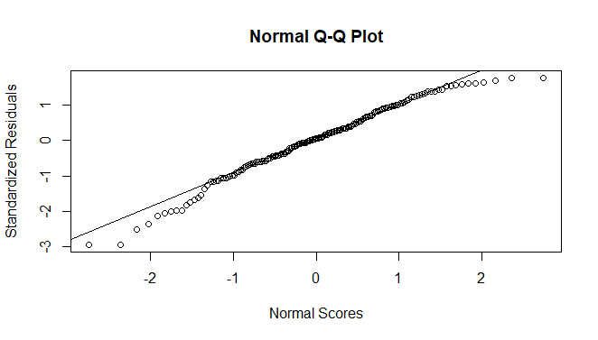
Skewness and Normality after transformation

Slide 14
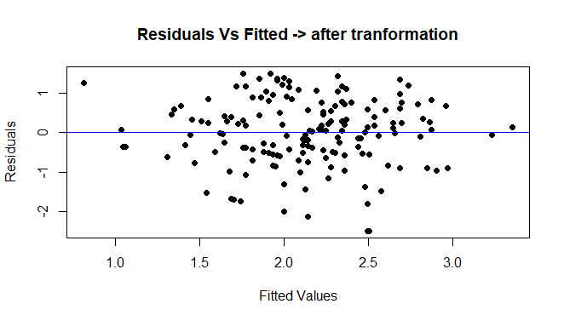
Fitted vs Residuals after transformation

Slide 15
Equation of population regression
Recall equations of line :
Algebra Line: y = mx + c, where
m = slope of the line
c = y-intercept
Statistics Line: y = 𝛃o + 𝛃1x , where
𝛃o => y-intercept = -28.149
𝛃1 = slope of the line = 153.551

Slide 16
Equation of regression on sample
Statistics Line: y = bo + b1x , where
bo = y-intercept ⇒ -1.4346
b1 = slope of the line ⇒ 13.6375
R square = 0.2189

Slide 17
Estimation of homerun with batting average of 0.300 :-
The home is 18.7796
Size of typical error in prediction :-
The size of error is 9.57
Percentage of variability in model:-
It is the value of R square i.e. 0.2296

Slide 18
Hypothesis test for linear relationship
Null hypothesis – There is no linear relationship between home runs and batting average.
Alternate Hypothesis – there is linear relationship between home runs and batting average.

Slide 19
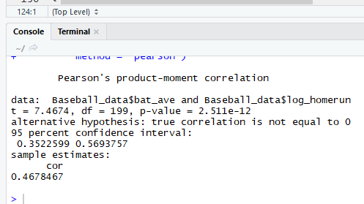
Correlation
Measures the strength of linear relationship between two variables.
It is denoted by r whose values lies between -1 and 1 and

Slide 20
95% confidence interval for the population correlation coefficient.
95 percent confidence interval :
0.3522599 0.5693757
95% confidence interval for the unknown true slope of the regression line.
(Intercept) -2.476523 -0.3511356
bat_ave 9.597822 17.7355310

Slide 21
95% confidence interval for a randomly chosen player with a 0.300 batting average.
fit lwr upr
18.77962 -0.278922 37.83816
95% confidence interval for the mean number of home runs for all players who had a batting
average of 0.300.
mean CI-95%
30.20 [6.49;53.91]

Slide 22
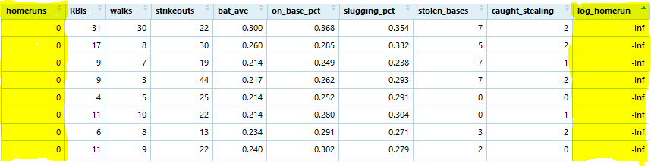
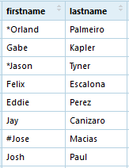
OUTLIERS

Slide 23
THANK YOU

