Slide 1

Analyzing Factors Influencing
Deposit
Subscription

Slide 2
TABLE OF CONTENT
01
Problem Statement
04
Conclusion
02
Business Question
05
Recommendations
03
Analysis Results
06
Dashboard

Slide 3

Problem Statement
Banks routinely conduct telemarketing campaigns to offer term deposit products to customers. However, each marketing activity requires significant operational costs, labor, and time. On the other hand, not all contacted customers are willing to open a deposit.
Without knowing the characteristics of customers who are more likely to accept the offer and the factors influencing campaign success, the bank risks allocating marketing resources inefficiently. Therefore, an analysis of historical data is required to understand campaign success patterns so that subsequent marketing strategies can be more accurately targeted.

Slide 4
Problem Statement
SMART Method :
Specific : Identifying customer characteristics and campaign factors associated with customers' decisions to subscribe to term deposits
Measurable : Identifying factors that have a significant relationship with campaign success and measuring the conversion rate across each customer segment.
Achievable : Formulating campaign strategy recommendations based on historical data analysis insights to help enhance campaign effectiveness.
Relevant :
Bank can understand the characteristics of potential customers who are likely to subscribe to term deposits.
Bank can evaluate campaign strategies effectively.
Bank can make data-driven, more effective decisions and improve resource efficiency.
Time Bound : The analysis is conducted using historical data as the foundation for formulating campaign strategy recommendations that can be implemented in the subsequent campaign period.

Slide 5
Bussiness Question
What is the overall distribution of the deposit campaigns conducted by the bank?
01
What are the characteristics of customers who exhibit a high propensity to subscribe to term deposits?
02
Is there a relationship between a customer's financial profile and their interest in subscribing to term deposits?
03
How well did the marketing campaigns perform in driving term deposit subscriptions?
04

Slide 6
Analysis Results

Slide 8
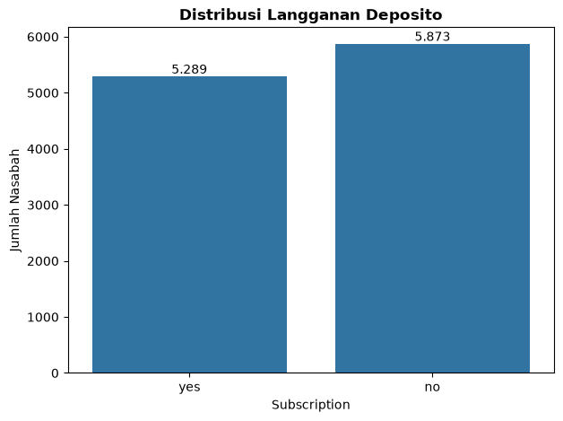
Overall Distribution of the Deposit Campaign
Insight
Based on the graph, out of the 11,162 customers contacted, only 5,289 decided to subscribe to a deposit

Slide 9
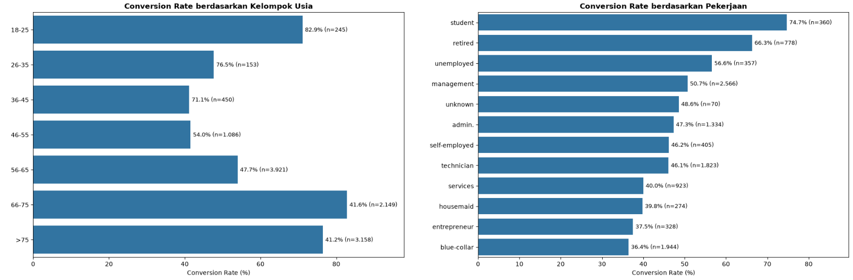
Customer Characteristics
Insight
By Age Category: The majority of conversions are among individuals aged 18–25, achieving a conversion rate of 82.9%.
By Job Category: In terms of conversion rate, students represent the highest-performing segment at 74.7%.

Slide 10
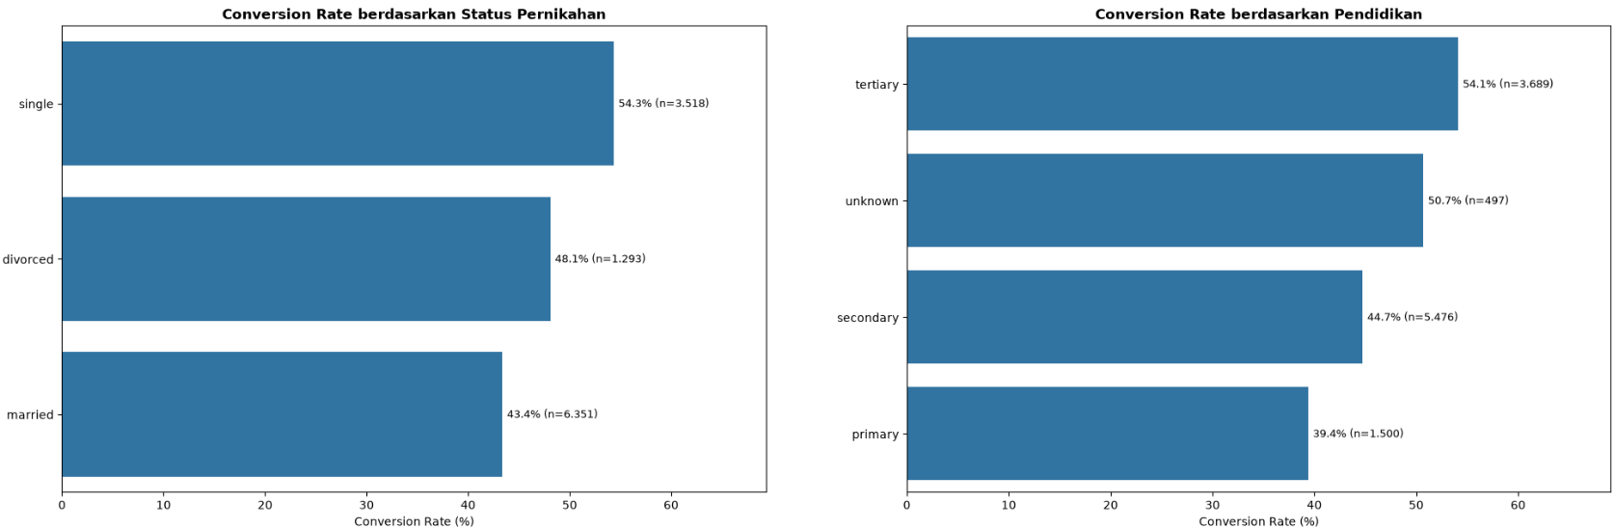
Customer Characteristics
Insight
By Marital Status: Single individuals exhibit a higher propensity to convert, with a conversion rate of 54.3%.
By Education Category: Customers with a tertiary education level achieve the highest conversion rate at 54.1%.

Slide 11
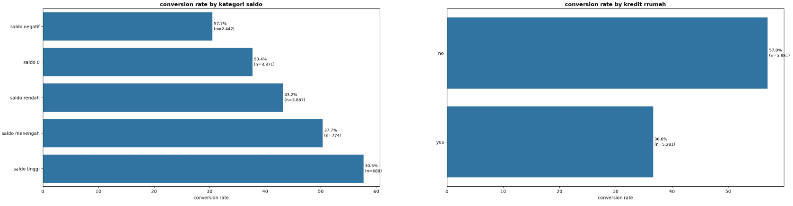
Financial Profile
Insight
By Balance Category: Customers with a high balance represent the highest conversion target, with a conversion rate of 57.7%.
By Housing Loan Category: Customers without a housing loan exhibit a higher conversion rate, reaching 57.0%.

Slide 12
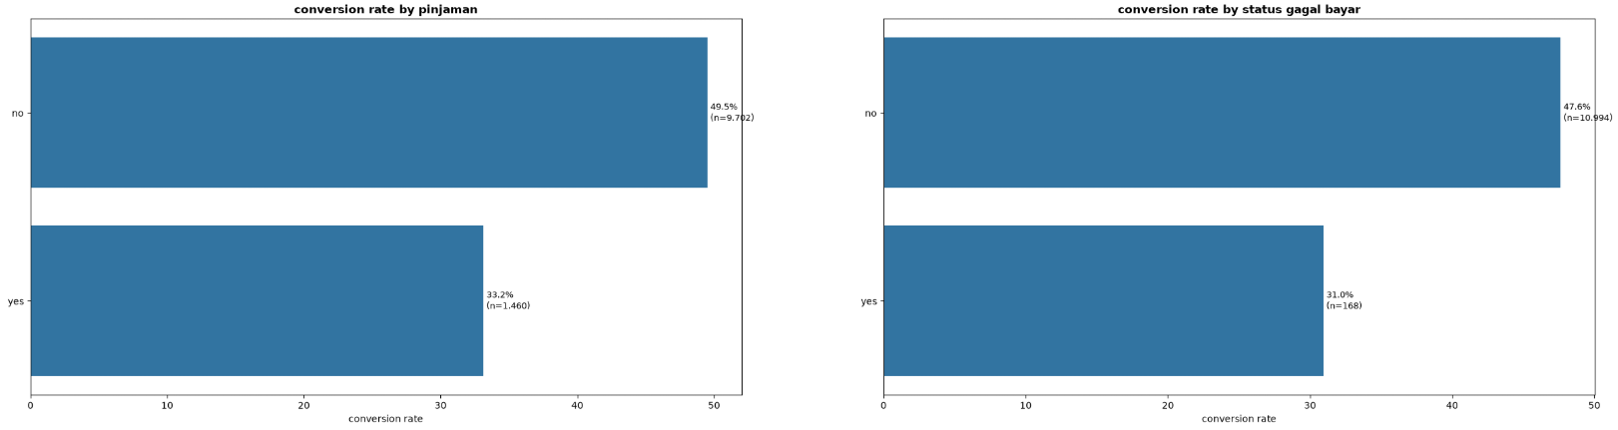
Financial Profile
Insight
By Loan Category: Customers without personal loans achieve a higher conversion rate at 49.5%.
By Credit Default Category: Customers with no history of credit default are successfully converted at a higher rate of 47.6%.

Slide 13
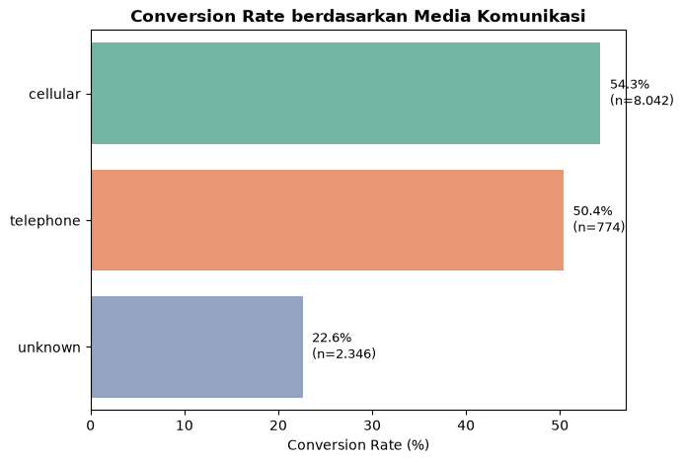
Marketing Campaign Performance
Insight
The visualization shows that cellular communication media yields a conversion rate of 54.3%, slightly higher than telephone, which has a conversion rate of 50.4%.

Slide 14
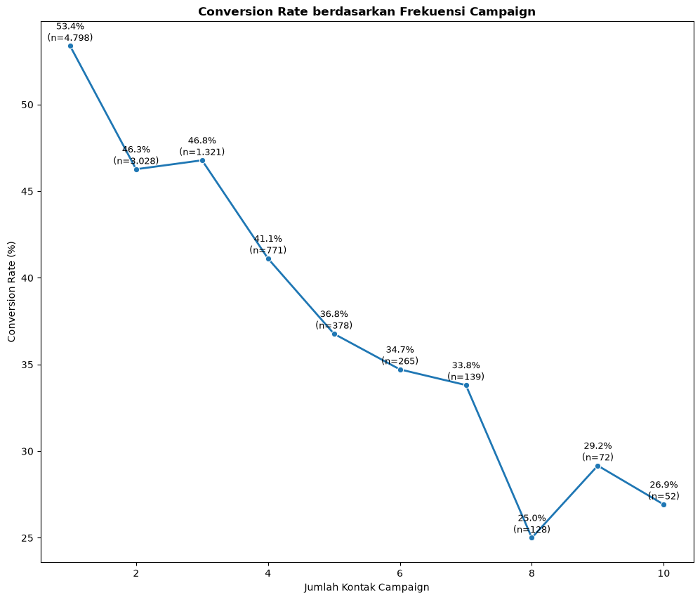
Marketing Campaign Performance
Insight
The highest conversion rate occurs during the first customer contact at 53.4%. After contacts exceed 4 times, the conversion rate tends to decline.
This indicates that campaign success is heavily concentrated within the first 1 to 3 contacts, whereas repeated follow-ups tend to be associated with lower campaign success rates.

Slide 15
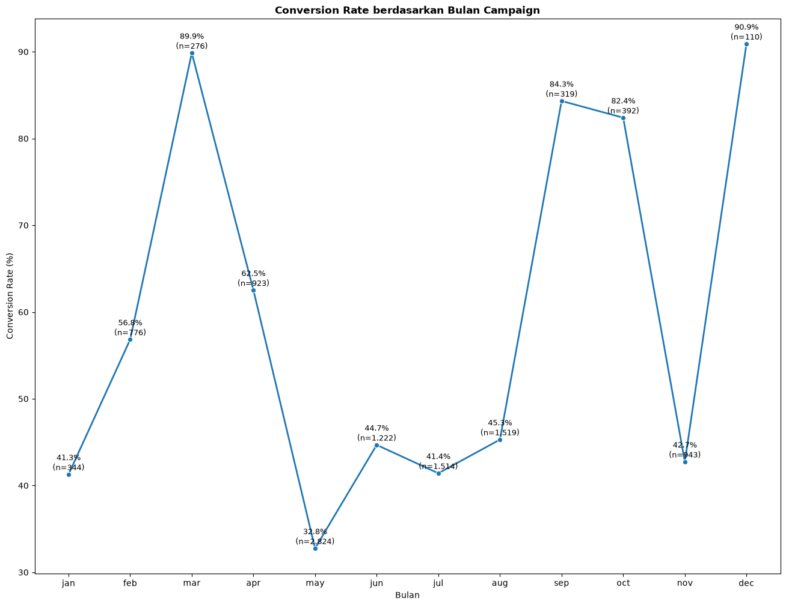
Marketing Campaign Performance
Insight
The highest conversion rate occurs in December at 90.9%. However, the total number of campaign interactions during this month is relatively low compared to other months. For instance, May recorded the highest volume of campaign outreach with 2,824 customers, yet it only yielded a deposit subscription conversion rate of 32.8%.

Slide 16

Conclusion
1
Demographic Profiles: Younger, single, and highly educated customers exhibit a relatively higher deposit subscription conversion rate compared to other demographic groups.
2
Financial Health: Customers with a high balance show a high conversion rate. Additionally, those without personal loans, housing loans, and histories of credit default also demonstrate elevated conversion rates.
3
Campaign Frequency: The highest conversion rate occurs during the first contact at 53.4%, which then tends to decline as the number of follow-ups increases. This indicates that campaigns are most effective when limited to 1 to 3 contacts.
4
Seasonal Timing: The best months for campaign execution are March, September, October, and December, as they yield relatively higher conversion rates compared to other months. However, because the actual volume of campaign interactions in these months is relatively low, this high conversion rate should be interpreted with caution regarding the sample size.

Slide 17
Recommendations
1
Target Customer Prioritization: Campaign efforts should prioritize customer segments that meet the following criteria :
Younger age groups (18-25)
Highly educated individuals
Single marital status
High account balances
No housing loans, personal loans, or histories of credit default.
2
Contact Frequency Optimization: Prioritize achieving campaign success within the first 1 to 3 contacts. If a customer remains uninterested after 3 contacts, consider reallocating resources to other high-potential prospects.
3
Communication Channel Strategy: Prioritize the use of cellular communication channels, as they yield a higher conversion rate.
4
Campaign Timing: Schedule and optimize campaign rollout timelines to align with the peak periods identified in the analysis.

Slide 18
DASHBOARD

Slide 19
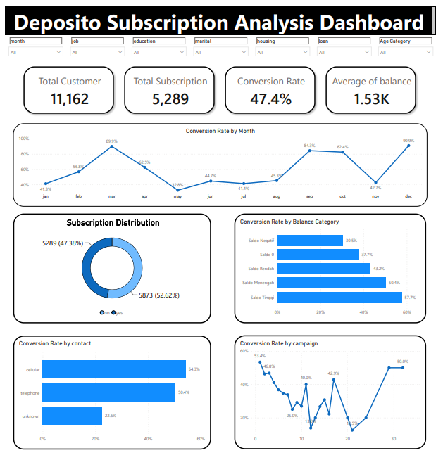

Slide 20
THANK YOU

