Slide 1

POWER BI

Slide 2
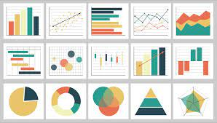
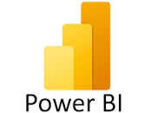
POWER BI
Power BI is a business intelligence tool provided by Microsoft which helps in analyzing , cleaning and visualizing raw data into actionable insights.
It combines Business analytics and data visualization that help organizations to make data driven decisions.
It converts data from different sources to build interactive dashboards and Business Intelligence reports.

Slide 3
COMPONENTS OF POWER BI
Power Query used for data mash-up and transformation.
Power BI Desktop used for companion development tool.
Power BI Mobile used for Android, iOS, Windows phones.
Power Pivot used for in-memory tabular data modelling.
Power View used for viewing data visualizations.
Power Map used for visualizing 3D geo-spatial data.
Power Q&A used for natural language Q&A.

Slide 4
WHY POWER BI?
Access to volumes of data from multiple sources.
Power BI helps to gather , analyze , publish and share excel business data.
Using Power BI with assure allows you to analyze and share massive volume of data.
Power BI allows us to gain insights from data and turn those insights into actions to make data driven business decisions using creative reports and dashboards.
It helps us to fetch data from multiple sensors and social media platforms to get access to real-time analytics.

Slide 5
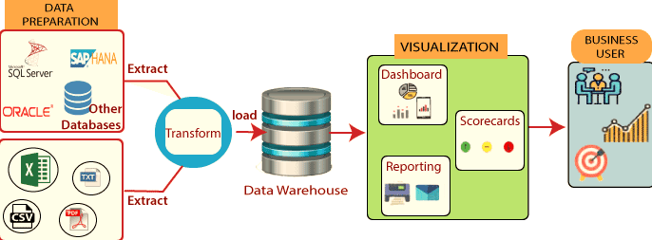
POWER BI ARCHITECTURE

Slide 6
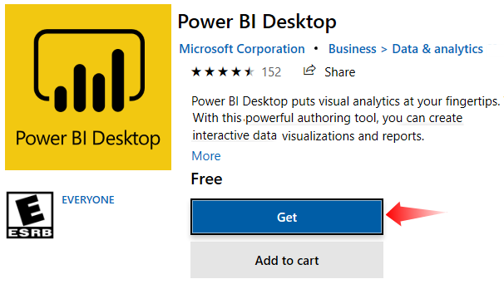
HOW TO DOWNLOAD AND INSTALL POWERBI?
Search “Power BI Desktop Install” on the internet.
https://powerbi.microsoft.com/en-us/desktop/
Click on the “Download Free” option to install Power BI.
Click on the “Get” option, and the Power BI Desktop setup will get downloaded on your computer.
Once the Power BI Desktop is downloaded, click on the “Install” option. You will see the following window.
Once the installation is completed, it will take us to the default page of Power BI.

Slide 7
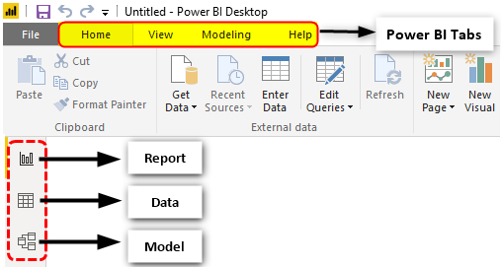
POWER BI DESKTOP PAGE
Report Layout: We can build all our Power Bi Reports and dashboards in this layout.
Data Layout: We can see all our uploaded or created data tables in this layout.
Model Layout: In this layout, we can create relationships between multiple tables based on the common columns of the different tables.

Slide 8
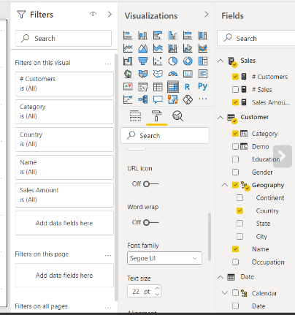
POWER BI DESKTOP
On the right-hand side in the “Report Layout,” we can see three options: “Filters,” “Visualizations,” and “Fields.”
Filters: In this section, we can apply filter columns of the table. Further in this section, we have “Filters on this page,” “Filters on all pages,” and “Filters on this Visual.”
Visualizations: We can use Power BI Visuals this section and create visuals for our data.
Fields: This section shows all the columns of our data table in A to Z order, not necessarily in the order of table columns.

Slide 9
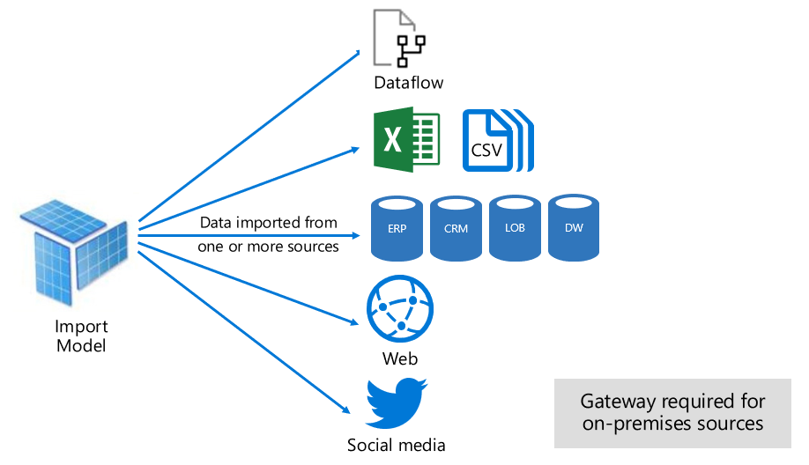
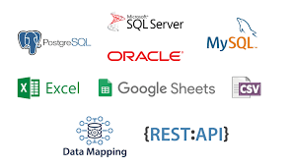
POWER BI DATA CONNECTIVITY

Slide 10
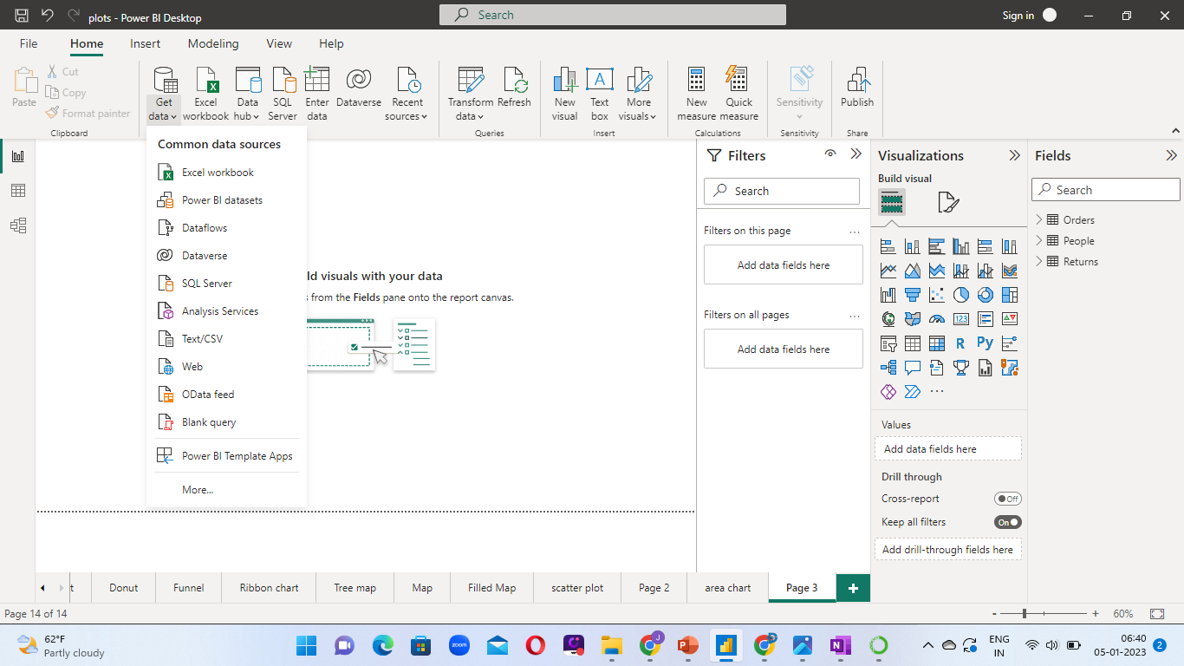
HOW TO LOAD DATA INTO THE POWER BI?

