Slide 1

SBRR Mahajana First Grade College(A),PG Wing, Pooja Bhagavat Memorial Mahajana Education Centre
Department of MCA
Minor Project
Blood Bank Website
Presented by, Internal Guide,
Vyshnavi S rachan
2nd Semester Assistant Professor &
Reg no:-P01BH22S126057 proffese

Slide 2
Introduction
The project blood bank management system is known to be a pilot project that is designed for the blood bank to gather blood from various sources and distribute it to the needy people who have high requirements for it.
The software is designed to handle the daily transactions of the blood bank and search the details when required.
It also helps to register the details of donors, blood collection details as well as blood issued reports.
The software application is designed in such a manner that it can suit the needs of all the blood bank requirements in the course of future

Slide 3
Abstract:
The Blood Bank Management System Online is a comprehensive and user-friendly web-based platform designed to streamline and enhance the efficiency of blood donation and distribution processes. This system aims to bridge the gap between blood donors, recipients, and blood banks, ensuring a well-coordinated and readily accessible supply of blood.
The primary objective of this system is to facilitate the easy registration of blood donors, allowing them to create profiles, provide their blood type, and availability for donation. On the other side, the system enables hospitals and medical facilities to request specific blood types and quantities when needed, ensuring a timely response to emergencies and medical treatments.
The Blood Bank Management System Online offers several key features, including:
Donor Registration and Profiles: Donors can register online, create profiles, and provide essential information such as blood type, contact details, and availability for donation.
Blood Inventory Management: Blood banks can manage their inventory by tracking blood types, quantities, and expiration dates. This ensures an efficient supply chain and reduces wastage.
Donation Scheduling: Donors can schedule donation appointments at their convenience, helping blood banks maintain a consistent supply of blood.

Slide 4
Emergency Requests: Hospitals can place urgent blood requests through the system, which alerts potential donors with matching blood types. This quick response can be crucial in life-threatening situations.
Notification System: Donors and recipients receive notifications via email or SMS about donation drives, urgent requests, and other relevant updates.
Search and Match: Hospitals can search for available blood units based on blood type, location, and availability, ensuring that the required blood type is readily accessible.
Admin Dashboard: Administrators have access to a comprehensive dashboard to manage donor profiles, monitor blood inventory, oversee donation drives, and track system activity.
Reports and Analytics: The system generates reports and analytics on blood inventory, donor engagement, and usage patterns, aiding in decision-making and resource planning.
Security and Privacy: The system employs robust security measures to protect sensitive donor and patient information, ensuring compliance with data protection regulations.
By digitizing and automating various aspects of blood donation and distribution, the Blood Bank Management System Online aims to make the process more efficient, transparent, and responsive to the needs of both donors and recipients. This system has the potential to save lives by ensuring that blood is available when and where it's needed most.

Slide 5
EXISTING SYSYTEM
Certainly, here are some points that describe the shortcomings and limitations of the existing system in blood bank management, which the proposed online system aims to address:
Manual Record-Keeping: The existing system relies heavily on manual record-keeping for donor information, blood inventory, and donation schedules. This process is time-consuming, prone to errors, and lacks real-time updates.
Limited Accessibility: Donors and recipients often face challenges in accessing information about blood donation drives, available blood types, and urgent requests. This leads to inefficiencies and delays in meeting critical medical needs.
Inefficient Communication: Communication between blood banks, donors, and hospitals is often fragmented, relying on phone calls or physical visits. This can lead to miscommunication, delays in coordinating donations, and missed opportunities.
Difficulty in Finding Matching Blood: Hospitals may struggle to find matching blood types quickly, particularly during emergencies. The lack of a centralized database hampers the efficiency of this process.
Wastage and Expiry: Without accurate real-time inventory management, blood units might expire before they are utilized, leading to wastage of precious resources.
Lack of Data Analysis: The existing system lacks the capability to generate meaningful reports and analytics for resource planning, donor engagement, and usage patterns. This inhibits data-driven decision-making.

Slide 6
Limited Donor Engagement: Donors might not be effectively engaged and motivated to donate regularly due to the lack of convenient scheduling options, awareness of blood drives, and recognition of their contributions.
Security Concerns: The manual storage of sensitive donor and patient information poses security risks. Unauthorized access to this data could lead to breaches of confidentiality.
Dependency on Physical Presence: The current system often requires donors to visit blood banks in person to inquire about donation drives or schedules. This can be inconvenient and discourages potential donors.
Inadequate Emergency Response: Urgent blood requests might not be communicated promptly to potential donors, delaying the availability of blood for critical medical situations.
Resource Inefficiencies: Blood banks might not have a clear overview of their inventory and donation drives, leading to inefficient allocation of resources and difficulties in managing demand.
The proposed Blood Bank Management System Online seeks to overcome these limitations by providing a comprehensive and automated solution that addresses the shortcomings of the existing manual system. It aims to streamline processes, enhance communication, improve resource management, and ultimately contribute to more efficient and effective blood donation and distribution.

Slide 7
PROBLEM STATEMENT
The existing blood donation system suffers from manual processes, disjointed communication, and inefficient donor engagement. This leads to errors, delays in emergencies, wasted resources, and compromised data security. A streamlined online solution is needed to connect blood banks, donors, and hospitals, improving real-time updates, scheduling, emergency response, and data analysis for a more effective and secure blood donation and distribution process.

Slide 8
PROPOSED SYSTEM
The proposed Blood Bank Management System Online is a comprehensive and efficient solution aimed at revolutionizing the blood donation and distribution process. This system will provide a user-friendly web-based platform connecting donors, blood banks, and hospitals in real-time.
Donors can easily register online, create profiles, and schedule appointments for blood donation. Blood banks will manage their inventory digitally, ensuring accurate tracking of blood types, quantities, and expiration dates. Hospitals can place urgent blood requests, triggering immediate notifications to potential donors with matching blood types.
The platform will facilitate seamless communication between all stakeholders through email and SMS notifications. It will offer a user-friendly interface for donors to check donation drives, make appointments, and receive updates. Hospitals can quickly locate available blood units, improving emergency response times.
Data analytics tools will generate insightful reports, aiding in decision-making and resource planning. Security measures will safeguard sensitive information and ensure compliance with privacy regulations.
Overall, the proposed system aims to overcome existing challenges by automating processes, enhancing communication, providing timely responses to emergencies, and optimizing blood resource management, ultimately contributing to more efficient and effective blood donation and distribution.

Slide 9
SYSTEM REQUIREMENTS
FRONTEND :
HTML5,CSS3,BOOTSTRP5,JAVASCRIPT,FIGMA
MIDDLE LAYER :
NODEJS, GOOGLE(API),EXPRESS.JS,NPM,REST(API),
BACK END :
MONGODB, POSTMAN
DEPLOYEMENT :
GITHUB AND NETLIFY

Slide 10
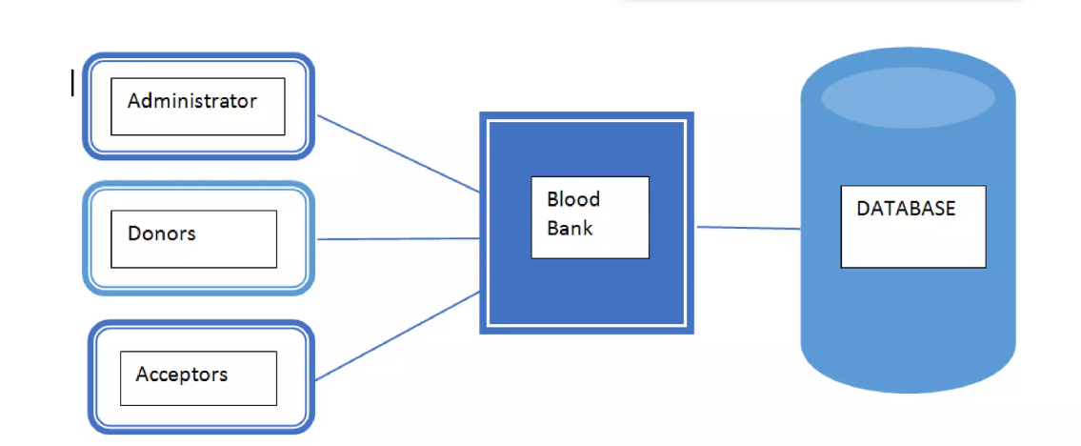
8.System Architecture

Slide 11
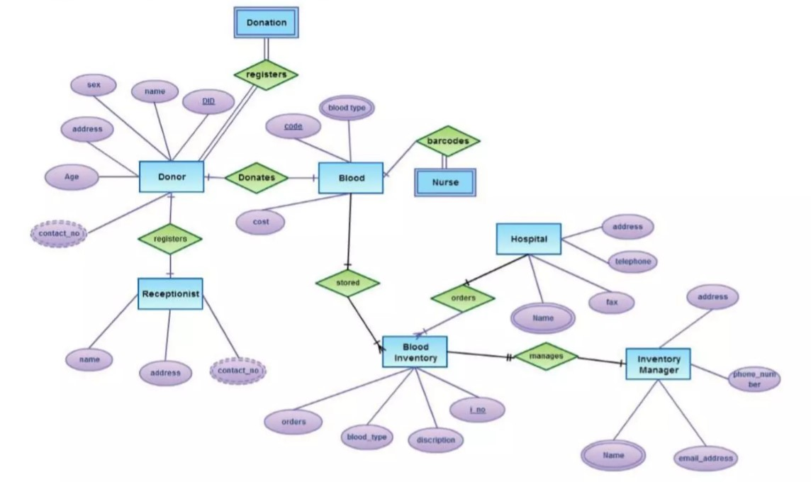
ER DIAGRAM

Slide 12
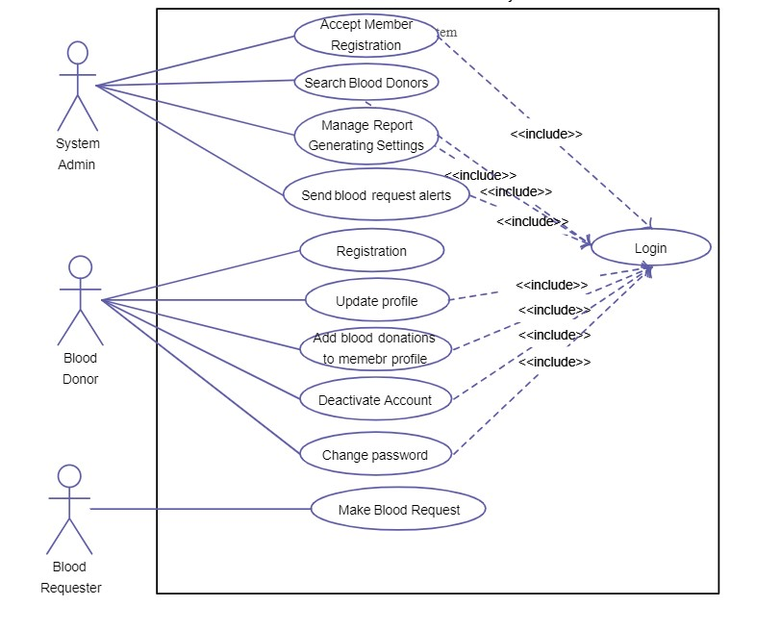
USE-CASE DIAGRAM

Slide 13
MODULE
User Registration and Authentication:
Allow users to sign up and log in securely.
Store user information, including blood type, in the database during registration
. . Blood Donor Management:
Enable donors to update their availability status.
Facilitate easy identification of potential donors during emergencies.
Blood Inventory Management:
Allow blood banks to update and monitor their available stock.
Maintain an up-to-date database of blood units.
Blood Admin Management:
Provide administrators with access to manage blood donation and request operations.
Enable administrators to validate and verify donors and recipients' information.
Hospital Management:
Allow hospitals to register and manage their profiles on the website.
Enable hospitals to create and track blood requests efficiently
Organization Management:
Allow organizations (e.g., NGOs, government bodies) to participate in blood donation drives.
Manage blood donation campaigns, view donor statistics, and coordinate with hospitals and blood banks

