Slide 1
ADC CARD

Slide 2
Block Diagram:
Power Management
AFE
FPGA
Cyclone-v
Serial Interface
SPI Interface
Clock Generator
Memory

Slide 3
FPGA Block
Raw Data
Transfer
FIFO Bank
Processed Data Transfer
High Speed Data Capture
Block
S2P Block
Shift Register
Processing Block
SPI Transfer Block
To Memory
Control and Timing Block
Notes:
For the selected ADC LTC2311-16, we must apply 105MHz external clk to SCK pin to generate 5Msps thereby we need 26 bits.

Slide 4
Interfacing High speed ADC
There are various schemes of interfacing serialized low-voltage differential signaling (LVDS) data outputs from high-speed analog-to-digital converters (ADCs) to a field-programmable gate arrays(FPGAs) described below.
The two key points required for reliable data capture
Bit clock edge selection
Frame alignment.
Schemes for capturing data from multiple ADC devices
One wire Interface:
ADC serial data rate of (Fs ×N) bits per second.
An associated 50% duty cycle bit clock is output with a frequency of (Fs ×N/2). The bit clock is typically center-aligned and both clock edge scan be used to latch serial ADC data. Therefore, the bit clock is referred to as a double data rate(DDR)bit clock.
An associated 50% duty cycle frame clock is output with a frequency of Fs. As the name suggests, the frame clock rising edge transitions are aligned with the framing ADC data bits(D0andDN-1). This alignment helps the receiver to correctly load parallel data after de-serialization. Note that the frame clock rising and falling edges are aligned with the transitions of data.

Slide 5
Interfacing High speed ADC
Two-wire interface
MSB-first
All the above interface will have one-bit clock.
Capturing data from a serialized ADC interface should implement two process namely
Latching the serialized data into S2P shift register using the ADC bit clock (serialized clock domain).
Aligning the parallel output data from the S2P registers correctly (parallel clock domain).
Important Note: Most FPGA shave a DDR flip-flop and register as part of the logic library. The DDR IO element accepts a single clock and registers data at the input data pin at both clock edges. The DDR IO element is also physically located close to the FPGA receiver pins, thus helping minimize any delays caused by routing in the FPGA. Therefore, TI recommends using the DDR IO element to interface to the ADC serial LVDS interface. Ideally, there is no additional skew between the serial LVDS data, LVDS bit clock, and LVDS frame clock signals caused by delays in the PCB and FPGA internal routing. In a real situation, the effects of trace delays in the PCB and FPGA routing cannot be ignored.

Slide 6
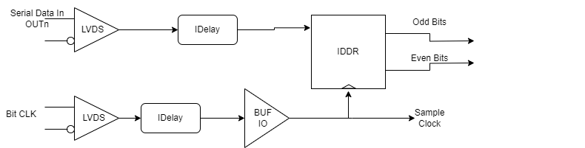
Latching Serialized ADC Data Bits into the S2P Shift Register
Two methods :-
Method1: Delay elements
Method2: PLL Replacing PLL with various delays for controlling data

Slide 7
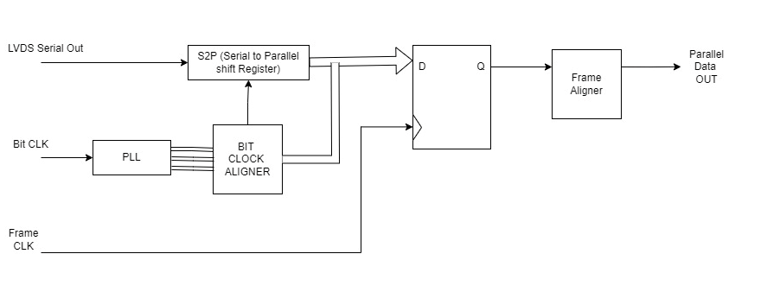
Capture Scheme Using PLL: One-Wire Interface

Slide 8
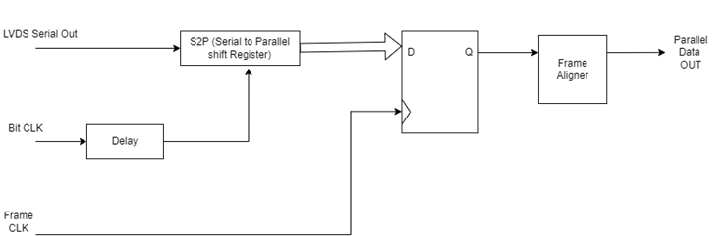
Capture Scheme Using Delays: One- Wire Interface

Slide 9
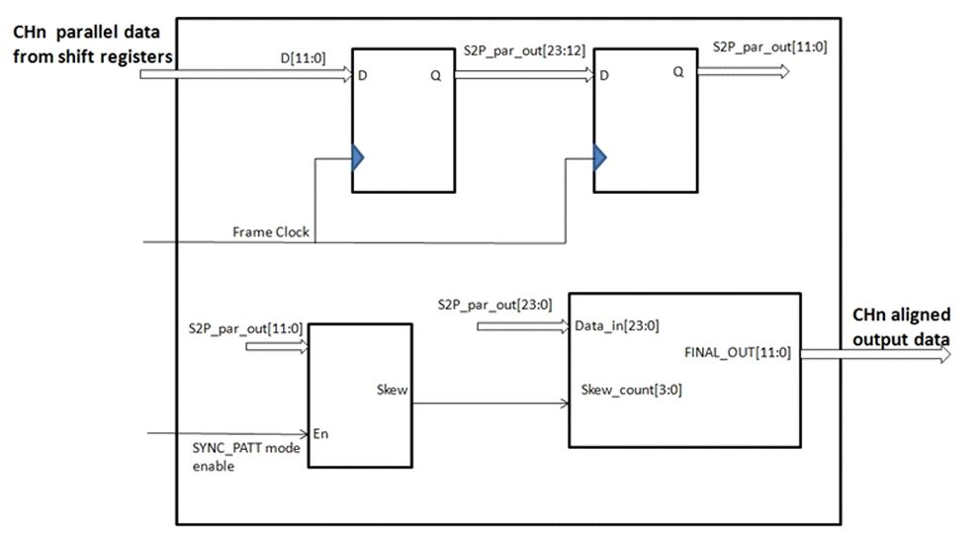
Frame Aligner

Slide 10
References
740-xxxxx Analog Filter Board.docx
QF4A512revD6.pdf
QFAN001-Interfacing to the QF4A512 Digital SPI port.pdf
https://www.ti.com/video/6301516529001
https://www.digikey.jp/htmldatasheets/production/1922805/0/0/1/ltc2311-16-datasheet.html
https://www.ti.com/lit/an/sbaa205/sbaa205.pdf?ts=1705987876680

