Slide 1



Microvision Embedded Pvt Ltd
MVE_EYE_LORA_MESH

Slide 2
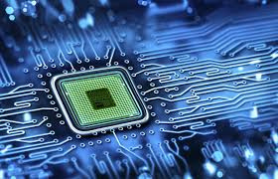
Microvision Embedded Pvt Ltd
ABOUT US
At Microvision Embedded Pvt Ltd, we specialize in developing innovative embedded systems that power a wide range of applications across industries. Our team of experts designs and implements hardware and software solutions tailored to meet the specific needs of our clients, ensuring high performance, efficiency, and reliability. From IoT devices to complex industrial automation systems, we are committed to delivering cutting-edge technology that drives progress and solves real-world challenges.

Slide 3

Microvision Embedded Pvt Ltd
ABOUT TECHNOLOGY
LoRa (Long Range) is a wireless communication technology designed for long-distance data transmission with low power consumption. It operates on unlicensed radio frequencies, typically in the sub-GHz range, allowing devices to communicate over distances of several kilometers, even in challenging environments like urban areas or remote locations.
LoRa is widely used in IoT (Internet of Things) applications because it enables devices like sensors, meters, and trackers to send small amounts of data over long distances with minimal energy usage, making it ideal for battery-powered devices. Its key features include long range, low power consumption, and support for a large number of devices within a network.
LoRa networks often use a star topology, where all devices communicate with a central gateway, which then forwards the data to a cloud or server for further processing. This technology is commonly applied in smart cities, agriculture, industrial automation, and environmental monitoring.
01
02
03

Slide 4
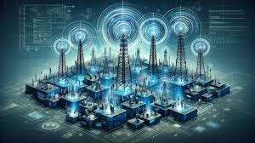

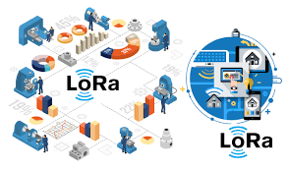
Microvision Embedded Pvt Ltd
OUR PROJECT
In this project, we're creating a LoRa mesh network, where group of devices creates the mesh network can communicate wirelessly over long distances. Each device will store key information, like signal strength (RSSI) and device IDs, using a linked list structure. This allows all nodes to share network information dynamically.
Even if a device is out of range, the mesh network enables communication by relaying messages through other nodes. When powered on, the network automatically selects a master node, and all devices maintain awareness of the full network topology. Additionally, we integrate MQTT to transmit LoRa-received messages, ensuring seamless and efficient data transfer across long-range, low-power networks.

Slide 5
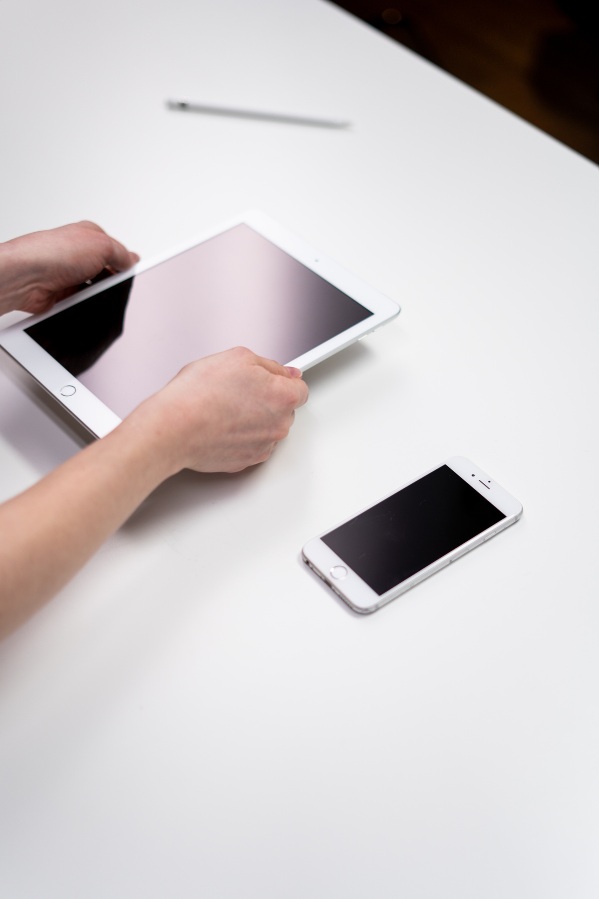

Microvision Embedded Pvt Ltd
OUR VISION
Our vision is to pioneer the future of wireless communication by developing a robust LoRa mesh network where multiple nodes work together seamlessly. As the demand for long-range, low-power communication grows, especially in IoT, smart cities, agriculture, and industrial automation, traditional communication systems face limitations in scalability and range.
01
By creating a decentralized LoRa mesh network, we’re enabling devices to communicate reliably over vast distances, even in challenging environments. This approach eliminates the need for constant infrastructure upgrades, offering a scalable, energy-efficient solution. In the future, this technology will be at the heart of wireless communication, powering autonomous systems, remote monitoring, and smart networks with minimal energy consumption and maximum coverage.
02

Slide 6
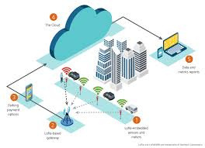
Microvision Embedded Pvt Ltd
OUR MISSION
01
Our mission is to develop a cutting-edge wireless communication system that delivers long-range connectivity with minimal power consumption. By leveraging LoRa mesh networking technology, we aim to create seamless communication between multiple devices over vast distances, ensuring reliable data transmission in any environment.
02
This project is focused on addressing the growing need for energy-efficient communication solutions, enabling IoT devices, sensors, and smart systems to operate for extended periods without frequent battery replacements. Through innovation and optimization, we are building a scalable, future-ready network that meets the challenges of modern wireless communication.

Slide 7




Microvision Embedded Pvt Ltd
CONTACT US
www.microvisionembedded.com
hr@microvisionembedded.com
High Street,HSR Layout, Bengaluru

Slide 8
Microvision Embedded Pvt Ltd
THANK YOU

