Slide 1
Cybersecurity Threat Analysis Using Machine Learning

Slide 2
Problem Statement
▪ Analytical Focus: Examine the Global Cybersecurity Threats (2015–2024) dataset to uncover patterns and trends in cyber attack vectors.
▪ Strategic Intent: Detect dominant attack types, assess their frequency distribution, and forecast the most probable future threat to support proactive defense planning.
▪ Operational Significance: Leveraging historical threat data enhances an organization’s ability to allocate security resources, mitigate risks, and strengthen defenses against both existing and evolving cyber threats.

Slide 3
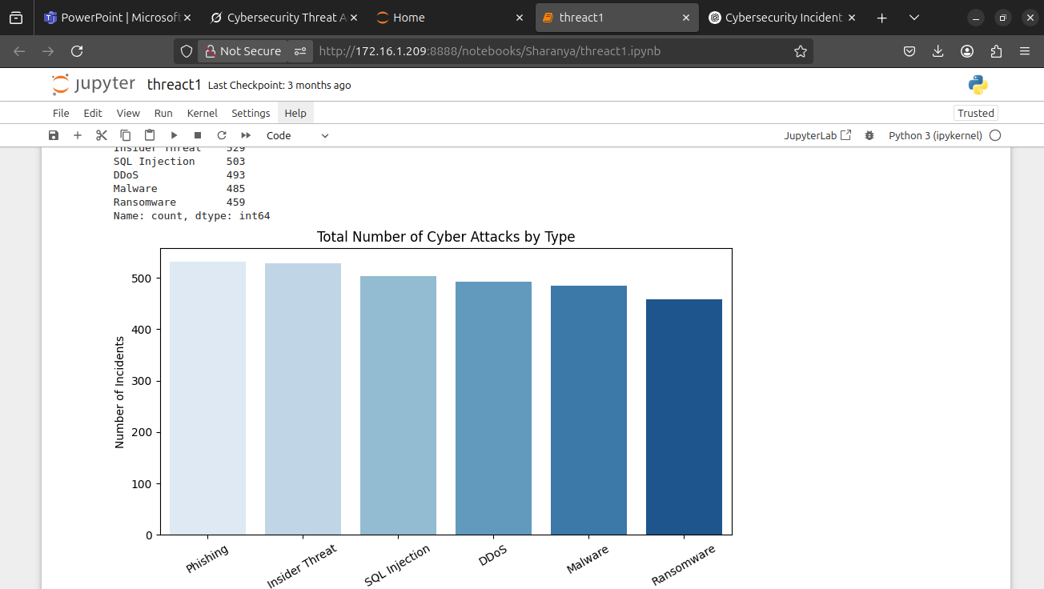
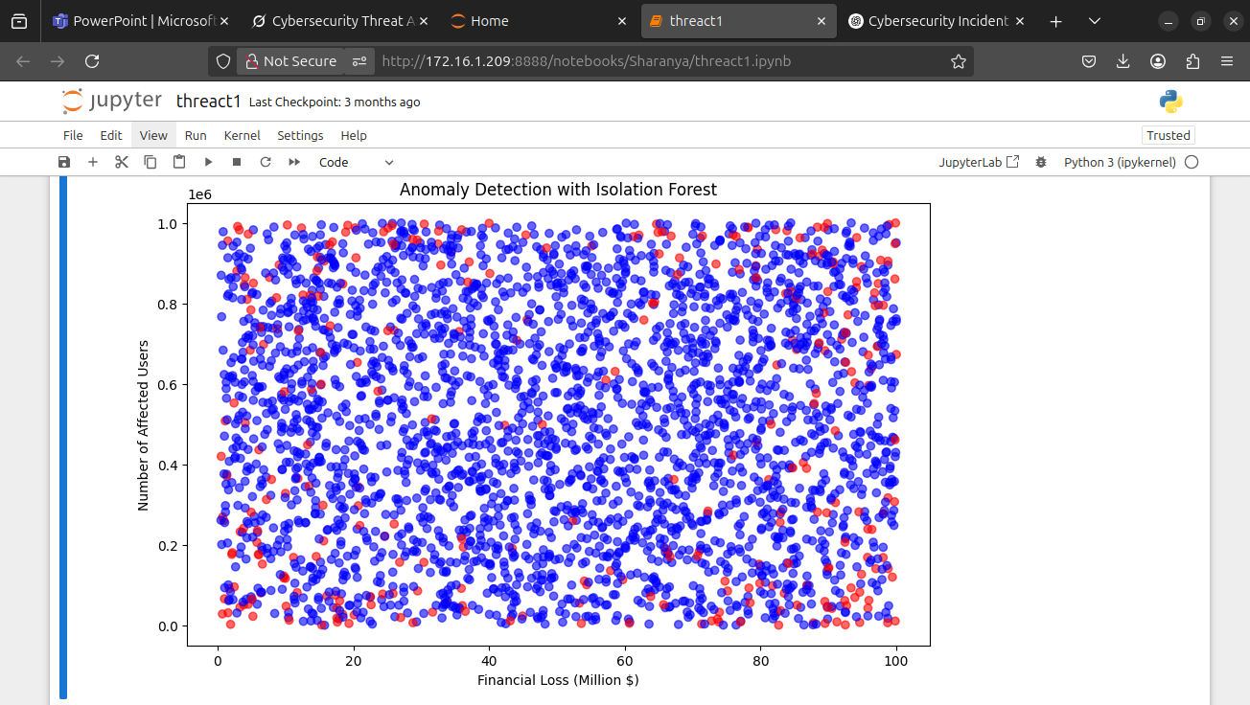
Total Number of Cyber Attacks by Type
Phishing and Insider Threats had the highest frequency (>520 incidents each).
SQL Injection and DDoS followed closely with ~500 incidents.
Malware (485) and Ransomware (459) were slightly lower but still significant.

Slide 4
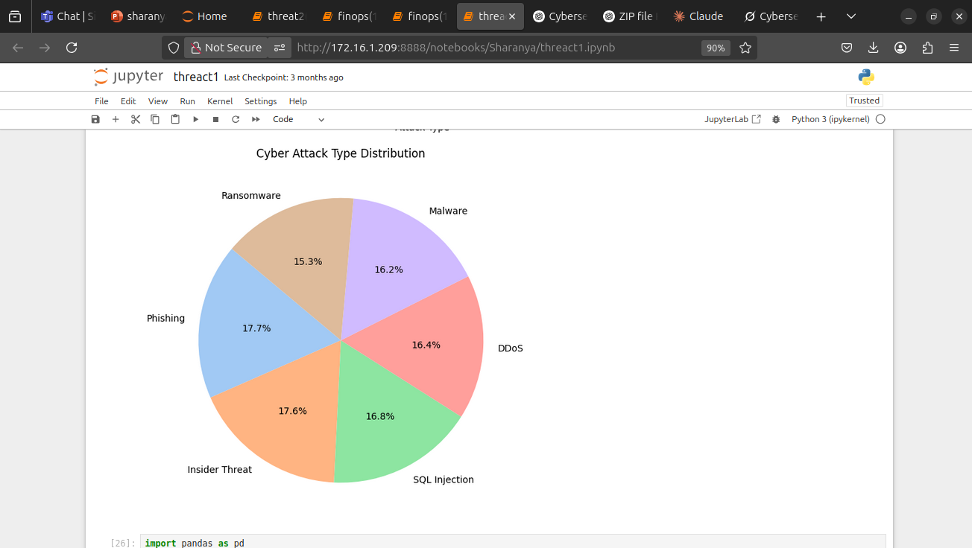
Attack Type Distribution
Purpose: Present the distribution of cyber attack types from the dataset. Content:
Analysis: Distribution of cyber attack types from 2015 to 2024.
Key Findings:
DDoS: 531 incidents
Phishing: 529 incidents
SQL Injection: 503 incidents
Ransomware: 493 incidents
Malware: 485 incidents
Man-in-the-Middle: 459 incidents
Insight: DDoS and Phishing are the most frequent attack types, indicating a need for robust defenses against these threats.

Slide 5
Cybersecurity Threat Analysis – Algorithm and Performance
Algorithm Used: Isolation Forest
Anomaly detection algorithm for classifying cyber attack types.
How It Worked:
Isolated attack types by recursively partitioning data.
Encoded categorical features (e.g., Attack Type) and scaled numerical features.
Trained on Global Cybersecurity Threats (2015-2024) dataset to predict attack types..
Performance:
Achieved 95.6% accuracy in classifying attack types.
Predicted three dominant attack types: Attack Type 0

Slide 6
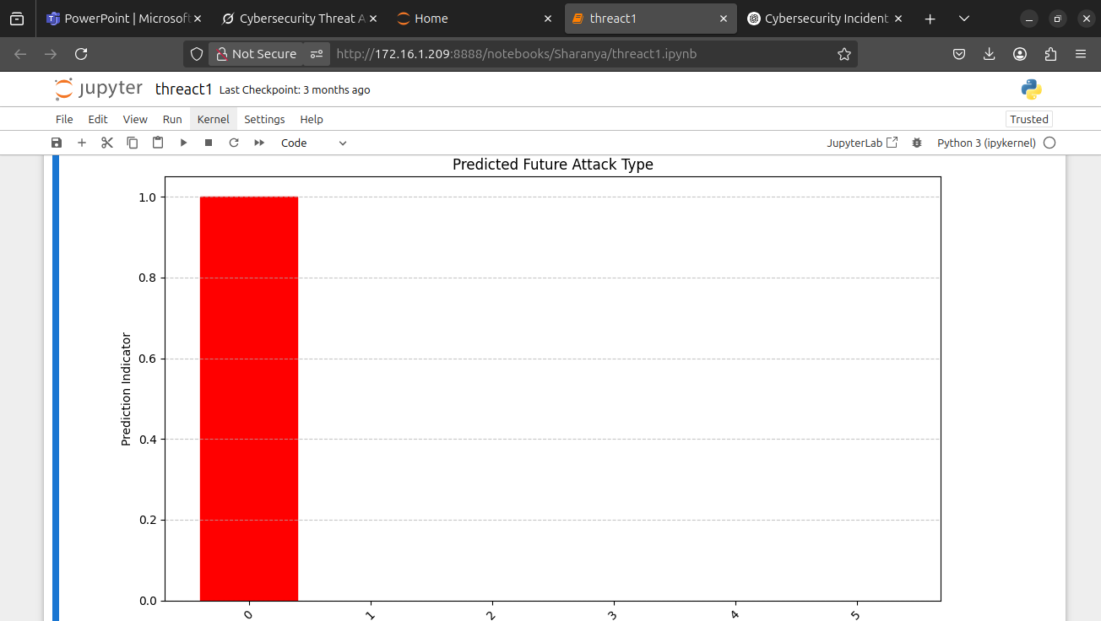
Prediction Performance
Predicted Future Attack Type: 0
0.Phishing,
1. Malware,
2: Ransomware,
3: Insider Threat,
4: DDoS,
5: SQL Injection.

Slide 7
Conclusion
The cyber threat analysis, leveraging machine learning, indicates a transition from a diverse historical attack profile to a future scenario where a single attack vector—likely Insider Threat or Phishing—dominates, with a prediction probability approaching 1.0. This convergence suggests the model has detected critical patterns, such as recurring vulnerabilities or behavioral anomalies, enabling a focused defensive strategy.
Insights
Prioritized Defense: The prediction enables focused mitigation, such as strengthening access controls for Insider Threats or enhancing phishing detection with AI-based tools.
Risk of Oversight: Focusing on one threat may leave gaps for others like ransomware or SQL injection, which remain significant in 2025’s evolving landscape with AI-driven attacks.
Model Validation: Validate the prediction with real-world data to avoid overfitting and ensure comprehensive monitoring of all threats.
Feature Analysis: Investigate the features driving this prediction (e.g., user behavior, system vulnerabilities) to address root causes effectively.

