Slide 1
What Fine - Tuning Actually Costs ?
Applied explanation of Full Finetuning, LoRA & QLoRA practically.

Slide 2
Does spending more on fine-tuning buy you more?
Full fine-tuning updates all 7.62 billion parameters. LoRA updates 0.03%. QLoRA does the same on a 4-bit base. The obvious assumption is that the expensive one is the good one.
So, we ran all three, at five ranks each, on identical data with identical seeds – eleven experiments, one variable at a time – and evaluated every one by executing the SQL it produced against the real database.
No, not here: full fine-tuning scored lowest. The interesting part is what it costs to find out.
Execution accuracy, not text match. A generated query that reads differently from the reference but returns the same rows is correct – and as slide 13 shows, that distinction changes the conclusion.

Slide 3
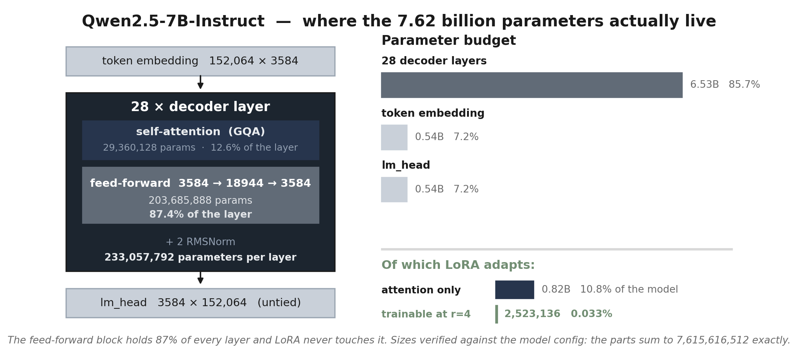
Qwen2.5-7B-Instruct, by the numbers
LoRA adapts the attention block only – 10.8% of the model – and within that, a rank-2 correction is 0.033%of the whole. The feed-forward network, 87% of every layer, is never touched.

Slide 4
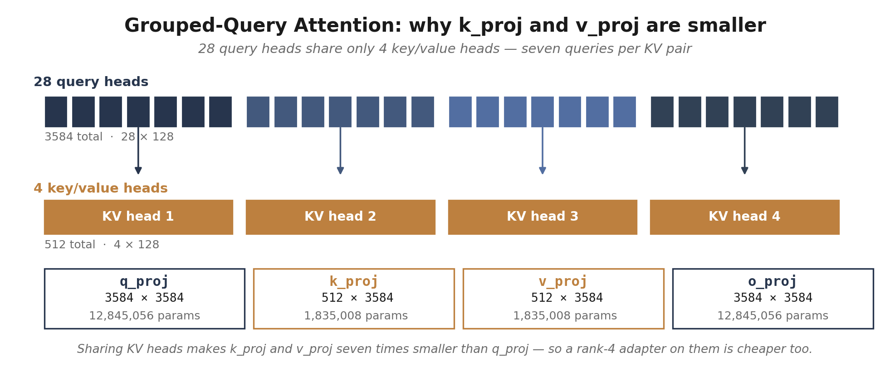
Why the four adapted matrices aren't the same size
Owen2.5-7B uses grouped-query attention: 28 query heads but only 4 key/value heads. That is why q_proj and o_proj are 3584*3584 while k_proj and v_proj are 512*3584 – seven times smaller.

Slide 5
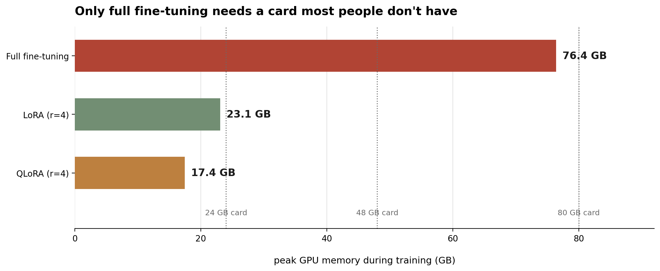
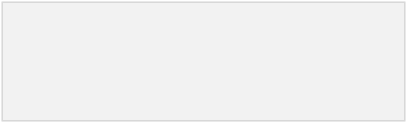
Full fine-tuning hits a wall you can measure
76.4 GB
15.24 GB
87 min
peak memory
full fine-tuning
checkpoint
per task
training time
on an H200
Figure 1. Peak allocated memory, measured. Full fine-tuning needs a card most people don't have; both adapter methods fit comfortably on a 24 GB one.

Slide 6
Freeze the model, train a low-rank correction
h = W₀x + ΔWx ΔW = B · A B ∈ ℝ^(d×r), A ∈ ℝ^(r×d), r ≪ d
W₀ the pretrained weight – frozen, never updated
B trainable, initialized to zeros – so ΔW = 0 at step one
A trainable, small random init
r the rank. This sweep tests r = 4, 8, 16, 32, 64
At r=4 on this model that is 2,523,136 trainable parameters against 7,615,616,512 — 0.033%, a 3,018× reduction.

Slide 7
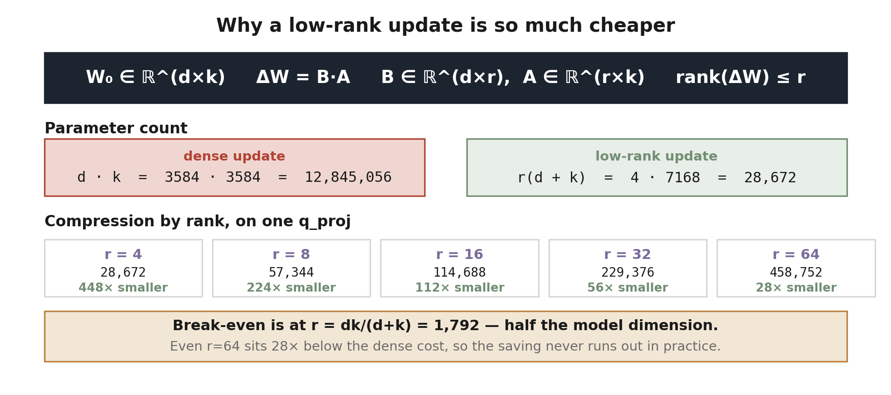
The arithmetic behind the saving
Constraining ΔW to rank r replaces a d×k grid of free parameters with two thin factors. The cost stops scaling with the area of the matrix and starts scaling with its perimeter.

Slide 8
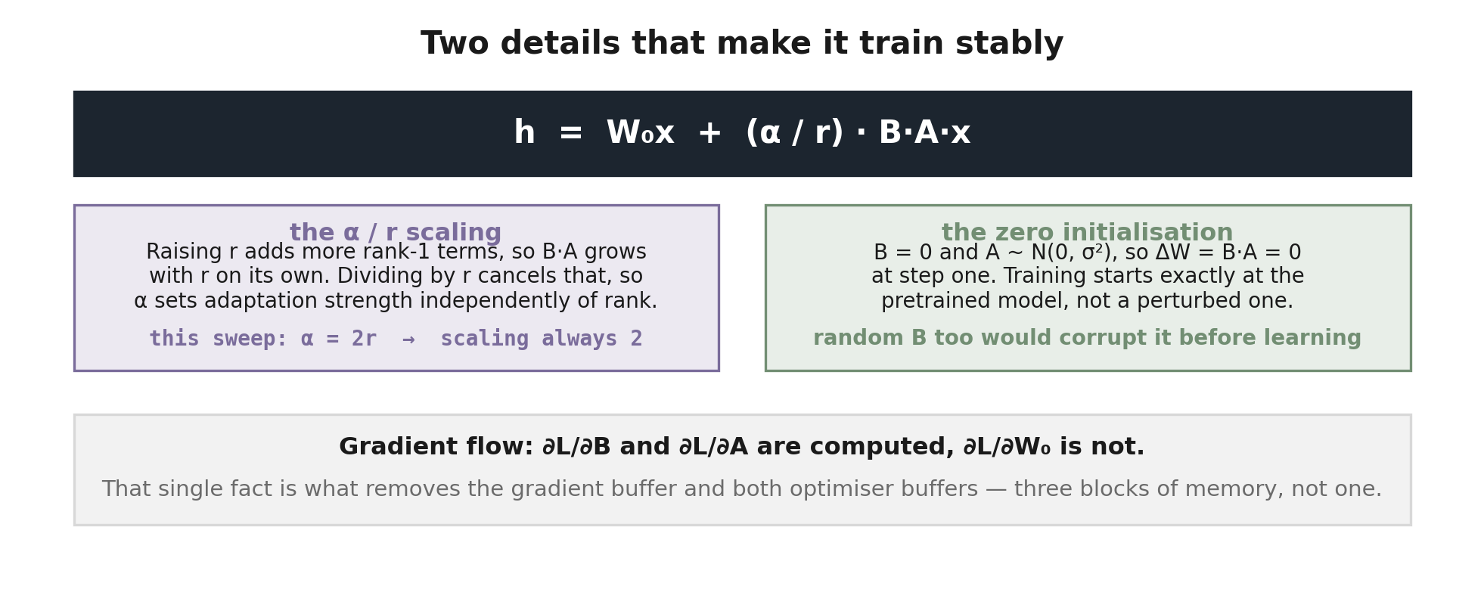
Why it trains stably: scaling and initialisation
Figure 4. Both details are in this sweep's configuration: α = 2r at every rank, and PEFT's default zero-init on B.

Slide 9
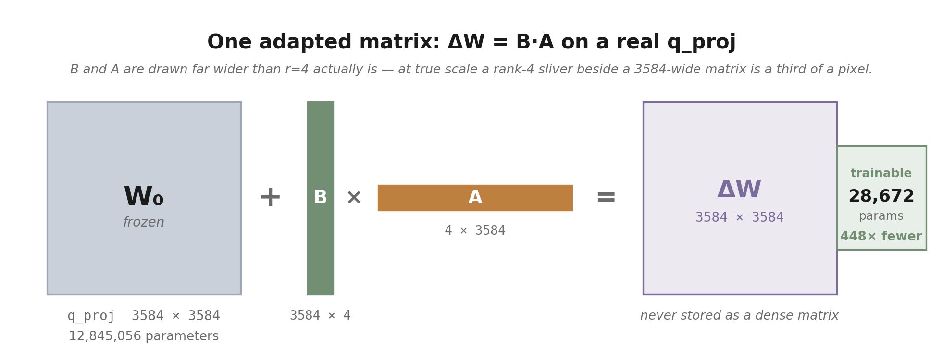
What that looks like on a real matrix
q_proj alone holds 12.8M parameters. The rank-4 correction that adapts it holds 28,672 — and the dense ΔW on the right is never materialised; only B and A are stored.

Slide 10
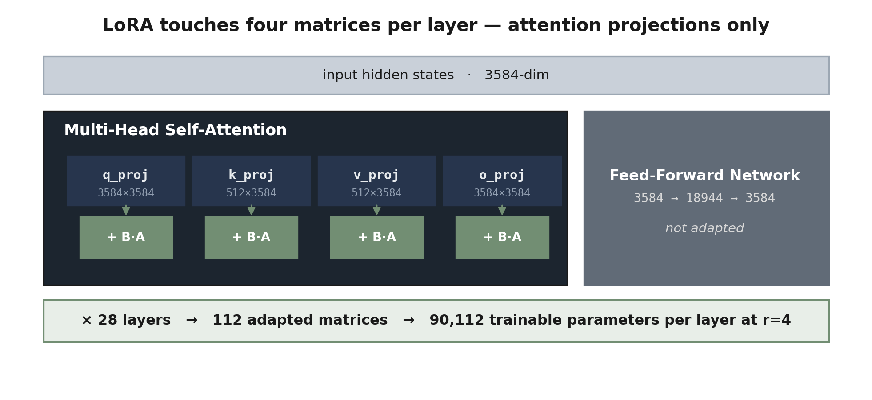
Which matrices actually get adapted
Figure 3. Real shapes from the model's own config. The feed-forward network — by far the largest block of parameters — is left untouched, which is a large part of why the trainable count is so small.

Slide 11
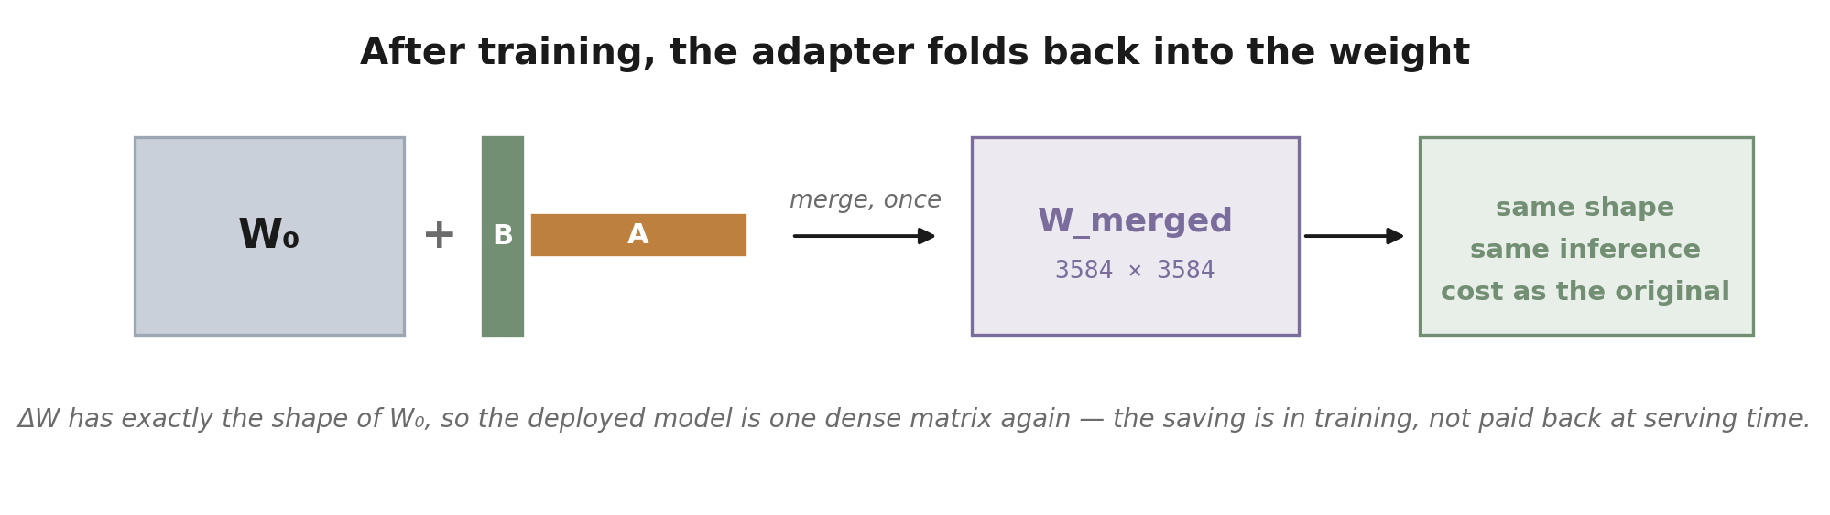
And it costs nothing at inference
This is what separates LoRA from adapter layers, which insert an extra module that must run on every forward pass forever. A LoRA adapter can be folded away entirely once training ends.

Slide 12
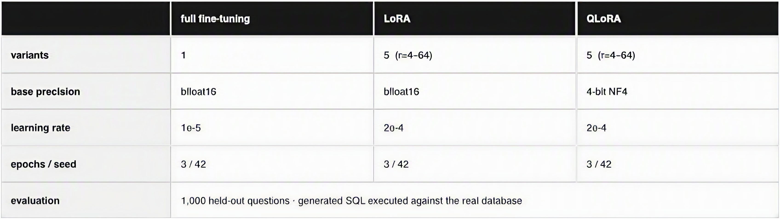
Eleven runs, one variable at a time
The learning rates differ on purpose. 1e-5 is standard for full fine-tuning; 2e-4 is standard for adapters, which train a much smaller subspace. Using one rate for both would have handicapped whichever method it suited less.
Figure 2. Everything else — data, sequence length, batch size, optimizer, schedule, seed — is held identical across all eleven.

Slide 13
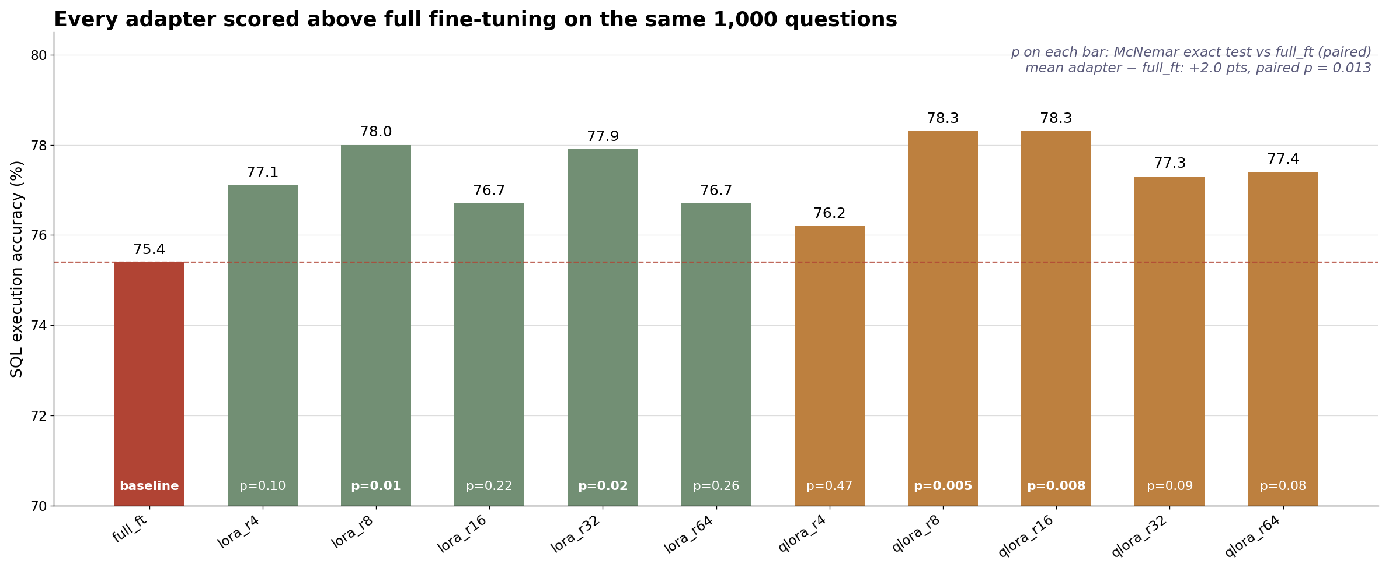
Accuracy barely moves; adapters average 2 points above full FT
Every model answered the same questions, so the test must be paired. Averaged over the ten adapters, full fine-tuning is 2.0 points lower (paired p = 0.013). Full FT vs LoRA r=8: unpaired p = 0.17 misses it; paired p = 0.011 finds it, but not after Holm correction for 55 pairs (p = 0.59).
Figure 3. Execution accuracy on 1,000 held-out questions. p on each bar: paired McNemar test against full_ft.

Slide 14
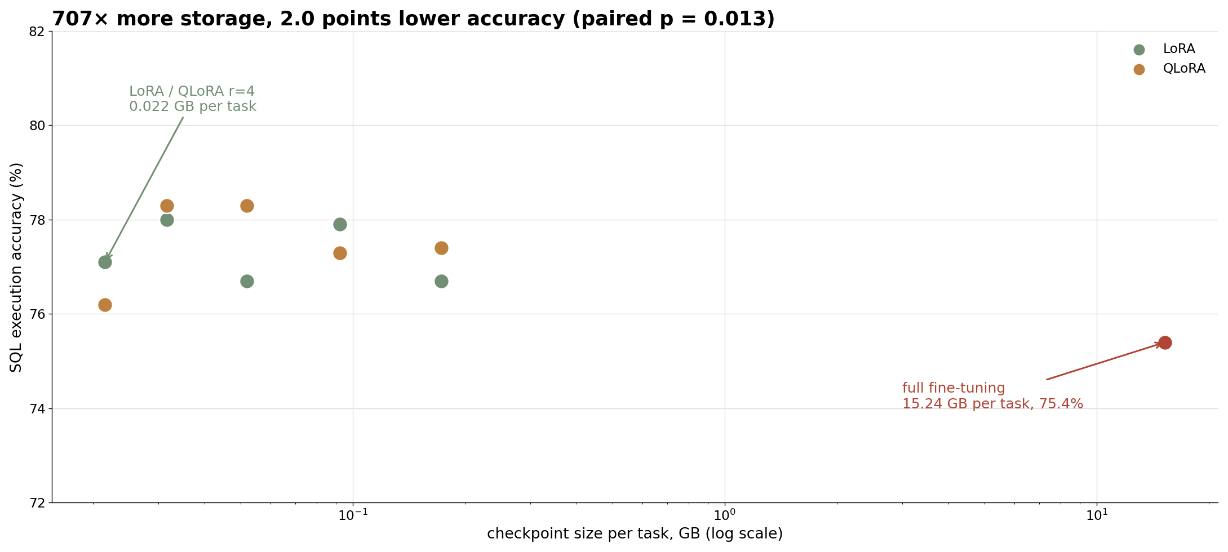
...while the cost of getting there differs by 707×
Figure 4. Same eleven runs, plotted against what each costs to store per task. Horizontal position spans nearly three orders of magnitude; vertical position barely moves.

Slide 15
Full fine-tuning finished last
full_ft
lora_r8
75.4% execution accuracy — the lowest of the eleven.
7.62B trainable parameters.
76.4 GB peak memory.
15.24 GB checkpoint.
87 minutes of H200 time.
78.0% execution accuracy — within 0.3 of the best.
5.05M trainable parameters.
23.1 GB peak memory.
0.032 GB checkpoint.
72 minutes of H200 time.
Paired over the same questions, full fine-tuning is 2.0 points below the adapters’ average (p = 0.013). With one seed and one learning rate, this is evidence about this setup, not proof that LoRA beats full fine-tuning in general.

Slide 16

QLoRA quantises the frozen base to 4 bits
The base model never trains, so precision lost there costs far less than precision lost in the adapters being optimised.
Full fine-tuning
LoRA r=4
QLoRA r=4
76.4 GB
23.1 GB
17.4 GB
QLoRA saves a further 5.7 GB over LoRA — real, but a much smaller step than the 53 GB LoRA already saved over full fine-tuning. The big win is the first one.
Accuracy cost of that quantisation: none detectable. QLoRA's five runs average 77.5% against LoRA's 77.3%, and at each rank a paired test finds no difference (p = 0.10–0.82).

Slide 17
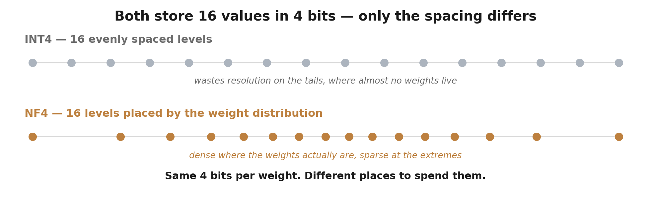
NF4: the same four bits, spent differently
Neural network weights cluster near zero, roughly normally. NF4 places its sixteen levels so each bucket carries about equal probability mass — so the error lands where the weights actually are, instead of being spread evenly across a range that is mostly empty.

Slide 18
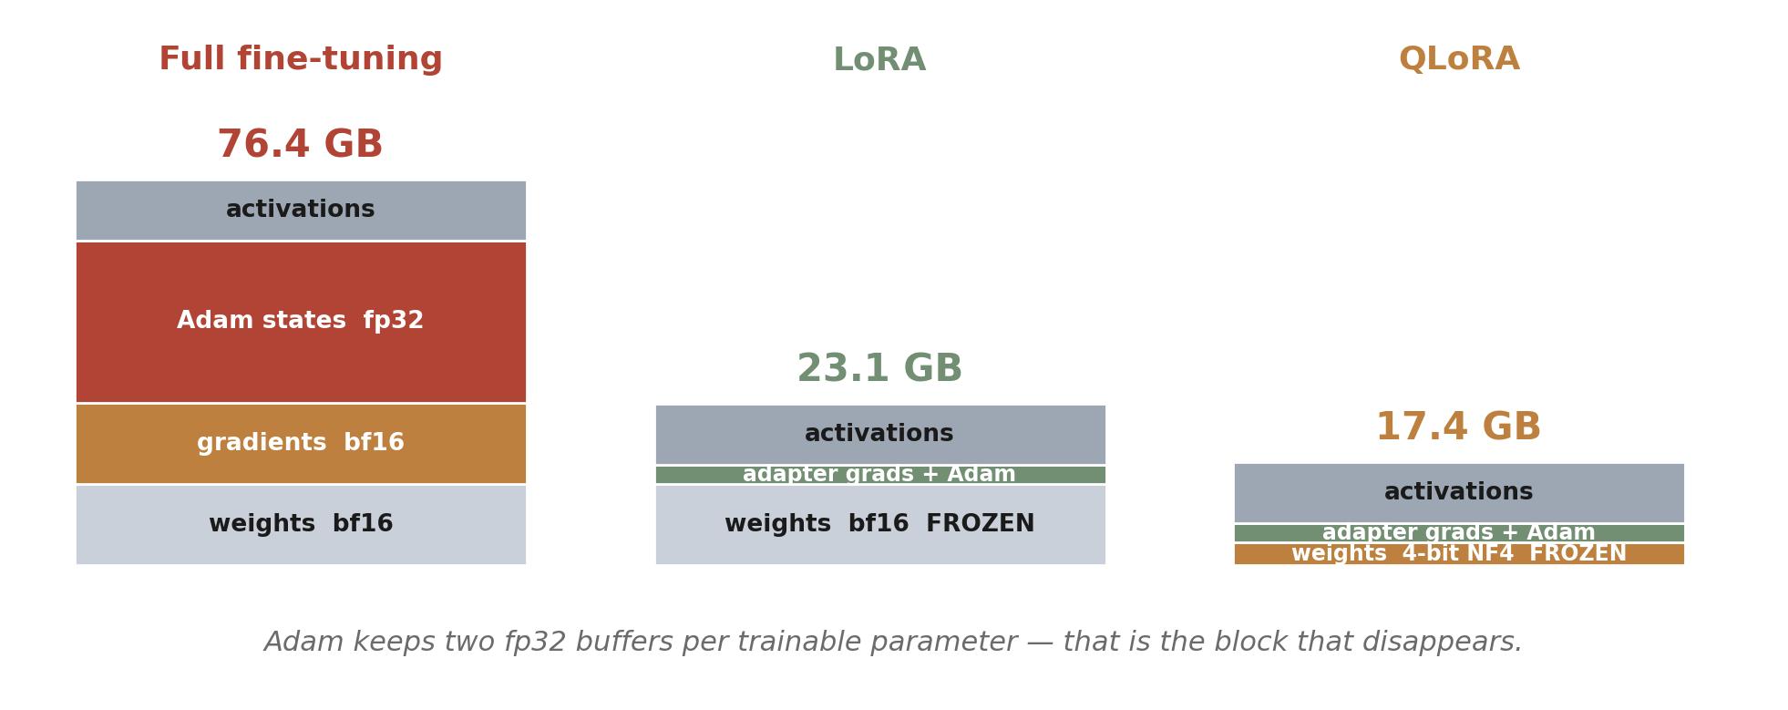
What each method holds in GPU memory
Freezing the weights removes the gradient buffer and both Adam buffers at once — three blocks, not one. Quantising the frozen weights then shrinks what is left of the base. Activations are unchanged by either.

Slide 19
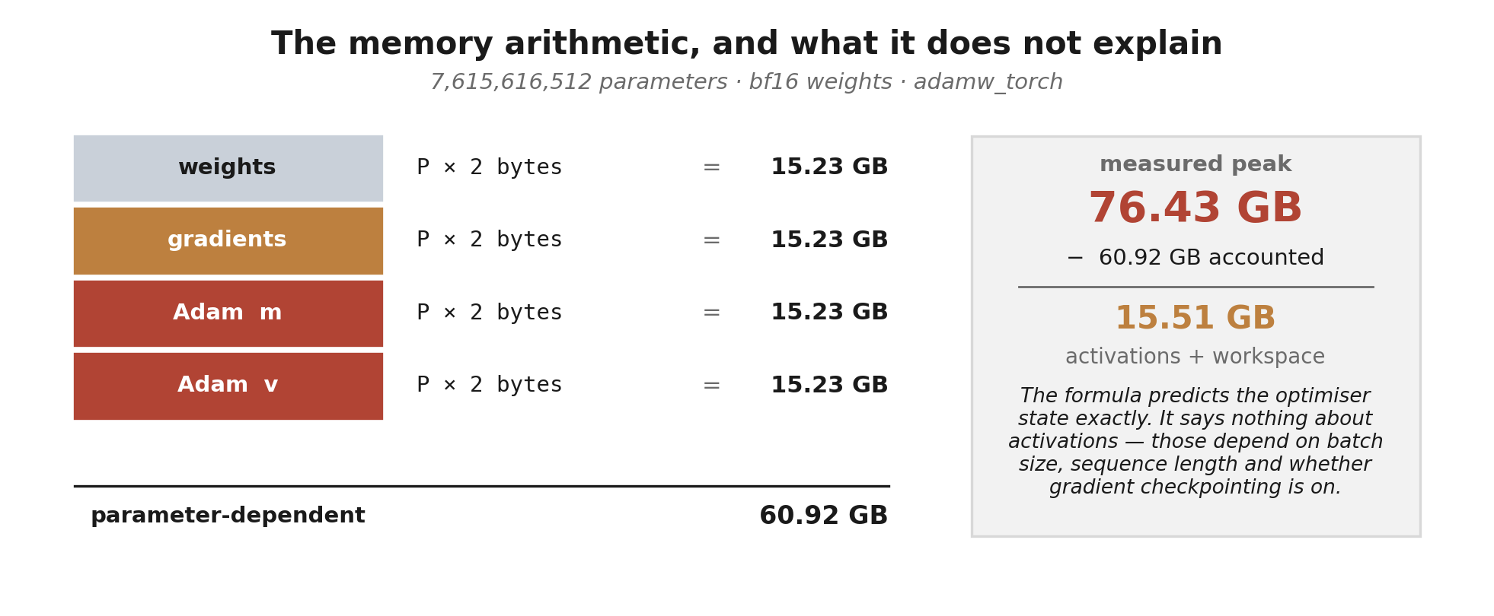
The arithmetic, checked against the measurement
Four buffers of identical size, one per parameter. Freezing the weights deletes three of them and leaves only the first — which is why the drop from 76.4 GB to 23.1 GB is so much larger than the drop from 23.1 to 17.4.

Slide 20
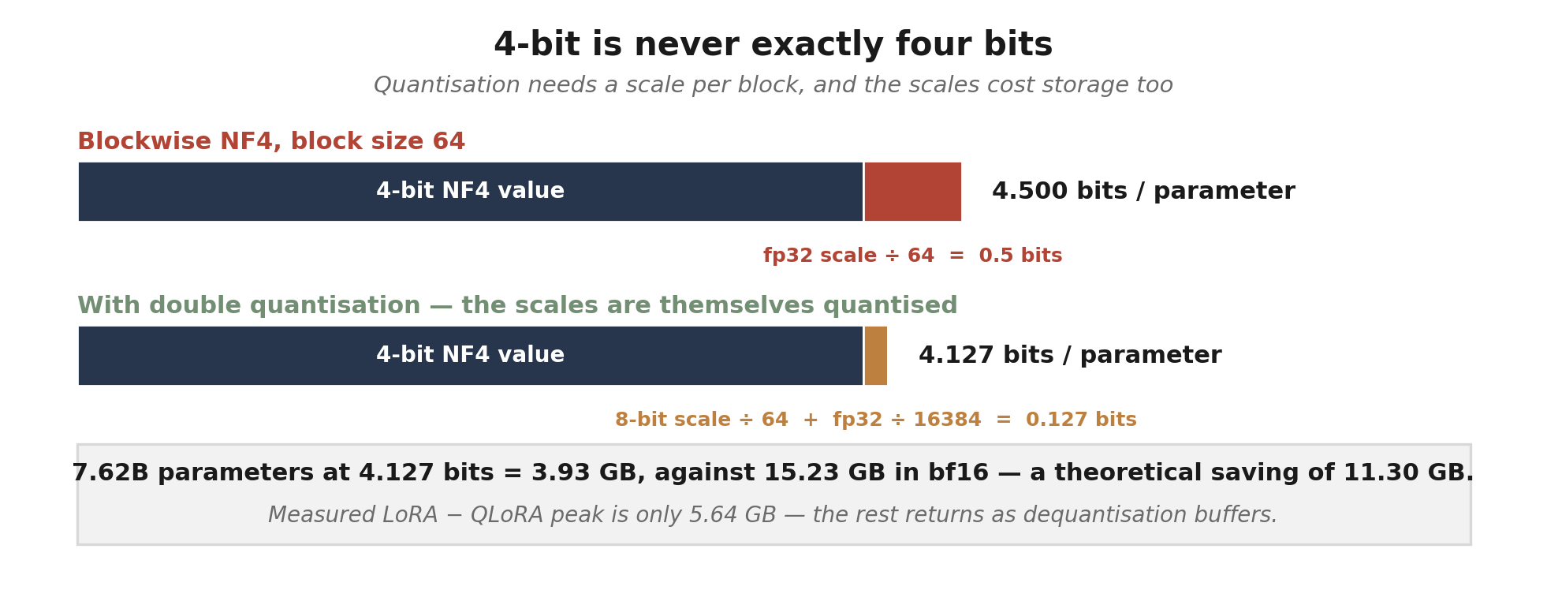
The bit budget, including what quantisation costs
Figure 8. Double quantisation is a second-order saving — 0.373 bits per parameter — which is small per weight and 355 MB across this model.

Slide 21
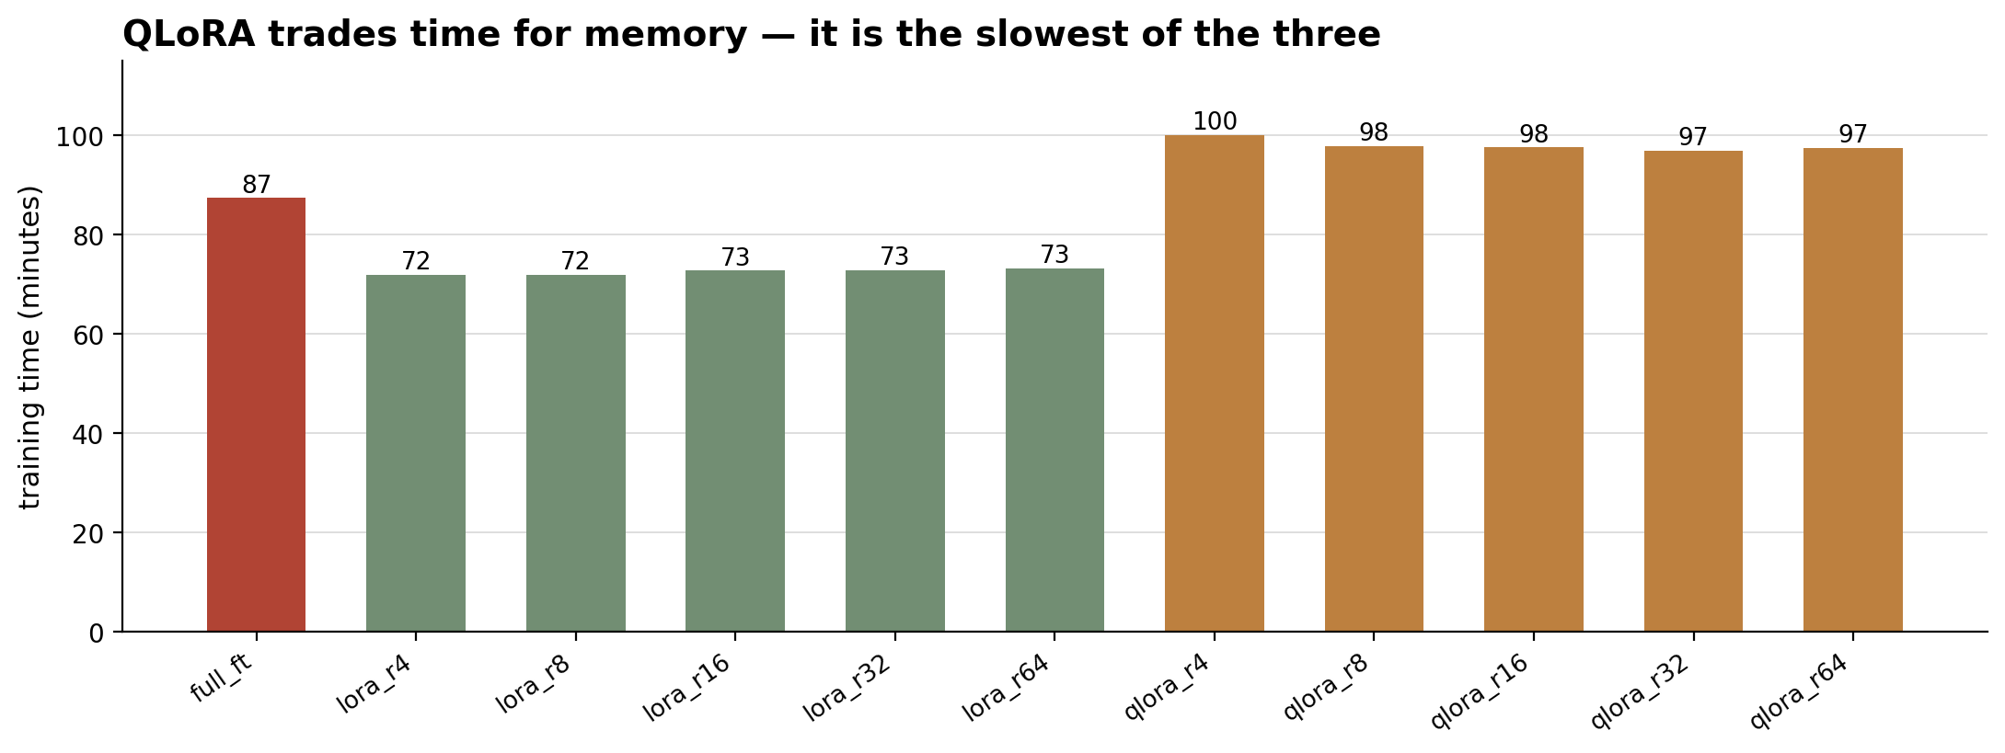
But QLoRA is the slowest of the three
LoRA averages 72 minutes, full fine-tuning 87, QLoRA 98. Every forward pass has to dequantise 4-bit weights back to bf16 before the matmul, and that overhead is paid on every step. QLoRA buys memory with time — it is not a free improvement on LoRA.
Figure 5. Wall-clock training time, measured on the same H200 for all eleven runs.

Slide 22
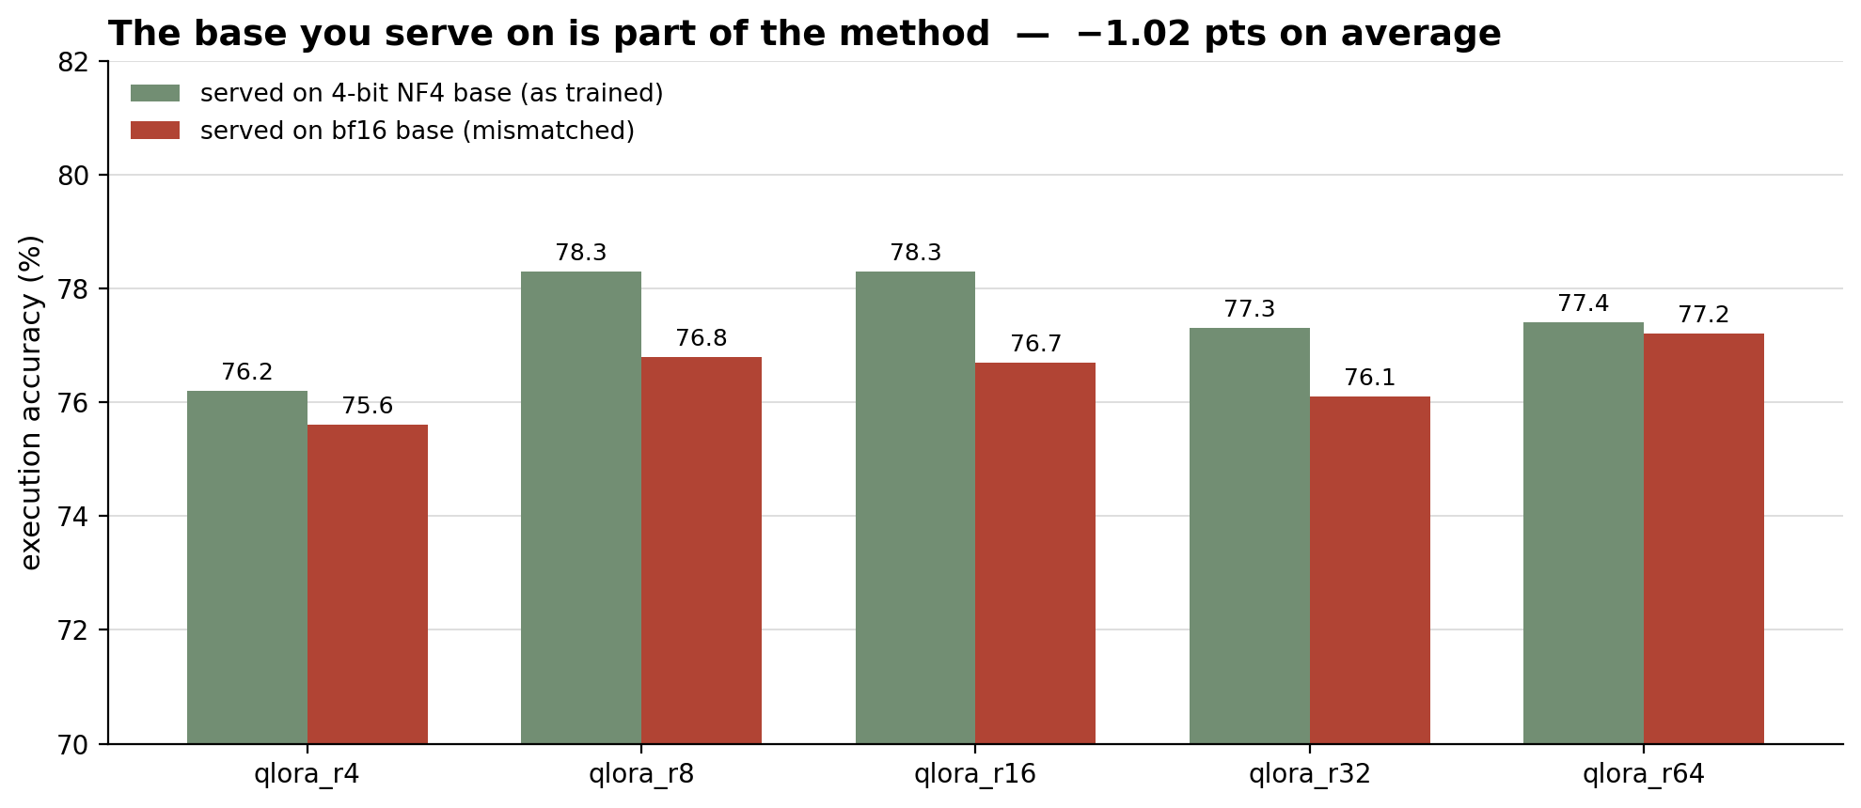
The base you serve on is part of the method
Take a QLoRA adapter trained against a 4-bit base, serve it on the bf16 base instead, and it loses 1.02 points on average (paired test over all five ranks, p = 0.009). Each rank drops. For scale, LoRA and full fine-tuning differ by 0.17 between two generation passes, which sets the noise floor. The adapter learned to correct a quantised model — move it and the correction is slightly wrong.

Slide 23
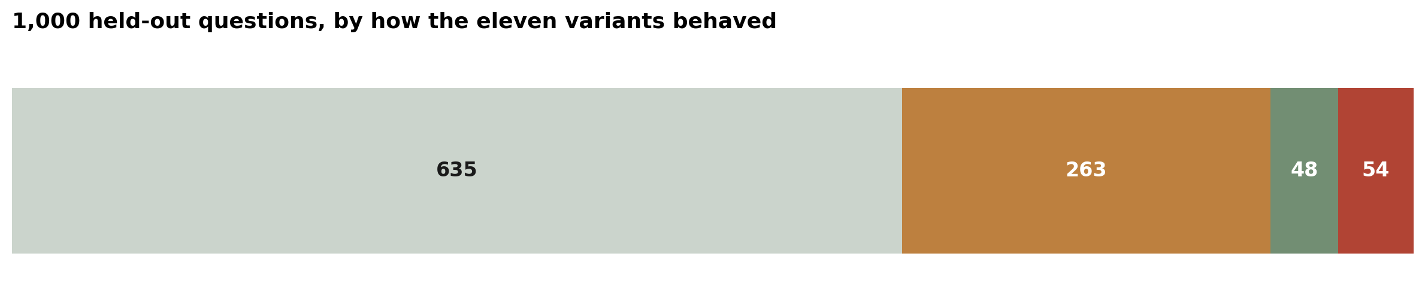
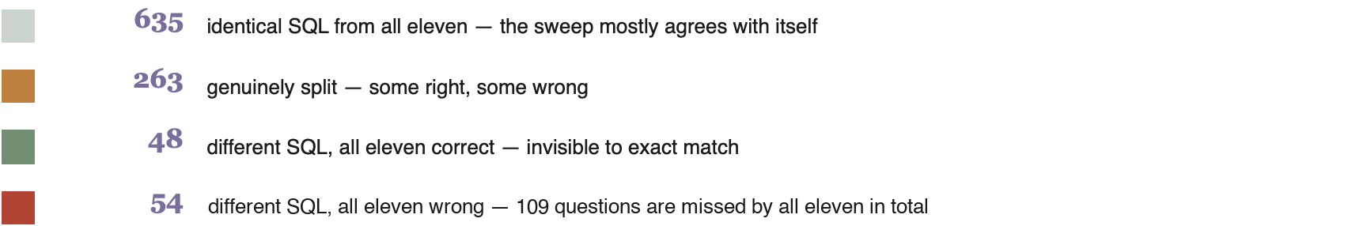
How often does that actually happen?
Figure 7. The 48 is the number that matters for method choice: on those questions, text-match scoring would have reported a failure that did not exist.

Slide 24
What this does not claim
One task, one model, one dataset
WikiSQL on Qwen2.5-7B-Instruct. Schema-constrained SQL generation is a narrow, well-structured task — these results may not survive on open-ended generation, long-context reasoning, or a domain further from pretraining.
Paired tests see only one kind of noise
McNemar and the paired bootstrap cover which questions were sampled, not training noise. And 55 pairwise tests give ~3 false positives by chance; none survive a Holm correction.
Single seed per variant
Every run used seed 42, and full fine-tuning one learning rate. Run-to-run variance is not measured, so the 2-point gap may be partly seed or tuning, not method.

Slide 25
Four things the measurements settled
Cost and quality are not coupled here
707× more storage, 3.3× more memory, and 2.0 points lower accuracy (paired p = 0.013)
The first step is the big one
Full → LoRA saves 53 GB. LoRA → QLoRA saves another 5.7 — and costs 26 minutes per run to do it.
Serve on the base you trained against
QLoRA adapters lose a measurable point on a mismatched base. It is part of the method, not a deployment detail.
Score what you actually care about
48 of 1,000 were right for all eleven despite different SQL; exact match marks some of them wrong.

