Slide 1
Customer Segmentation
Using K-Means Clustering in Python

Slide 2

Goal/Objective
Cluster customers based on Age, Income, and Spending Score.

Slide 3
Process Steps
1
2
3
4
5
6
7
1. Import Libraries
2. Load and Explore Dataset
3. Preprocess Data
4. Elbow Method for k
5. Apply KMeans
6. Visualize Clusters (2D & 3D)
7. Interpret Results

Slide 4
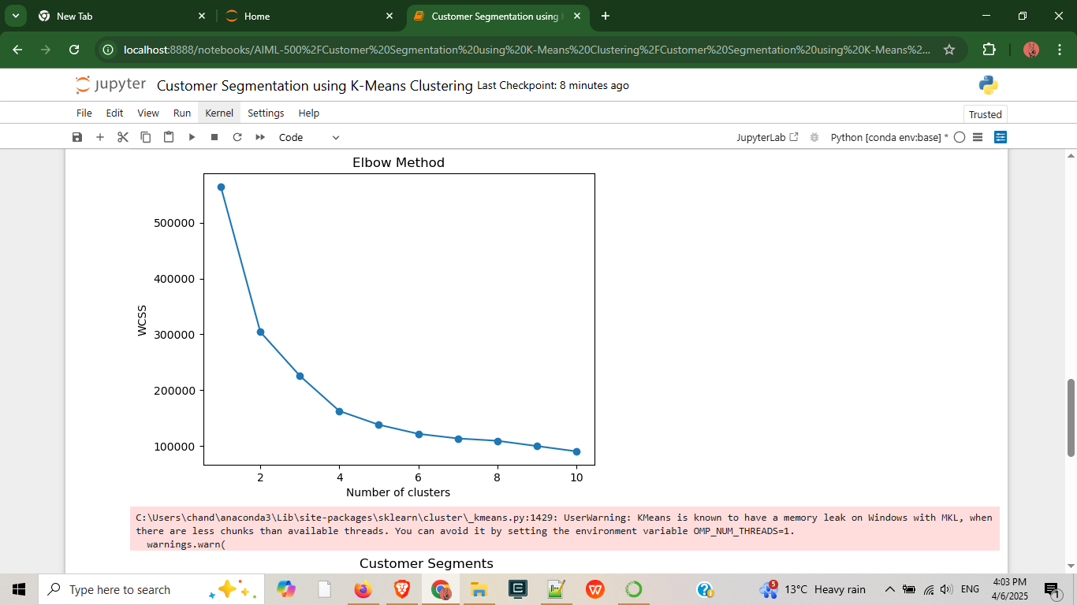

Slide 5
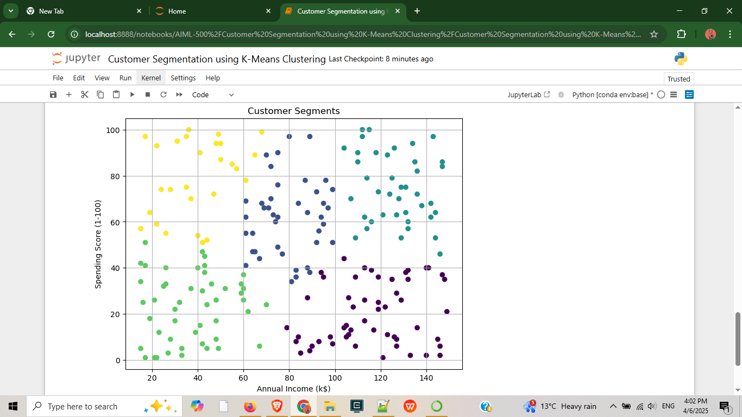

Slide 6
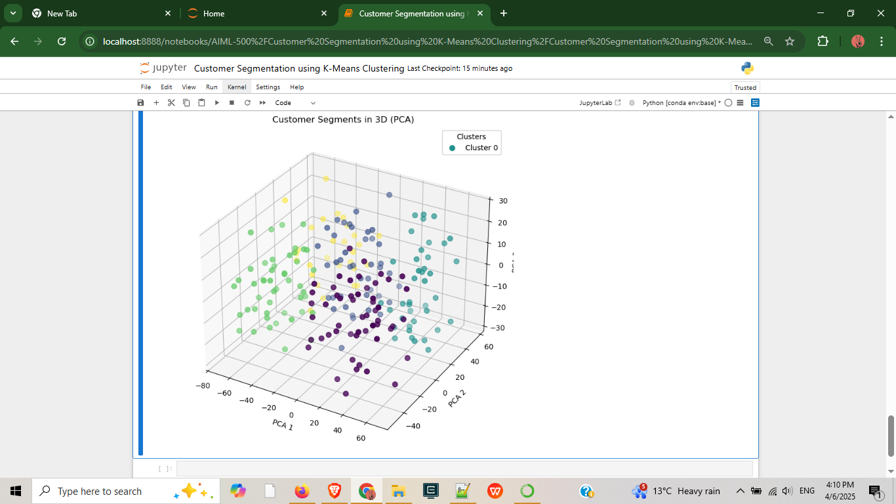

Slide 7
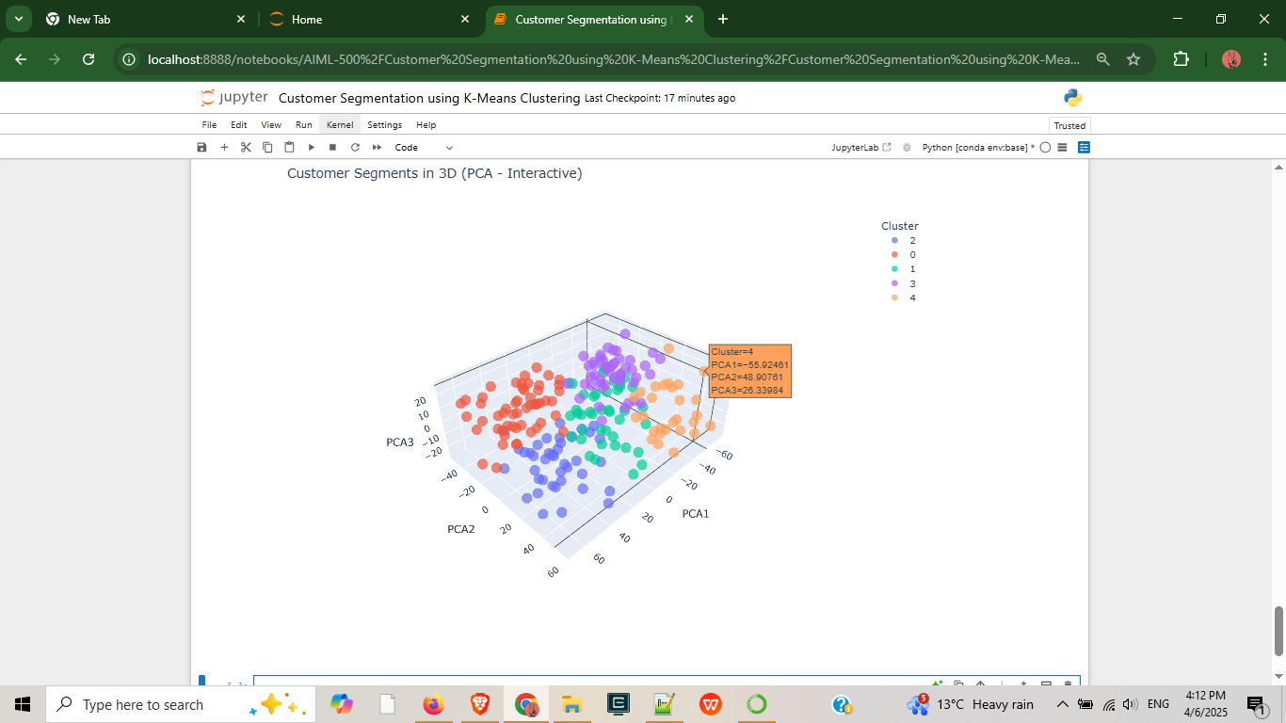

Slide 8
Insights & Clusters
Cluster 0: High income, low spending
Cluster 1: Moderate all-around
Cluster 2: High income, high spending
Cluster 3: Low income, low spending
Cluster 4: Low income, high spending

Slide 9
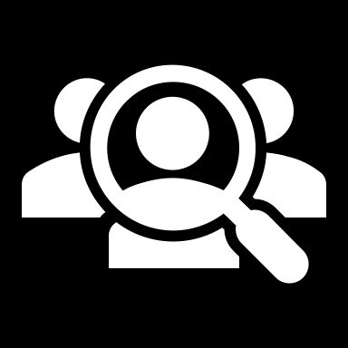
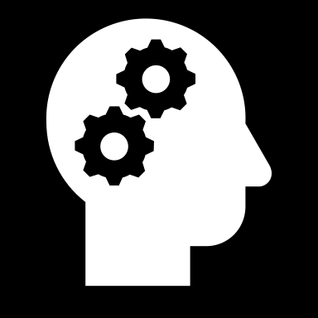
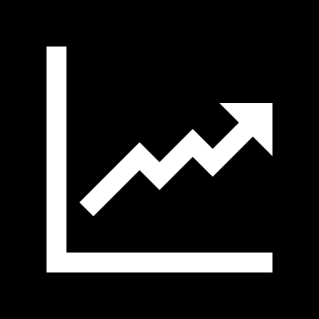
Value Proposition
IDENTIFY CUSTOMER SEGMENTS FOR PERSONALIZED MARKETING.
IMPROVE BUSINESS DECISIONS USING UNSUPERVISED ML.
ENHANCE CUSTOMER SATISFACTION AND INCREASE REVENUE.

Slide 10



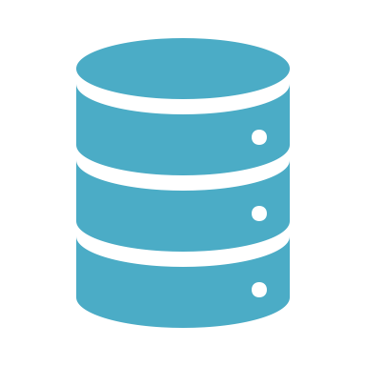
Tools/Resources Used
Jupyter Notebook
pandas, matplotlib, seaborn
scikit-learn, plotly
Synthetic Dataset

