Slide 1
Parkinson's Disease Detection using SVM
A Machine Learning Project using Support Vector Machine

Slide 2
Goal/Objective
To predict whether a person has Parkinson's disease using biomedical voice data. SVM does a best job in classification as it gives good accuracy on voice features and works well on high dimensional data.

Slide 3
Problem Definition
Classify individuals as having Parkinson's disease or not based on voice metrics.

Slide 4
Data Collection
Used publicly available Parkinson’s dataset (UCI Machine Learning Repository).
Dataset includes features like frequency related
jitter : variation in frequency,
shimmer : variation in amplitude
NHR : Noise-to-harmonics
HNR : Harmonics-to-noise.

Slide 5
Data Preprocessing
Removed missing values , imputed them using mean.
Standardized features using the StandardScaler.

Slide 6
Feature Engineering
Selected the relevant biomedical voice measurements.
No feature text extraction needed as the data is already numeric.

Slide 7
Model Selection and Training
Used Support Vector Machine (SVM) with a linear kernel.
Trained the model on 80% of the data.

Slide 8
Train-Test Split
Split the dataset into training and testing sets (80/20 split).
Ensured balanced data preprocessing for both sets.

Slide 9
Model Evaluation
Used accuracy, precision, recall and confusion matrix.
Accuracy achieved: ~79.5%
High recall for Parkinson’s class but low for Healthy class.

Slide 10
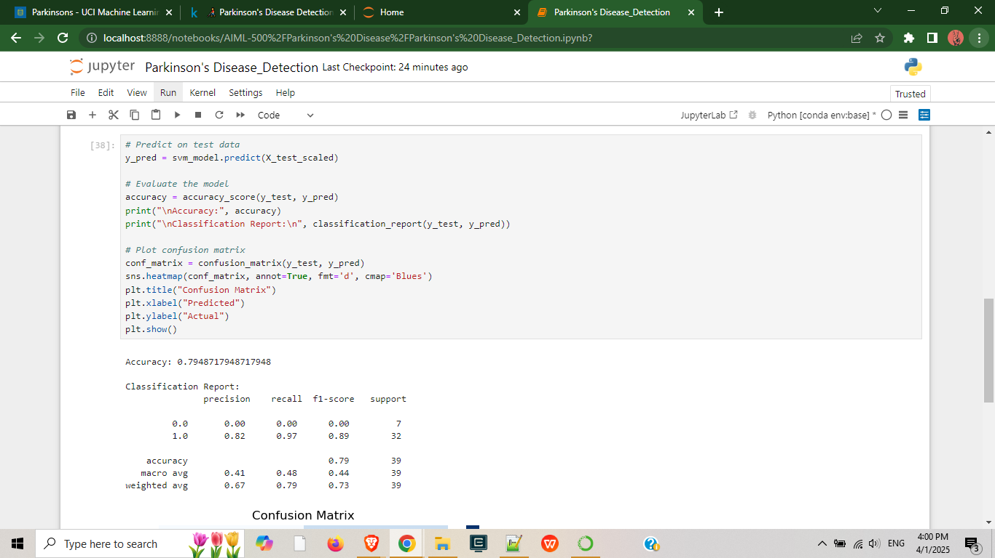

Slide 11
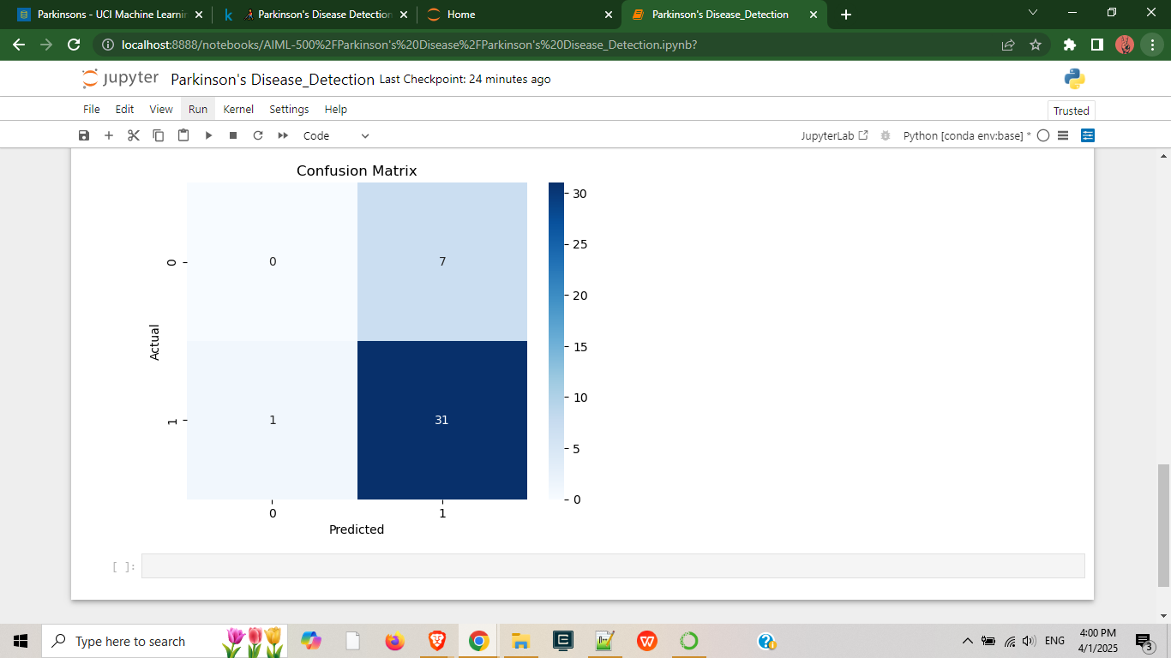

Slide 12
Results Interpretation
Model is good at detecting Parkinson's (recall ~97%).
Further improvement needed via rebalancing or tuning.

Slide 13
Tools/Resources Used
Jupyter Notebook
Python Libraries: pandas, scikit-learn, seaborn, matplotlib
UCI Parkinson’s Dataset

Slide 14
Value Proposition
A practical machine learning solution for early detection of Parkinson's disease.
Provides both the doctors and researchers with a voice-based diagnostic assistant.
Model can be extended with larger, more balanced datasets and clinical features.

