Slide 1
ONLINE COURSE RECOMENDATION SYSTEM
PYSPARK
KARNASSAGAR S (9517202109026)
CHANDRA PRAKASH C (9517202109251)

Slide 2
1.Abstract
Our project focuses on building a course recommendation system using collaborative filtering with Alternating Least Squares (ALS) in PySpark.
It leverages course-related data (from Udemy) to recommend top courses to users based on their preferences, such as the number of subscribers, course price, duration, and other relevant features.
The data is preprocessed, explored, and visualized to provide insights into course distributions and relationships between different features. Afterward, a recommendation system is implemented and trained, aiming to predict and suggest courses for users.
The model is evaluated using Root Mean Square Error (RMSE) to measure prediction accuracy, and top course recommendations are generated for each user.

Slide 3
2.Scope
Data Preprocessing:
Load and clean the dataset (handle missing values, null counts). Explore the data by analyzing course features such as level, price, duration, subject, and more. Visualize course trends like price distribution, subscribers per course, and correlations between numeric features.
Exploratory Data Analysis (EDA):
Perform visualizations to gain insights into the data (e.g., courses published per year, distribution by course level). Analyze the relationship between course prices, subscribers, and other metrics.
Recommendation System Development:
Implement collaborative filtering using the ALS algorithm from PySpark’s MLlib.
Generate user and course identifiers, and use course subscribers as proxy ratings for recommendations.
Train the ALS model and evaluate its performance using RMSE.
Provide top course recommendations for users based on their implicit ratings..

Slide 4
Scope cont..
Model Evaluation and Recommendations:
Evaluate the model's predictions using the test set and refine by filtering invalid predictions.Recommend top 5 courses for each user using the trained ALS model.
Deployment:
Save and load the trained ALS model for further use in generating real-time course recommendations.

Slide 5
3.Objective
The primary objective of our project is to build a recommendation system that provides personalized course recommendations to users based on their implicit behavior (number of subscribers acting as a proxy for user engagement). The system is aimed at increasing course discoverability and improving user satisfaction by suggesting relevant courses based on prior interactions. Specific goals include:
Data Exploration and Insights:
Extract meaningful patterns and trends in the course dataset.
Modeling User Preferences:
Implement collaborative filtering with the ALS algorithm to capture user preferences based on implicit feedback.
Model Performance:
Evaluate and optimize the model for accurate course recommendations.
Deployment:
Save and load models for future predictions, offering recommendations for users dynamically.

Slide 6
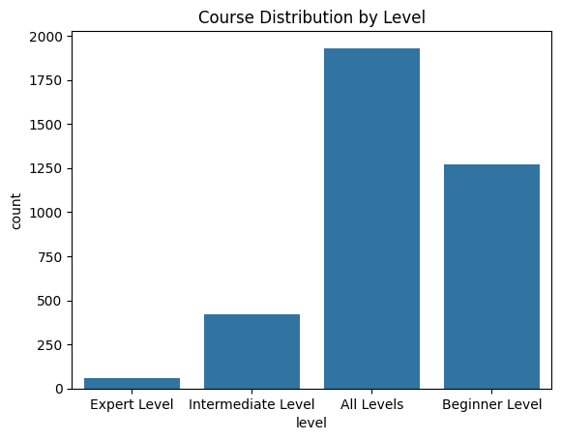
4.Output

Slide 7
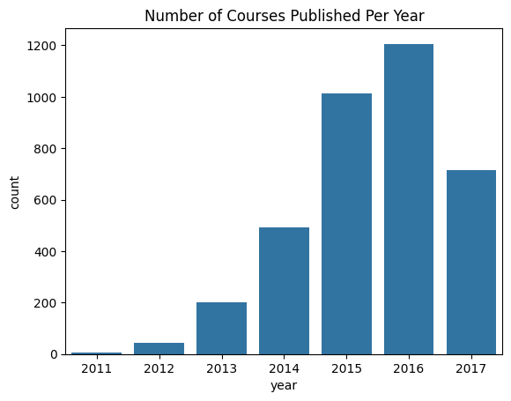
Plotting of courses Published per year

Slide 8
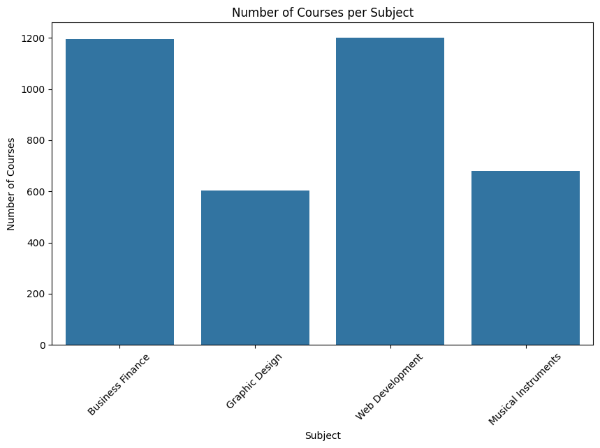
Plotting n.o of courses per subject

Slide 9
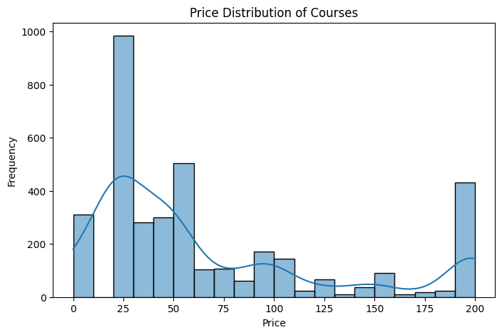
Histogram of price distribution of courses

Slide 10
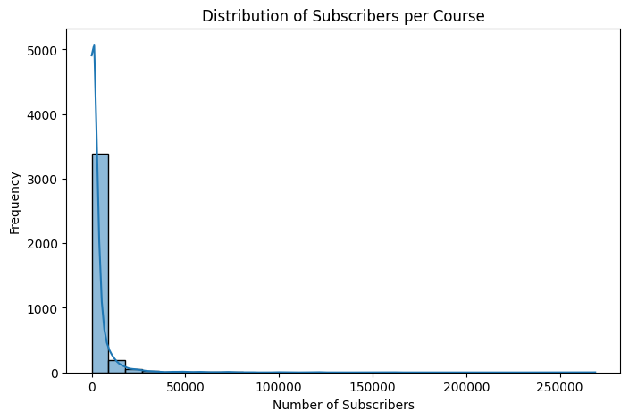
Distribution of subscribers per course

Slide 11
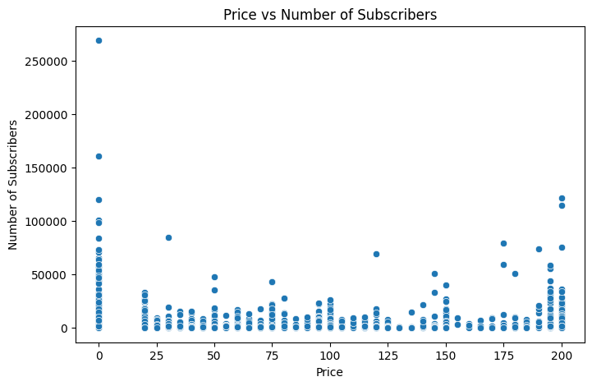
Plotting Price vs number of subscribers

Slide 12
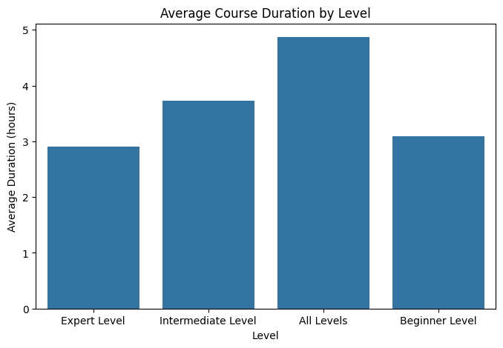
Average course duration by level

Slide 13
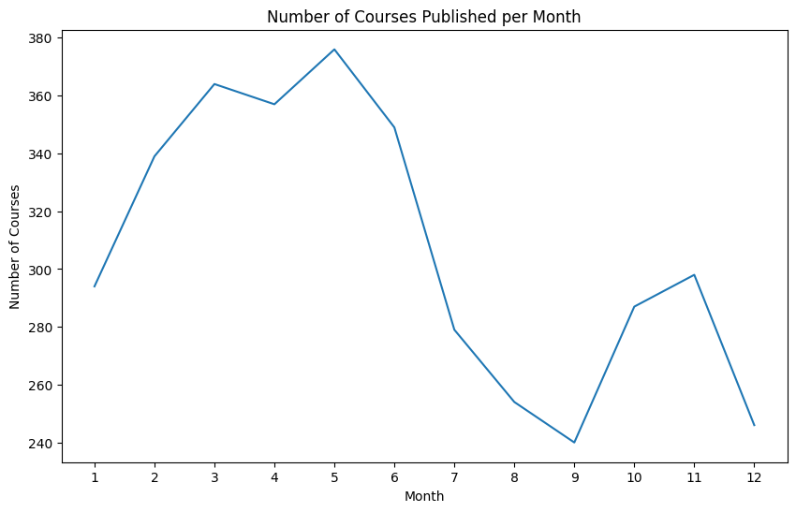
N.o Of courses published per month

Slide 14
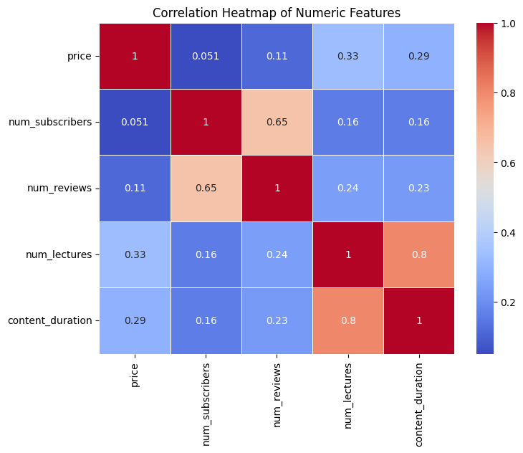
Heatmap correlation

Slide 15
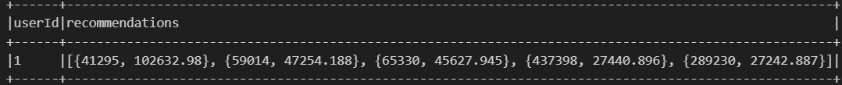
Recommendation

Slide 16
Conclusion
This project successfully developed and implemented a course recommendation system using the Alternating Least Squares (ALS) collaborative filtering algorithm in PySpark. The system was built upon a dataset of Udemy courses, which was extensively explored and analyzed through various visualizations and statistical insights. Key metrics such as the number of subscribers, price, course level, and content duration were examined to understand user preferences and course popularity trends.The project successfully achieved its objective of developing a scalable course recommendation system that can be deployed to assist users in discovering relevant courses based on implicit preferences.

