Slide 1
Next Hike Project -03
Project By - Chandra Sekhar Mahanta

Slide 2
Introduction
Objective :
This Project is main Aim objective data process Visualize, and Feature Engineering
Mention data sheet used and their relevence

Slide 3
Work flow
Step By Step guide
✔ Step 01: Loaded and Inspected The Dataset. ✔ Step 02: Cleaned Missing Values. ✔ Step 03: Univariate Analysis Showed. ✔ Step 04: Multivariate Analysis Showed. ✔ Step 05: Feature Engineering. ✔ Step 06: Feature Engineering and Size Impact. ✔ Step 07: Market Trends and Historical Pricing.
✔ Step 08: Customer Preferences and Amenities.

Slide 4
Data Sheet Preprocessing: Refining the Data
Data Loading
Feature Engineering
Normalization/Scaling
Explore using .head(), .tail(), .describe(), .duplicates(), handling missing data, date manipulation, outlier detection, and dropping irrelevant columns
Extract relevant features from the data
Transform features to a common scale

Slide 5
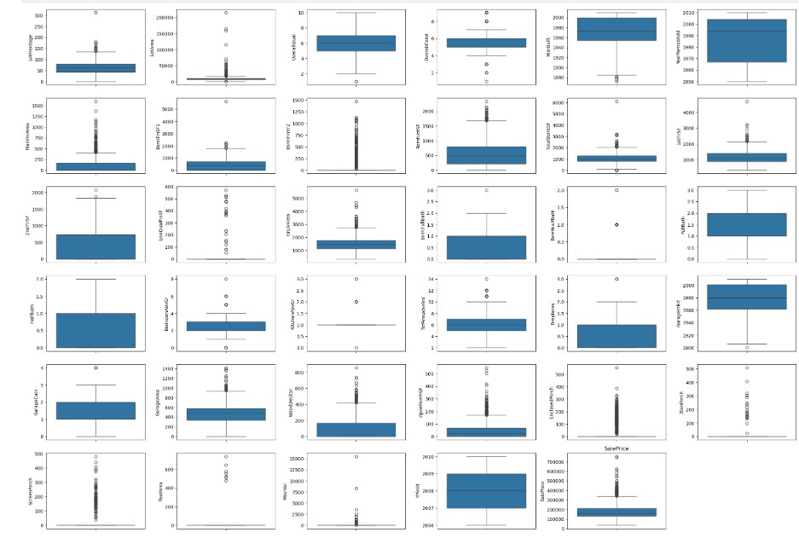
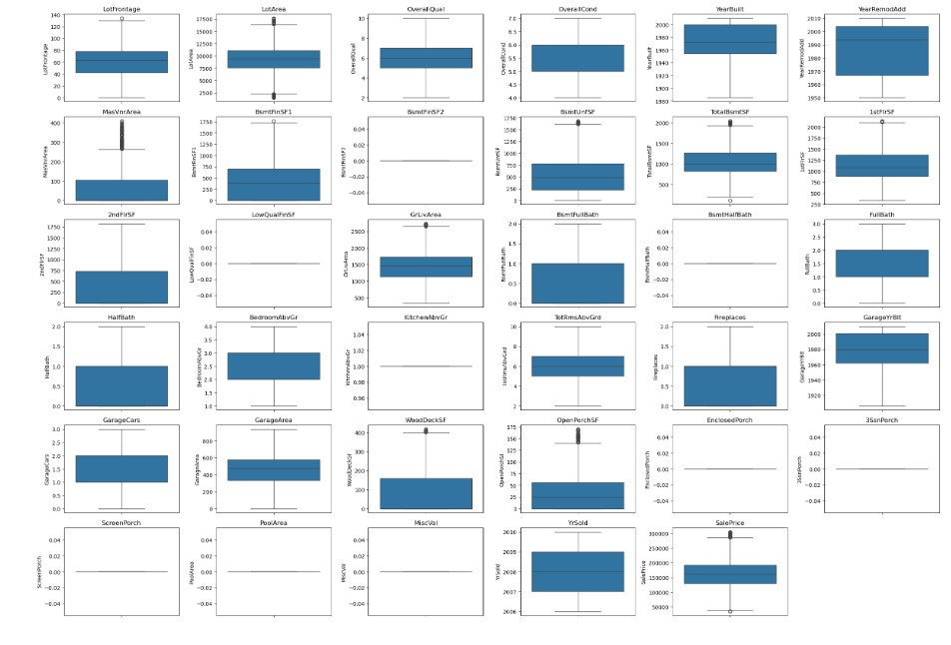
PERFERMING THE EDA ON DATA SHEET
Before Handling Outliers
After Handling Outliers
After handle Checking outlier with visualize with using box plot all numeric columns
Checking outlier with visualize with using box plot all numeric columns

Slide 6
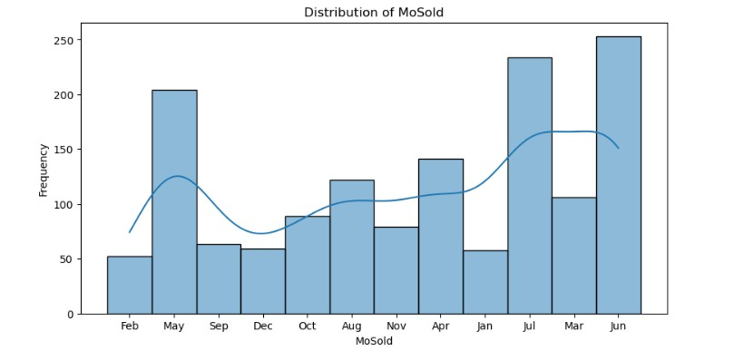
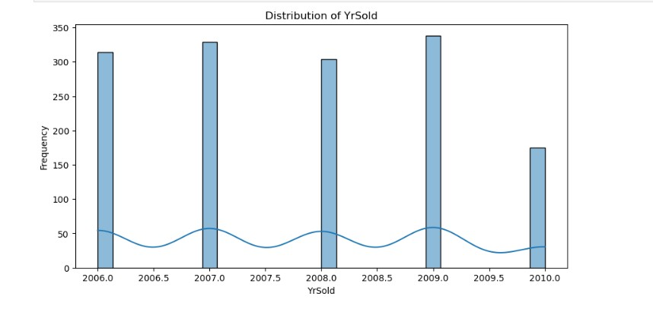
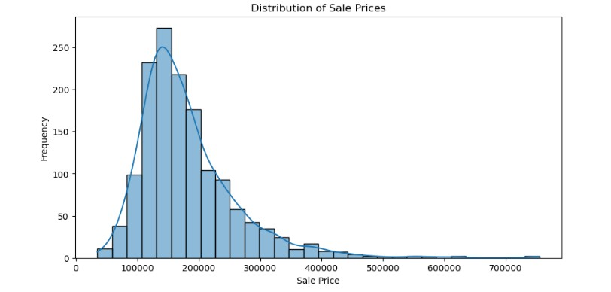
Univariate Analysis
1- Represents different house sale prices, ranging from approximately 0 to 700,000.
2-Show the distribution of sale prices, with the majority of houses priced between 100,000 and 250,000.
3-The distribution is right-skewed (positively skewed), meaning most houses are at the lower price range, with fewer high-priced properties
1- Represents the months in which properties were sold (e.g., Feb, May, Sep, etc.).
2- This Bar Show the frequency of sales for each month.
3- The highest number of sales occurred in May, June, and July, indicating peak selling seasons. Sales are lower in February and December.
1- Show the frequency of sales per year.
2- The highest number of sales occurred in 2006, 2007, 2008, and 2009, with nearly equal distribution.
3- Sales in 2010 are noticeably lower compared to the previous years.

Slide 7
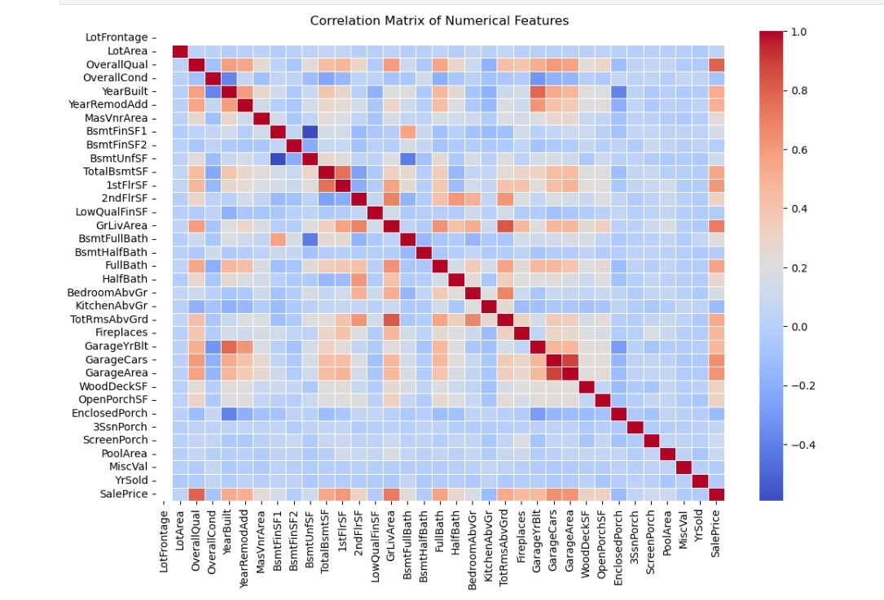
Multivariate Analysis
1- Red (Closer to 1): Strong positive correlation between features.
2- Blue (Closer to -1): Strong negative correlation between features.
3- White/Light Colors (Near 0): Little to no correlation
4- Features like GarageCars, GarageArea, TotalBsmtSF, and GrLivArea show high correlation with SalePrice, meaning they strongly influence property prices.
5- YearBuilt and YearRemodAdd are positively correlated, indicating homes built recently have undergone more renovations.
6- GarageCars and GarageArea have a strong positive correlation, meaning larger garages accommodate more cars.
7- Some features have negative correlations, implying inverse relationships.

Slide 8
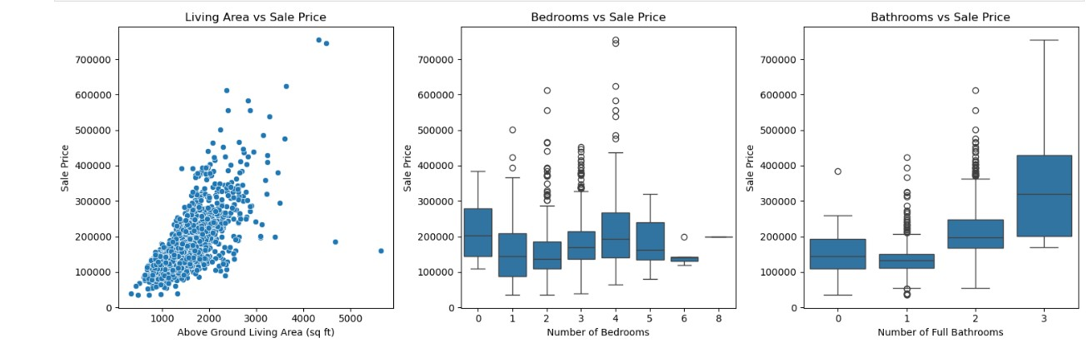
Feature Engineering
Bathrooms vs. Sale Price (Middle - Box Plot)
1- Bathrooms have a stronger impact on price than bedrooms, but less than living area.
2- Multiple outliers suggest additional features like location, lot size, and overall quality may influence sale prices.
Living Area vs. Sale Price (Left - Scatter Plot)
1- Shows a positive correlation between the above-ground living area (sq ft) and the sale price.
2- Larger living areas generally result in higher sale prices, though there are some outliers.
3- The trend suggests that larger homes tend to be more expensive.
Bedrooms vs. Sale Price (Middle - Box Plot)
1- Represents the distribution of sale prices across different bedroom counts.
2- The median sale price does not increase significantly with the number of bedrooms.
3- A large number of outliers, indicating that some homes with fewer bedrooms still have very high prices.

Slide 9
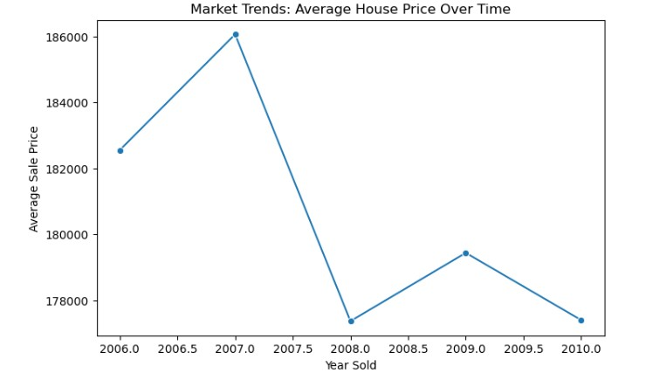
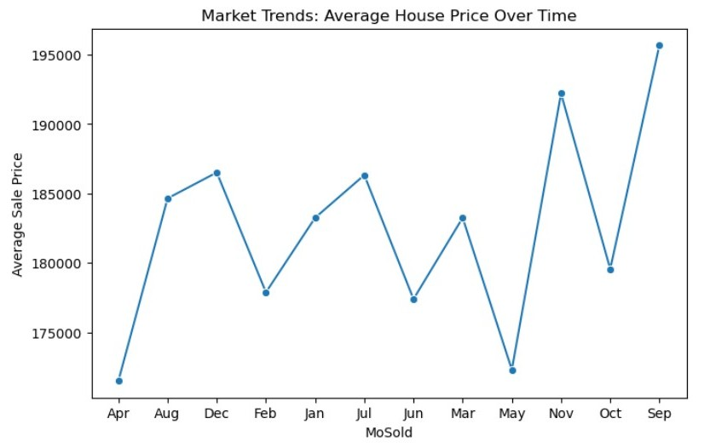
Market Trends and Historical Pricing
1- The average sale price increased from 2006 to 2007, reaching its peak in 2007 (~$186,000).
2- After 2007, there was a sharp decline in 2008, likely due to the global financial crisis (2008 housing market crash).
3- A slight recovery is visible in 2009, where prices increased again.
4- However, in 2010, the decline continued, showing that the market had not fully recovered.
1- The house prices fluctuate throughout the year, indicating seasonal variations in the housing market.
2- Lowest prices are observed in April and May, suggesting a potential dip in demand during these months.
3- Highest prices occur in September and November, which might indicate peak demand seasons.

Slide 10
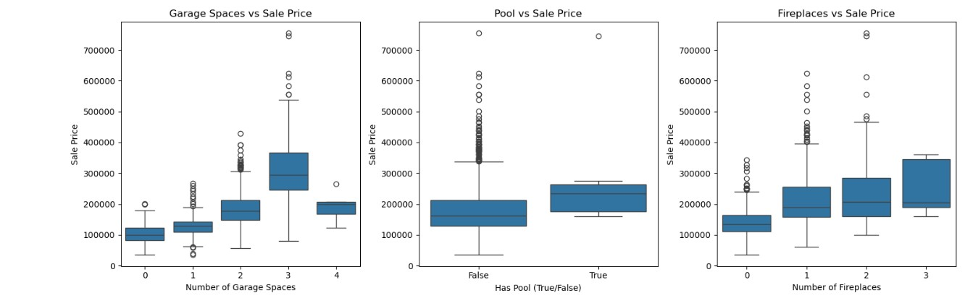
Customer Preferences and Amenities
Garage Spaces vs Sale Price:
1- Houses with more garage spaces tend to have higher sale prices.
2- There is a clear increasing trend in sale price as the number of garage spaces increases.
Pool vs Sale Price:
1- Houses with a pool generally have higher sale prices compared to those without a pool.
2- However, the number of houses with a pool appears to be fewer, as indicated by a smaller box.
Fireplaces vs Sale Price:
1- Houses with more fireplaces tend to have higher sale prices.
2- Sale price variation increases as the number of fireplaces increases, indicating a wider range of home values.

Slide 11
Future Scope: Leveraging Data for Growth
Predictive Analytics
Demand Optimization
Forecast bike rental demand based on weather and time
Optimize bike availability in high-demand areas
Real-Time Monitoring
Environmental Benefits
Implement dashboards for tracking rentals and weather conditions
Assess the impact of bike rentals on reducing carbon emissions

Slide 12
Preprocessing and Feature Engineering : A Recap
1
Processed Data
2
Visualization
Ready for comprehensive analysis
Revealed insights about seasonality, hourly trends, and overall demand
3
Key Values
Understanding user behavior and optimizing for efficiency

Slide 13
THANK YOU

