Slide 1
Modules and packages in Python

Slide 2
Python Modules
Python modules are the files containing Python statements and definitions.
Modules in Python are with a .py extension.
The name of the module will be the name of the file.
A Python module can have a set of functions, classes or variables defined and implemented.
We use modules to break down large programs into small manageable and organized files.
Furthermore, modules provide reusability of code.
We can define our most used functions in a module and import it, instead of copying their definitions into different programs.
We can import a module using the “import” statement and access the definitions inside it.

Slide 3
Python Packages
Packages are the way of structuring the python modules.
As our application program grows larger in size with a lot of modules, we place similar modules in one package and different modules in different packages.
A package is basically a directory with Python files and a file with the name __init__.py.
This makes a project easy to manage and conceptually clear.
A directory can contain subdirectories and files, a Python package can have sub-packages and modules.
For python version older than 3.3 a directory must contain a file named __init__.py in order for Python to consider it as a package.
We can import modules from packages using the dot (.) operator.

Slide 4
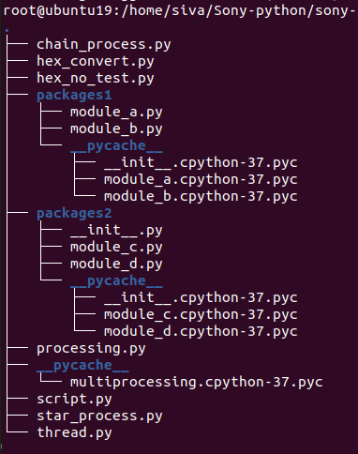
Example Python Directory structure
The package may or may not contain the __init__.py file on the package after the python version 3.3.
But when we import any python package on the script.py at initially it will execute the __inti__.py file on the package directory.
So if we have imported any modules on __init__.py file then again it is not necessary to insert on the script.py instead we can import only package.
Usually packages are the collection of python scripts or modules.
When we execute the python modules it will create the __pycache__ directory on the same location of the module. It will save the compiled version of the python module what we have executed with the extension of .pyc
Python modules and packages will increase the code reusability.

Slide 5
Conclusion
Python __init__.py on the package directory will be executed at initial when we import the package.
So common operation for all the modules on particular package we can write on this __init__.py file.
Before python version 3.3 it is compulsory to have the __init__.py file on the python package directory.
The python package and module concepts will increase the code reusability.
The python packages may have the sub packages directory, But the same sub packages directory also may have the __init__.py file. These sub packages are called by using the dot (.) operator.

