Slide 1
Customer Segmentation using Unsupervised Learning
Chandra Hass Paladugula
Nikhilesh Chintala
Srinivas Galla
Vamsi Krishna Meka

Slide 2
Project Objective:
Perform unsupervised clustering on mall customers to identify meaningful segments.
Enable data-driven marketing decisions based on customer profiles.
Data Set Overview:
Source: Mall_Customers.csv
200 records, 5 columns: CustomerID, Gender, Age, Annual Income, Spending Score
Target: Segment customers using Age, Income, and Spending Score
Additional Dataset tested: https://www.kaggle.com/datasets/zubairmustafa/shopping-mall-customer-segmentation-data?resource=download

Slide 3
Data Processing Steps:
Loaded and inspected dataset using pandas.
Handled duplicates and missing values (none present).
Standardized numerical features using StandardScaler.
Exploratory Data Analysis (EDA):
Visualized distributions for Age, Income, and Spending Score.
Created scatter plots by Gender.
Correlation heatmaps revealed spending is weakly correlated with age and income.

Slide 4
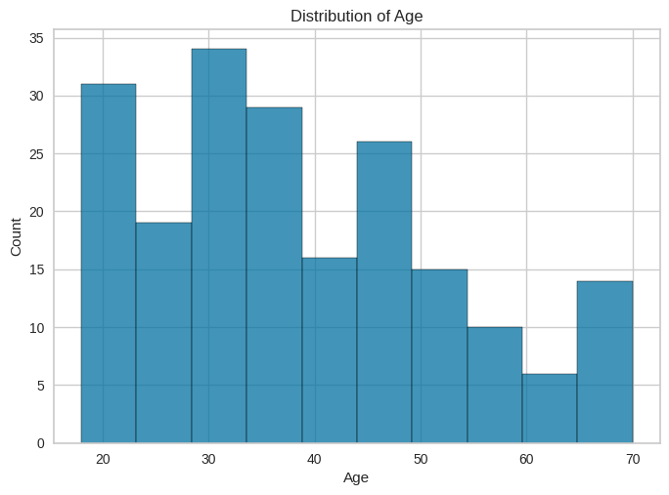
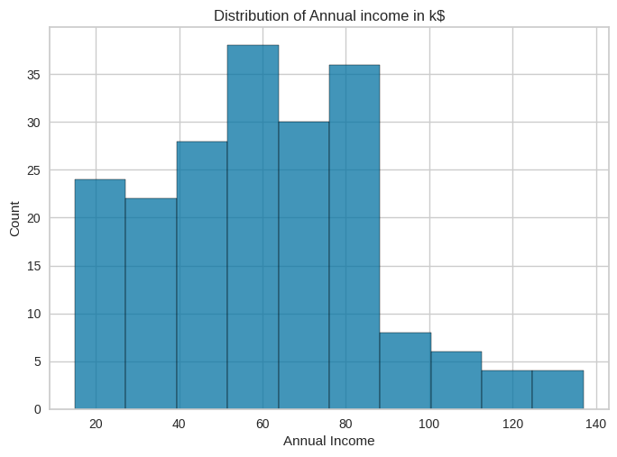
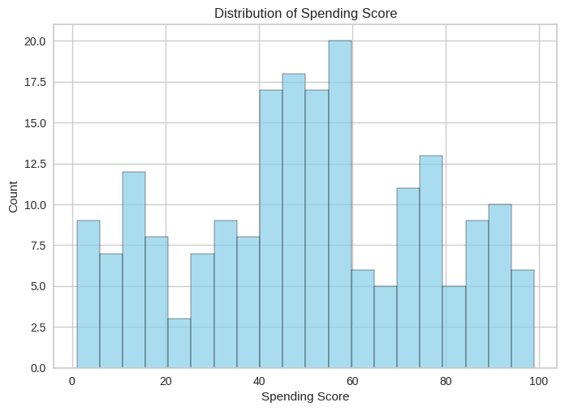
Histogram Plots for Distrubtion of Age,Annual Income and Spending score

Slide 5
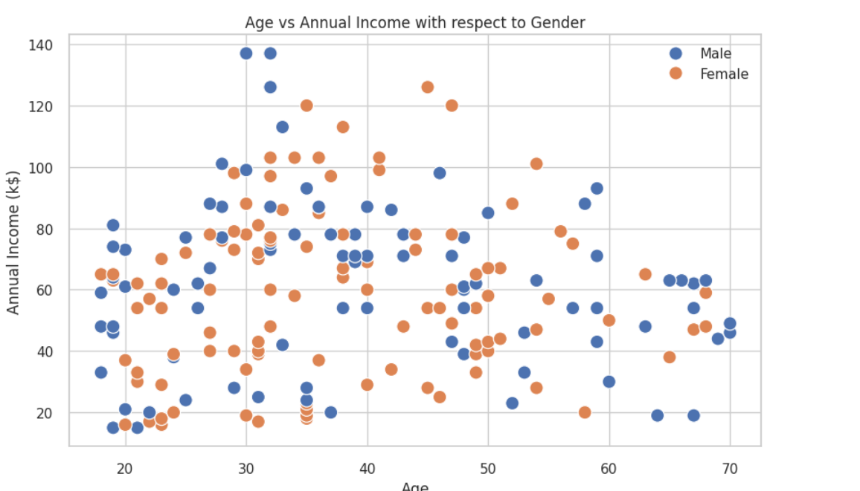
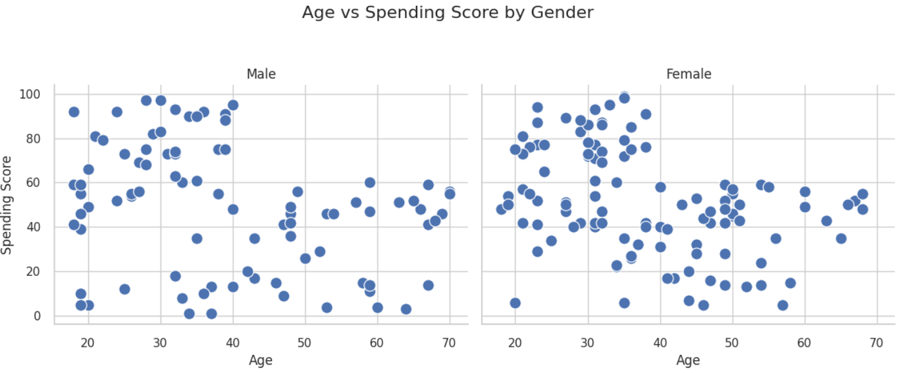
Scatter Plot for Age vs Annual Income and Spending Score

Slide 6
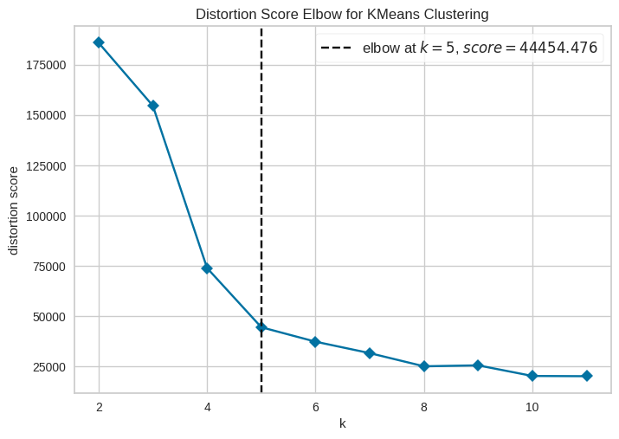
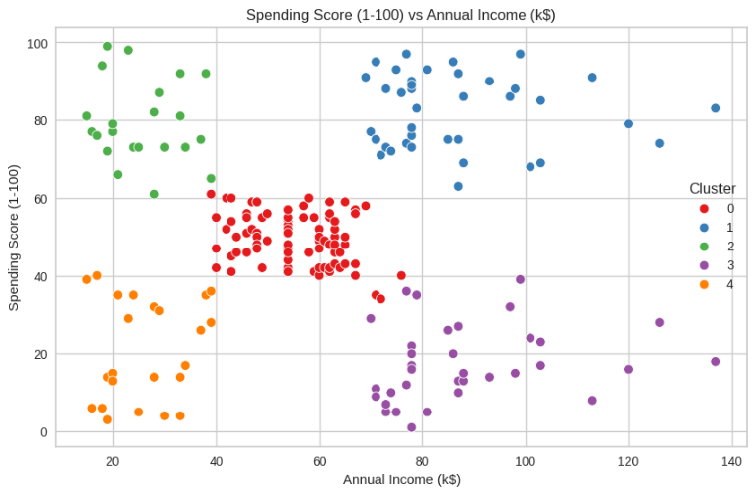
K-Means Clustering
The optimal number of clusters (K) was determined using the Elbow Method. The Elbow Method helps identify the point where adding more clusters does not significantly reduce the within-cluster variance.
Fig1: Elbow Method Plot for K-Means Clustering. Fig 2: K-Means Clustering Scatter Plot.

Slide 7
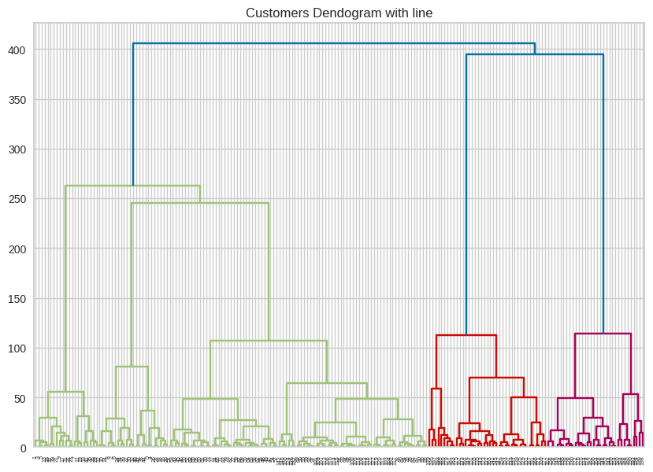
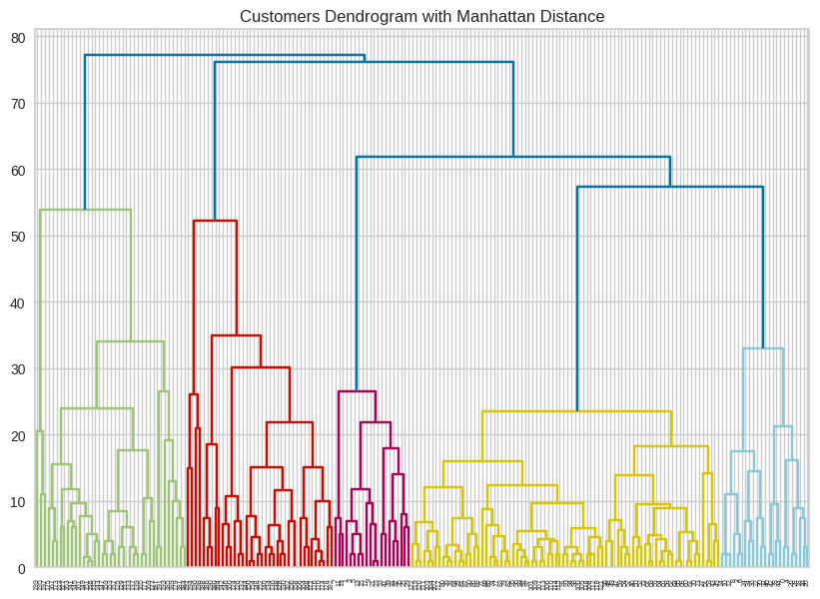
Hierarchical Clustering
Dendrograms were generated using various linkage methods.
Dendrogram (Ward Linkage, Euclidean Distance). Dendrogram (Average Linkage, Manhattan Distance).

Slide 8
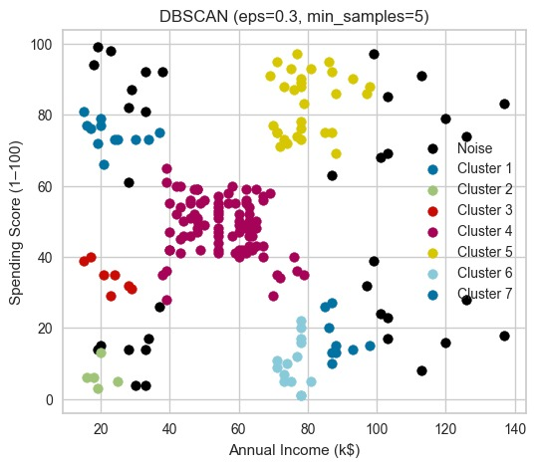
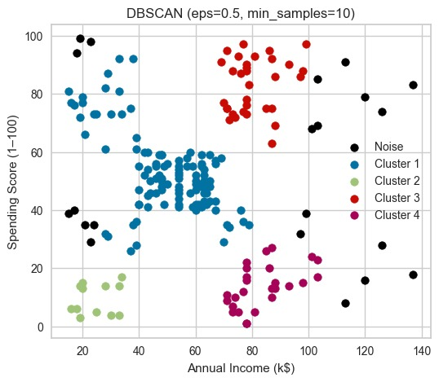
DBSCAN Clustering
DBSCAN detected clusters of varying shapes and identified outliers. The clustering is done using hyper-parameters eps and min_samples.
DBSCAN Scatter Plot with Clusters and Outliers.

Slide 9
THANK YOU

