Slide 1
Udyog Saarthi App
CSE7101- Capstone Project
Review-1
Batch Number:ISE-13
Under the Supervision of:
Ms .Smitha S P
Assistant Professor
School of Computer Science and Engineering
Presidency University
Roll Number | Student Name
20221ISE0088 | Pruthvi BS
20221ISE0117 | Ganavi HR
20221ISE0135 | Chandrakala KT
Name of the Program: Btech Information science and engineering
Name of the HoD: Dr.Zafar Ali Khan N
Name of the Program Project Coordinator: Ms. Suma NG
Name of the School Project Coordinators: Dr. Sampath A K , Dr. Geetha A

Slide 2
Problem Statement Number: PSCS_39
Organization: Ministry of Social Justice & Empowerment.
Category :Software
Problem Description:
Persons with Disabilities (PwDs), especially under categories D & E (Intellectual Disability, Autism Spectrum Disorder, Multiple Disabilities, Mental Illness, Specific Learning Disabilities), face challenges in accessing job notifications, awareness of 4% job reservation, and coaching opportunities. Lack of curated, accessible content and low literacy among parents further limits their employability, leading to unemployment for nearly 64% of PwDs in India.

Slide 3
Problem Statement:
Despite progress in accessibility and skill development, 64% of Persons with Disabilities (PwDs) in India remain unemployed. Particularly those under D & E categories (Intellectual Disability, Autism, Multiple Disabilities, Mental Illness, Specific Learning Disabilities) struggle due to lack of awareness, inaccessible job notifications, and low parental literacy.
This leads to missed opportunities under the 4% reservation, preventing PwDs from securing dignified jobs and limiting their inclusion in society. There is a strong need for a centralized, accessible platform that bridges the gap between job opportunities, coaching support, and awareness.

Slide 4
Objective:
To build a Progressive Web App that provides accessible job notifications for PwDs.
To offer coaching and training resources in simple, disability-friendly formats.
To assist PwDs in applying for jobs through guided steps.
To spread awareness among parents/guardians.
To increase employability and promote inclusion of PwDs in society.

Slide 5
Background and Related Work:
Existing portals (Naukri, Employment News) are not disability-friendly.
PwDs lack awareness about government job reservations.
Accessibility features like text-to-speech and high contrast are rarely integrated in job apps.
Related apps focus more on education or accessibility tools, not job coaching.
Thus, there is a gap for an employment-focused, accessible PWA for PwDs.

Slide 6
Analysis of Problem Statement:
Issues: Inaccessibility, lack of awareness, missed opportunities, low parental literacy.
Impact: 64% of PwDs remain unemployed.
Need: A centralized, accessible platform for jobs, training, and guidance aligned with RPwD Act 2016.

Slide 7
Innovation / Novel Contributions:
Curated job notifications in simplified language.
Accessibility features: Large font, high contrast.
Progressive Web App (PWA) with offline support.
Integration with coaching/training directories.

Slide 8
Github Link
GitHub Link:
https://github.com/ISE-13/Udyog-Saarthi-.git

Slide 9
Software & Hardware Requirements:
Software:
Backend: Node.js , JavaScript
Frontend: HTML, CSS, Angular+Bootstrap if required
API’s(Job listing APIs)
GitHub
Authentication: Secure login with JWT or OAuth.
Accessibility Tools: ARIA labels, screen reader support.
Hardware:
Standard Laptop/PC (8GB RAM, 256GB HDD, Windows/Linux)

Slide 10
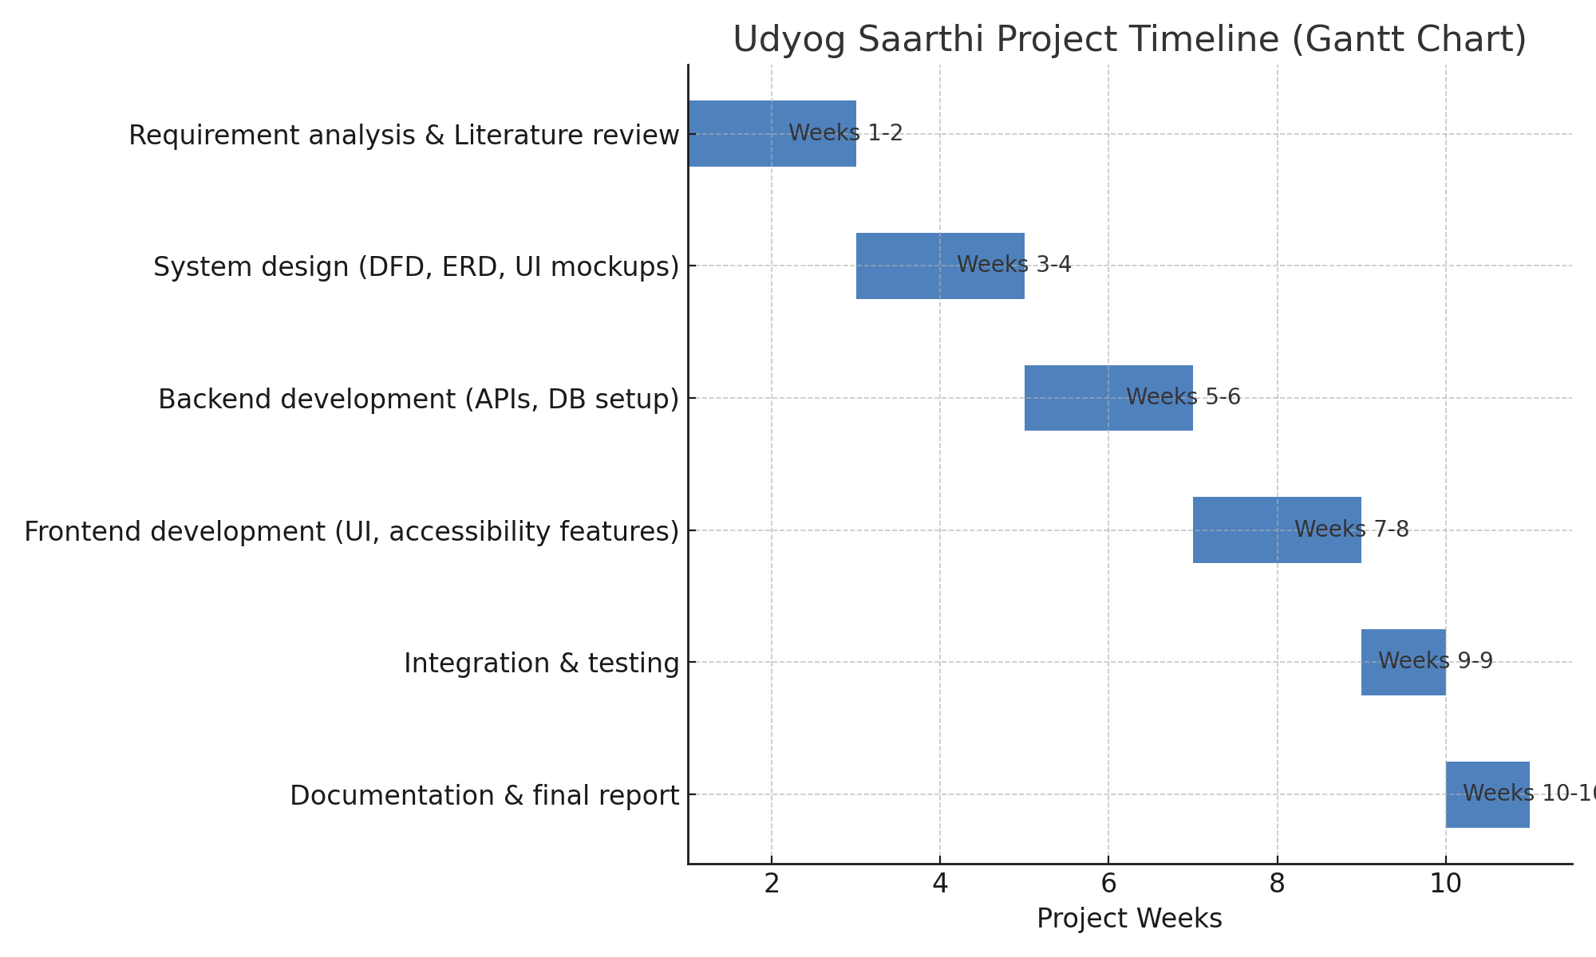
Timeline (Gantt Chart)
Week 1-2: Requirement analysis & Literature review
Week 3-4: System design (DFD, ERD, UI mockups)
Week 5-6: Backend development (APIs, DB setup)
Week 7-8: Frontend development (UI, accessibility features)
Week 9: Integration & testing
Week 10: Documentation & final report

Slide 11
References (IEEE format):
Ministry of Statistics, “Persons with Disabilities Report,” Govt. of India, 2021.
Ministry of Social Justice and Empowerment, “Rights of Persons with Disabilities Act (RPwD),” 2016.
United Nations, “Sustainable Development Goals,” 2015.
W3C, “Web Content Accessibility Guidelines (WCAG) 2.1,” 2018.

Slide 12


