Slide 1
jdbc

Slide 2
Content:
➢ Basic on JDBC
➢ Understand the API
➢ JDBC architecture
➢ JDBC Driver
➢ Installation of DB server and DB Client
➢ JDBC steps
➢ Different types of statements
➢ Prepared statements
➢ Callable statements
➢ Stored procedure
➢ ResultSet
➢ JDBC transaction
➢ Batch updates
➢ SavePoint
➢ Metadata
➢ Types of metadata

Slide 3
Basic on JDBC
What is JDBC?
JDBC stands for Java Database Connectivity, which is a standard Java API for database-independent connectivity between the Java programming language and a wide range of databases.
Why use JDBC?
Before JDBC, ODBC API was the database API to connect and execute query with the database. But, ODBC API uses ODBC driver which is written in C language (i.e. platform dependent and unsecured). That is why Java has defined its own API (JDBC API) that uses JDBC drivers (written in Java language).
The JDBC library includes APIs for each of the tasks mentioned below that are commonly associated with database usage.
Making a connection to a database.
Creating SQL or MySQL statements.
Executing SQL or MySQL queries in the database.
Viewing & Modifying the resulting records.
Where use JDBC?
Java can be used to write different types of executables, such as −
Java Applications
Java Servlets
Java ServerPages (JSPs)
All of these different executables are able to use a JDBC driver to access a database, and take advantage of the stored data.

Slide 4
Server and Client Software
DB Server name:
Oracle
My-sql
Derby
Note: There should be client software which should be installed in client machine to access the server. Example of DB server My-SQL and client software is SQL-Yog.
services.msc in run command to see running services.
Web Server:
Apache-Tomcat
JBoss
WebLogic
WebSpere
Client Software:
Web-client Software:(browser)
DB client Software : i) SQL-yog ii) Toad iii) Sqirrel
Mobile client Software:(WhatsApp or any application that is use sqlite DB)

Slide 5
API (Application Programing Interface):
What is API?
API (Application programming interface) is a document that contains description of all the features of a product or software. It represents classes and interfaces that software programs can follow to communicate with each other. An API can be created for applications, libraries, operating systems, etc
JDBC is an API which gives many data services using which we can communicate to any of the database server in a loosely coupled manner.
JDBC is an Java base API it’s all in the form of jar file
An API may have many services or implementations which are exposing to the consumers throw interfaces.
Java program can access the data services expose by JDBC API through Interface and Helper classes
JDBC API contents many interfaces and helper classes which has distributed into two packages
1) Java.sql and 2) javax.sql
Most of the features of JDBC are present in the java.sql and few are in javax.sql.

Slide 6
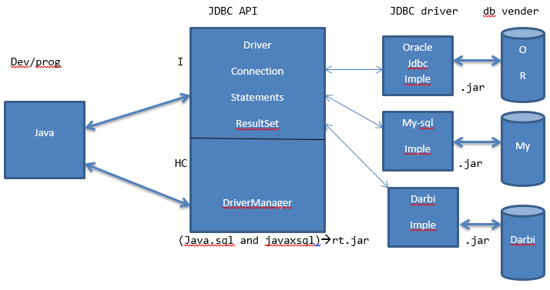
JDBC Architecture

Slide 7
JDBC Driver
What is JDBC Driver?
JDBC Driver is a software component that enables java application to interact with the database.
JDBC drivers implement the defined interfaces in the JDBC API, for interacting with your database server.
For example, using JDBC drivers enable you to open database connections and to interact with it by sending SQL or database commands then receiving results with Java.
JDBC driver is given by different DB (Data Base) Vendors and it is specific to the database server that is every database has its own JDBC driver.
JDBC driver are given in the form of jar file.
Driver classes by Venders:
Oracle:→oracle jdbc.driver.OracleDriver
My-SQL:→com.mysql.jdbc.Driver
Derby:→org.apache.derby.jdbc.EmbadedDriver
MS-SQL Server:→com.mycrosoft.sqlserver.jdbc.SqlServerDriver
There are 4 types of JDBC drivers:
1. JDBC-ODBC bridge driver
2. Native-API driver (partially java driver)
3. Network Protocol driver (fully java driver)
4. Thin driver (fully java driver)
Important Note:
To write JDBC program we need both JDBC API as well as driver.

Slide 8
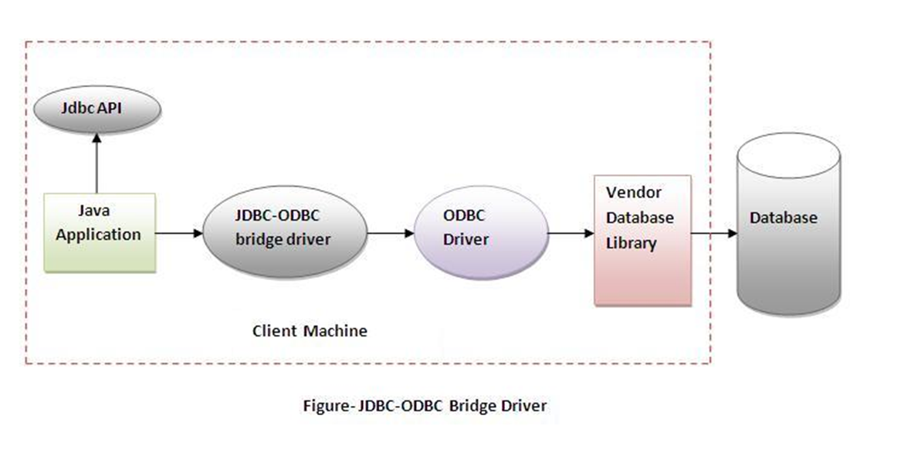
1) JDBC-ODBC bridge driver
The JDBC-ODBC bridge driver uses ODBC driver to connect to the database. The JDBC-ODBC bridge driver converts JDBC method calls into the ODBC function calls. This is now discouraged because of thin driver.
Advantages:
easy to use.
can be easily connected to any database.
Disadvantages:
Performance degraded because JDBC method call is converted into the ODBC function calls.
The ODBC driver needs to be installed on the client machine.

Slide 9
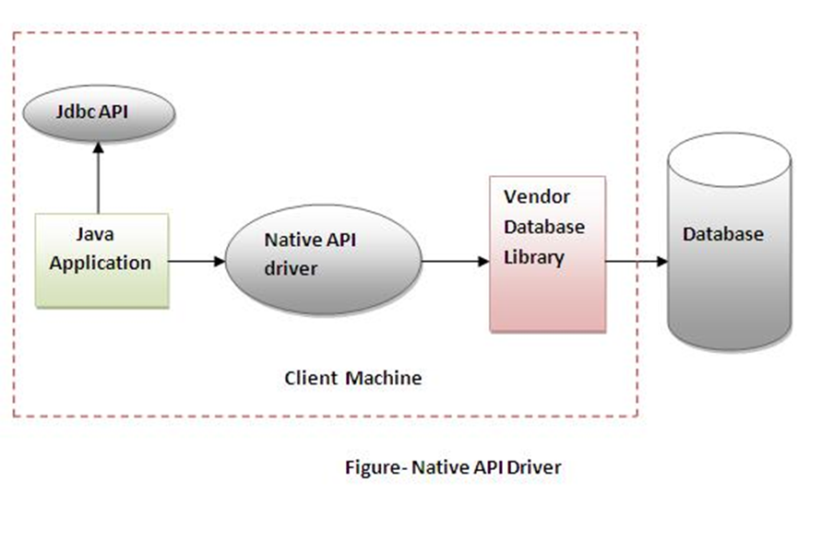
2) Native-API driver
The Native API driver uses the client-side libraries of the database. The driver converts JDBC method calls into native calls of the database API. It is not written entirely in java.
Advantages:
• performance upgraded than JDBC-ODBC bridge driver.
Disadvantages:
• The Native driver needs to be installed on the each client machine.
• The Vendor client library needs to be installed on client machine.

Slide 10
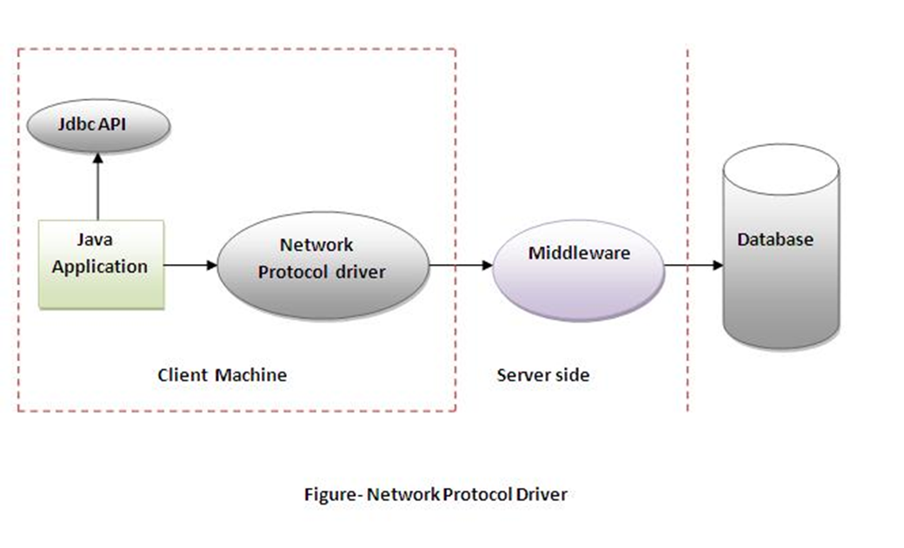
3) Network Protocol driver
The Network Protocol driver uses middleware (application server) that converts JDBC calls directly or indirectly into the vendor-specific database protocol. It is fully written in java.
Advantages:
• No client side library is required because of application server that can perform many tasks like auditing, load balancing, logging etc.
Disadvantages:
• Network support is required on client machine.
• Requires database-specific coding to be done in the middle tier.
• Maintenance of Network Protocol driver becomes costly because it requires database-specific coding to be done in the middle tier.

Slide 11
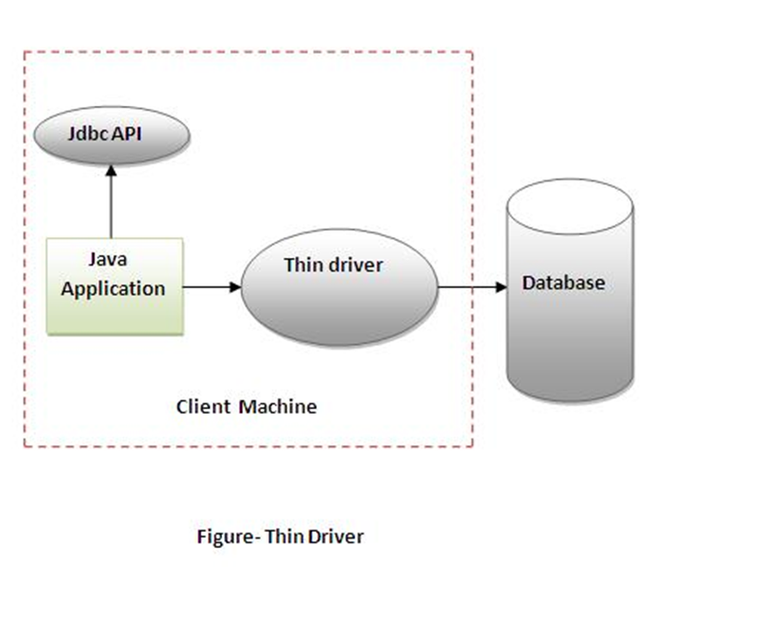
4) Thin driver
The thin driver converts JDBC calls directly into the vendor-specific database protocol. That is why it is known as thin driver. It is fully written in Java language.
Advantages:
• Better performance than all other drivers.
• No software is required at client side or server side.
Disadvantages:
• Drivers depends on the Database.

Slide 12
JDBC steps
There are 5 steps to connect any java application with the database in java using JDBC. They are as follows:
1) Load and register driver
2) Establish the connection with DB server
3) Create the platform /statement
4) Execute SQL statement/query
5) Process the resulted data (optional)
6) Close all JDBC resources.

Slide 13
1) Load and Register Driver
Before performing any DB operation with the DB server, it is important to load and register the driver
The driver object must be register with DriverManager using a static method.
public static void registerDriver(pass the object of Driver Class)
There are two ways of loading and register the driver:
Creating an object of driver class and registering the object with DriverManager.
Ex, Oracle:
OracleDriver od=new Oracle();
DriverManager.registerDriver(od);
This type of code creates tight coupling, between java program and database server, hence we need to use another way i.e. by using Class.forName().
2) The forName() method of Class class is used to register the driver class. This method is used to dynamically load the driver class.
Ex, Oracle:
Class.forName(“oracle.jdbc.driver.OracleDriver”);
Ex, My-SQL:
Class.forName(“com.mysql.jdbc.Driver”);
Ex, My-SQL:
Driver d=new Driver();
DriverManager.registerDriver(d);

Slide 15
JDBC Specification:
Steps for specification (to be followed by venders)
Driver class (implementation class) should implement java.sql.Driver interface for My-SQL and oracleDriver for Oracle.
Inside this implementation class there should be a static block. (Loaded only once as classes is loaded only time).
This class object should be registered inside DriverManager class using register Driver Method and an object of same class should be passed.
Fully qualified class name of driver is com.mysql.jdbc.Driver example of My-SQL.
Example of 1st way Loading and Registering the Driver of My-SQL:
public class Driver implements java.sql.Driver{
static{
Driver d=new Driver();
DriverManager.registerDriver(d);}
}

Slide 16
2) Establish the connection with DB server
After loading and registering the driver manager , we can established the connection
getConnation is a static method which is present java.sql.DriverManager class which helps to establish the connection.
The getConnection() method takes string url and based on the url its connection to an appropriate server.
If the url is wrong then method throws SQLException
getConnection() is pure implementation of factory design patter
There are 3 overloaded getConnection() method:
public static Connection getConnection(“url”); throws SQLExceptoin Ex, getConnection(“jdbc:mysql://localhost:3606?user=root&password=dinga”);
public static Connection getConnection(String url, String username, String passwrd); throws SQLExceptoin Ex, getConnection(“jdbc:mysql://localhost:3606”,”root” ,”dinga”);
public static Connection getConnection(String url, Properties props); throws SQLExceptoin Ex, Properties props=new Properties(); FileReader fr=new FileReaer(“dbconfig.properties”); props.load(fr); getConnection(jdbc:mysql://localhost:3606”,props);

Slide 17
Note: Connection is an interface which is the path of jdbc api for which implementation is given by different DB vender as the part of jdbc driver

Slide 18
Properties files:
Properties is a type of data which source the data in the form of key and value
The keys must always be unique but the values can be duplicate
The important feature of property files are it is platform independent that is technology independent.
To read the data somewhere property files we have to use
java.IO.FileReader
java.util.properites
While reading the data from a property files, we may possible get a checked exception called java.io.FileNotFoundException
Java.io.IOException.
Since file reader is a costly resource we have to ideally close it within the finally block
To fetch the data from a property files we have to overloaded methods
+ String getProperty(String key);
In this method the key is taken as an argument
If the key is present then the method return associated value
If the key is not present then the method returns null, but not any error or any exception
+String getProperty(String key, String msg);
If the key present then the method returns associated value
If the key is not pre then the method returns msg
Costly Resource:
Costly resources is something resources which consume system resources or the network resources costly resources must be closed after the used, other ways it’s reduce the performance of the application.
Close is the methods which close the costly resources.

Slide 19
URL (uniform resource locator):
URL is an address or a path to identify any resource unique way over the web.
URL generally contents all the host information.
Local host:
jdbc:mysql://localhost:3606
jdbc:mysql://localhost:3606/jsppiders
jdbc:mysql://localhost:3606/jspiders?user=root&password=dinga
Remote Host:
jdbc:mysql://192.168.25.1:3606
jdbc:mysql:// 192.168.25.1:3606/jsppiders
jdbc:mysql:// 192.168.25.1:3606/jspiders?user=root&password=dinga

Slide 20
3) Create the platform /statement
To execute SQL statement and query we need to create platform so that on the created platform we can execute different types of SQL statements.
Statements create a platform for execution of any types of SQL queries like DDL, DML, TCL, etc.
There are three type of statement on JDBC:
Statement(I)
PreparedStatement(I)
CallableStatement(I)
All the above statements are interfaces which are the part of JDBC API and implementation are given by different DB venders has the part of JDBC driver.

Slide 21
Statement(I)
Whenever a query is executed through statements then that query is compiled and then it is executed. That is the query is compiling and executed every time. Hence it must be used for execution of query’s which are not repeated.
Statement stmnt=con.createStatement();
Commonly used methods of Statement interface:
The important methods of Statement interface are as follows:
1) public ResultSet executeQuery(String sql): is used to execute SELECT query. It returns the object of ResultSet.
2) public int executeUpdate(String sql): is used to execute specified query, it may be create, drop, insert, update, delete etc.
3) public boolean execute(String sql): is used to execute queries that may return multiple results.
4) public int[] executeBatch(): is used to execute batch of commands.

Slide 22
Prepared Statement(I)
To execute similar repeated queries if we use statement then it compile and then execute, that is every query is compiled every time hence it takes more time. Hence the performance will be low. we used PreparedStatements for execution of similar multiple repeated queries.
PreparedStatement is an interface which is the part of JDBC API present in java.sql
We pass generic dynamic query at the time of creation of Prepared Statement Object
PreparedStatement psmt=con.prepareStatement(Gdq)
Generic Dynamic Query accepts place holders
PreparedStatement is pre compiled statement
PreparedStatement support the concept of compile once and execute multiple times.
PreparedStatement gives the batter performance while executing similar multiple queries.
Place Holder:
1) place holder is like a variable with accept dynamic values
2) A query can have any no of place holder
3) We have to set the data for the place holder before the execution.
4) The no of place holder add the no of data must be exact match.
5) The data can be set to place holder using setXXX() method.

Slide 23
Why use Prepared Statement?
Improves performance: The performance of the application will be faster if you use PreparedStatement interface because query is compiled only once.
Methods of PreparedStatement interface
Method | Description
public void setInt(int paramIndex, int value) | sets the integer value to the given parameter index.
public void setString(int paramIndex, String value) | sets the String value to the given parameter index.
public void setFloat(int paramIndex, float value) | sets the float value to the given parameter index.
public void setDouble(int paramIndex, double value) | sets the double value to the given parameter index.
public int executeUpdate() | executes the query. It is used for create, drop, insert, update, delete etc.
public ResultSet executeQuery() | executes the select query. It returns an instance of ResultSet.

Slide 24
CallableStatement(I)
To call the stored procedures and functions, CallableStatement interface is used.
We can have business logic on the database by the use of stored procedures and functions that will make the performance better because these are precompiled.
Suppose you need the get the age of the employee based on the date of birth, you may create a function that receives date as the input and returns age of the employee as the output.
What is the difference between stored procedures and functions.
Stored Procedure | Function
is used to perform business logic. | is used to perform calculation.
must not have the return type. | must have the return type.
may return 0 or more values. | may return only one values.
We can call functions from the procedure. | Procedure cannot be called from function.
Procedure supports input and output parameters. | Function supports only input parameter.
Exception handling using try/catch block can be used in stored procedures. | Exception handling using try/catch can't be used in user defined functions.
How to get the instance of CallableStatement?
public CallableStatement prepareCall("{ call procedurename(?,?...?)}");// for stored procedure
CallableStatement stmt=con.prepareCall("{?= call sum4(?,?)}"); // for function

Slide 25
Stored Procedure:
Stored procedure is a SQL subroutine which is created, compiled and stored in the data base.
We get the stored procedure in the ready to execute format.
Stored procedure can have multiple SQL statements.
A procedure can take any no of inputs(in parameter) and procedure can return any no of output(out parameter)
Advantage of Stored Procedure:
Faster in performance
Helps in separation or decoupling SQL logic from java logic
Can write multiple query’s in single unite
A procedure can return multiple results set
Syntax for writing the parameter: [Type][Name][Data type][Length]
Example:
CREATE PROCEDURE `jspider`.`inserData` (in emid int(10),in esal double(8,2), in emname varchar(10), in edept varchar(10))
BEGIN
insert into jspider.emp (eid,sal,ename,dept) values(emid,esal,ename,edept)
END$$

Slide 26
Three types of parameters exist: IN, OUT, and INOUT. The PreparedStatement object only uses the IN parameter. The CallableStatement object can use all the three.
Parameter | Description
IN | A parameter whose value is unknown when the SQL statement is created. You bind values to IN parameters with the setXXX() methods.
OUT | A parameter whose value is supplied by the SQL statement it returns. You retrieve values from theOUT parameters with the getXXX() methods.
INOUT | A parameter that provides both input and output values. You bind variables with the setXXX() methods and retrieve values with the getXXX() methods.
The String variable SQL, represents the stored procedure, with parameter placeholders.
Using the CallableStatement objects is much like using the PreparedStatement objects. You must bind values to all the parameters before executing the statement, or you will receive an SQLException.
If you have IN parameters, just follow the same rules and techniques that apply to a PreparedStatement object; use the setXXX() method that corresponds to the Java data type you are binding.
When you use OUT and INOUT parameters you must employ an additional CallableStatement method, registerOutParameter(). The registerOutParameter() method binds the JDBC data type, to the data type that the stored procedure is expected to return.
Once you call your stored procedure, you retrieve the value from the OUT parameter with the appropriate getXXX() method. This method casts the retrieved value of SQL type to a Java data type.

Slide 27
ResultSet interface
The object of ResultSet maintains a cursor pointing to a particular row of data. Initially, cursor points to before the first row.
Methods of ResultSet interface interface
1) public boolean next(): | is used to move the cursor to the one row next from the current position.
2) public boolean previous(): | is used to move the cursor to the one row previous from the current position.
3) public boolean first(): | is used to move the cursor to the first row in result set object.
4) public boolean last(): | is used to move the cursor to the last row in result set object.
5) public boolean absolute(int row): | is used to move the cursor to the specified row number in the ResultSet object.
6) public boolean relative(int row): | is used to move the cursor to the relative row number in the ResultSet object, it may be positive or negative.
7) public int getInt(int columnIndex): | is used to return the data of specified column index of the current row as int.
8) public int getInt(String columnName): | is used to return the data of specified column name of the current row as int.
9) public String getString(int columnIndex): | is used to return the data of specified column index of the current row as String.
10) public String getString(String columnName): | is used to return the data of specified column name of the current row as String.

Slide 28
JDBC transaction
Transaction represents a single unit of work.
A transaction consider is set of SQL operation which has to be executed together as a single unite whether in if any one operation fail than all the executed operation revert back, executed all or executed none.
After establishing the connection with DB server the auto commit mode is enabled, hence any changes made to the data is saved permanently in the data base
We can explicitly disable the auto commit mode, but in this case after the execution we have to save the changes made
In JDBC, Connection interface provides methods to manage transaction.
Connection con=DriverManager.getConnection(url);
con.setAutoCommit(false);
Statement stmt=con.createStatement();
Stmt.execute(qry);
con.commit();//save
Method | Description
void setAutoCommit(boolean status) | It is true bydefault means each transaction is committed bydefault.
void commit() | commits the transaction.
void rollback() | cancels the transaction.
Advantage of Transaction Mangaement
fast performance It makes the performance fast because database is hit at the time of commit.

Slide 29
Batch updates
Every independent DB operation is considered as costly operation hence instead of executing independent DB operation it’s better to add a DML operation into a batch and then execute the batch.
Batch update is applicable only for DML statements
Using batch update we can greatly improve the performance
A batch is considered as set of or collection of multiple DML statements
Batch update can be executed by using statement as well as PreparedStatements.
We can add all the SQL operation using below method of Statement and PreparedStatement:
+ void addBatch(String DML query)
We can execute the batch below method:
+ int [] arr= executeBatch()
Once we execute the batch, we get an integer array
The size of the array depends on the no of query added to the batch
The order of an array depends on the order in which the query are added to the batch
Every element is an integer value which indicates the outcome of execution of DML statements which work added to the batch.

Slide 30
SavePoint
SavePoint is an interface present in java.sql package and implementation is provided by different DB venders has the part of JDBC driver
SavePoint is used to implement transaction feature of database
SavePoint sp=null;
try{ con.setAutocommit(false);
sql-op-1
sql-op-2
sql-op-3
sp=con.setSavePoint(“after 3”)
sql-op-4
sql-op-5
con.commit();
}catch(SQLException){
If(sp!=null){
con.rollBack(sp);
con.commit();
}else{
con.rollBack();}}

Slide 31
Metadata
Data about the data is called Meta-Data
Example, Database name, Driver name, the no of column in the table, name of particular column etc.
There are two types of Meta-Data in JDBC;
DataBaseMetaData
ResultSetMetaData
DataBaseMetaData: this is gives you better information about the data base, like the database name, version, driver name etc.
ResultSetMetaData: This is gives you Meta information about the table which is associated with one result set.
Ex, No of column in the table, Name of the particular column etc.
getMetaData() is the method which is used to get Meta-Data.
Ex, DataBaseMetaData dbmeta=con.getMetaData();
ResultSet rs=stmt.executeQuery(“Select* from emp”);
ResultSetMetaData remeta=rs.getMetaData();

