Slide 1
Servlet
(server side java program)

Slide 2
Contents:
1. Basic on Servlet
2. Architecture
3. Servlet Terminology
4. Servlet API
5. Servlet Interface
6. GenericServlet
7. HttpServlet
8. Context Config
9. life Cycle of Servlet
10. Servlet Chaining
11. Session Management

Slide 3
What is a Servlet?
Servlet is a technology i.e. used to create web application.
Servlet is an API that provides many interfaces and classes including documentations.
Servlet is an interface that must be implemented for creating any servlet.
Servlet is a class that extend the capabilities of the servers and respond to the incoming request. It can respond to any type of requests.
Servlet is a web component that is deployed on the server to create dynamic web page.
A servlet is a server side java program which performs different types of logic, processes the client request and gives the response to clients.
Servlet are mange by container(servlet container)
An application have any no of servlets

Slide 4
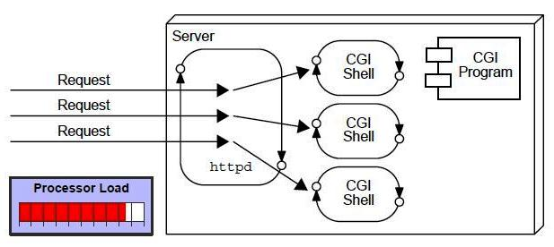
Why Servlet?
Before servlet
CGI(Commmon Gateway Interface):
CGI technology enables the web server to call an external program and pass HTTP request information to the external program to process the request. For each request, it starts a new process.
Disadvantages of CGI:
There are many problems in CGI technology:
If number of clients increases, it takes more time for sending response.
For each request, it starts a process and Web server is limited to start processes.
It uses platform dependent language e.g. C, C++, perl.

Slide 5
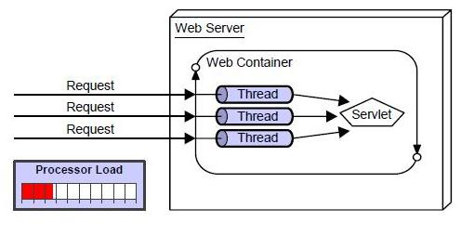
Why Servlet?
Advantage of Servlet:
better performance: because it creates a thread for each request not process.
Portability: because it uses java language.
Robust: Servlets are managed by JVM so no need to worry about momory leak, garbage collection etc.
Secure: because it uses java language
There are many advantages of servlet over CGI. The web container creates threads for handling the multiple requests to the servlet. Threads have a lot of benefits over the Processes such as they share a common memory area, lightweight, cost of communication between the threads are low.

Slide 6
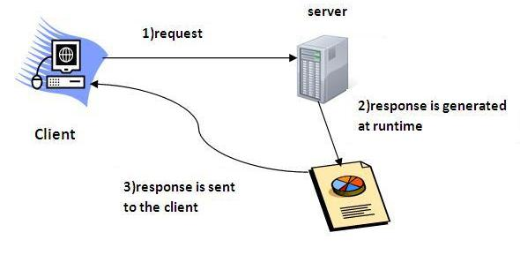
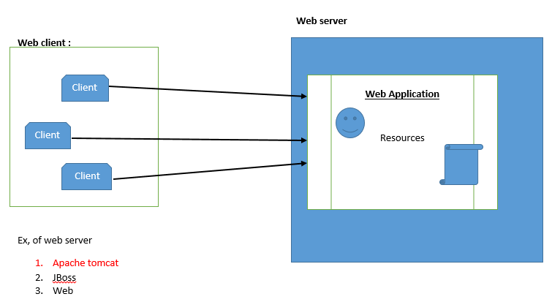
How Web Applications work:

Slide 7
Servlet Terminology
HTTP (Hyper Text Transfer Protocol)
Http Request Methods
Container
Server
Content Type

Slide 8
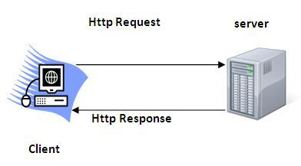
HTTP (Hyper Text Transfer Protocol)
Http is the protocol that allows web servers and browsers to exchange data over the web.
It is a request response protocol.
It is stateless means each request is considered as the new request. In other words, server doesn't recognize the user bydefault.

Slide 9
Http Request Methods
Every request has a header that tells the status of the client. There are many request methods. Get and Post requests are mostly used.
The http request methods are:
GET
POST
HEAD
PUT
DELETE
OPTIONS
TRACE

Slide 10
What is the difference between Get and Post?
GET | POST
1) In case of Get request, only limited amount of data can be sent because data is sent in header. | In case of post request, large amount of data can be sent because data is sent in body.
2) Get request is not secured because data is exposed in URL bar. | Post request is secured because data is not exposed in URL bar.
3) Get request can be bookmarked | Post request cannot be bookmarked
4) Get request is idempotent. It means second request will be ignored until response of first request is delivered. | Post request is non-idempotent
5) Get request is more efficient and used more than Post | Post request is less efficient and used less than get.

Slide 11
Container
Container is an engine or smartness which manages all the resources or JEE components. If any server has JEE container than only we can run JEE application.
We can integrate JEE components with many servers.
Responsible for container:
Life cycle management
Session management
Security management
Etc.
Note:
Web.xml is passed by the container at the time of application loading and if web.xml has any errors then server throws ParseException.
All the application is sequentially loaded by the container

Slide 12
web.xmL/deployment descriptor:
It is a configuration file which has information like servlet, JSP, security information, welcome file, filters, listeners, session time out etc.
an application can have maximum one web.xml
in 2.x all the application configuration used to be done using web.xml when jee 3 version we can use @notation

Slide 13
Server
It is a running program or software that provides services.
Server represent a runtime environment which can only understand .class
There are two types of servers:
Web Server
Web server contains only web or servlet container. It can be used for servlet, jsp, struts, jsf etc. It can't be used for EJB.
Example of Web Servers are: Apache Tomcat and Resin.
Application Server
Application server contains Web and EJB containers. It can be used for servlet, jsp, struts, jsf, ejb etc.
Example of Application Servers are:
JBoss Open-source server from JBoss community.
Glassfish provided by Sun Microsystem. Now acquired by Oracle.
Weblogic provided by Oracle. It more secured.
Websphere provided by IBM.

Slide 14
Content Type
Content Type is also known as MIME (Multipurpose internet Mail Extension) Type. It is a HTTP header that provides the description about what are you sending to the browser.
There are many content types:
text/html
text/plain
application/msword
application/vnd.ms-excel
application/jar
application/pdf
application/octet-stream
application/x-zip
images/jpeg
video/quicktime etc

Slide 15
Servlet API
In this api there are mainly two package we used to create web application
i) javax.servlet ii) javax.servlet.http
javax.servlet:
The javax.servlet package contains many interfaces and classes that are used by the servlet or web container. These are not specific to any protocol.
javax.servlet.http:
The javax.servlet.http package contains interfaces and classes that are responsible for http requests only.

Slide 16
javax.servlet package
Interfaces:
Servlet
ServletRequest
ServletResponse
RequestDispatcher
ServletConfig
ServletContext
SingleThreadModel
--------------etc
Classes:
GenericServlet
ServletInputStream
ServletOutputStream
-------------etc

Slide 17
javax.servlet.http package
Interfaces:
HttpServletRequest
HttpServletResponse
HttpSession
--------etc
Classes:
HttpServlet
Cookie
-------etc

Slide 18
Servlet Interface
Servlet interface provides common behavior to all the servlets.
There are 5 methods in Servlet interface.
1. public void init(ServletConfig config):
initializes the servlet. It is the life cycle method of servlet and invoked by the web container only once.
2. public void service(ServletRequest request,ServletResponse response):
provides response for the incoming request. It is invoked at each request by the web container.
3. public void destroy():
is invoked only once and indicates that servlet is being destroyed.
4. public ServletConfig getServletConfig():
returns the object of ServletConfig.
5. public String getServletInfo():
returns information about servlet such as writer, copyright, version etc.

Slide 19
GenericServlet class
GenericServlet abstract class implements Servlet, ServletConfig and Serializable interfaces. It provides the implementation of all the methods of these interfaces except the service method.
GenericServlet class can handle any type of request so it is protocol-independent.
You may create a generic servlet by inheriting the GenericServlet class and providing the implementation of the service method.
Methods:
As we know Generic Servlet is implement Servlet interface, so this class override 4 abstract method except service() method.so 5 method is same as Servlet(I)
And other methods are
public ServletContext getServletContext(): returns the object of ServletContext.
public String getInitParameter(String name): returns the parameter value for the given parameter name.
public String getServletName(): returns the name of the servlet object.

Slide 20
ServletConfig Interface
An object of ServletConfig is created by the web container for each servlet. This object can be used to get configuration information from web.xml file.
An implementation object (config) object is created by container immediately after servlet object creation.
For every servlet object, a config object is created that is config object is associated with servlet object.
Advantage of ServletConfig:
The core advantage of ServletConfig is that you don't need to edit the servlet file if information is modified from the web.xml file.
Methods of ServletConfig interface:
public String getInitParameter(String name):Returns the parameter value for the specified parameter name.
public Enumeration getInitParameterNames():Returns an enumeration of all the initialization parameter names.
public String getServletName():Returns the name of the servlet.
public ServletContext getServletContext():Returns an object of ServletContext.

Slide 21
ServletContext Interface
An object of ServletContext is created by the web container at time of deploying the project. There is only one ServletContext object per web application.
Advantage of ServletContext and its Usage:
Easy to maintain if any information is shared to all the servlet
This object can be used to get configuration information from web.xml file.
The ServletContext object can be used to set, get or remove attribute from the web.xml file.
The ServletContext object can be used to provide inter-application communication.
Methods of ServletContext interface:
public String getInitParameter(String name):Returns the parameter value for the specified parameter name.
public Enumeration getInitParameterNames():Returns the names of the context's initialization parameters.
public void setAttribute(String name,Object object):sets the given object in the application scope.
public Object getAttribute(String name):Returns the attribute for the specified name.
public void removeAttribute(String name):Removes the attribute with the given name from the servlet context.

Slide 22
Difference Between Config and Context:
Config object is associated with servlet and context objet is associated with application
Config object is only one for one servlet and context is for an entire application
Config object is created after servlet object creation but context object is created at the time of loading an application (before servlet object creation)
Config can store only initParameter(can’t store attributes) but context can store contextParameter and attributes.
Scope of config is servlet scope and context is for application(the highest Scope)
Modification made to the data of config as a impact only on the servlet but modification made to the data of context has an impact on the entire application

Slide 23
Attribute in Servlet
Attribute is the data in the form of key and value pair. Key must be a unique String and value can be any object.
An attribute in servlet is an object that can be set, get or removed from one of the following scopes:
1) request scope
2) session scope
3) application scope/context
The servlet programmer can pass informations from one servlet to another using attributes
Attribute specific methods of ServletRequest, HttpSession and ServletContext interface
public void setAttribute(String name,Object object):sets the given object in the application scope.
public Object getAttribute(String name):Returns the attribute for the specified name.
public Enumeration getInitParameterNames():Returns the names of the context's initialization parameters as an Enumeration of String objects.
public void removeAttribute(String name):Removes the attribute with the given name from the servlet context.

Slide 24
HttpServlet class
The HttpServlet is an abstract class extends the GenericServlet abstract class and implements Serializable interface.
HttpServlet is very specific to http protocol. It provides http specific methods such as doGet, doPost, doHead, doTrace etc.
All the methods are concrete. But still the class is abstract.
Methods:
public void service(ServletRequest req,ServletResponse res) dispatches the request to the protected service method by converting the request and response object into http type.
protected void service(HttpServletRequest req, HttpServletResponse res) receives the request from the service method, and dispatches the request to the doXXX() method depending on the incoming http request type.
protected void doGet(HttpServletRequest req, HttpServletResponse res) handles the GET request. It is invoked by the web container.
protected void doPost(HttpServletRequest req, HttpServletResponse res) handles the POST request. It is invoked by the web container.
-------etc

Slide 25
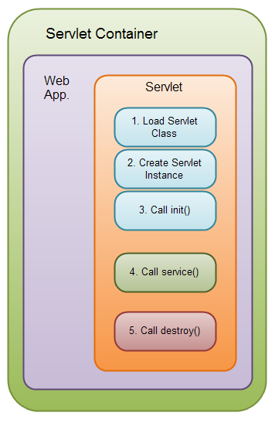
Life Cycle of a Servlet (Servlet Life Cycle)
The web container maintains the life cycle of a servlet instance.
Servlet class is loaded.
Servlet instance is created.
init() method is invoked.
service method is invoked.
destroy method is invoked.

Slide 26
1) Servlet class is loaded:
The classloader is responsible to load the servlet class. The servlet class is loaded when the first request for the servlet is received by the web container.
2) Servlet instance is created:
The web container creates the instance of a servlet after loading the servlet class. The servlet instance is created only once in the servlet life cycle.
3) init method is invoked:
The web container calls the init method only once after creating the servlet instance. The init method is used to initialize the servlet.
Syntax: public void init(ServletConfig config) throws ServletException
4) service method is invoked:
The web container calls the service method each time when request for the servlet is received.
Syntax: public void service(ServletRequest request, ServletResponse response)throws ServletException, IOException
5) destroy method is invoked:
The web container calls the destroy method before removing the servlet instance from the server. It gives the servlet an opportunity to clean up any resource for example memory, thread etc.
Syntax: public void destroy()

Slide 27
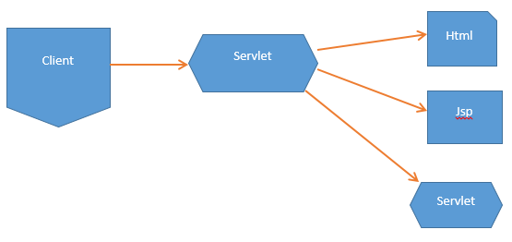
Servlet Chaining:
Generally on the request comes from servlet, the servlet is executed and give the response to the client. But instead of responding the servlet can communicate with other resources like html, jsp, or servlet. This way of servlet to resource communication is called servlet chaining.
Servlet chaining can be done by using
RequestDispaatcher
sendRedirect
Cont……

Slide 28
RequestDispatcher interface:
RequestDispather is an Interface present in javax.servlet Package
RequestDispatcher is used for servlet chaining by dispatching the request from one servlet to other resource.
We can get an implementation object of type RequestDispather by using below method:
public RequestDispatcher getRequestDispatcher(String resource)
Example,
public RequestDispatcher rd=req.getRequestDispatcher(“resource”); //resources are like name of html,jsp or servlet
Request.getRequestDispatcher helps to communicate with resource of the same application
There are two important method of RequestDispatcher:
public void include(ServletRequest, ServletResponse)
public void forward(ServletRequest, ServletResponse)

Slide 29
include() and forward() of RequestDispatcher Interface:
include ():
Include() method include the responses of the other resources into a servlet
Include() method works like response merger
Any no of inclusion can be done that is multiple inclusions are possible.
We can include resource like html or servlet or JSP.
forward():
Forward () is used to forward the existing request from one servlet to other resource.
From one servlet logically only one forward is possible that is once.
In case of forward the data and the type of request which is available for the first servlet is also available for the 2nd resource.
If the type of req is get for the first servlet then for the 2nd servlet also type of req is get
We can pass the data from one servlet to other servlet by using request.set attribute and request.get attribute.

Slide 30
SendRedirect in servlet
The sendRedirect() method of HttpServletResponse interface can be used to redirect response to another resource, it may be servlet, jsp or html file.
It works at client side because it uses the url bar of the browser to make another request. So, it can work inside and outside the server.
Difference between forward() and sendRedirect() method:
forward() method | sendRedirect() method
The forward() method works at server side. | The sendRedirect() method works at client side.
It sends the same request and response objects to another servlet. | It always sends a new request.
It can work within the server only. | It can be used within and outside the server.
Example: request.getRequestDispacher("servlet2").forward(request,response); | Example: response.sendRedirect("servlet2");

Slide 31
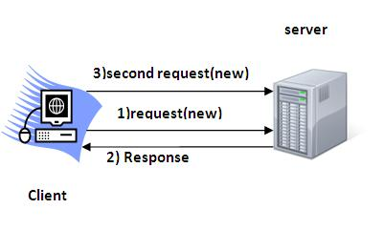
Session Management
Session management is a way to maintain state (data) of an user.
Http protocol is a stateless so we need to maintain state using session managment. Each time user requests to the server, server treats the request as the new request. So we need to maintain the state of an user to recognize to particular user.
There are four techniques used in Session managment:
Cookies
Hidden Form Field
URL Rewriting
HttpSession

Slide 32
Cookies in Servlet
A cookie is a small piece of information that is persisted between the multiple client requests.
A cookie has a name, a single value, and optional attributes such as a comment, path and domain qualifiers, a maximum age, and a version number.
Types of Cookie
There are 2 types of cookies in servlets.
Non-persistent cookie
Persistent cookie
Non-persistent cookie:
It is valid for single session only. It is removed each time when user closes the browser.
Persistent cookie:
It is valid for multiple session . It is not removed each time when user closes the browser. It is removed only if user logout or sign-out.
Advantage of Cookies
Simplest technique of maintaining the state.
Cookies are maintained at client side.
Disadvantage of Cookies
It will not work if cookie is disabled from the browser.

Slide 33
Cookie class javax.servlet.http.Cookie class provides the functionality of using cookies.
Constructor of Cookie class
Cookie()
Cookie(String name, String value)
Useful Methods of Cookie class
For adding cookie or getting the value from the cookie, we need some methods provided by other interfaces. They are:
public void addCookie(Cookie ck):method of HttpServletResponse interface is used to add cookie in response object.
public Cookie[] getCookies():method of HttpServletRequest interface is used to return all the cookies from the browser.
public void setMaxAge(int expiry) | Sets the maximum age of the cookie in seconds.
public String getName() | Returns the name of the cookie
public String getValue() | Returns the value of the cookie.
Cont……

Slide 34
Create Cookie:
Cookie ck=new Cookie("user",“azam");//creating cookie object
response.addCookie(ck);//adding cookie in the response
Delete Cookie:
It is mainly used to logout or signout the user
Cookie ck=new Cookie("user","");//deleting value of cookie
ck.setMaxAge(0);//changing the maximum age to 0 seconds
response.addCookie(ck);//adding cookie in the response
Get Cookies:
Cookie ck[]=request.getCookies();
for(int i=0;i<ck.length;i++){ //if multiple cookies added or get all the cookies
out.print("<br>"+ck[i].getName()+" "+ck[i].getValue());
//printing name and value of cokies
}

Slide 35
2) Hidden Form Field
In case of Hidden Form Field a hidden (invisible) textfield is used for maintaining the state of an user.
In such case, we store the information in the hidden field and get it from another servlet. This approach is better if we have to submit form in all the pages and we don't want to depend on the browser.
Syntax,
<input type="hidden" name="uname" value=“Azam">
Advantage of Hidden Form Field:
It will always work whether cookie is disabled or not.
Disadvantage of Hidden Form Field:
It is maintained at server side.
Extra form submission is required on each pages.
Only textual information can be used.

Slide 36
3)URL Rewriting
In URL rewriting, we append a token or identifier to the URL of the next Servlet or the next resource. We can send parameter name/value pairs using the following format:
"<a href='servlet2?uname="+n+"'>visit</a>“
Advantage of URL Rewriting
It will always work whether cookie is disabled or not (browser independent).
Extra form submission is not required on each pages.
Disadvantage of URL Rewriting
It will work only with links.
It can send Only textual information.

Slide 37
4) HttpSession interface
In such case, container creates a session id for each user. The container uses this id to identify the particular user. An object of HttpSession can be used to perform two tasks:
bind objects
view and manipulate information about a session, such as the session identifier, creation time, and last accessed time.
Get the HttpSession object:
public HttpSession getSession():Returns the current session associated with this request, or if the request does not have a session, creates one.
Methods are used HttpSession interface:
public String getId():Returns a string containing the unique identifier value.
public void invalidate():Invalidates this session then unbinds any objects bound to it.
To set the attribute in the session scope, we have used the setAttribute() method of HttpSession interface and to get the attribute, we have used the getAttribute method.

Slide 38
Thank you

