Slide 1
jsp

Slide 2
Content:
JSP Introduction
Life cycle of a JSP Page
The JSP API
JSP Scripting elements
JSP Implicit Objects
JSP directives
Exception Handling in JSP
JSP Action Tags
Expression Language (EL) in JSP
JSTL (JSP Standard Tag Library)

Slide 3
JSP Introduction
JSP technology is used to create web application just like Servlet technology.
A JSP page consists of HTML tags and JSP tags. The jsp pages are easier to maintain than servlet because we can separate designing and development. It provides some additional features such as Expression Language, Custom Tag etc.
JSP is use for presentation logic
JSP is managed by JSP Container present in the Server
In JSP we can perform all the types of logic but as per the MVC architecture we perform only presentation logic.
JSP is a server side page display in the browser.
JSP is invert out of Servlet.
In JSP we can use multiple JSP elements and each JSP elements performs its own dynamic activity like Importing the java class, writing the methods, Displaying java contents etc
Advantage of JSP over Servlet
1) Extension to Servlet (We can use all the features of servlet in JSP)
2) Easy to maintain (we can easily separate our business logic with presentation logic)
3) Fast Development: No need to recompile and redeploy (If JSP page is modified)
4) Less code than Servlet (In JSP, we can use a lot of tags such as action tags, jstl, custom tags etc. that reduces the code.)

Slide 4
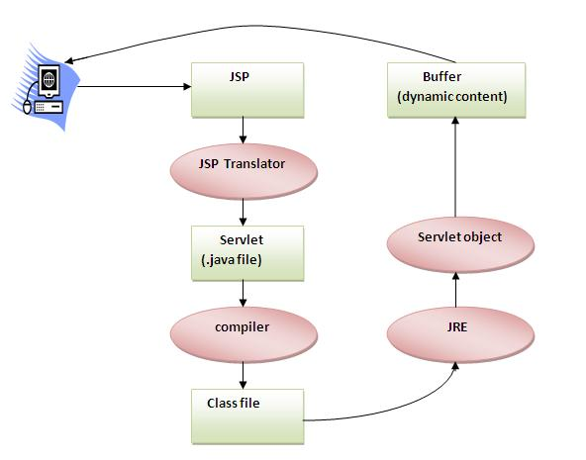
Life cycle of a JSP Page
The JSP pages follows these phases:
Translation of JSP Page
Compilation of JSP Page
Classloading (class file is loaded by the classloader)
Instantiation (Object of the Generated Servlet is created).
Initialization ( jspInit() method is invoked by the container).
Reqeust processing ( _jspService() method is invoked by the container).
Destroy ( jspDestroy() method is invoked by the container).
Note: jspInit(), _jspService() and jspDestroy() are the life cycle methods of JSP.

Slide 5
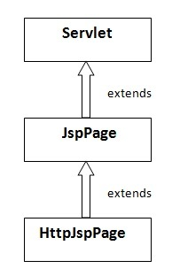
The JSP API
The JSP API consists of two packages:
javax.servlet.jsp
javax.servlet.jsp.tagext
javax.servlet.jsp package
The javax.servlet.jsp package has two interfaces and classes.The two interfaces are as follows:
JspPage
HttpJspPage
The classes are as follows:
JspWriter
PageContext
JspFactory
JspEngineInfo
JspException
JspError
Methods of JspPage interface
public void jspInit():
public void jspDestroy():
Method of HttpJspPage interface:
public void _jspService():

Slide 6
JSP Scripting elements
The scripting elements provides the ability to insert java code inside the jsp. There are three types of scripting elements:
scriptlet tag
expression tag
declaration tag
JSP scriptlet tag
A scriptlet tag is used to execute java source code in JSP.
Syntax is as follows:
<% java source code %>
JSP expression tag
The code placed within JSP expression tag is written to the output stream of the response. So you need not write out.print() to write data. It is mainly used to print the values of variable or method.
Syntax of JSP expression tag: <%= statement %>
declaration tag
he JSP declaration tag is used to declare fields and methods.
The code written inside the jsp declaration tag is placed outside the service() method of auto generated servlet.
Syntax of JSP declaration tag
The syntax of the declaration tag is as follows: <%! field or method declaration %>

Slide 7
Difference between JSP Scriptlet tag and Declaration tag
Jsp Scriptlet Tag | Jsp Declaration Tag
The jsp scriptlet tag can only declare variables not methods. | The jsp declaration tag can declare variables as well as methods.
The declaration of scriptlet tag is placed inside the _jspService() method. | The declaration of jsp declaration tag is placed outside the _jspService() method.

