Slide 1
oops
AZAM AMIR REZA

Slide 2
Content:
Basic knowledge of OOPS
Naming conventions
Object and Class
METHOD and Method Overloading
MEMORY ALLOCATION
Blocks (static & non-static)
Constructor and Constructor Overloading
this keyword & static keyword
Call by Value and Call by Reference
Static and non-static reference variable
Composition(Has a Relationship)
INHERITANCE(Is a Relationship)
Constructor chaining
Method Overriding
TYPE CASTING(Up, Down, instanceOf)
Polymorphism
ABSTRACTION(Abstract class, Interface)
Loose-Coupling
Packages
Encapsulation
Library
String class
Array (class type)

Slide 3
Basic knowledge of OOPS
Object means a real word entity such as pen, chair, table etc. Object-Oriented Programming is a methodology or paradigm to design a program using classes and objects. It simplifies the software development and maintenance by providing some concepts:
Object
Class
Inheritance
Polymorphism
Abstraction
Encapsulation
Advantage of OOPs over Procedure-oriented programming language :
1)OOPs makes development and maintenance easier where as in Procedure-oriented programming language it is not easy to manage if code grows as project size grows.
2)OOPs provides data hiding whereas in Procedure-oriented programming language a global data can be accessed from anywhere.
3)OOPs provides ability to simulate real-world event much more effectively. We can provide the solution of real word problem if we are using the Object-Oriented Programming language
Object-based programming language:
Object based programming language follows all the features of OOPs except Inheritance. JavaScript and VBScript are examples of object based programming languages.
Note: Smalltalk is considered as the first truly object-oriented programming language.

Slide 4
Naming conventions
Java naming convention is a rule to follow as you decide what to name your identifiers such as class, package, variable, constant, method etc.
But, it is not forced to follow. So, it is known as convention not rule.
Advantage of naming conventions in java:
By using standard Java naming conventions, you make your code easier to read for yourself and for other programmers. Readability of Java program is very important. It indicates that less time is spent to figure out what the code does.
Name | Convention
class name | should start with uppercase letter and be a noun e.g. String, Color, Button, System, Thread etc.
interface name | should start with uppercase letter and be an adjective e.g. Runnable, Remote, ActionListener etc.
method name | should start with lowercase letter and be a verb e.g. actionPerformed(), main(), print(), println() etc.
variable name | should start with lowercase letter e.g. firstName, orderNumber etc.
package name | should be in lowercase letter e.g. java, lang, sql, util etc.
constants name | should be in uppercase letter. e.g. RED, YELLOW, MAX_PRIORITY etc.
Java follows camelcase syntax for naming the class, interface, method and variable.
If name is combined with two words, second word will start with uppercase letter always e.g. actionPerformed(), firstName, ActionEvent, ActionListener etc.

Slide 5
Object and Class
Object is the physical as well as logical entity whereas class is the logical entity only.
Object:
An entity that has state and behaviour is known as an object e.g. chair, bike, marker, pen, table, car etc. It can be physical or logical. The example of logical object is banking system.
An object has three characteristics:
State : represents data (value) of an object.
Behaviour: represents the behaviour (functionality) of an object such as deposit, withdraw etc.
Identity: Object identity is typically implemented via a unique ID. The value of the ID is not visible to the external user. But, it is used internally by the JVM to identify each object uniquely.
For Example: Pen is an object. Its name is Reynolds, colour is white etc. known as its state. It is used to write, so writing is its behaviour.
Object is an instance of a class. Class is a template or blueprint from which objects are created. So object is the instance(result) of a class.

Slide 6
Class:
A class is a group of objects that has common properties. It is a template or blueprint from which objects are created.
Class is a definition block is used to define the members of class ,
The member can be data member or function member
The data members are used to store data required for the program when as the function members are used to operate on the data members
The members are classified into tow type static and non-static, a) The static members are declared using static keyword and is also known as class members b) The non-static member declared without static keyword it’s also known as instance variable of the class. A variable that is created inside the class but outside the method, is known as instance variable. Instance variable doesn't get memory at compile time. It gets memory at runtime when object(instance) is created. That is why, it is known as instance variable.
The members of a class can be access from any class based on the access spicier
The static members of a class are refer by using class name
A class in java can contain:
data member
method
constructor
block
class and interface

Slide 7
Difference between object and class:
There are many differences between object and class.
No. | Object | Class
1) | Object is an instance of a class. | Class is a blueprint or templatefrom which objects are created.
2) | Object is a real world entity such as pen, laptop, mobile, bed, keyboard, mouse, chair etc. | Class is a group of similar objects.
3) | Object is a physical entity. | Class is a logical entity.
4) | Object is created through new keyword mainly e.g. Student s1=new Student(); | Class is declared using class keyword e.g. class Student{}
5) | Object is created many times as per requirement. | Class is declared once.
6) | Object allocates memory when it is created. | Class doesn't allocated memory when it is created.
7) | There are many ways to create object in java such as new keyword, newInstance() method, clone() method, factory method and deserialization. | There is only one way to define class in java using class keyword.

Slide 8
Reference variable:
Reference variables are special variable which is used to refer an instance of the classes.
The reference variable should be declared by using class name.
For a reference variable we can assign either null value or an instance of class.
The instance of the class can be created by using new keyword and constructor of the class.
The new keyword is used to instance of class whereas the constructors are used to initialize the instance.
The new keyword is used to allocate memory at runtime.
Whenever we create instance of the class copy of non-static member are loaded in the memory, to refer each instance we should create reference variable or object references.
An instance can refer by any no of reference variables. In such case modifying the state of the instance from 1 reference variable will reflect in another reference variable also
The instance created will always have non-static data member and non-static function member
The modifying the states of one statements will not update the entire instance.
Syntax className reference_variable_name; Ex,
Demo1 obj1;
obj1-null
obj1=new Demo1();
Note: The variables declaration using data type are known as positive variable, is used to store primitive values.

Slide 9
Different ways to create an object in Java:
There are many ways to create an object in java. They are:
By new keyword
By newInstance() method
By clone() method
By factory method etc.
Anonymous object
Anonymous simply means nameless. An object that have no reference is known as annonymous object.
If you have to use an object only once, anonymous object is a good approach.

Slide 10
Method
In java, a method is like function i.e. used to expose behavior of an object.
Syntax,
access_specifier static/non-static return_type name_of_method(arguments)
{
operation
}
Access specifier: visibility of the method. You can use any of them as access specifier e.g. public, protected,package,private
Static or Non-static: You can declare method as static or non-static
Return type: You can return as void or primitive data type or array type or class type or interface type.
Note: A java method can return only one value if we have to return multiple values of same type then go for arrays
If we have to return multiple values of diff type then go for objects
Arguments: You can pass as primitive data type, array type, class type, interface type as a arguments
Pass the object address to reference variable IF Method Argument is Class Type:
U can change data member to the another class and it will copied to that class which is references and u will get change value in the main class
Advantage of Method:
Code Reusability
Code Optimization

Slide 11
Method Overloading:
Defining multiple methods in a class with same name and different arguments is known as method overloading
In class we can overload both static method and non- static methods
The overloaded methods are executed based on the method arguments
Method overloading is used to achieved compile time polymorphism
When we go for Method Overloading?
While develop an application or function if the come cross an operation to be perform with different parameters then we go for method overloading.
Advantage of method overloading:
Method overloading increases the readability of the program.
Different ways to overload the method
There are two ways to overload the method in java
By changing number of arguments
By changing the data type
Why Method Overloading is not possible by changing the return type of method?
In java, method overloading is not possible by changing the return type of the method because there may occur ambiguity.
Can we overload main() method?
Yes, by method overloading. You can have any number of main methods in a class by method overloading.

Slide 12
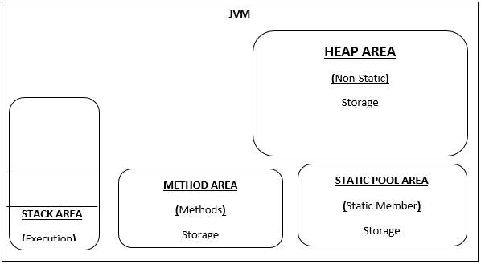
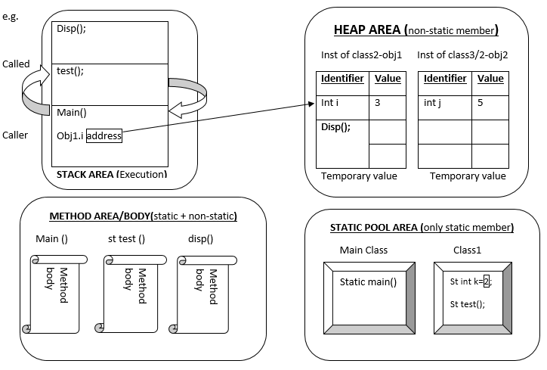
MEMORY ALLOCATION
To execute any program the JVM makes use of following memory area:-
Heap Area: The Heap Area is used to store the instance in the program. In the heap area the memory allocated is random. The new operator loads the non-static member into heap area.
Static Pool Area: This area is used for storing the static member of the class .The pool will be created for each class; the class loader program of JVM is responsible to load the static member of the class to the static position.
Method Area: The method area is used to store the definition statements of methods.
Stack Area: The stack area is used for execution purpose and normal statements to which have to be executed in JVM should be come to stack area.
Note: The local variable components always store in stack memory area.

Slide 13
Blocks (static & non-static)
Java language provides initialize block to initialize the data member of the class
There are two types of blocks
Static initialize block :
Static initialize block is used to initialize the static members of the class. The static block are executed at the time of class loading by class loader , we can define multiple static blocks ,JVM executed sequentially
If main class run contains main method and static blocks then JVM first run static block and then main method
Non-Static initialize:
The non-static initialize blocks is used to initialize the non-static data member of the class
The non-static blocks is executed whenever instance class is to be created
In a class we can define multiple non-st blocks , which will be executed sequentially
Can we execute a program without main() method?
Yes, one of the way is static block but in previous version of JDK not in JDK 1.7.
class A3{
static{
System.out.println("static block is invoked");
System.exit(0);
}
}

Slide 14
Constructor and Constructor Overloading
Constructors are special member of the class which is used to initialize the data members of the class.
The constructors are executed whenever the instances of class are created.
Every class must have constructor in order to create an instance of the class.
The constructor can be created either by compiler or by user.
The constructor define by compiler is known as default constructor
Compiler defines a constructor if the class does not have any user define constructor. If in case the class is having user define constructor then the compiler not define default constructor.
The constructor define by programmer is known as user define constructor .the user can define either 0 or with argument constructor.
The constructor defines with arguments constructor are known as parameter constructor.
Whenever as object created using parameter constructor we need to pass value to the constructor
The constructor cannot be declare as static
Constructor Overloading:
In a class defining multiple constructor with deferent parameters is known as constructor overloading
When defining overloading constructor the constructor should deferent in terms of parameter type or parameter length.
Constructor overloading help us to create an instance of class to the different initialization.
While defining a constructor the constructor name should be same as class name, and constructor should not have return type.
Note: Does constructor return any value?
Ans: yes, that is current class instance (You cannot use return type yet it returns a value).

Slide 15
Difference between constructor and method
Java Constructor | Java Method
Constructor is used to initialize the state of an object. | Method is used to expose behaviour of an object.
Constructor must not have return type. | Method must have return type.
Constructor is invoked implicitly. | Method is invoked explicitly.
The java compiler provides a default constructor if you don't have any constructor. | Method is not provided by compiler in any case.
Constructor name must be same as the class name. | Method name may or may not be same as class name.

Slide 16
static keyword & this keyword
static keyword: The static keyword in java is used for memory management mainly. The static can be apply:
variable (also known as class variable)
method (also known as class method)
block
nested class
1) static variable: If you declare any variable as static, it is known static variable.
The static variable can be used to refer the common property of all objects (that is not unique for each object) e.g. company name of employees, college name of students etc.
The static variable gets memory only once in class area at the time of class loading.
Advantage of static variable is It makes your program memory efficient (i.e it saves memory).
2) static method: If you apply static keyword with any method, it is known as static method.
A static method belongs to the class rather than object of a class.
A static method can be invoked without the need for creating an instance of a class.
static method can access static data member and can change the value of it.
There are two main restrictions for the static method. They are:
The static method can not use non static data member or call non-static method directly.
“this” and “super” kewword cannot be used in static context.
why java main method is static?
because object is not required to call static method if it were non-static method, jvm create object first then call main() method that will lead the problem of extra memory allocation.

Slide 17
static keyword & this keyword
this keyword:
The java language provides special keyword by name “this” which is used to refer current object member
“this” key word always points to the current object that is it refers to the current object
“this” key word should be used either in a non-static method content or in the constructor body
“this” keyword can’t be used in the static methods
Whenever the local variable name and the data member name are same, in such case the data members name can be differentiate local variable name by using “this” keyword.

Slide 18
Call by Value and Call by Reference
There is only call by value in java, not call by reference. If we call a method passing a value, it is known as call by value. The changes being done in the called method, is not affected in the calling method.
In case of call by reference original value is changed if we made changes in the called method. If we pass object in place of any primitive value, original value will be changed. In this example we are passing object as a value.
If the method argument is a class type then while invoking such method we have to pass the instance of the class mentioned in the method argument.
The instance can be passed directly or we can pass the reference of instance also
If we passing the ref of instance then any modification to that instance will reflect in the other references
** Java does not support pass by ref since java language is not be using pointer concept ,however we can pass the object address to reference variable not true pointers.

Slide 19
Static and non-static reference variable
A ref variable can be declare as the data member of the class
It can be static data member or non-static data member
If a ref variable static then we can only one copy of the ref variable in memory, this can also be call as static object
If the ref variable is non-static then for each instance variable a copy of ref variable will be create this can also be called as non-static object.
Whenever a ref variable is data member of the class then the memory allocation access either in the heap or in the static pool
If a ref variable is declare as static and final then we get a single copy of ref variable which cannot be reassign
If a non-static ref variable is final we get multiple copy of ref variable for each instance which cannot be re assign

Slide 20
Composition or Aggregation (Has a Relationship)
If a class have an entity reference, it is known as Aggregation. Aggregation represents HAS-A relationship.
Consider a situation, Employee object contains many information's such as id, name, emailId etc. It contains one more object named address, which contains its own information’s such as city, state, country, zipcode etc.
Why use Aggregation?
For Code Reusability.
When use Aggregation?
Code reuse is also best achieved by aggregation when there is no is-a relationship.
Inheritance should be used only if the relationship is-a is maintained throughout the lifetime of the objects involved; otherwise, aggregation is the best choice.

Slide 21
INHERITANCE(Is a Relationship)
Inheritance in java is a mechanism in which one object acquires all the properties and behaviors of parent object.
Inheritance represents the IS-A relationship, also known as parent-child relationship.
Why use inheritance in java
A) For Method Overriding (so runtime polymorphism can be achieved). B)For Code Reusability.
Syntax of Java Inheritance
class Subclass-name extends Superclass-name
{ //methods and fields }
The extends keyword indicates that you are making a new class that derives from an existing class.
In the terminology of Java, a class that is inherited is called a super class. The new class is called a subclass.
Note:
Always subclass inherits the non-static properties from the super class.
The static properties will never be inherited to the sub class.
Whenever we create the instance of sub class that instance will always have the non-static properties of sub class and its super class
If a class is declare as final, such classes can’t have subclasses in other words we can’t inherit the properties of final class. We can create an instance of final class and we can access it as non-static properties.
A constructor of a super class will not be inherited to subclass, but constructor plays major rule in inheritance
Whenever we create an object of sub class it will always have the non-static properties of any level super class
Object is a super class for every java class
Every java class should define a super class, if user is not define a super class then compiler define default super class by name “Object”
Each and every class created in java language is always having properties of Object class.

Slide 22
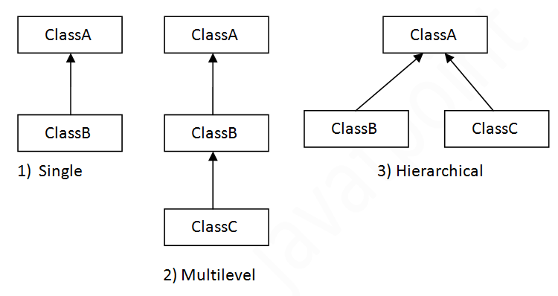
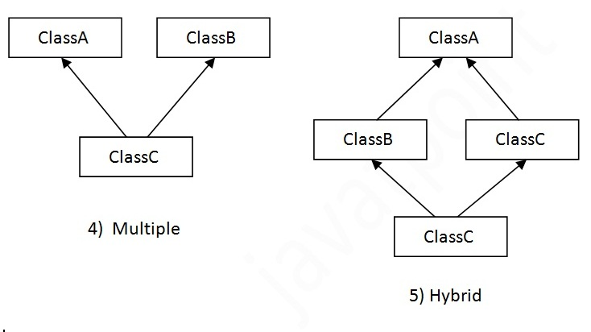
Types of inheritance in java
On the basis of class, there can be three types of inheritance in java: single, multilevel and hierarchical.
In java programming, multiple and hybrid inheritance is supported through interface only.
There are 4 types of inheritance:-
Single Inheritance: In this type of inheritance a sub class inherits properties from only one super class.
Multi-level inheritance: In this case the sub class inherits the properties of super class which inherits the properties of another super class. We can define any level of inheritance
Multiple Inheritances: Sub class inheriting from more than one super class is known as multiple inheritances java does not support multiple inheritances through classes.
Hierarchical Inheritance: In this type of inheritance more than one subclass inherits the properties from one super class, In other words the sub classes having common super class. This type of inheritance is used to achieve generalization.

Slide 23
Constructor chaining
Constructor chaining is a phenomenon where subclass constructor makes a call the super class constructor, the super class constructor makes a call to its super class constructor. Constructor chaining can be done either implicitly or explicitly.
Constructor Calling System in Inheritance:
In an inheritance program the sub class constructor should make a call to the constructor of superclass.
The call can be made either implicitly or explicitly.
Sub class can call super class in the using “super () “statements.
If compiler makes a call to super class is called as implicitly, implicitly call zero argument constructor ,in other words Compiler can call only the 0 arguments of the super class constructor ,if super class constructor designing parameter then compiler not make a implicitly call , we should go for explicitly call.
Use of “super ()” statement and Rules:
“super ()” statements used to make a call to the super class constructor from sub class constructor.
“super ()” statements should be used only inside the constructor body.
“super ()” statements should be the first statements of constructor body; it can’t be used anywhere else.
Multiple super statements are not allowed in the constructor.

Slide 24
Constructor chaining
Use of “this ()” statement and Rules: Constructor of a class can call another constructor of same class using “this()” statements
“this()” statements can be used call constructor of the current class, it can’t call the constructor of super class
“this()”statements can be used to call method 0 argument or parameterize const.
“this()”statements should be used only In the constructor body and it must be the first statements of the constructor. Multiple this statements are not allowed
Recursive constructor calls are not allowed.
Use of “this” and “super” keyword both and their differences:
Java provides the special keywords by “super” which is used to refer super class properties in subclass calling or from subclass.
Java also provides the special keywords by “this” which is used to identify or refer to that current class global properties and differentiate to local variable as well.
The super keywords should be used either in non-static method context or constructor context.
“this” keyword should be used in the method context.
It can’t be used in static context.

Slide 25
Q. Why java doesn’t support multiple Inheritances?

Slide 26
Method Overriding
Inheriting in a method on super class changing in the implementation in the sub class is known as method over ridding
To override a method inheritance is must.
When sub class overrides the method of super class sub class should rewrite the same method signature of the super class, it should change the implementation.
Using method overriding we can achieved runtime polymorphism
The sub class can’t override bellow method of super class:-
Static method-because the static methods can’t be inheriting to subclass
Final non- static method: because the final key word doesn’t allow to change the method implementation.it can be inheriting to the sub class
Private non- static methods: because the private access is restricted only to the class where it is declare
When we go for Method Overriding?
When developing an apps if we come cross the situation where the functionality should be written with different implementation then we go for method overriding.

Slide 27
TYPE CASTING(Up, Down, instanceOf)
Casting one type of function to another type is known as type casting.
There are two type of casting:-
Primitive Data type casting (Simple): Datatype----casted--->datatype .
Class type casting (V.V.Imp): classtype--- casted -- >classtype.
Primitive Data type casting:
In the Primitive data type casting, a data type is casted to another data type.
There are two type of Primitive data type casting:-
Widening: Casting lower data type to any of the higher data type is known as Widening. The widening can be done implicitly by compiler hence it is also known as implicit widening or auto-widening.
Narrowing: Casting higher data type to any of the lower data type is known as Narrowing. The Narrowing should be explicitly performed in the code. Compiler can’t perform narrowing because whenever narrowing is performed data loss happens.
Syntax, datatype variable= (data type) value;

Slide 28
TYPE CASTING(Up, Down, instanceOf)
2) Class type type casting:
Casting one class type to another class type is known as Class type Casting.
To perform to class type casting we have to fulfill provide rules:-
The classes should have is a relationship(inheritance)
The object should have the properties of the class to which we have to casted
Class type casting can be done in two ways
1) Up casting: Casting subclass type to super class type is known as up casting. Up casting can be done either implicit or explicit. The implicit casting done by compiler
2) Down casting: Casting super class type to sub class type is known as down casting. The down casting should be done explicit in the code.
Note: Down casting should be perform only on the object which is already up casting
Why is Upcasting? Generally, upcasting is not necessary. However, we need upcasting when we want to write general code that deals with only the super type.
Why is Down casting?
Down casting is used more frequently than upcasting. Use down casting when we want to access specific behaviors of a subtype.

Slide 29
TYPE CASTING(Up, Down, instanceOf)
During compilation the compiler check the class type casting statements, if classes having is a relationship then compiler compiles statements otherwise compiler goes an error in compatible type.
*classcastEx is a type of RuntimeExp which through by jvm and runtime.
Why this ClassCast Exception is occurred? Whenever an object of a class type is casted to another class type which is not having the properties in the object then jvm throughs classcastExp
Why compiler doesn’t detect at compile time? Because the compiler only check the is a relationship not the properties
How to avoid ClassCastExp? …..The ClassCastExp can be avoided by using “instanceOf” operator.
Note:
When an instance of a class is casted to another class then we can access only those properties the class type which is casted.
If a ref variable type of super class, to that ref variable we can assign any of its sub class object because of implicit up casting. In other word, a super class ref variable can point any of the sub class objects

Slide 30
Polymorphism
An object showing different behavior at different stage of a its life cycle is known as polymorphism,
There are two type of polymorphism:
Compile time polymorphism
Runtime polymorphism
1. Compile Time Polymorphism:
In compile time polymorphism the method declaration is binded to the method definition at compile time by compiler.
Since the binding is happening at operation time it is known as compile time binding or static binding or early binding, for overloaded methods ,static methods and final methods compile time binding happens. Hence this method is example for compile time polymorphism.
2. Runtime Polymorphism:
In run time polymorphism the method declaration is binded to the method definition by the JVM during execution. Since binding is happening at runtime it is known as runtime binding or dynamic binding or late binding. The method overriding is an example for runtime polymorphism since binding happens at execution time.to achieved runtime polymorphism we have to fulfill the following concept.
Inheritance
Method overriding
Up casting
Note: Whenever we create an instance of a subclass which is having override methods, if we refer that instance either by subclass ref or by super class methods we get override implementation only.

Slide 31
ABSTRACTION(Abstract class, Interface)
Abstraction is a process of hiding the class implementation from its utilization. The abstraction specified that don’t show how object functionality is implemented but provide an interface to use the functionality.
To achieved the abstraction we have to follow the below steps:
Generalize the behavior of the classes in an interface.
Provide implementation in the class according to the specification
Refer that implementation of the class by using interface reference variable
The abstraction can be achieved either by using abstract class or interfaces
If we need pure abstraction then we should use interfaces. If we need concrete an abstract method then we should go for abstract class
Advantages of abstraction:
We can achieved generalization
We can hide the implementation
We can achieve loose coupling between the objects.
The abstraction is used to developed API’s(Application Programming Interfaces)
The other major advantage of abstraction is any changes in the implementation will have very less impact on the utilization of the class.
A reference variable can of tow type;
1) Class type: If the reference variable is class type then we can assign either class type instance or sub class type instance.
2) Interface type: If the ref variable is interface type or abstract class then we can assign only the instance of implementation class.

Slide 32
abstract class
A class declare with abstract key word is known as abstract class
Defining a method with declaration and implementation is known as concrete method. The concrete method are complete method which has both declaration and definition
Defining a method with only declaration, without implementation is known as Abstract methods. The abstract method should be declare using abstract key word and it should be define in the abstract class only
An abstract class can have both abstract and concrete methods
In abstract class we can define static member and non-static members
We can’t create an instance of abstract class ,hence we can’t refer the non-static members of abstract class
Abstract keyword can’t be compatible bellow keywords
Static
Final
Private
Note:
If a class extends an abstract class then the class provide the implementation to all the abstract methods of the abstract class , otherwise the class should be declare as abstract.
If class declare as abstract it is not mandatory to declare as abstract method in the abstract class hence an abstract class not a pure abstract body. To get pure abstract body we should go for interfaces

Slide 33
Interface
An interface is a java type which is use to declare only abstract methods.
An interface method should be abstract in nature, and it should be public in access.
Inside interface body we can’t create concrete methods.
Interface variables should be static and final, we can’t define non-static variables.
By default the interface variable are static final and public.
By default interface methods are abstract and public.
Inside interface we can’t develop constructer.
We can’t create an instance of interface type, we can declare a ref variable of interface type.
Class should provide the implementation to the interface methods by using “implements” keywords.
A class can implement any no of interfaces.
The class which provides an implementation to the interface methods is known as implementation class.
Whenever a class implements an interface the class must provide implementation to all the abstract methods of interfaces otherwise class should be declare as abstract.
An interface can inherit of another interface by using extends keywords , an interface can’t inherits from a class
Why use Java interface?
There are mainly three reasons to use interface. They are given below.
It is used to achieve fully abstraction.
By interface, we can support the functionality of multiple inheritance.
It can be used to achieve loose coupling.

Slide 34
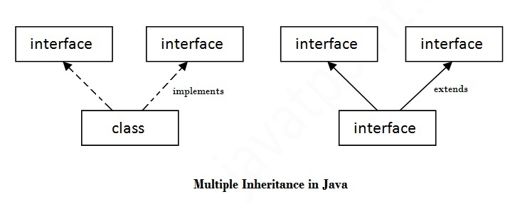
Interface
Multiple inheritance in Java by interface:
If a class implements multiple interfaces, or an interface extends multiple interfaces i.e. known as multiple inheritance.
Q) Multiple inheritance is not supported through class in java but it is possible by interface, why?
As we have explained in the inheritance chapter, multiple inheritance is not supported in case of class. But it is supported in case of interface because there is no ambiguity as implementation is provided by the implementation class.
Q) What is marker or tagged interface?
An interface that have no member is known as marker or tagged interface. For example: Serializable, Cloneable, Remote etc. They are used to provide some essential information to the JVM so that JVM may perform some useful operation.

Slide 35
Loose-Coupling
Loose-Coupling: Loose-Coupling is a concept of developing programs in a different layer in such a way that object utilization is independent of its implementation. It is develop in three different layers.
Object implementation layer: In this layer the functionality of the objects are implanted in the class, the declaration of the function are done in the interfaces. Here generalization concept is used
Object creation layer: In this layer the object of the class is created based on the requirement or need. Here factory design pattern is used
Utilization layer: in this layer the functionality of the object is used by using interface reference variables
The advantage of Loose-Coupling:
Any changes in the implements layer will not have impact on the utilization layer. Hence modification and enhancement will be easy.
Note:
If an instance of a class depends on the implements of another class instance directly then it is known as tight coupling. Such type of programming will always consumes more times and effort maintain and updating the code. Any changes in the implementation of dependent object will impact on the other object. to overcome this we have to use loose coupling which is done by using interface reference variable

Slide 36
Difference between abstract class and interface
Abstract class | Interface
1) Abstract class can have abstract and non-abstract methods. | Interface can have only abstract methods.
2) Abstract class doesn't support multiple inheritance. | Interface supports multiple inheritance.
3) Abstract class can have final, non-final, static and non-static variables. | Interface has only static and final variables.
4) Abstract class can have static methods, main method and constructor. | Interface can't have static methods, main method or constructor.
5) Abstract class can provide the implementation of interface. | Interface can't provide the implementation of abstract class.
6) The abstract keyword is used to declare abstract class. | The interface keyword is used to declare interface.
7) Example: public abstract class Shape{ public abstract void draw(); } | Example: public interface Drawable{ void draw(); }

Slide 37
Package
A java package is a group of similar types of classes, interfaces and sub-packages.
Package in java can be categorized in two form, built-in package and user-defined package.
There are many built-in packages such as java, lang, awt, javax, swing, net, io, util, sql etc.
Collection of java programs developed of particular functionality this known as package
The package can have some package
Collection of java package is known java library
Is package should be declare using package declaration statements
The syntaxes are: package packageaName; or package pack1.pack2;// one is parent 2nd one is child package
The package declaration should be always the first line of the source file. In a source file we can have only one package declaration statements
How to access package from another package?
There are three ways to access the package from outside the package.
import package.*; (If you use package.* then all the classes and interfaces of this package will be accessible but not subpackages. The import keyword is used to make the classes and interface of another package accessible to the current package.)
import package.classname; (If you import package.classname then only declared class of this package will be accessible.)
fully qualified name.(If you use fully qualified name then only declared class of this package will be accessible. Now there is no need to import. But you need to use fully qualified name every time when you are accessing the class or interface.It is generally used when two packages have same class name e.g. java.util and java.sql packages contain Date class.)

Slide 38
Package
Java inbuilt Packages

Slide 39
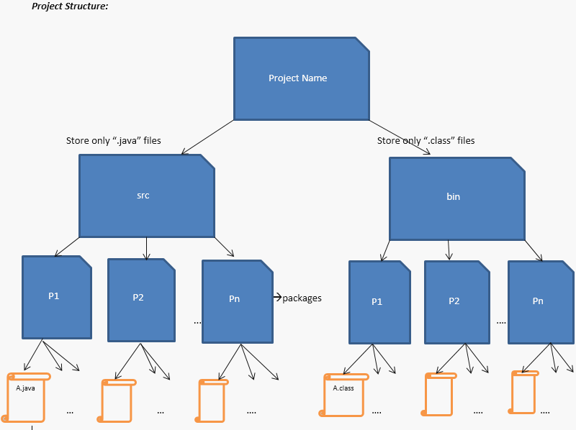
Package
User define Packages

Slide 40
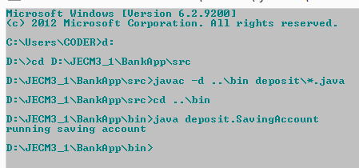
Package
Syntax of to complile and execute with package:

