Slide 1
spring
AZAM AMIR REZA

Slide 2
Content:
MVC
SPRING
Inversion Of Control (IOC) and Dependency Injection
Advantages of Spring Framework
Spring Modules
Steps to Create spring application
IOC and IOC Container
Spring Xml file
Scope
Dependency Injection
Auto wiring
Spring java configuration
Spring MVC
SPRING ARCHITECTURE

Slide 3
MVC
MVC is an n-layered arch
It makes an application re-usable and loose coupled
It is the common arch to develop EE applications
Note:
MVC can be used to create application with multiple layers
MVC is used when designing framework or application
MVC will have minimum three layers
View
Technology’s we are using
Html
CSS
Ajax
etc.
Controller
Technology’s we are using
Servlet
Spring
etc.
Model
Service
Spring, java mail, EJB
DAO
Jdbc, hibernate
DB

Slide 4
View layers:
A view is used to write a presentation logic
A view can interact with client and controller
Controller:
Controller is used to write a request processing and navigation logic
Controller can interact with view and Service
Service:
A service is used to Business logic
And it interact with controller and DAO
DAO:
Is used to persistence Logic
And interact with database
DTO/MODEL:
Is used to transfer the data
And its interact with all the layers

Slide 5
SPRING
Spring is a light weight and open source framework created by Rod Johnson in 2003.
Spring is an important integration technology
Spring is an configuration framework
Spring implements IOC and DI
It can be thought of as a framework of frameworks because it provides support to various frameworks such as Struts, Hibernate, Tapestry, EJB, JSF etc. The framework, in broader sense, can be defined as a structure where we find solution of the various technical problems.
The Spring framework comprises several modules such as IOC, AOP, DAO, Context, ORM, WEB MVC etc.

Slide 6
Inversion Of Control (IOC) and Dependency Injection
These are the design patterns that are used to remove dependency from the programming code. They make the code easier to test and maintain. Let's understand this with the following code:
class Employee{
Address address;
Employee(){ address=new Address(); }
}
In such case, there is dependency between the Employee and Address (tight coupling). In the Inversion of Control scenario, we do this something like this:
class Employee{
Address address;
Employee(Address address){ this.address=address; }
}
Thus, IOC makes the code loosely coupled. In such case, there is no need to modify the code if our logic is moved to new environment.
In Spring framework, IOC container is responsible to inject the dependency. We provide metadata to the IOC container either by XML file or annotation.
Advantage of Dependency Injection
makes the code loosely coupled so easy to maintain
makes the code easy to test

Slide 7
Advantages of Spring Framework
1) Predefined Templates: Spring framework provides templates for JDBC, Hibernate, JPA etc. technologies. So there is no need to write too much code. It hides the basic steps of these technologies.
2) Loose Coupling: The Spring applications are loosely coupled because of dependency injection.
3) Easy to test: The Dependency Injection makes easier to test the application. The EJB or Struts application require server to run the application but Spring framework doesn't require server.
4) Lightweight: Spring framework is lightweight because of its POJO implementation. The Spring Framework doesn't force the programmer to inherit any class or implement any interface. That is why it is said non-invasive.
5) Fast Development: The Dependency Injection feature of Spring Framework and it support to various frameworks makes the easy development of JavaEE application.
6) Powerful abstraction: It provides powerful abstraction to JavaEE specifications such as JMS, JDBC, JPA and JTA.
7) Declarative support: It provides declarative support for caching, validation, transactions and formatting.

Slide 8
Test: This layer provides support of testing with JUnit and TestNG.
Spring Core Container
The Spring Core container contains core, beans, context and expression language (EL) modules.
Core and Beans: These modules provide IOC and Dependency Injection features.
Context: This module supports initialization (I18N), EJB, JMS, Basic Remotting.
Expression Language: It is an extension to the EL defined in JSP. It provides support to setting and getting property values, method invocation, accessing collections and indexers, named variables, logical and arithmetic operators, retrieval of objects by name etc.
AOP, Aspects and Instrumentation: These modules support aspect oriented programming implementation where you can use Advices, Pointcuts etc. to decouple the code.
The aspects module provides support to integration with AspectJ.
The instrumentation module provides support to class instrumentation and classloader implementations.
Data Access / Integration: This group comprises of JDBC, ORM, OXM, JMS and Transaction modules. These modules basically provide support to interact with the database.
Web: This group comprises of Web, Web-Servlet, Web-Struts and Web-Portlet. These modules provide support to create web application.

Slide 9
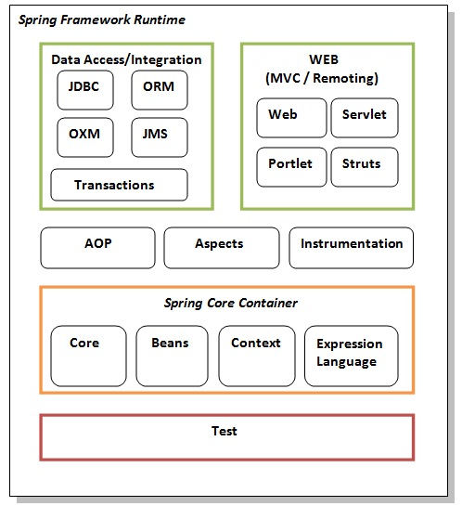
Spring Modules
Spring framework comprises of many modules such as core, beans, context, expression language, AOP, Aspects, Instrumentation, JDBC, ORM, OXM, JMS, Transaction, Web, Servlet, Struts etc. These modules are grouped into Test, Core Container, AOP, Aspects, Instrumentation, Data Access / Integration, Web (MVC / Remoting) as displayed in the following diagram.

Slide 10
Steps to Create spring application
Steps
Create a java project
define standard package
Create lib folder and add spring jars into class path
Create spring configuration xml or Copy spring configuration file if you have already and paste inside src folder
Jar files we need
Commons-logging
Spring-beans-4.2.2
Context
Core
Expression
6. Create a Bean class
7. In spring xml file for object creation
<bean id=”id” class=”fully qualified name of Bean class”></bean>
8. In the main class or Test class
//container way of creating objec
ApplicationContext container=new ClassPathXmlApplicationContext("spring-config.xml");
CalculatorBean fromContainer=container.getBean(CalculatorBean.class)
fromContainer.add(4, 6);

Slide 11
Inversion Of Control (IOC) and IOC Container
IOC (Inversion of Control):
It is a process of inverting a control to xml entity
IOC can be implemented as container
IOC is a container which creates and manages life cycle of a bean object
In applications we invert to control for two things
Creation of object
DI (Dependency Injection)
IOC Container:
The IoC container is responsible to instantiate, configure and assemble the objects. The IoC container gets informations from the XML file and works accordingly. The main tasks performed by IoC container are:
to instantiate the application class
to configure the object
to assemble the dependencies between the objects
There are two types of IoC containers. They are:
BeanFactory
ApplicationContext

Slide 12
Inversion Of Control (IOC) and IOC Container
Using BeanFactory:
The XmlBeanFactory is the implementation class for the BeanFactory interface. To use the BeanFactory, we need to create the instance of XmlBeanFactory class as given below:
Resource resource=new ClassPathResource("applicationContext.xml");
BeanFactory factory=new XmlBeanFactory(resource);
The constructor of XmlBeanFactory class receives the Resource object so we need to pass the resource object to create the object of BeanFactory.
Using ApplicationContext:
The ClassPathXmlApplicationContext class is the implementation class of ApplicationContext interface. We need to instantiate the ClassPathXmlApplicationContext class to use the ApplicationContext as given below:
ApplicationContext context = new ClassPathXmlApplicationContext("applicationContext.xml");
The constructor of ClassPathXmlApplicationContext class receives string, so we can pass the name of the xml file to create the instance of ApplicationContext.

Slide 13
Inversion Of Control (IOC) and IOC Container

Slide 14
Spring Xml file:
Since it is root element in xml file
We stand is the container for declaring been element
Bean tag is used to declare a java class for which container has to create and object
Bean has two attributes this id and class.
Id attribute is a reference of the bean object created by container. Id attribute must have unique value
Class attribute is used to declare the class for which object has to be created. Value for class should be fully qualified name of the java class
For initialize the property with the xml file:
First you need to create set method in the Bean class
Then you need to configure in xml
<property name="name" value="New Shanti Sagar"></property>
Property Tag:
This tag is used to set value for a property to set() method
Property tag has two attributes 1) name and 2) value
Name: Value for name attribute must be property name from java class
Value: value attribute is used to pass value for the property. Value attribute should be used the data type of the property is a string primitive or wrapper class

Slide 15
Spring Xml file:
In XML to set the values through parameterized constructor we use property tag
<constructor-arg value="azam"/>
This tag is used to pass the argument for the constructor
Constructor arg pass single argument for the bean
Constructor arg can be used with <property/> tag
Note:
To initialize property of Bean class we can use <constructor-arg> or <property > tag, depending upon the logic used in the class setter or constructor for the initialization.
Sytax,
<bean id="tea" class="com.azam.spring.bean.TeaShop">
<constructor-arg value="azam"/>
<property name="price" value="10"/>
</bean>

Slide 16
Scope:
Scope is the boundary which can be used to carry the data
Spring Bean can five different scopes:
Singleton
Prototype
Request
Session
Global
Note:
By default spring creates only one object for a bean tag
To change the scope of bean we need to use scope attribute in the bean tag.
Ex, <bean id="tea" class="com.azam.spring.bean.TeaShop" scope=”prototype”>
Prototype: It will create a new instance of a Bean whenever referred in an application.
Request & Session: Can be used when working with servlet container.
Global: It can be used when working with portal application.
Note:
Spring avoids developer from writing singleton or factory design patterns

Slide 17
Dependency Injection:
To understand the DI better, Let's understand the Dependency Lookup (DL) first:
Dependency Lookup
The Dependency Lookup is an approach where we get the resource after demand. There can be various ways to get the resource. for example: we get the resource(instance of A class) directly by new keyword. Another way is factory method:
A obj = new AImpl(); or A obj = A.getA();
Problems of Dependency Lookup:
There are mainly two problems of dependency lookup.
tight coupling The dependency lookup approach makes the code tightly coupled. If resource is changed, we need to perform a lot of modification in the code.
Not easy for testing This approach creates a lot of problems while testing the application especially in black box testing.
Dependency Injection:
The Dependency Injection is a design pattern that removes the dependency of the programs. In such case we provide the information from the external source such as XML file. It makes our code loosely coupled and easier for testing. Dependency Injection can be done in two ways
Setter/ Property Injection
Constructor Injection
Note: When an object is having reference to another object for functionality, it is referred as dependent object.

Slide 18
Dependency Injection:
Setter/ Property Injection
<bean id="petrol" class="com.azam.dep.FuelBean">
</bean>
<bean id="bus" class="com.azam.dep.VehicleBean">
<property name="fb" ref="petrol"/>
</bean>
2) Constructor Injection
<bean id="fuel" class="di.FuelBean"></bean>
<bean id="vehicle" class="di.Vehicle">
<constructor-arg>
<ref bean="fuel"/>
</constructor-arg>
</bean>

Slide 19
Autowiring:
Autowiring feature of spring framework enables you to inject the object dependency implicitly. It internally uses setter or constructor injection.
Advantage of Autowiring:
It requires the less code because we don't need to write the code to inject the dependency explicitly.
Disadvantage of Autowiring:
No control of programmer. It can't be used for primitive and string values.
Autowiring Modes:
No. | Mode | Description
1) | no | It is the default autowiring mode. It means no autowiring bydefault.
2) | byName | The byName mode injects the object dependency according to name of the bean. In such case, property name and bean name must be same. It internally calls setter method.
3) | byType | The byType mode injects the object dependency according to type. So property name and bean name can be different. It internally calls setter method.
4) | constructor | The constructor mode injects the dependency by calling the constructor of the class. It calls the constructor having large number of parameters.
5) | autodetect | It is deprecated since Spring 3.

Slide 20
Autowiring:
1. byName autowiring: In case of byName autowiring mode, bean id and reference name must be same.
It internally uses setter injection. Syntax
<bean id="b" class="org.sssit.B"></bean>
<bean id="a" class="org.sssit.A" autowire="byName"></bean>
2. byType autowiring mode: In case of byType autowiring mode, bean id and reference name may be different. But there must be only one bean of a type.
It internally uses setter injection.
<bean id="b1" class="org.sssit.B"></bean>
<bean id="a" class="org.sssit.A" autowire="byType"></bean>
3. constructor autowiring mode: In case of constructor autowiring mode, spring container injects the dependency by highest parameterized constructor.
<bean id="b" class="org.sssit.B"></bean>
<bean id="a" class="org.sssit.A" autowire="constructor"></bean>
4. no autowiring mode: In case of no autowiring mode, spring container doesn't inject the dependency by autowiring.
<bean id="b" class="org.sssit.B"></bean>
<bean id="a" class="org.sssit.A" autowire="no"></bean>

Slide 21
Spring java configuration::
Configure @annotation we need to use a tag spring xml
Syntax,
<context: component-scan base-packag=”fully qualified of package”/>
@Component:
It is used to create a bean object from spring container
@component should be placed about the flash definition.
@Value:
This is used to pass value for property with data type spring primitive or wrapper class
@Autowired:
Is used to inject dependent object by container and auto wired by default is byType
@Qualifier is used to inject dependent object byName;
@autowire works property injection and constructor injection

Slide 22
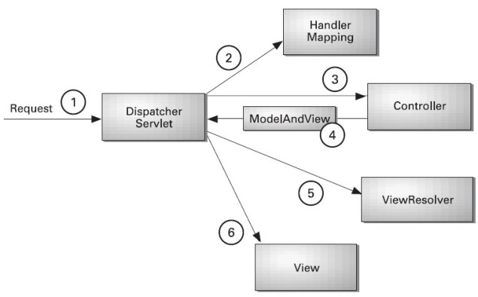
Spring MVC
In Spring Web MVC, DispatcherServlet class works as the front controller. It is responsible to manage the flow of the spring mvc application.
Understanding the flow of Spring Web MVC:

Slide 23
Spring MVC
Dispatcher Controller:
Dispatcher servlet: it is implementation of front controller design pattern
Dispatcher servlet is the entry and exit for the application
At the initialization of dispatcher servlet its load spring configuration file and instantiate application context.
Dispatcher servlet is responsible for sending request to the controller
Dispatcher servlet its sends response to the client
Note: dispatcher servlet is a servlet
Handler Mapping:
Handle mapping is the helper component to find controller or dispatcher servlet.
Handle mapping takes URL and returns the name to dispatcher servlet
Controller:
Controller is helper component of dispatcher servlet which process request for dispatcher servlet.
Controller takes request and can return Model, view name to dispatcher servlet.
View Resolver:
It is a helper component for Dispatcher
View resolver takes view name and returns to dispatcher servlet

Slide 24
Spring MVC
@annotation:
@Component
@RequestMapping
@Value
@Autowired
@RequstParam
@Model Attribute:
It is used to convert request parameters to a DTO object.
@RequestMapping(value="/sendWithModel")
public String sendMsgWithModel(@ModelAttribute MsgDTO dto){
System.out.println("exam of model attribute");
System.out.println("email\t"+dto.getEmail());
return "/success.jsp";
}
Model and View:
Model and view is used to send data and view name to dispatcher servlet
Data in model and view object will be in request scope
To view data we should use express language
${senderEmail}

Slide 25
Spring MVC
@Component
@RequestMapping(value="/")
public class ReachargeController {
@RequestMapping(value="/rc")
public String recharge(@RequestParam String email, @RequestParam String msg){
/*String email=request.getParameter("email");
String msg=request.getParameter("msg");*/
System.out.println("message send to \t"+email);
return "/success.jsp";

Slide 26
SPRING ARCHITECTURE:
A
O
P
ORM
J
E
E
M
V
C
JDBC
I O C
NOTE:
Spring is an important integration technology
In spring there are 6 modules
Spring IOC is the core module which is required for a spring application others modules or optional and can be used to integrate other technologies like Hibernate, Struts etc.
Note: Spring is not an ORM tools

