Slide 1

Reactjs On SharePoint
Komala Reddy

Slide 2
Steps to create an app in SharePoint
Set up the environment
Store the necessary files in the SharePoint libraries
SharePoint page
Run the webpack
Prerequisites

Slide 3
PREREQUISITES
Nodejs with npm
Typescript
Webpack
Install nodejs
Install necessary npm packages
Install typescript compiler as a Nodejs package
Install webpack-npm globally

Slide 4
Prerequisites
REACT & WEBPACK - TYPESCRIPT
Lay out the project
Let’s start out with a new directory. We’ll name it proj for now, but you can change it to whatever you want.
mkdir proj
cd proj
To start, we’re going to structure our project in the following way: Ensure that the node modules is installed in the proj folder.
proj
dist
src
Node modules
components

Slide 5
Prerequisites
Install dependencies
First ensure Webpack is installed globally in the proj folder.
Webpack is a tool that will bundle your code and optionally all of its dependencies into a single .js file.
Let’s now add React and React-DOM, along with their declaration files, as dependencies to your package.json file:
That @types/ prefix means that we also want to get the declaration files for React and React-DOM

Slide 6
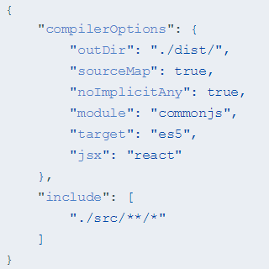
REACT & WEBPACK - TYPESCRIPT
Add a TypeScript configuration file
You’ll want to bring your TypeScript files together - both the code you’ll be writing as well as any necessary declaration files.
To do this, you’ll need to create a tsconfig.json which contains a list of your input files as well as all your compilation settings.
Create a new file in your project root named tsconfig.json and fill it with the following contents

Slide 7
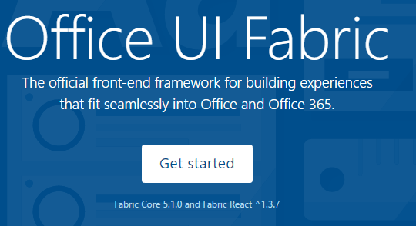
REACT & WEBPACK - TYPESCRIPT
Office UI Fabric
Install the Office UI Fabric component npm package to use the components from the Office UI Fabric.
npm install office-ui-fabric-react --save

Slide 8
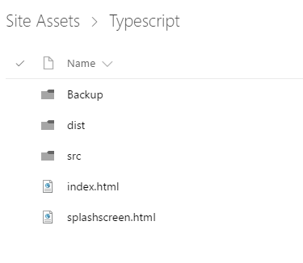
Store the necessary files in the SharePoint libraries
Let us take an example of the ElancerApp. Store the necessary files in the Site Assets folder. Index.html to reference the app controls. This can be configured in content-editor webpart. Splashscreen.html is optional.

Slide 9
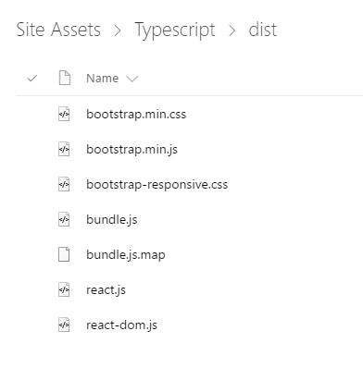
Store the necessary files in the SharePoint libraries
Store the bundle.js and bundle.js.map in the dist folder when we run the command webpack. We need bootstrap relevant file to make the app responsive. Also, react.js and react-dom.js for the react.

Slide 10
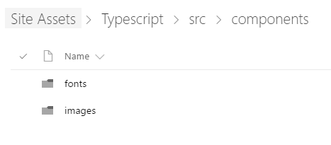
Store the necessary files in the SharePoint libraries
We can store the fonts and images in the src > components folder

Slide 11
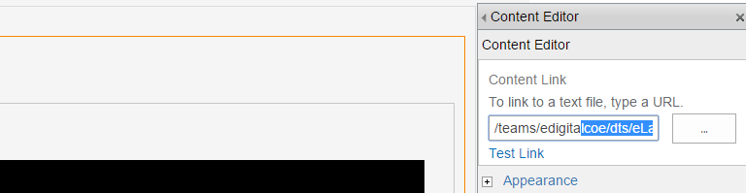
SharePoint page
Reference index.html in the SharePoint page
Create a SharePoint page in the team site.
Reference the index.html in the content editor web part.

Slide 12
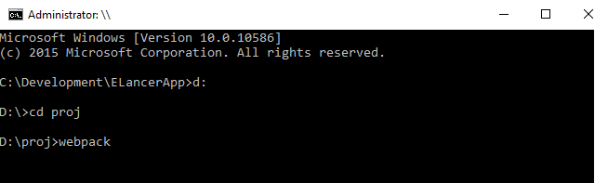
Run the webpack
Run the webpack command in the command prompt where the proj is set up.
This will update the bundle.js and bundle.js.map files in the package.
Upload these in the SharePoint Site Assets folder.
Refresh the page to check the relevant changes done in the code.

