Slide 1
MACHINE LEARNING PROJECT FOR YOUR PORTFOLIO
INTERNAL
Akash Kamerkar

Slide 2
Agenda
Introduction
Goals and objectives for this session
Timeline for the session
Overview of the session structure
Question and Answer (Q&A) session

Slide 3
Introduction

Slide 4



Introduction
Hello there!
My name is Akash, and I am passionate about the world of data science. Currently, I hold the position of Data Scientist at ABB
Data scientist for ABB we are developing digital apps/product which mainly focus on predictive maintenance workbench ,We make predictions about future events, then use those predictions to improve decision-making
Data science Mentor at Great learning
As a mentor on the Great Learning platform, I am currently providing guidance and support to data science students by conducting mock interviews and helping them prepare for their future careers
Data science Mentor at Topmate
I am associated with Topmate as a Data Science Mentor. Through more than 250 mentorship sessions, I have had the privilege of sharing my expertise and insights with individuals seeking guidance in the field of data science

Slide 5
Goals and objectives for this session

Slide 6
Goals and objectives for this session
Understand the Life cycle of Machine Learning Project
Get some Hands-on
Learn Basics of deployment and understand How deployment work in Industry
End Of session You will have One Machine Learning Project to add in your Resume

Slide 7
Timeline for the session

Slide 8
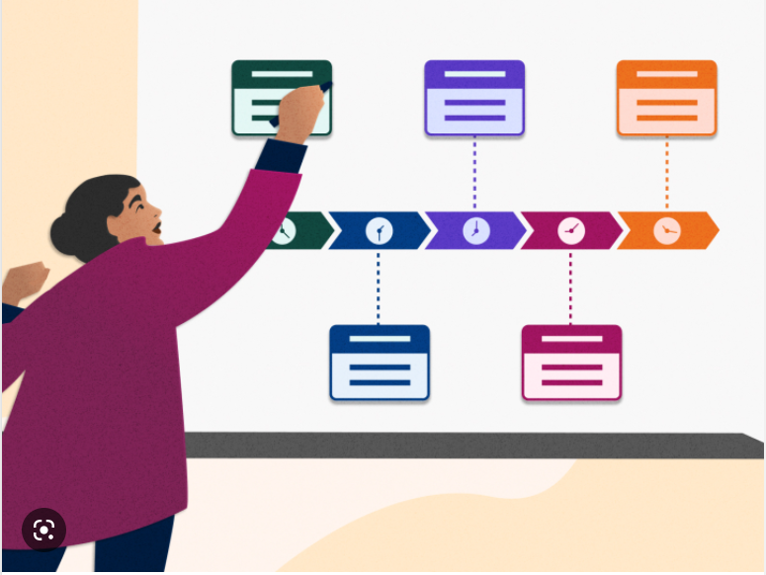
Timeline
ML Project development phase | Date
0) Introduction | 20th May
1) Problem statement discussion and data loading. | 22nd May
2) Exploratory data analysis | 26th May
3) Data pre-processing | 29th May
4) Model Building | 2nd June
5) Model deployment 1 | 5th June
6) Model deployment 2

Slide 9
Overview of the session structure

Slide 10
Session structure
Session Time:8pm-9pm
1 Hour
15min : Check the progress of Notebook of 2 persons
After Every session I will share the
PPT
30min : Learning
Jupyter Notebook
10min : Hands-on
Related resources
10min : QA

Slide 11
Question and Answer (Q&A) session

