Slide 1
FUNCTIONAL DEPENDENCIES & NORMALIZATION

Slide 2
Outline
1 Informal Design Guidelines for Relational Databases
1.1Semantics of the Relation Attributes
1.2 Redundant Information in Tuples and Update Anomalies
1.3 Null Values in Tuples
1.4 Spurious Tuples
2 Functional Dependencies (FDs)
2.1 Definition of FD
2.2 Inference Rules for FDs
2.3 Equivalence of Sets of FDs
2.4 Minimal Sets of FDs

Slide 3
Outline(contd.)
3 Normal Forms Based on Primary Keys
3.1 Normalization of Relations
3.2 Practical Use of Normal Forms
3.3 Definitions of Keys and Attributes Participating in Keys
3.4 First Normal Form
3.5 Second Normal Form
3.6 Third Normal Form
4 General Normal Form Definitions (For Multiple Keys)
5 BCNF (Boyce-Codd Normal Form)

Slide 4
Why normalization?
Formal measure of why one grouping of attributes into a relation schema may be better than the other.
In this chapter the theory behind the evaluation of relational schemas for design quality is discussed.
In other words to measure formally why one set of groupings of attributes into relation schemas is better than another.
Two levels of relation schemas
  The logical or conceptual view
    How users interpret the relation schemas and the meaning of their attributes.
  Implementation or storage view
    How the tuples in the base relation are stored and updated.
    The storage "base relation" level

Slide 5
1 Informal Design Guidelines for Relational Databases (1)
What is relational database design?
The grouping of attributes to form "good" relation schemas
Two levels of relation schemas
  The logical "user view" level
  The storage "base relation" level
Design is concerned mainly with base relations
What are the criteria for "good" base relations?

Slide 6
1.1 Semantics of the Relation Attributes
GUIDELINE 1: Informally, each tuple in a relation should represent one entity or relationship instance. (Applies to individual relations and their attributes).
Attributes of different entities (EMPLOYEEs, DEPARTMENTs, PROJECTs) should not be mixed in the same relation
Only foreign keys should be used to refer to other entities
Entity and relationship attributes should be kept apart as much as possible.
Bottom Line: Design a schema that can be explained easily relation by relation. The semantics of attributes should be easy to interpret.

Slide 7
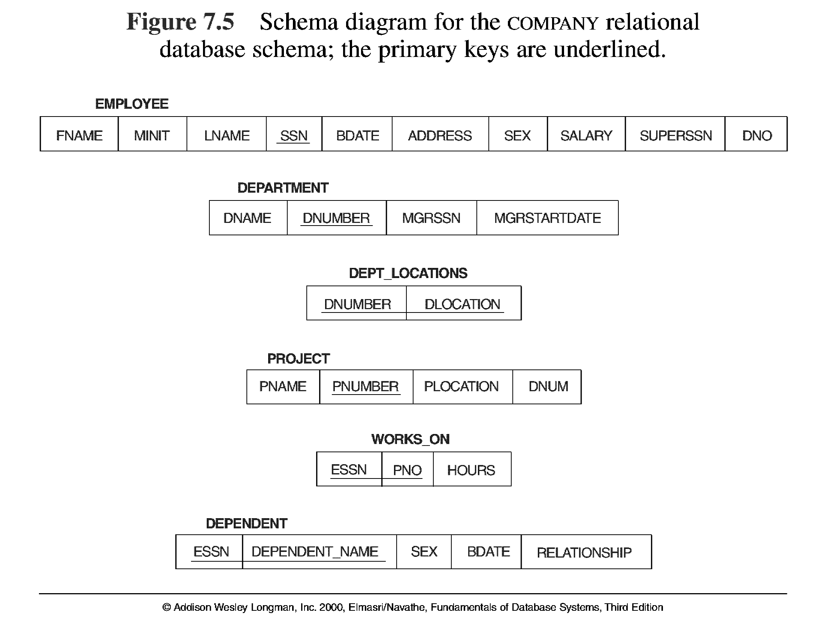
A COMPANY relational database schema

Slide 8
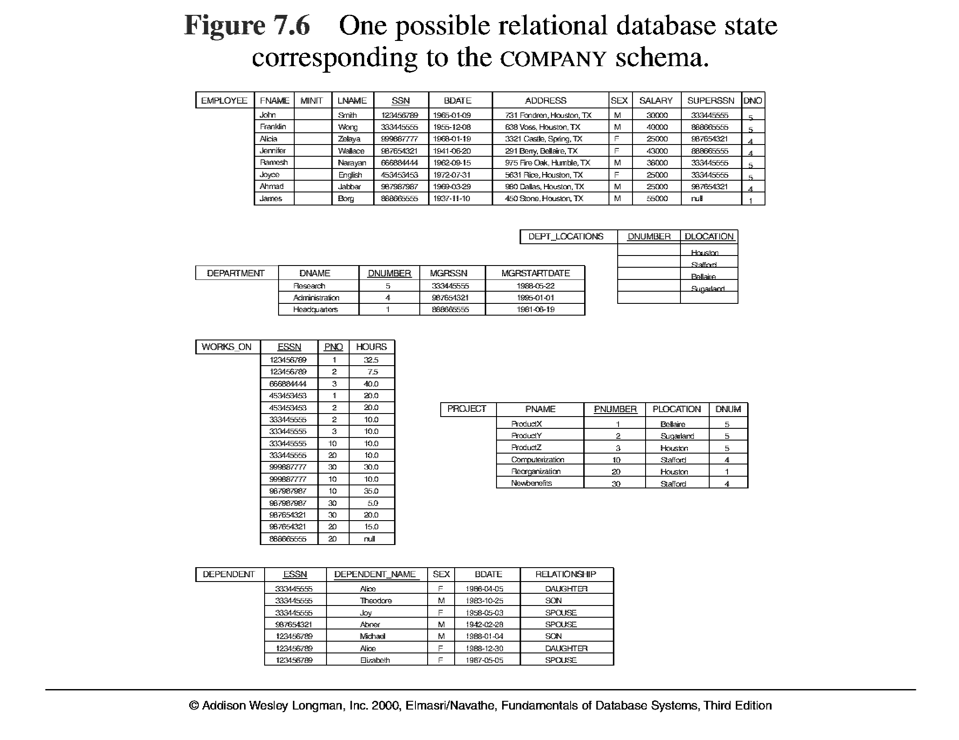
A sample relational database state corresponding to COMPANY database

Slide 9
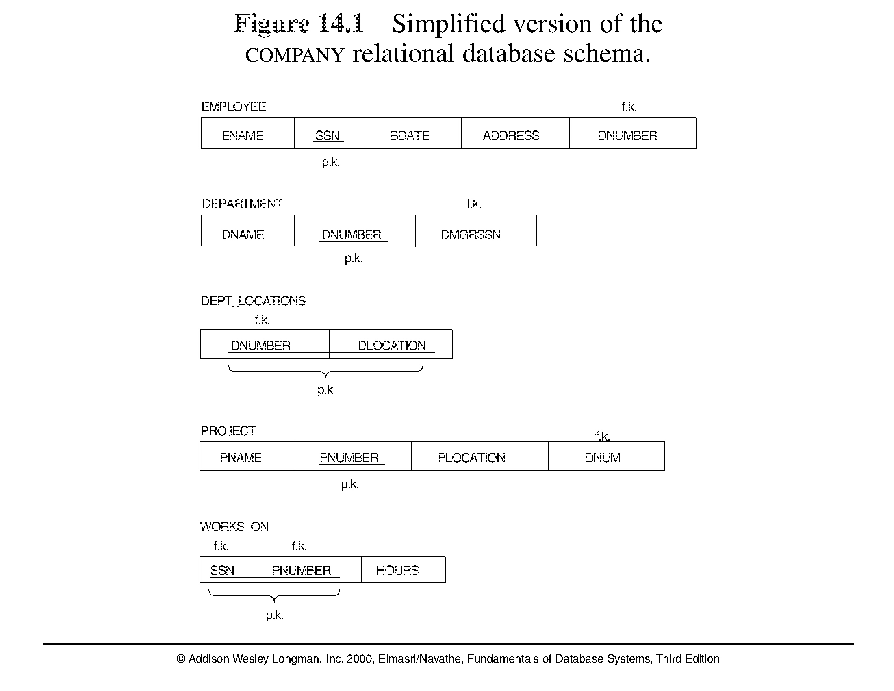
A simplified COMPANY relational database schema

Slide 10
1.2 Redundant Information in Tuples and Update Anomalies
Mixing attributes of multiple entities may cause problems
Information is stored redundantly wasting storage
Problems with update anomalies
  Insertion anomalies
  Deletion anomalies
  Modification anomalies

Slide 11
EXAMPLE OF AN UPDATE ANOMALY (1)
Consider the relation:
EMP_PROJ ( Emp#, Proj#, Ename, Pname, No_hours)
Update Anomaly: Changing the name of project number P1 from “Billing” to “Customer-Accounting” may cause this update to be made for all 100 employees working on project P1.

Slide 12
EXAMPLE OF AN UPDATE ANOMALY (2)
Insert Anomaly: Cannot insert a project unless an employee is assigned to .
Inversely - Cannot insert an employee unless an he/she is assigned to a project.
Delete Anomaly: When a project is deleted, it will result in deleting all the employees who work on that project. Alternately, if an employee is the sole employee on a project, deleting that employee would result in deleting the corresponding project.

Slide 13
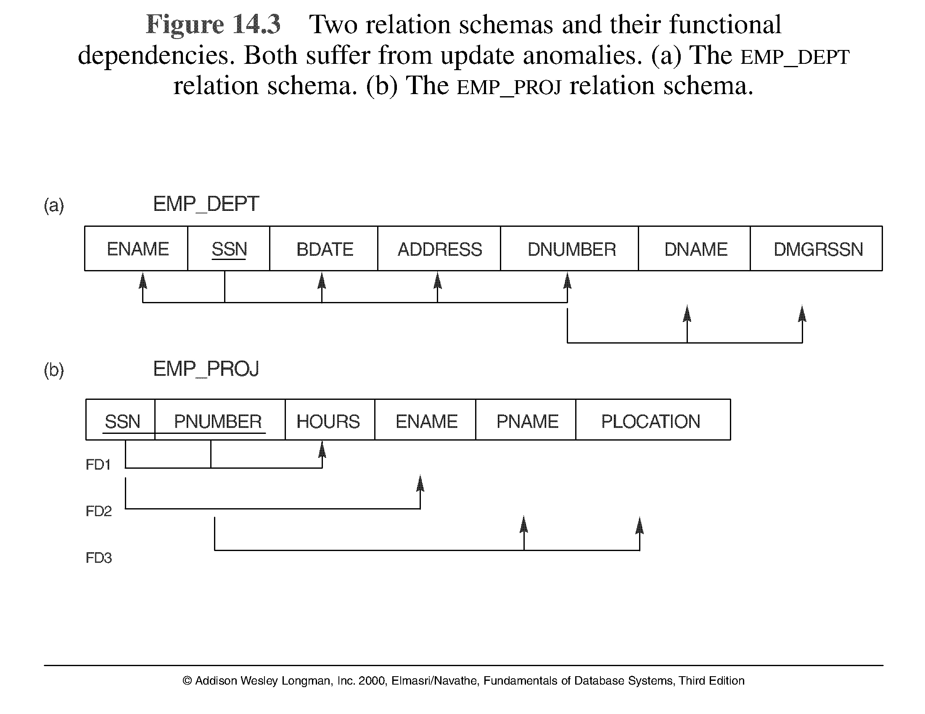
Two relation schemas suffering from update anomalies

Slide 14
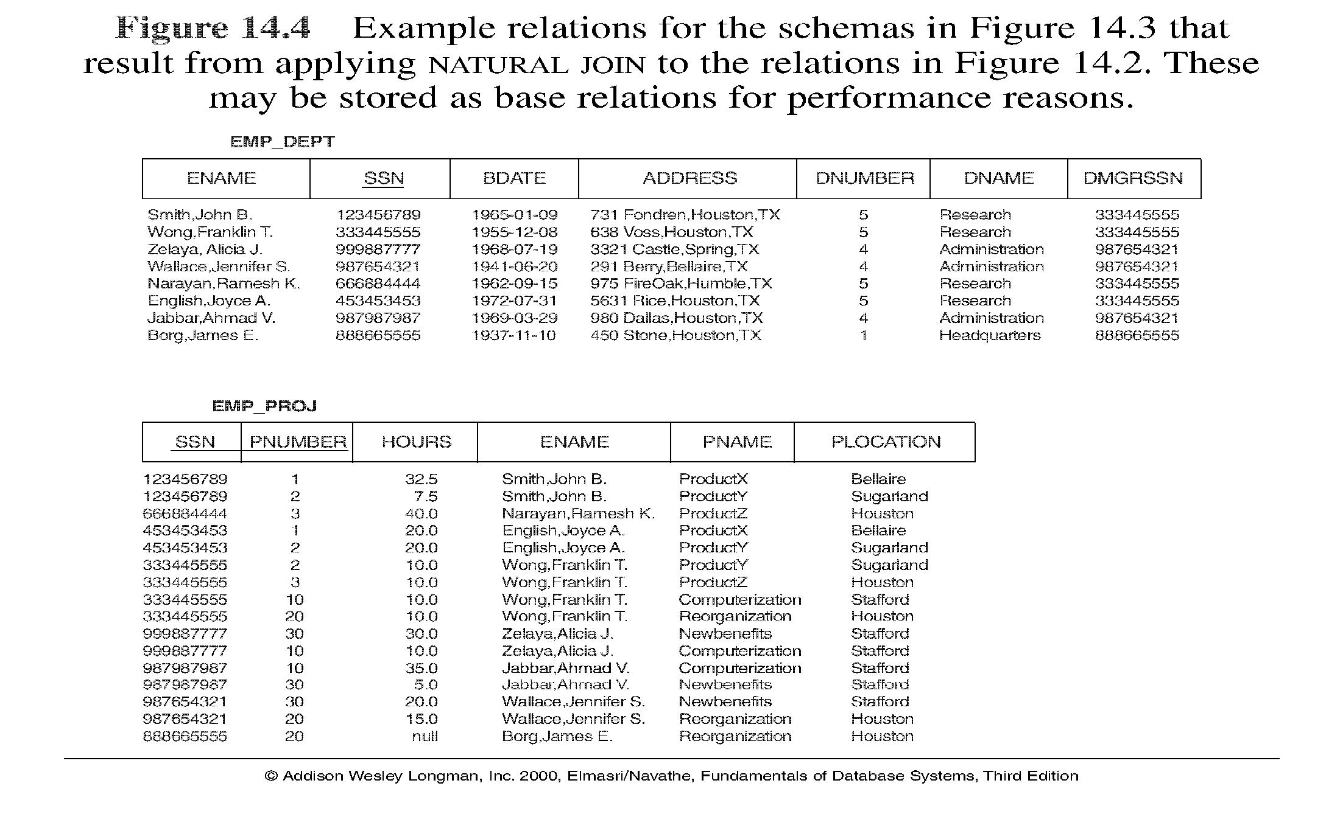
Example States for EMP_DEPT and EMP_PROJ

Slide 15
Guideline to Redundant Information in Tuples and Update Anomalies
GUIDELINE 2: Design a schema that does not suffer from the insertion, deletion and update anomalies. If there are any present, then note them so that applications can be made to take them into account

Slide 16
Problems with Null Values
If many attributes are grouped together as a fat relation, it gives rise to many nulls in the tuples.
Waste storage
Problems in understanding the meaning of the attributes
Difficult while using Nulls in aggregate operators like count or sum

Slide 17
1.3 Null Values in Tuples
GUIDELINE 3: Relations should be designed such that their tuples will have as few NULL values as possible
Attributes that are NULL frequently could be placed in separate relations (with the primary key)
Reasons for nulls:
  attribute not applicable or invalid
  attribute value unknown (may exist)
  value known to exist, but unavailable

Slide 18
1.4 Spurious Tuples
Bad designs for a relational database may result in erroneous results for certain JOIN operations
The "lossless join" property is used to guarantee meaningful results for join operations
GUIDELINE 4: The relations should be designed to satisfy the lossless join condition. No spurious tuples should be generated by doing a natural-join of any relations.

Slide 19


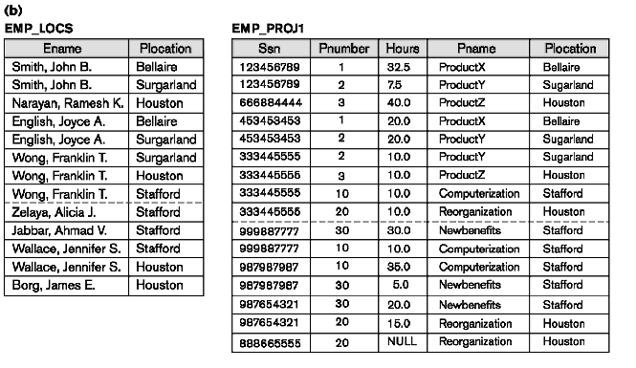
Example of Spurious Tuples

Slide 20
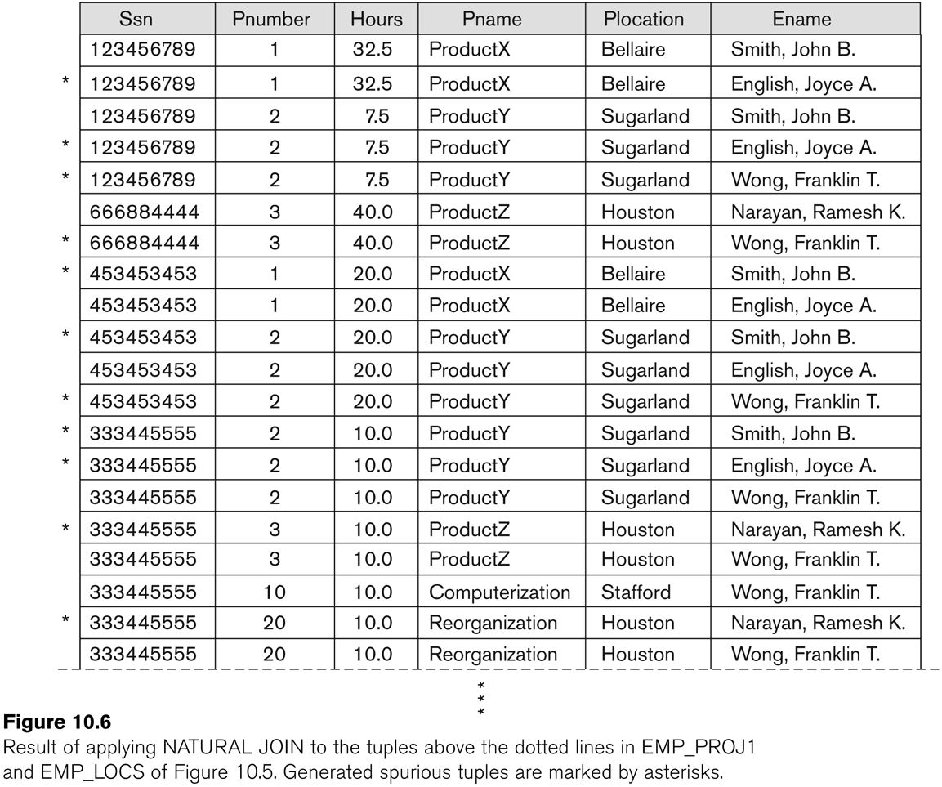
Example of Spurious Tuples generation

Slide 21
Generation of spurious tuples
The two relations EMP_PROJ1 and EMP_LOCS as the base relations of EMP_PROJ, is not a good schema design.
Problem is if a Natural Join is performed on the above two relations it produces more tuples than original set of tuples in EMP_PROJ.
These additional tuples that were not in EMP_PROJ are called spurious tuples because they represent spurious or wrong information that is not valid.
This is because the PLOCATION attribute which is used for joining is neither a primary key, nor a foreign key in either EMP_LOCS AND EMP_PROJ1.

Slide 22
Spurious Tuples (2)
There are two important properties of decompositions:
non-additive or losslessness of the corresponding join
preservation of the functional dependencies.
Note that property (a) is extremely important and cannot be sacrificed. Property (b) is less stringent and may be sacrificed.

Slide 23
Summary and Discussion of Design Guidelines
Anomalies cause redundant work to be done during
  Insertion
  Modification
  Deletion
Waste of storage space due to nulls and difficulty of performing aggregation operations and joins due to null values
Generation of invalid and spurious data during joins on improperly related base relations.

Slide 24
2.1 Functional Dependencies (1)
Functional dependencies (FDs)
  Is a constraint between two sets of attributes from the database.
  Assumption
    The entire database is a single universal relation schema R={A1,A2…An}
    Where A1,A2 … are the attributes.

Slide 25
2.1 Functional Dependencies (1)
Functional dependencies (FDs) are used to specify formal measures of the "goodness" of relational designs
FDs and keys are used to define normal forms for relations
FDs are constraints that are derived from the meaning and interrelationships of the data attributes
A set of attributes X functionally determines a set of attributes Y if the value of X determines a unique value for Y

Slide 26
Functional Dependencies (2)
X -> Y holds if whenever two tuples have the same value for X, they must have the same value for Y
For any two tuples t1 and t2 in any relation instance r(R): If t1[X]=t2[X], then t1[Y]=t2[Y]
X -> Y in R specifies a constraint on all relation instances r(R)
Written as X -> Y; can be displayed graphically on a relation schema as in Figures. ( denoted by the arrow: ).
FDs are derived from the real-world constraints on the attributes

Slide 27
Examples of FD constraints (1)
social security number determines employee name
SSN -> ENAME
project number determines project name and location
PNUMBER -> {PNAME, PLOCATION}
employee ssn and project number determines the hours per week that the employee works on the project
{SSN, PNUMBER} -> HOURS

Slide 28
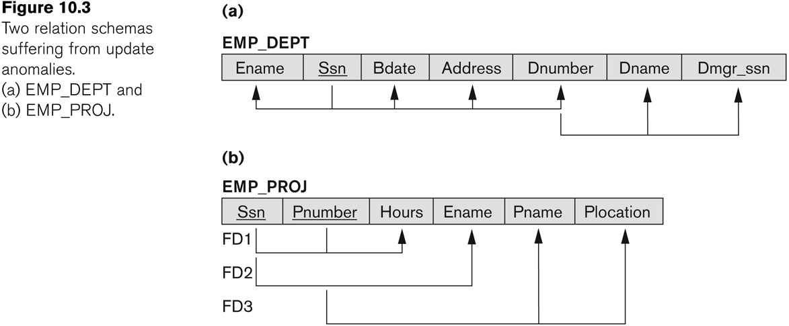
Graphical representation of Functional Dependencies

Slide 29
Examples of FD constraints (2)
An FD is a property of the attributes in the schema R, not of a particular legal relation state r of R.
It must be defined explicitly by someone who knows the semantics of the attributes of R.
The constraint must hold on every relation instance r(R)
If K is a key of R, then K functionally determines all attributes in R
  (since we never have two distinct tuples with t1[K]=t2[K])

Slide 30
Relation state of TEACH
TEACH
TEACHER
COURSE
TEXT
TEACHER -> COURSE
TEXT -> COURSE
Smith | Data Structures | Bartram
Smith | Data Management | Al-Nour
Hall | Compilers | Hoffmann
Brown | ooad | Augenthaler

Slide 31
Redundant functional dependencies
Given a set F of FDs, a FD A→B of F is said to be redundant with respect to the FDs of F iff A→B can be derived from the set of FDs F-{A→B}
Redundant FDs are extra and unnecessary and can be safely removed from the set F.
Eliminating redundant FDs allows us to minimize the set of FDs.
Membership Algorithm helps us to determine redundant FDs.

Slide 32
Membership Algorithm
Assuming F is a set of functional dependencies with A→ B ε F. To determine if A→ B is redundant with respect to the other FDs of the set F
Remove A→B. Initialize G=F-{A→B}. If G≠0 proceed to step 2. else stop executing the algorithm since A→B is non redundant.
Apply inference rules to check if A → B can be deduced from G.
Note:
Example: 4.5

Slide 33
Another Example
F={SSN → {ENAME, BDATE, ADDRESS, DNUMBER},
DNUMBER → {DNAME, DMGRSSN}}
The inferred functional dependencies are
SSN → {DNAME, DMGRSSN}
SSN → SSN
DNUMBER → DNAME
To determine a systematic way to infer dependencies, a set of inference rules has to be discovered that can be used to infer new dependencies from a given set of dependencies. This is denoted by F X→Y

Slide 34
Inference Rules for Functional Dependencies
F is the set of functional dependencies that are specified on relation schema R.
Schema designers specifies the most obvious FDs.
The other dependencies can be inferred or deduced from FDs in F.

Slide 35
2.2 Inference Rules for FDs (1)
Given a set of FDs F, we can infer additional FDs that hold whenever the FDs in F hold
Armstrong's inference rules:
IR1. (Reflexive) If Y subset-of X, then X -> Y
IR2. (Augmentation) If X -> Y, then XZ -> YZ
(Notation: XZ stands for X U Z)
IR3. (Transitive) If X -> Y and Y -> Z, then X -> Z
IR1, IR2, IR3 form a sound and complete set of inference rules
    These are rules hold and all other rules that hold can be deduced from these

Slide 36
Inference Rules for FDs (2)
Some additional inference rules that are useful:
(Decomposition) If X -> YZ, then X -> Y and X -> Z
(Union) If X -> Y and X -> Z, then X -> YZ
(Psuedotransitivity) If X -> Y and WY -> Z, then WX -> Z
The last three inference rules, as well as any other inference rules, can be deduced from IR1, IR2, and IR3 (completeness property)

Slide 37
Closures, cover and Equivalence of FDs
Given a set F of FDs, we can determine all the FDs that can be logically implied by F.
The most important application of this logic is in the normalization process of relations.
  Closures
  Covers
  Equivalence of FDs

Slide 38
Example of Closure
Department has one manager (DEPT_NO -> MGR_SSN)
Manager has a unique phone number
(MGR_SSN->MGR_PHONE) then these two dependencies together imply that (DEPT_NO->MGR_PHONE)
This defines a concept called as closure that includes all possible dependencies that can be inferred from the given set F.
The set of all dependencies that include F as well as all dependencies that can be inferred from F is called the closure of F (F⁺)

Slide 39
Closure of a FD
Closure of a set F of FDs is the set F⁺ of all FDs that can be inferred from F
Closure of a set of attributes X with respect to F is the set X ⁺ of all attributes that are functionally determined by X
X ⁺ can be calculated by repeatedly applying IR1, IR2, IR3 using the FDs in F

Slide 40
Algorithm: Determining X⁺ , the closure of X under F
X⁺ = X
repeat
old X⁺ : = X⁺ ;
for each functional dependency Y → Z in F do
if Y is subset of X⁺ then X⁺ : = X⁺ U Z;
Until (X⁺ = old X⁺ )

Slide 41
Example : Computing closure
F: = { ssn → ename,
pnumber → {pname, plocation},
{ssn, pnumber} → hours }
Applying the algorithm:
{ssn}⁺ = {ssn, ename}
{pnumber}⁺ = {pnumber, pname, plocation}
{ssn, pnumber}⁺ = { ssn, pnumber, ename, pname, plocation, hours}

Slide 42
2.3 Equivalence of Sets of FDs
Two sets of FDs F and G are equivalent if:
- every FD in F can be inferred from G, and
- every FD in G can be inferred from F
Hence, F and G are equivalent if F ⁺ =G ⁺
Definition: F covers G if every FD in G can be inferred from F (i.e., if G ⁺ subset-of F ⁺)
F and G are equivalent if F covers G and G covers F
There is an algorithm for checking equivalence of sets of FDs

Slide 43
Non Redundant Cover Algorithm
Initialize G to F. That is set G=F.
Test every FD of G for redundancy using the Membership Algorithm until there are no more FDs of G to be tested.
The set G is a non redundant cover of F.
Note:
Example 4.8

Slide 44
Extraneous Attributes
Further reduction of the size of the FDs of F by removing either extraneous left attributes with respect to F or extraneous right attributes with respect to F.
F be a set of FDs over schema R and let A1A2→B1B2.
A1 is extraneous iff
FΞF-{A1A2→B1B2}U{A2→B1B2}

Slide 45
Canonical Cover
For a given set F of FDs, a canonical cover, denoted by Fc, is a set of FDs where the following conditions are simultaneously satisfied:
1. Every FD of Fc is simple. That is RHS of every FDs of Fc has only one attribute
2. Fc is left-reduced.
3. Fc is nonredundant.
Note:
Example 4.10

Slide 46
2.4 Minimal Sets of FDs (1)
A set of FDs is minimal if it satisfies the following conditions:
Every dependency in F has a single attribute for its RHS.
We cannot remove any dependency from F and have a set of dependencies that is equivalent to F.
We cannot replace any dependency X -> A in F with a dependency Y -> A, where Y proper-subset-of X ( Y subset-of X) and still have a set of dependencies that is equivalent to F.

Slide 47
Algorithm : Finding a minimal cover F for a set of functional dependencies E
Set F := E
Replace each f.d X→ { A₁, A₂, …, A_{n}} in F by the f.d s X → A₁ , X → A₂ , …. X → A_{n}
For each f.d X → A in F
  for each attribute B that is an element of X
  if { { F – { X → A}} U { ( X –{B} ) → A} is equivalent to F
  then replace X → A with ( X-{B}) → A in F
For each remaining f.d X → A in F
  if { F - { X → A}} is equivalent to F,
  then remove X → A from F

Slide 48
Example: Finding minimal cover of E
E : { B→ A, D→ A, AB→ D}
Check if AB → D can be replaced with A → D or B → D
Given B→ A
Augmenting with B on both sides => BB → AB => B → AB
Now B → AB and given AB → D
Hence B → D
Now E ‘ = {B→ A, D→ A, B→ D}
B→ D & D→ A => B → A So remove B → A
Minimum cover of E = { B → D, D → A}

Slide 49
Minimal Sets of FDs (2)
Every set of FDs has an equivalent minimal set
There can be several equivalent minimal sets
There is no simple algorithm for computing a minimal set of FDs that is equivalent to a set F of FDs
To synthesize a set of relations, we assume that we start with a set of dependencies that is a minimal set

Slide 50
3 Normal Forms Based on Primary Keys
3.1 Normalization of Relations
3.2 Practical Use of Normal Forms
3.3 Definitions of Keys and Attributes Participating in Keys
3.4 First Normal Form
3.5 Second Normal Form
3.6 Third Normal Form

Slide 51
3.1 Normalization of Relations (1)
Normalization: The process of decomposing unsatisfactory "bad" relations by breaking up their attributes into smaller relations
Normal form: Condition using keys and FDs of a relation to certify whether a relation schema is in a particular normal form

Slide 52
Normalization of Relations (2)
2NF, 3NF, BCNF based on keys and FDs of a relation schema
4NF based on keys, multi-valued dependencies : MVDs; 5NF based on keys, join dependencies : JDs
Additional properties may be needed to ensure a good relational design (lossless join, dependency preservation)

Slide 53
3.2 Practical Use of Normal Forms
Normalization is carried out in practice so that the resulting designs are of high quality and meet the desirable properties
The practical utility of these normal forms becomes questionable when the constraints on which they are based are hard to understand or to detect
The database designers need not normalize to the highest possible normal form. (usually up to 3NF, BCNF or 4NF)
Denormalization: the process of storing the join of higher normal form relations as a base relation—which is in a lower normal form

Slide 54
3.3 Definitions of Keys and Attributes Participating in Keys (1)
A superkey of a relation schema R = {A₁, A₂, ...., A_{n}} is a set of attributes S subset-of R with the property that no two tuples t₁ and t₂ in any legal relation state r of R will have t₁[S] = t₂[S]
A key K is a superkey with the additional property that removal of any attribute from K will cause K not to be a superkey any more.

Slide 55
Definitions of Keys and Attributes Participating in Keys (2)
If a relation schema has more than one key, each is called a candidate key. One of the candidate keys is arbitrarily designated to be the primary key, and the others are called secondary keys.
A Prime attribute must be a member of some candidate key
A Nonprime attribute is not a prime attribute—that is, it is not a member of any candidate key.

Slide 56
3.2 First Normal Form
Disallows composite attributes, multivalued attributes, and nested relations; attributes whose values for an individual tuple are non-atomic
Considered to be part of the definition of relation

Slide 57
1NF
The objective of normalizing a table is to remove its repeating groups and ensure that all entries of the resulting table have at most a single value.
Two ways of doing it
  Flattening the table and selecting suitable primary keys
  Decomposing into two new tables that will replace the original tables.
    One table contains the table identifier of the original table and all the non-repeating attributes
    The other table contains a copy of the table identifier and all the repeating attributes.

Slide 58

Normalization into 1NF
X
O
But, redundancy
Slide 10- <number>

Slide 59
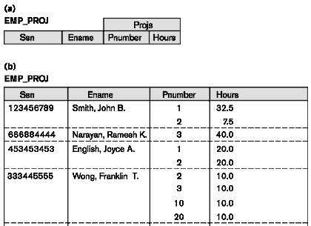
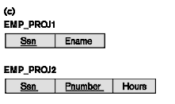
Normalization nested relations into 1NF
Nested Relation
Extension of EMP_PROJ
Decomposition

Slide 60
Partial Dependencies
Given a relation r(R) the sets of attributes X and Y(X,Y C R) and X→Y, we can say that Y is fully dependent on X iff there is no proper subset W of X such that W→Y.
If there is a proper subset W of X such that W→Y then Y is said to be partially dependent on attribute X.
PROJECT_EMPLOYEE
Emp_id → Emp_name, Emp_dept where as Proj_id, Emp_id → emp_name, Emp_ dept Hence partially dependent.
PROJ_ID
EMP_ID
EMP_NAME
EMP_DEPT
EMP_HRLY_RATE
TOTAL_HOURS

Slide 61
3.3 Second Normal Form (1)
Uses the concepts of FDs, primary key
Definitions:
Prime attribute - attribute that is member of the primary key K
Full functional dependency - a FD Y -> Z where removal of any attribute from Y means the FD does not hold any more
Examples: - {SSN, PNUMBER} -> HOURS is a full FD since neither SSN -> HOURS nor PNUMBER -> HOURS hold
- {SSN, PNUMBER} -> ENAME is not a full FD (it is called a partial dependency ) since SSN -> ENAME also holds

Slide 62
Second Normal Form (2)
A relation schema R is in second normal form (2NF) if every non-prime attribute A in R is fully functionally dependent on the primary key
R can be decomposed into 2NF relations via the process of 2NF normalization

Slide 63
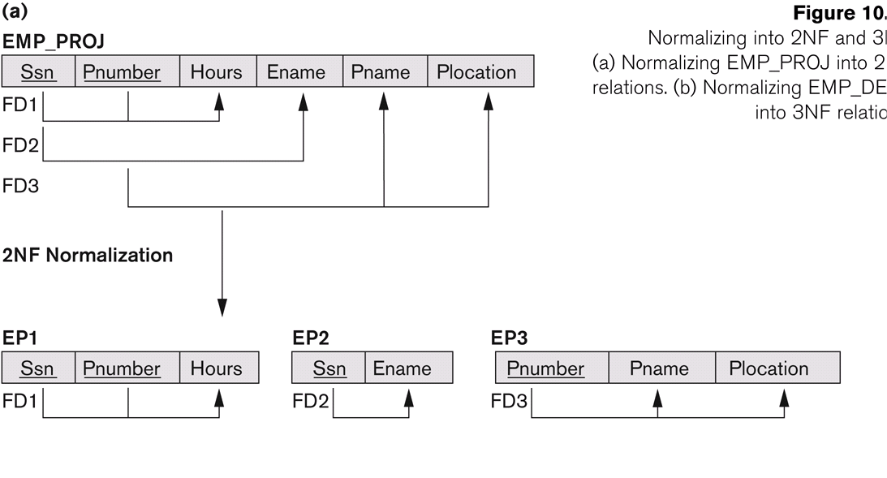
Normalizing into 2NF

Slide 64
3.4 Third Normal Form (1)
Definition:
Transitive functional dependency - a FD X -> Z that can be derived from two FDs X -> Y and Y -> Z
Examples:
- SSN -> DMGRSSN is a transitive FD since
SSN -> DNUMBER and DNUMBER -> DMGRSSN hold
- SSN -> ENAME is non-transitive since there is no set of attributes X where SSN -> X and X -> ENAME

Slide 65
Third Normal Form (2)
A relation schema R is in third normal form (3NF) if it is in 2NF and no non-prime attribute A in R is transitively dependent on the primary key
R can be decomposed into 3NF relations via the process of 3NF normalization
NOTE:
In X -> Y and Y -> Z, with X as the primary key, we consider this a problem only if Y is not a candidate key. When Y is a candidate key, there is no problem with the transitive dependency .
E.g., Consider EMP (SSN, Emp#, Salary ).
Here, SSN -> Emp# -> Salary and Emp# is a candidate key.

Slide 66
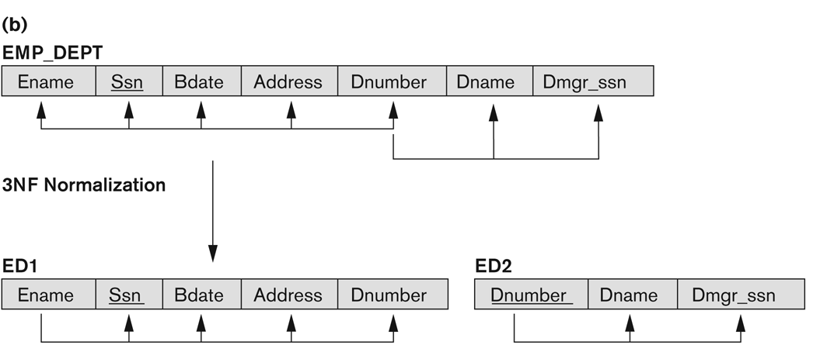
Normalization into 3NF

Slide 67
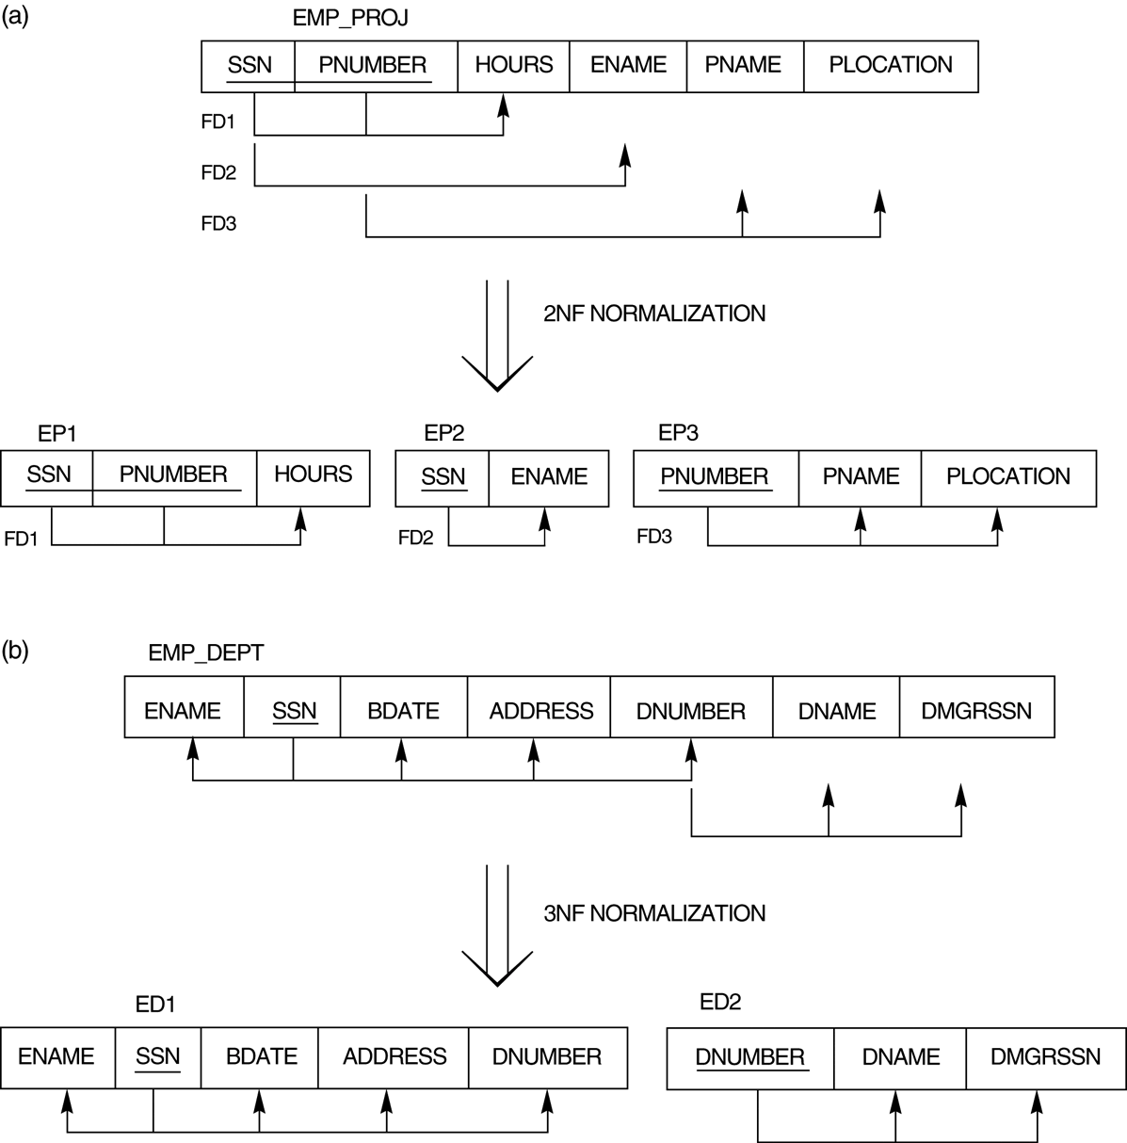
Normalizing into 2NF and 3NF.

Slide 68
4 General Normal Form Definitions (For Multiple Keys) (1)
The above definitions consider the primary key only
The following more general definitions take into account relations with multiple candidate keys
A relation schema R is in second normal form (2NF) if every non-prime attribute A in R is fully functionally dependent on every key of R

Slide 69
General Normal Form Definitions (2)
Definition:
Superkey of relation schema R - a set of attributes S of R that contains a key of R
A relation schema R is in third normal form (3NF) if whenever a FD X -> A holds in R, then either:
(a) X is a superkey of R, or
(b) A is a prime attribute of R
NOTE: Boyce-Codd normal form disallows condition (b) above

Slide 70
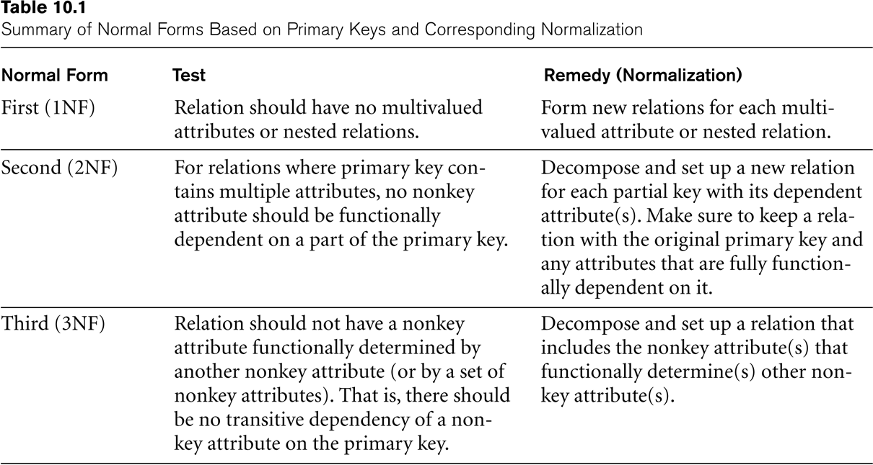
SUMMARY

Slide 71
5 BCNF (Boyce-Codd Normal Form)
A relation schema R is in Boyce-Codd Normal Form (BCNF) if whenever an FD X -> A holds in R, then X is a superkey of R
Each normal form is strictly stronger than the previous one
  Every 2NF relation is in 1NF
  Every 3NF relation is in 2NF
  Every BCNF relation is in 3NF
There exist relations that are in 3NF but not in BCNF
The goal is to have each relation in BCNF (or 3NF)

Slide 72
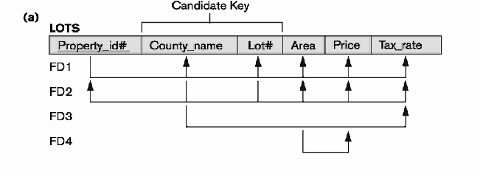
Normalize the following relation

Slide 73
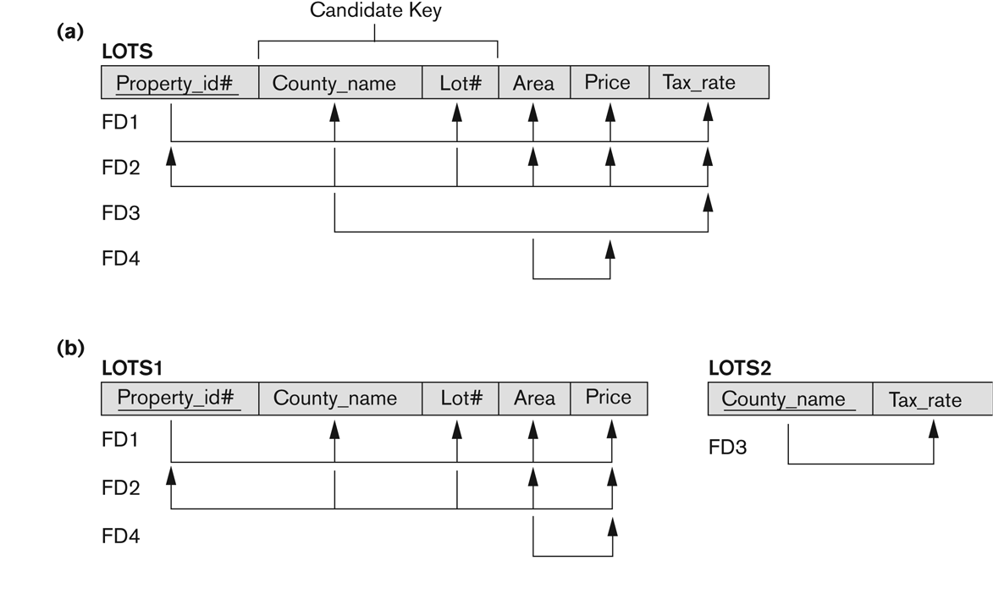
Normalization into 2NF
Slide 10- <number>

Slide 74
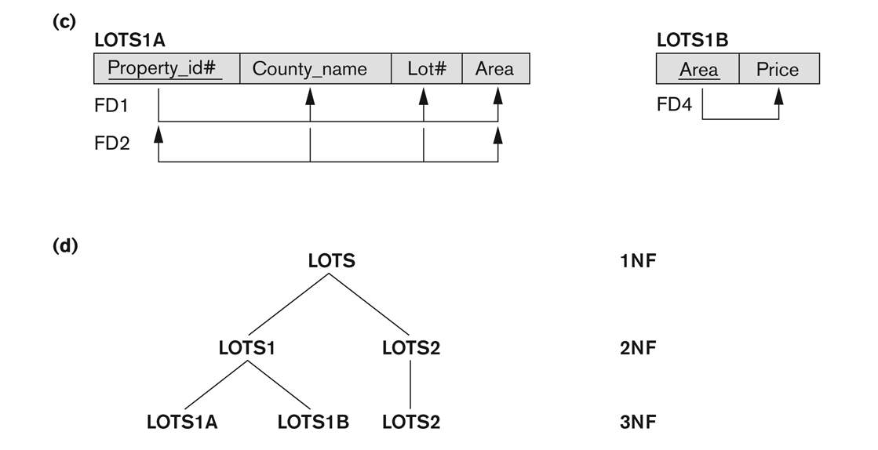
Normalization into 3NF

Slide 75
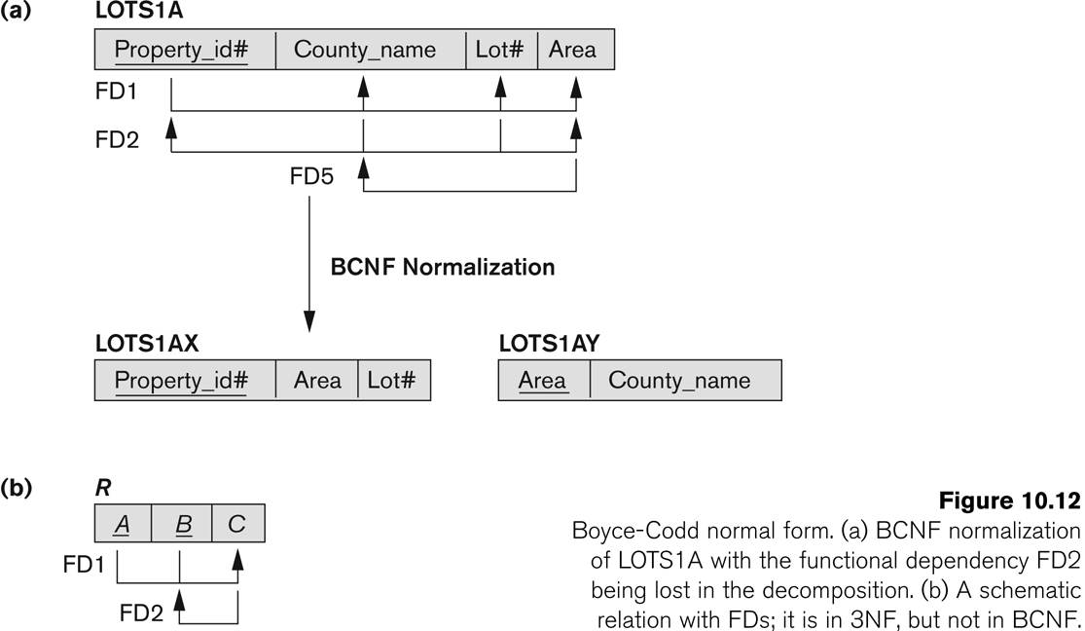
Boyce-Codd normal form

Slide 76
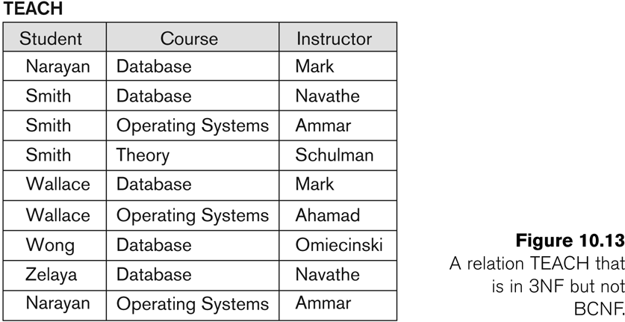
A relation TEACH that is in 3NF but not in BCNF

Slide 77
Achieving the BCNF by Decomposition (1)
Two FDs exist in the relation TEACH:
fd1: { student, course} -> instructor
fd2: instructor -> course
{student, course} is a candidate key for this relation and that the dependencies shown follow the pattern in the prev. figure. So this relation is in 3NF but not in BCNF
A relation NOT in BCNF should be decomposed so as to meet this property, while possibly forgoing the preservation of all functional dependencies in the decomposed relations.

Slide 78
Achieving the BCNF by Decomposition (2)
Three possible decompositions for relation TEACH
  {student, instructor} and {student, course}
  {course, instructor } and {course, student}
  {instructor, course } and {instructor, student}
All three decompositions will lose fd1. We have to settle for sacrificing the functional dependency preservation. But we cannot sacrifice the non-additivity property after decomposition.
Out of the above three, only the 3rd decomposition will not generate spurious tuples after join.(and hence has the non-additivity property).

Slide 79
Fourth Normal Form (4NF)
Multi-valued dependency (MVD)
  Represents a dependency between attributes (for example, A,B and C) in a relation, such that for each value of A there is a set of values for B and a set of value for C. However, the set of values for B and C are independent of each other.
A multi-valued dependency can be further defined as being trivial or nontrivial.
A MVD A →> B in relation R is defined as being trivial if
  B is a subset of A or
  A U B = R
A MVD is defined as being nontrivial if neither of the above two conditions is satisfied.

Slide 80
Fourth Normal Form (4NF)
Fourth normal form (4NF)
  A relation that is in Boyce-Codd normal form and contains no nontrivial multi-valued dependencies.

Slide 81
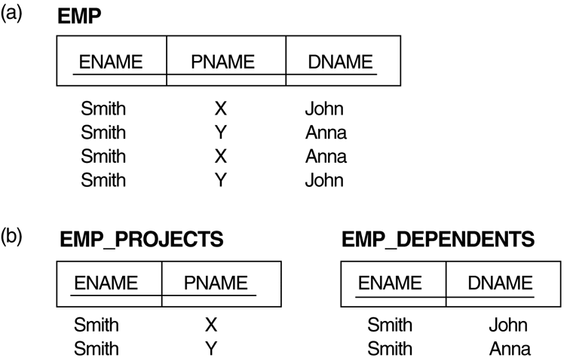
Multivalued Dependencies and Fourth Normal Form
The EMP relation with two MVDs: ENAME —>> PNAME and ENAME —>> DNAME.
Decomposing the EMP relation into two 4NF relations EMP_PROJECTS and EMP_DEPENDENTS

Slide 82
Multivalued Dependencies and Fourth Normal Form (3)
Inference Rules for Functional and Multivalued Dependencies:
IR1 (reflexive rule for FDs): If X ⊇ Y, then X –> Y.
IR2 (augmentation rule for FDs): {X –> Y} ⏐= XZ –> YZ.
IR3 (transitive rule for FDs): {X –> Y, Y –>Z} ⏐= X –> Z.
IR4 (complementation rule for MVDs): {X —>> Y} ⏐= X —>> (R – (X ∪ Y))}.
IR5 (augmentation rule for MVDs): If X —>> Y and W ⊇ Z then WX —>> YZ.
IR6 (transitive rule for MVDs): {X —>> Y, Y —>> Z} ⏐= X —>> (Z 2 Y).
IR7 (replication rule for FD to MVD): {X –> Y} ⏐= X —>> Y.
IR8 (coalescence rule for FDs and MVDs): If X —>> Y and there exists W with the properties that (a) W ∩ Y is empty, (b) W –> Z, and (c) Y ⊇ Z, then X –> Z.
Chapter 11-<number>

Slide 83
Multivalued Dependencies and Fourth Normal Form (4)
Definition:
A relation schema R is in 4NF with respect to a set of dependencies F (that includes functional dependencies and multivalued dependencies) if, for every nontrivial multivalued dependency X —>> Y in F⁺, X is a superkey for R.
Note: F⁺ is the (complete) set of all dependencies (functional or multivalued) that will hold in every relation state r of R that satisfies F. It is also called the closure of F.
Chapter 11-<number>

Slide 84
Multivalued Dependencies and Fourth Normal Form (6)
Lossless (Non-additive) Join Decomposition into 4NF Relations:
PROPERTY LJ1’
The relation schemas R₁ and R₂ form a lossless (non-additive) join decomposition of R with respect to a set F of functional and multivalued dependencies if and only if
(R₁ ∩ R₂) —>> (R₁ - R₂)
or by symmetry, if and only if
(R₁ ∩ R₂) —>> (R₂ - R₁)).
Chapter 11-<number>

Slide 85
Multivalued Dependencies and Fourth Normal Form (7)
Algorithm 11.5: Relational decomposition into 4NF relations with non-additive join property
Input: A universal relation R and a set of functional and multivalued dependencies F.
Set D := { R };
While there is a relation schema Q in D that is not in 4NF do
{ choose a relation schema Q in D that is not in 4NF;
find a nontrivial MVD X —>> Y in Q that violates 4NF;
replace Q in D by two relation schemas (Q - Y) and (X υ Y);
};
Chapter 11-<number>

Slide 86
Fifth Normal Form (5NF)
Fifth normal form (5NF)
  A relation that has no join dependency.
Lossless-join dependency
  A property of decomposition, which ensures that no spurious tuples are generated when relations are reunited through a natural join operation.
Join dependency
  Describes a type of dependency. For example, for a relation R with subsets of the attributes of R denoted as A, B, …, Z, a relation R satisfies a join dependency if, and only if, every legal value of R is equal to the join of its projections on A, B, …, Z.

Slide 87
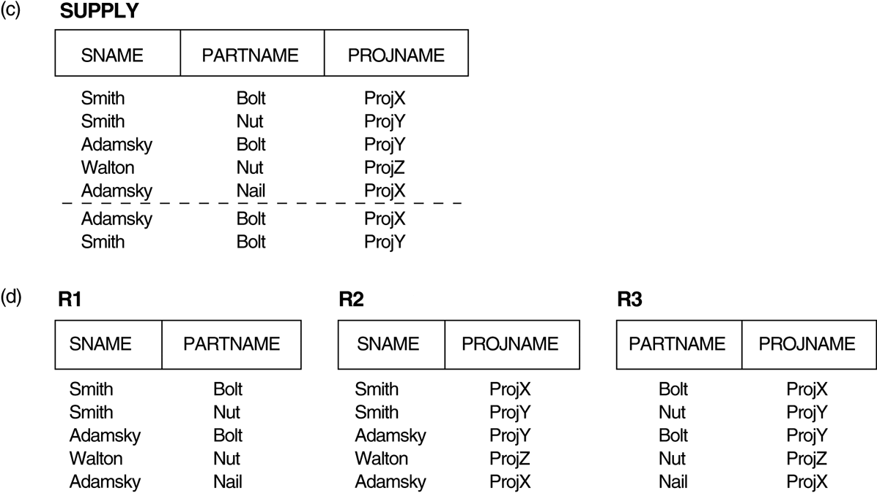
Relation SUPPLY with Join Dependency and conversion to Fifth Normal Form
(c) The relation SUPPLY with no MVDs is in 4NF but not in 5NF if it has the JD(R1, R2, R3).
(d) Decomposing the relation SUPPLY into the 5NF relations R1, R2, and R3.

Slide 88
4. Join Dependencies and Fifth Normal Form (1)
Definition:
A join dependency (JD), denoted by JD(R₁, R₂, ..., R_{n}), specified on relation schema R, specifies a constraint on the states r of R. The constraint states that every legal state r of R should have a non-additive join decomposition into R₁, R₂, ..., R_{n}; that is, for every such r we have
* (π_{R1}(r), π_{R2}(r), ..., π_{Rn}(r)) = r
Note: an MVD is a special case of a JD where n = 2.
A join dependency JD(R₁, R₂, ..., R_{n}), specified on relation schema R, is a trivial JD if one of the relation schemas R_{i} in JD(R₁, R₂, ..., R_{n}) is equal to R.
Chapter 11-<number>

Slide 89
Join Dependencies and Fifth Normal Form (2)
Definition:
A relation schema R is in fifth normal form (5NF) (or Project-Join Normal Form (PJNF)) with respect to a set F of functional, multivalued, and join dependencies if, for every nontrivial join dependency JD(R₁, R₂, ..., R_{n}) in F⁺ (that is, implied by F), every R_{i} is a superkey of R.
Chapter 11-<number>

Slide 90
6. Other Dependencies and Normal Forms (1)
Template Dependencies:
Template dependencies provide a technique for representing constraints in relations that typically have no easy and formal definitions.
The idea is to specify a template—or example—that defines each constraint or dependency.
There are two types of templates: tuple-generating templates and constraint-generating templates.
A template consists of a number of hypothesis tuples that are meant to show an example of the tuples that may appear in one or more relations. The other part of the template is the template conclusion.
Chapter 11-<number>

Slide 91
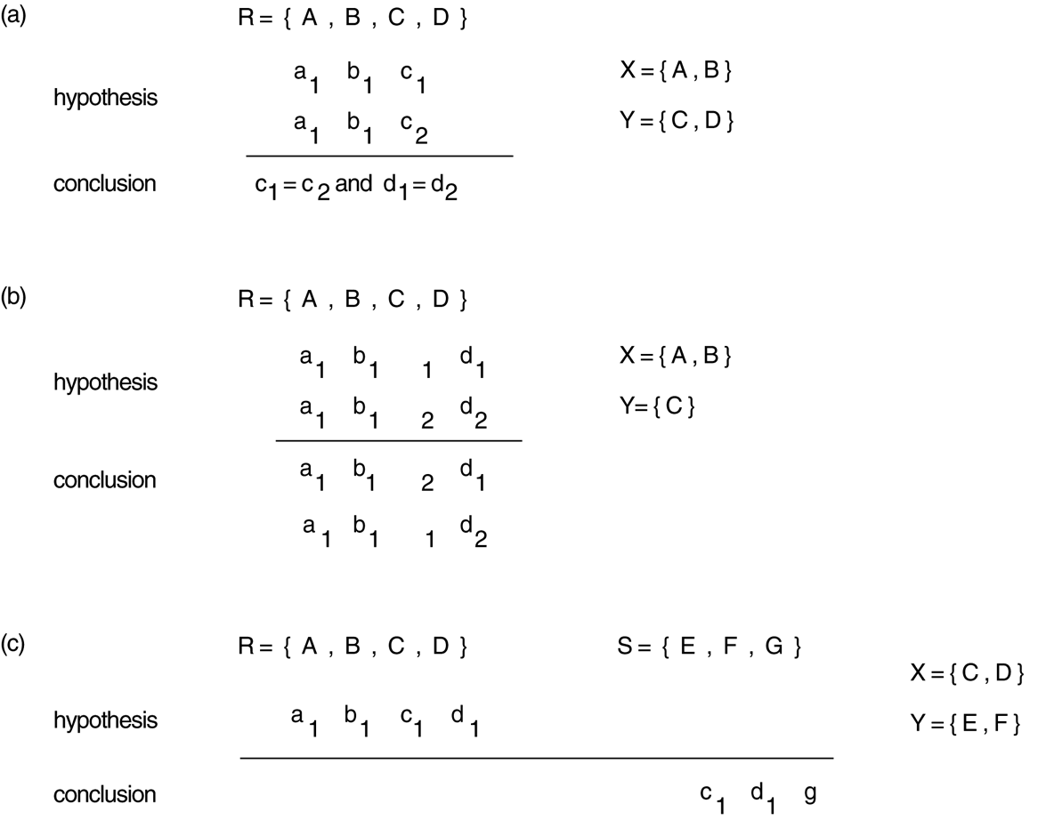
Other Dependencies and Normal Forms (2)
Templates for some common types of dependencies.
(a) Template for functional dependency X –> Y. (b) Template for the multivalued dependency X —>> Y . (c) Template for the inclusion dependency R.X < S.Y.
Chapter 11-<number>

Slide 92
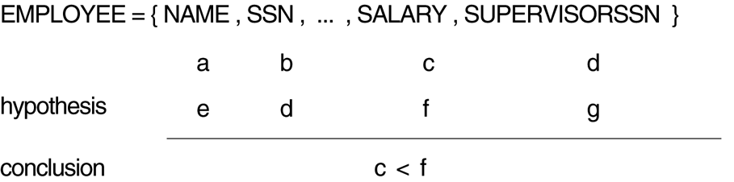
Other Dependencies and Normal Forms (3)
Templates for the constraint that an employee’s salary must be less than the supervisor’s salary.
Chapter 11-<number>

Slide 93
Other Dependencies and Normal Forms (4)
Domain-Key Normal Form (DKNF):
Defintion:A relation schema is said to be in DKNF if all constraints and dependencies that should hold on the valid relation states can be enforced simply by enforcing the domain constraints and key constraints on the relation.
The idea is to specify (theoretically, at least) the “ultimate normal form” that takes into account all possible types of dependencies and constraints. .
For a relation in DKNF, it becomes very straightforward to enforce all database constraints by simply checking that each attribute value in a tuple is of the appropriate domain and that every key constraint is enforced.
The practical utility of DKNF is limited
Chapter 11-<number>

Slide 94
References:
R. Elmasri S.B. Navathe, “Fundamentals of Database PearsonEducation, 2004.

