Slide 1
Module – I Introduction into Unix OS

Slide 2
Contents -
Unit – 1 - Introduction to Unix OS
Definition of Operating System
Unix Operating System
Features of Unix
Unix Architecture
Kernel and Shell
Files and Processes
System Calls
POSIX
Internal & External Commands

Slide 3
Definition of Operating System -
An operating system can be defined as an interface between user and hardware. It is responsible for the execution of all processes, Resource allocation, CPU management, File management and many other tasks.
The main purpose of an operating system is to provide an environment in which an user can execute programs in convenient and efficient manner.

Slide 4
Definition of Unix Operating System -
Unix is a portable, multitasking, multiuser, time-sharing operating system (OS) originally developed in 1969 by a group of employees at AT&T Bell Labs.
Unix was first programmed in assembly language but was reprogrammed in C in 1973.
Unix has been supported to more machine families than any other operating system. As a result, it has come to be identified with the concept of open systems.
Unix operating systems are widely used in PCs, servers and mobile devices. The Unix environment was also an essential element in the development of the Internet and networking.

Slide 5
Features of Unix -
Multitasking and multiuser.
Programming interface.
Use of files as abstractions of devices and other objects.
Built-in networking (TCP/IP is standard)
Persistent system service processes called "daemons" and managed by init or inet.
Note:
A daemon is a long-running background process that answers requests for services. The term originated with Unix, but most operating systems use daemons in some form or another.
In Unix, the names of daemons conventionally end in "d". Some examples include inetd, httpd, nfsd, sshd, named, and lpd.

Slide 6
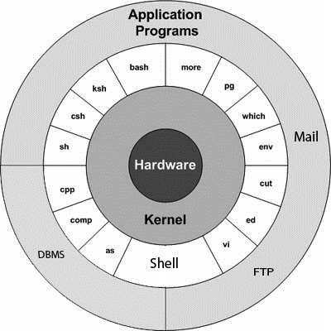
Unix Architecture -

Slide 7
To be continued…
What is Kernel?
A kernel is the core component of an operating system. Using inter-process communication and system calls, it acts as a bridge between applications and the data processing performed at the hardware level. When an operating system is loaded into memory, the kernel loads first and remains in memory until the operating system is shut down again. The kernel is responsible for low-level tasks such as disk management, task management and memory management.

Slide 8
Note –
A kernel is a program that -
Controls all computer operations.
Coordinates all executing utilities.
Ensures that executing utilities do not interfere with each other or consume all system resources.
Schedules and manages all system processes.
By interfacing with a kernel, a shell provides a way for a user to execute utilities and programs.

Slide 9
To be continued…
What is System Call?
A system call is just what its name implies -- a request for the operating system to do something on behalf of the user's program. The system calls are functions used in the kernel itself.
Detail Explanation –
In computing, a system call is the programmatic way in which a computer program requests a service from the kernel of the operating system it is executed on.
A system call is a way for programs to interact with the operating system. A computer program makes a system call when it makes a request to the operating system’s kernel.

Slide 10
To be continued…
System call provides the services of the operating system to the user programs via Application Program Interface (API).
It provides an interface between a process and operating system to allow user-level processes to request services of the operating system.
System calls are the only entry points into the kernel system.
All programs needing resources must use system calls.
Application Program Interface (API) –
Stands for “Application Programming Interface” - An API is a set of commands, functions, protocols, and objects that programmers can use to create software or interact with an external system. It provides developers with standard commands for performing common operations so they do not have to write the code from scratch.

Slide 11
System Calls -
In computing, a system call is the programmatic way in which a computer program requests a service from the kernel of the operating system it is executed on. A system call is a way for programs to interact with the operating system. A computer program makes a system call when it makes a request to the operating system’s kernel. System call provides the services of the operating system to the user programs via Application Program Interface(API). It provides an interface between a process and operating system to allow user-level processes to request services of the operating system. System calls are the only entry points into the kernel system. All programs needing resources must use system calls.

Slide 12
To be continued…
Services Provided by System Calls -
Process creation and management
Main memory management
File Access, Directory and File system management
Device handling(I/O)
Protection
Networking
etc.

Slide 13
To be continued…
Services Provided by System Calls -
Process creation and management
Main memory management
File Access, Directory and File system management
Device handling(I/O)
Protection
Networking etc.
Types of System Calls - There are 5 different categories of system calls, such as -
Process control - end, abort, create, terminate, allocate and free memory.
File management - create, open, close, delete, read file etc.
Device management
Information maintenance
Communication

Slide 14
To be continued…
Types of System Calls : There are 5 different categories of system calls –
Process control - end, abort, create, terminate, allocate and free memory.
File management - create, open, close, delete, read file etc.
Device management
Information maintenance
Communication

Slide 15
To be continued…
What is Shell?
A shell is software that provides an interface for an operating system's users to provide access to the kernel's services.
On Unix-based or Linux-based operating systems, a shell can be invoked through the shell command in the command line interface (CLI), allowing users to direct operations through computer commands, text or script.
Shells also exist for programming languages, providing them with autonomy from the operating system and allowing cross-platform compatibility.

Slide 16
The Bourne Shell – The Bourne shell (sh)-
is written by Steve Bourne at AT&T Bell Labs, is the original UNIX shell.
It is the preferred shell for shell programming because of its compactness and speed.
A Bourne shell drawback is that it lacks features for interactive use, such as the ability to recall previous commands (history). The Bourne shell also lacks built-in arithmetic and logical expression handling.
The Bourne shell is the Solaris OS default shell. It is the standard shell for Solaris system administration scripts.
For the Bourne shell the -
Command full-path name is /bin/sh and /sbin/sh.
Non-root user default prompt is $.
Root user default prompt is #.

Slide 17
The C Shell – The C shell (csh) -
Is a UNIX enhancement written by Bill Joy at the University of California at Berkeley.
Incorporated features for interactive use, such as aliases and command history.
Includes convenient programming features, such as built-in arithmetic and a C-like expression syntax.
For the C shell the:
Command full-path name is /bin/csh.
Non-root user default prompt is hostname %.
Root user default prompt is hostname #.

Slide 18
The Korn Shell – The Korn shell (ksh) -
Was written by David Korn at AT&T Bell Labs
Is a superset of the Bourne shell.
Supports everything in the Bourne shell.
Has interactive features comparable to those in the C shell.
Includes convenient programming features like built-in arithmetic and C-like arrays, functions, and string-manipulation facilities.
Is faster than the C shell.
Runs scripts written for the Bourne shell.
For the Korn shell the:
Command full-path name is /bin/ksh.
Non-root user default prompt is $.
Root user default prompt is #.

Slide 19
The GNU Bourne-Again (BASH) Shell – The BASH shell (bash) -
Is compatible to the Bourne shell.
Incorporates useful features from the Korn and C shells.
Has arrow keys that are automatically mapped for command recall and editing.
For the GNU Bourne-Again shell the -
Command full-path name is /bin/bash.
Default prompt for a non-root user is bash-x.xx$.
(Where x.xx indicates the shell version number. For example, bash-3.50$)
Root user default prompt is bash-x.xx#.
(Where x.xx indicates the shell version number. For example, bash-3.50$#).

Slide 20
Shell | Path | Default Prompt (non-root user) | Default Prompt (Root user)
The Bourne Shell (sh) | /bin/sh and /sbin/sh | $ | #
The C Shell (csh) | /bin/csh | % | #
The Korn Shell (ksh) | /bin/ksh | $ | #
The GNU Bourne-Again Shell (Bash) | /bin/bash | bash-x.xx$ | bash-x.xx#

Slide 21
Files & Processes -
What does Unix File System (UFS) mean?
The UNIX file system is the file system used by UNIX operating systems.
The UNIX operating system is useful as an alternative to end-user systems like Microsoft Windows. UNIX was originally developed at Bell Labs in the 1970s, and became popular as a modular OS for the savvy "power user“.
The UNIX file system is also known as the Berkeley Fast File System or BSD Fast File System.
Note: Details will be discussed later.

Slide 22
To be continued…
Explain – Processes in Unix Operating System
A program/command when executed, a special instance is provided by the system to the process. This instance consists of all the services/resources that may be utilized by the process under execution.
- Whenever a command is issued in Unix, it creates/starts a new process.
- Through a 5 digit ID number Unix keeps account of the processes, this number is call process id or pid. Each process in the system has a unique pid.
- Used up pid’s can be used in again for a newer process since all the possible combinations are used.
- At any point of time, no two processes with the same pid exist in the system because it is the pid that Unix uses to track each process.

Slide 23
POSIX -
What is Posix?
The Portable Operating System Interface (POSIX) is a set of interface standards specified by the IEEE computer society (Institute of Electrical & Electronics Engineers) and based on UNIX.
It provides the definition for the application programming interfaces, the associated utility interfaces and command line shells for compatibility of different applications and software with different operating systems and variants of UNIX.
POSIX is an evolving family of computer standards that consists of a wide spectrum of operating system components ranging from the C programming language and interfaces based on shell to administration of computer systems.

Slide 24
Internal & External Commands -
The UNIX system is command-based i.e. things happen because of the commands that you key in. All UNIX commands are seldom more than four characters long.
They are grouped into two categories –
Internal Commands : Commands which are built into the shell.
For all the shell built-in commands, execution of the same is fast in the sense that the shell doesn’t have to search the given path for them in the PATH variable and also no process needs to be spawned for executing it. Examples: source, cd, fg etc.

Slide 25
To be continued…
External Commands : Commands which aren’t built into the shell.
When an external command has to be executed, the shell looks for its path given in PATH variable and also a new process has to be spawned and the command gets executed.
They are usually located in /bin or /usr/bin.
e.g.- For example, when you execute the “cat” command, which usually is at /usr/bin
Examples: ls, cat etc.

Slide 26
Contents -
Unit – 2 – Utilities of Unix OS
Calendar (cal)
Display system date (date)
Message display (echo)
Calculator (bc)
Password Changing (password)
Knowing who are logged in (who)
System information using uname
File name of terminal connected to the standard input (tty)

Slide 27
Cal Command -
Description –
On Unix-like operating systems, the cal commands display a formatted calendar in the terminal.
Syntax -
cal [month] [year] [-m month] [-y year] [-h] [-3] [-1] [-A num] [-B num]
[-d YYYY-MM] [-j] [-N]
Example –
cal - Display the calendar for this month, with today highlighted.

Slide 28
To be continued…
Options –
-h | Don’t highlight today’s date | cal -h
-w | Show the calendar along with week number | cal -w
-m month | Display the calendar for December of this year | cal -m December
-y year | Display the entire year 2000 calendar. | cal -y 2000
-3 | Display last month, this month, and next month. | cal -3
-1 | Display only this month. This is the default. | cal -1
--months 6 | Display the current month and next 5 months | cal --months 6

Slide 29
Date Command -
Description –
On Unix-like operating systems, the date command is used to print out, or change the value of, the system's time and date information.
Syntax -
date [-u|--utc|--universal] [MMDDhhmm[[CC]YY][.ss]]
Example –
date - Running date with no options will output the system date and time

Slide 30
To be continued…
Options –
date -s "11/20/2003 12:48:00" | Set the system date and time to November 20, 2003, 12:48 PM.
date "+DATE: %m/%d/%y%nTIME: %H:%M:%S" | Outputs the date and time in the following format: DATE: 02/08/01 TIME: 16:44:55

Slide 31
To be continued…
Format –
%a | The abbreviated weekday name (e.g., Sun) | date "+%a"
%A | The full weekday name (e.g., Sunday) | date "+%A"
%b | The abbreviated month name (e.g., Jan). | date "+%b"
%B | Locale's full month name (e.g., January). | date "+%B"
%c | The date and time (e.g., Thu Mar 3 23:05:25 2005). | date "+%c"
%H | Hour (00..23). | date "+%H"
%M | Minute (00..59). | date "+%M"
%S | Second (00..60). | date "+%S"
%u | Day of week (1..7); 1 is Monday. | date "+%u"
%w | Day of week (0..6); 0 is Sunday. | date "+%w"

Slide 32
To be continued…
Format –
%x | Locale's date representation (e.g., 12/31/99). | date "+%x"
%X | Locale's time representation (e.g., 23:13:48). | date "+%X"
%y | Last two digits of year (00..99). | date "+%y"
%Y | Full four digits of year (0000..9999) | date "+%Y"

Slide 33
Message display (echo Command) -
Description –
echo command in linux is used to display line of text/string that are passed as an argument. This is a built in command that is mostly used in shell scripts and batch files to output status text to the screen or a file.
Syntax -
echo [option] [string]
Example –
echo “Hello World”
Note - -e here enables the interpretation of backslash escapes.

Slide 34
To be continued…
Options –
\b | It removes all the spaces in between the text. | echo -e “Hello \bWorld"
\c | Suppress trailing new line with backspace interpretor ‘-e‘ to continue without emitting new line. | echo -e "Hello \cWorld"
\n | This option creates new line from where it is used. | echo -e "Hello \nWorld"
\t | This option is used to create horizontal tab spaces. | echo -e "Hello \tWorld"
\r | Carriage return with backspace interpretor ‘-e’ to have specified carriage return in output. | echo -e "Hello \rWorld"
\v | This option is used to create vertical tab spaces. | echo -e "Hello \vWorld"
* | This command will print all files/folders, similar to ls command. | echo *

Slide 35
To be continued…
Options –
The echo can be used with redirect operator to output to a file and not standard output.
echo "Hello" > a
For checking the content –
cat a

Slide 36
Calculator Command (bc)
Description –
bc command is used for command line calculator. It is similar to basic calculator by using which we can do basic mathematical calculations.
Syntax -
bc [ -hlwsqv ] [long-options] [ file ... ]
Options:
-h : Print the usage
-v : Print the version number and copyright

Slide 37
To be continued…
Arithmetic Operators | -- N/A -- | echo "12+5" | bc
Assignment Operators | var = value : Assign the vale to the variable var += value : similar to var = var + value var -= value : similar to var = var – value etc. | echo "var=10;var" | bc echo "var=10;var^=2;var" | bc x=`echo "var=500;var%=7;var" | bc` $ echo $x
Increment Operators | ++var : Pre increment operator var++ : Post increment operator | echo "var=10;++var" | bc echo "var=10;var++" | bc
Decrement Operators | – – var : Pre decrement operator var – – : Post decrement operator | echo "var=10;--var" | bc echo "var=10;var--" | bc
Logical Operators | expr1 && expr2 - Result is 1 if both expressions are non-zero. expr1 || expr2 - Result is 1 if either expression is non-zero. ! expr - Result is 1 if expr is 0. | echo "10 && 5" | bc echo "0 || 0" | bc echo "! 0" | bc

Slide 38
Who am I? (who Command)
Description –
who command is used to find out the following information -
Time of last system boot
Current run level of the system
List of logged in users and more
Syntax –
who [options] [filename]
Note: The who command is used to get information about currently logged in user on to system.

Slide 39
To be continued…
Examples –
The who command displays the following information for each user currently logged in to the system if no option is provided -
Login name of the users
Terminal line numbers
Login time of the users in to system
Remote host name of the user
who
2. To display host name and user associated with standard input such as keyboard –
who -m –H
3. To show all active processes which are spawned by INIT process –
who -p -H

Slide 40
To be continued…
Examples –
4. To show list of users logged in to system – who –u
5. To show time of the system when it booted last time – who -b -H
6. To show system login process details – who -l –H
7. To display all details of current logged in user – who –a
8. To display system’s username - who am I

Slide 41
System Information using uname
Description –
The command ‘uname’ displays the information of the system.
Syntax – uname [option]
Options –
-a = It prints all the system information in the following order - Kernel name, network node hostname, kernel release date, kernel version, machine hardware name, hardware platform, operating system.
uname -a
-s = Its prints the kernel name.
uname -s
-n = It prints the hostname of the network node. (Current Computer)
uname –n
-r = It prints the kernel release
uname -r
-v = It prints the kernel release date
uname –v

Slide 42
To be continued…
-m = It prints the machine hardware name.
uname -m
-o = It prints the name of the operating system.
uname -o

Slide 43
Know your terminal (tty) -
Description –
Linux operating system represents everything in a file system, the hardware devices that attach are also represented as a file.
The terminal is also represented as a file. There a command exists called tty which displays information related to terminal.
The tty command of terminal basically prints the file name of the terminal connected to standard input.
tty is short of teletype, but popularly known as a terminal it allows us to interact with the system by passing on the data (input) to the system, and displaying the output produced by the system.
Syntax –
tty[option]
Note – tty – prints the filename of the terminal connected to standard input

Slide 44
Contents -
Unit – 3 – Unix file system
File System
Classification of Unix File System
HOME variable/Environment variables
Inode Number
Absolute & Relative Pathnames
Significance of . And ..
Displaying pathname of the current directory (pwd)
Changing the current directory (cd)
Making a directory (mkdir)
Remove directories (rmdir)
Listing contents of directory (ls)
Count number of lines, words etc. command (wc)

Slide 45
File System of Unix OS -
Unix file system is a logical method of organizing and storing large amounts of information in a way that makes it easy to manage.
A file is a smallest unit in which the information is stored. Unix file system has several important features.
All data in Unix is organized into files.
All files are organized into directories.
These directories are organized into a tree-like structure called the file system.

Slide 46
File System of Unix OS -
Note –
Files in Unix System are organized into multi-level hierarchy structure known as a directory tree.
At the very top of the file system is a directory called “root” which is represented by a “/”.
All other files are “descendants” of root.

Slide 47
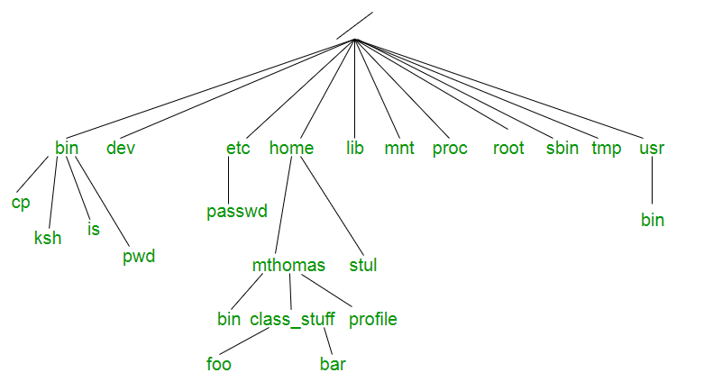
File System of Unix OS -

Slide 48
To be continued…
Topics | Description
/ | The slash / character alone denotes the root of the file system tree.
/bin | Stands for “binaries” and contains certain fundamental utilities, such as ls or cp, which are generally needed by all users.
/boot | Contains all the files that are required for successful booting process.
/dev | Stands for “devices”. Contains file representations of peripheral devices and pseudo-devices.
/etc | Contains system-wide configuration files and system databases. Originally also contained “dangerous maintenance utilities” such as init, but these have typically been moved to /sbin or elsewhere.
/home | Contains the home directories for the users.
/lib | Contains system libraries, and some critical files such as kernel modules or device drivers.
/media | Default mount point for removable devices, such as USB sticks, media players, etc.

Slide 49
To be continued…
Topics | Description
/mnt | Stands for “mount”. Contains file system mount points. These are used, for example, if the system uses multiple hard disks or hard disk partitions. It is also often used for remote (network) files systems, CD-ROM/DVD drives, and so on.
/proc | Virtual file system showing information about processes as files.
/root | The home directory for the super-user “root” – that is, the system administrator.
/tmp | A place for temporary files. Many systems clear this directory upon startup or it might be explicitly cleared by a startup script at boot time.
/usr | Originally the directory holding user home directories, its use has changed. It now holds executables, libraries, and shared resources that are not system critical.
/usr/bin | This directory stores all binary programs distributed with the operating system not residing in /bin, /sbin or (rarely) /etc.
/usr/include | Stores the development headers used throughout the system. Header files are mostly used by the #include directive in C/C++ programming language.
/usr/lib | Stores the required libraries and data files for programs stored within /usr or elsewhere.

Slide 50
To be continued…
Topics | Description
/var | A short for “variable.” A place for files that may change often – especially in size, for example process-ID lock files.
/var/log | Contains system log files.
/var/mail | The place where all the incoming mails are stored. Users (other than root) can access their own mail only. Often, this directory is a symbolic link to /var/spool/mail.
/var/spool | Spool directory. Contains print jobs, mail spools and other queued tasks.
/var/tmp | A place for temporary files which should be preserved between system reboots.

Slide 51
Classification of Unix File System -
The Unix files system contains several different types of files –
Ordinary files
Directories
Special files
Pipes
Sockets
Symbolic Links

Slide 52
Ordinary Files -
An ordinary file is a file on the system that contains data, text, or program instructions.
Used to store information, such as some text that we have written or an image we have drawn. This is the type of file that we usually work with.
Always located within/under a directory file.
Do not contain other files.
In long-format output of ls -l, this type of file is specified by the “-” symbol.

Slide 53
Directories -
Directories store both special and ordinary files. For users familiar with Windows or Mac OS, UNIX directories are equivalent to folders.
A directory file contains an entry for every file and subdirectory that it houses. If you have 10 files in a directory, there will be 10 entries in the directory.
Each entry has two components.
(1) The Filename
(2) A unique identification number for the file or directory
(called the Inode number)
Used to organize groups of files.
May contain ordinary files, special files or other directories.
All files are descendants of the root directory, ( named / ) located at the top of the tree.
In long-format output of ls –l , this type of file is specified by the “d” symbol.

Slide 54
Special Files -
Used to represent a real physical device such as a printer, tape drive or terminal, used for Input/output (I/O) operations.
Device or special files are used for device Input/Output(I/O) on UNIX and Linux systems. They appear in a file system just like an ordinary file or a directory.
On UNIX systems there are two flavors of special files for each device –
character special files
block special files
In long-format output of ls -l, character special files are marked by the “c” symbol.
In long-format output of ls -l, block special files are marked by the “b” symbol.

Slide 55
Pipes -
UNIX allows us to link commands together using a pipe.
The pipe acts a temporary file which only exists to hold data from one command until it is read by another.
A Unix pipe provides a one-way flow of data. The output or result of the first command sequence is used as the input to the second command sequence.
To make a pipe, put a vertical bar (|) on the command line between two commands.
For example: who | wc -l
In long-format output of ls –l , named pipes are marked by the “p” symbol.

Slide 56

Sockets -
A Unix socket (or Inter-process communication socket) is a special file which allows for advanced inter-process communication.
A Unix Socket is used in a client-server application framework. In essence, it is a stream of data, very similar to network stream (and network sockets), but all the transactions are local to the file system.
In long-format output of ls -l, Unix sockets are marked by “s” symbol.
Definition - A socket is one endpoint of a two-way communication link between two programs running on the network. A socket is bound to a port number so that the TCP layer can identify the application that data is destined to be sent to. An endpoint is a combination of an IP address and a port number.

Slide 57
Symbolic Links -
Symbolic link is used for referencing some other file of the file system. Symbolic link is also known as Soft link.
It contains a text form of the path to the file it references.
In long-format output of ls –l , Symbolic link are marked by the “l” symbol (that’s a lower case L).
Note: Detailed topics are discussed later.

Slide 58
Environment Variables -
What is computer environment?
The computing environment is the platform (platform = OS + processor) where a user can run programs.
What is a variable?
A variable is a location for storing a value which can be a filename, text, number or any other data. It is usually referred to with its Symbolic name which is given to it while creation. The value thus stored can be displayed, deleted, edited and re-saved. Variables play an important role in computer programming because they enable programmers to write flexible programs.
What are Environment variables?
Environment variables are dynamic values which affect the processes or programs on a computer. Environment variables can be created, edited, saved and deleted and give information about the system behavior.
Note: Environment variables can change the way a software/programs behave.

Slide 59
Environment Variables -
PATH | This variable contains a colon (:) separated list of directories in which system looks for executable files.
USER | The username.
HOME | Default path to the user’s home directory.
UID | User’s unique id.
TERM | Default terminal emulator.
SHELL | Shell being used by the user.
LANG | Shows the variable stores the value of the language that the user understand.
env | Displays all the environment variables.

Slide 60
Set New Environment Variables -
Define a new variable | VAR=8254 (All variables names are case-sensitive, in Upper Case)
Check the value of the newly created variable | echo $VAR
Remove a variable | unset VAR
To set value of an environment variable | export VAR = value
Tips:
Do not leave space between variable name and “=“ sign, otherwise will get an error.
Do not forget the “$” sign when we want to check the value of the variable.

Slide 61
Word Count -
wc stands for word count. As the name implies, it is mainly used for counting purpose.
It is used to find out number of lines, word count, byte and characters count in the files specified in the file arguments.
By default it displays four-columnar output.
First column shows number of lines present in a file specified
Second column shows number of words present in the file
Third column shows number of characters present in file
Fourth column itself is the file name which are given as argument.
Syntax - wc [OPTION]... [FILE]...
NOTE: Ctrl + D

Slide 62
Word Count -
Options –
wc -l : Prints the number of lines in a file.
wc -w : prints the number of words in a file.
wc -c : Displays the count of bytes in a file.
wc -m : prints the count of characters from a file.
wc -L : prints only the length of the longest line in a file.

Slide 63
Displaying pathname of the current directory (pwd) -
What is PWD?
‘pwd‘ stands for ‘Print Working Directory‘. As the name states, command ‘pwd‘ prints the current working directory or simply the directory user is, at present. It prints the current directory name with the complete path starting from root (/). This command is built in shell command and is available on most of the shell – bash, Bourne shell, ksh etc.
Syntax - pwd
Print your current working directory – /bin/pwd OR pwd

Slide 64
Changing the current directory (cd) -
The Linux cd command, cd stands for change directory is a Linux command line utility for navigating to file system. The Linux cd command is a basic command but most frequently used command Linux system.
Absolute Path is the full path of directory and always starts with / in Linux system. For example: /tmp, /usr/bin, /var/www etc.
Relative Path is the partial path of any directory or subdirectory. It can be started from any location of file path except /. For example: ./script.sh, ../../www etc.
Significance of . and .. –
Single dot (.) : current directory (present directory).
Double dot (..) : parent directory.
Tiled (~) sign : home directory of current users.
$HOME variable : prints the home directory of current users.

Slide 65
Changing the current directory (cd) -
Change to specific directory – cd /tmp
Change to other directory with cd - cd /var/www
Change to last working directory - cd - -
Change to users home directory - cd ~ OR cd $HOME
Change to one level up directory - cd . .
Change to multiple level up in directory structure - cd . ./. .
Change directory with relative path - cd . ./. ./public

Slide 66
Create Directories (mkdir) -
mkdir command is one of the basic Unix commands which allows you to create new directories.
Syntax - mkdir [OPTION]... DIRECTORY...
Example –
Creates a new directory called mydir whose parent is the current directory. = $mkdir mydir
Create the mydir directory, and set its permissions such that all users may read, write, and execute the contents. = $mkdir -m a=rwx mydir
(Option –m = Set file mode)
How to create multiple directories at one time. = $mkdir test1 test2 test3
How to create several subdirectories at one time. =
$mkdir -p /home/test/test1/test2/test3/test4

Slide 67
Remove directory (rmdir) -
rmdir command is used remove empty directories from the file system in Linux. The rmdir command removes each and every directory specified in the command line only if these directories are empty. So if the specified directory has some directories or files in it then this cannot be removed by rmdir command.
rmdir [-p] [-v | –verbose] [–ignore-fail-on-non-empty] directories …
Example –
This will first remove the child directory and then remove the parent directory.
rmdir -p mydir/mydir1
Remove the directories mydir1, mydir2, and mydir3, if they are empty. If any of these directories are not empty, then an error message will be printed for that directory, and the other directories will be removed.
rmdir mydir1 mydir2 mydir3
Remove the directory mydir/mydir1 if it is empty. Then, remove directory mydir, if it is empty after mydir/mydir1 was removed.
rmdir mydir/mydir1 mydir

Slide 68
Listing Directories (ls command) -
ls is a Linux shell command that lists directory contents of files and directories.
Example –
List Files using ls with no option = ls
List Files With option –l = ls –l
View Hidden Files = ls –a
List Files with Human Readable Format = ls –lh
List Files and Directories with ‘/’ Character at the end = ls –F
List Files in Reverse Order = ls –r
Recursively list Sub-Directories = ls –R
Reverse Output Order = ls –ltr
Sort Files by File Size = ls –ls
Sort by modifcation time (newest first) = ls –t
List with inode number = ls -i

Slide 69
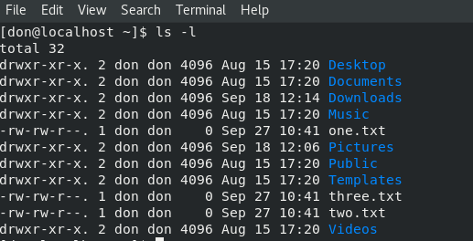
Field Explanation –
File Permissions
Number of links
Owner
Group
Size
Last modified date & time
File name

Slide 70
Absolute Pathname vs. Relative Pathname
A path is a unique location to a file or a folder in a file system of an OS.
A path to a file is a combination of / and alpha-numeric characters.
Absolute Path-name –
An absolute path is defined as the specifying the location of a file or directory from the root directory (/).
To write an absolute path-name -
Start at the root directory ( / ) and work down.
Write a slash ( / ) after every directory name (last one is optional)
Example –
cat /home/test/abc.sql

Slide 71
Some More Example -
Changing directory with relative path concept –
$pwd
/home/kt
$cd abc
$pwd
/home/kt/abc
Changing directory with absolute path concept –
$pwd
/home/kt
$cd /home/kt/abc
$pwd
/home/kt/abc

Slide 72
Absolute Pathname vs. Relative Pathname
Relative Path-name –
Relative path is defined as the path related to the present working directory (pwd). It starts at the current directory and never starts with a / .
Significance of . and ..
UNIX offers a shortcut in the relative pathname– that uses either the current or parent directory as reference and specifies the path relative to it. A relative path-name uses one of these cryptic symbols –
.(a single dot) - this represents the current directory.
..(two dots) - this represents the parent directory.
Example –
$pwd
/home/kt/abc
$cd .. ***moves one level up***
$pwd
/home/kt
$pwd
/home/kt/abc ***moves two level up***
$cd ../..
$pwd
/home

Slide 73
Contents -
Unit – 4 – Ordinary file handling
Displaying & Creating files (cat & echo)
Copying a file (cp)
Deleting a file (rm)
Renaming / Moving a file (mv)
Paging output (more & less)
Printing a file (lp)
Knowing file type (file)
Comparing files (cmp)
Finding common between two files (comm)
Displaying file difference (diff)
Creating archive file (tar)

Slide 74
To be continued -
Unit – 4 – Ordinary file handling
Compress file (gzip)
Uncompress file (gunzip)
Archive file (zip)
Extract compress file (unzip)

Slide 75
Displaying & Creating Files (cat) -
The file can be created by the following ways –
Create a file with cat command
Create a file with echo command
Create a file with ed text editor
Create a file with vi text editor
Creating files with cat command - The cat command is used to create and display a file.
Syntax - cat > Sample
…
Ctrl + d
Note:
To display the content of the file Sample, the syntax is – cat Sample
cat file1 file2 > file 3 – Concatenates file1 & file2 and write the results file3

Slide 76
Displaying & Creating Files (echo) -
To create a file –
Type the command echo and then continue to type the text that we want to appear in the file.
After completing or typing the text, need to type > file_name
Hit the Enter key
Syntax – echo –e “hello[–Options]world” > Sample
Note - This method is useful for creating short files with containing one or two lines of text.
Options -
etc.
\b | Backspace | \n | New line
\c | Print line without new line | \t | New tab
\f | Form feed | \v | Vertical Tab

Slide 77
Examples of echo command -
Input a line of text and display on standard output – $echo “Hello World”
Declare a variable and echo its value - $x=10 [enter] $echo The value of x is = $x
Note: The ‘-e‘ option in Linux acts as interpretation of escaped characters that are backlashed.
Using option ‘\n‘ – New line with backspace interpretor ‘-e‘ treats new line from where it is used. – $echo –e “Hello \nWorld”
Using option ‘\t‘ – horizontal tab with backspace interpretor ‘-e‘ to have horizontal tab spaces. -
$echo –e “Hello \tWorld”
Using option ‘\v‘ – vertical tab with backspace interpretor ‘-e‘ to have vertical tab spaces. –
$echo –e “Hello \vWorld”
Using option ‘\r‘ – carriage return with backspace interpretor ‘-e‘ to have specified carriage return in output. - $echo –e “Hello \rWorld”
Using option ‘\c‘ – suppress trailing new line with backspace interpretor ‘-e‘ to continue without emitting new line. - $echo –e “Hello \cWorld”
Omit echoing trailing new line using option ‘-n‘. – $echo –n “Hello World”

Slide 78
Copying a files (cp) -
cp stands for copy. This command is used to copy files or group of files or directory. It creates an exact image of a file on a disk with different file name. cp command require at least two filenames in its arguments.
There are several ways to copy files from one to another –
Copying a file in the same directory
Copying more than one file
Copying files to another directory
Copying files from another directory
Syntax -
cp [OPTION] Source Destination
cp [OPTION] Source Directory
cp [OPTION] Source-1 Source-2 Source-3 Source-n Directory

Slide 79
cp Options -
Option | Function
cp -r | To copy a directory along with its sub directories.
cp file1 file2 directory name | To copy multiple file or directories in a directory.
cp -backup | To backup the existing file before over writing it.
cp -i | Asks for confirmation to overwrite
cp -l | To create hard link file.

Slide 80
Deleting a file (rm) -
The ‘rm’ means remove. This command is used to remove a file.
The command line doesn't have a recycle bin or trash unlike other GUI's to recover the files.
Hence, be very much careful while using this command. Once you have deleted a file, it is removed permanently.
Syntax – rm<filename>
Option | Description | Example
rm *extension | Used to delete files having same extension. | rm *.txt
rm -r or R | To delete a directory recursively. | rm -r sandy
rm -i | Remove a file interactively. | rm -i (for file) rm –ri (for directory)
rm -rf | Remove a directory forcefully. | rm -f (for file) rm –rf (for directory)

Slide 81
Renaming/Moving a file (mv) -
mv stands for move. mv is used to move one or more files or directories from one place to another in file system like UNIX.
It has two distinct functions –
It renames a file or folder.
It moves group of files to different directory.
Note: No additional space is consumed on a disk during renaming. This command normally works silently means no prompt for confirmation.
Syntax - mv [Option] source destination
Options –
-i (interactive – prompt before overwrite) | mv -i a.txt b.txt
-f (force) | mv -f a.txt b.txt
-u (update) | move when source is newer than destination

Slide 82
Example –
Move main.c & def.h files to /home/usr/rapid/ directory | mv main.c def.h /home/usr/rapid/
Move all C files in current directory to subdirectory bak | mv *.c bak
Move all files in subdirectory bak to current directory | mv bak/* .
Rename file main.c to main.bak | mv main.c main.bak
Rename directory bak to bak2 | mv bak bak2
Update - move when main.c is newer | mv -u main.c bak
Move main.c and prompt before overwrite bak/main.c | mv -v main.c bak

Slide 83
Paging Output (more Command) -
As 'cat' command displays the file content. Same way 'more' command also displays the content of a file.
Only difference is that, in case of larger files, 'cat' command output will scroll off the screen while 'more' command displays output one screen full at a time.
Following keys are used in 'more' command to scroll the page -
Enter key - To scroll down page line by line.
Space bar - To go to next page.
b key - To go to the backward page.
/ key - Lets you search the string.
Syntax - more <file_name>
Example - more Sample

Slide 84
Paging Output (less Command) -
The 'less' command is same as 'more' command but include some more features such as,
it automatically adjust with the width and height of the terminal window, while 'more' command cuts the content as the width of the terminal window get shorter.
Syntax - less <file_name>
Example - less Sample
Note:
Definition of MIME type -
MIME stands for Multipurpose Internet Mail Extensions. It's a way of identifying files on the Internet according to their nature and format.

Slide 85
Determine the type of the file (file command) -
file command is used to determine the type of a file. .file type may be of human-readable(e.g. ‘ASCII text’) or MIME type(e.g. ‘text/plain; charset=US-ASCII’). This command tests each argument in an attempt to categorize it.
It has three sets of tests as follows –
File system Test – Need to check the file is empty or not (or Special file or not)
Magic Test – Check that file is in the proper format or not
Language Test
Syntax – file [options] [filename]
Options –
Options | Descriptions | Syntax
-b | This is used to display just file type in brief mode. | file –b Sample
* | Command displays the all files' file type. | file *
Directory_name/* | This is used to display all files file types in particular directory. | file directory/*
[range]* | To display the file type of files in specific range. | file [range]*
- i | To view the mime type of file | file –i Sample

Slide 86
Files comparison commands (cmp & comm Commands) -
This command is used to compare two files character by character.
Syntax - cmp file1 file2
Example – To compare the two files – file1 & file2 – cmp file1.txt file2.txt
This command is used to compare two sorted files.
Syntax - comm [options] file1 file2
One set of options allows selection of ‘columns’ to suppress.
-1: suppress lines unique to file1 (column 1)
-2: suppress lines unique to file2 (column 2)
-3: suppress lines common to file1 and file2 (column3)
Example - Only show column-3 that contains lines common between file1 and file2
comm -12 file1 file2

Slide 87
Files comparison commands (diff & uniq Commands) -
diff Command - This command is used to compare two files line by line.
The output indicates how the lines in each file are different, and the steps involved to change file1 to file2.
Options -
‘LaR’ – Add lines in range ‘R’ from file2 after line ‘L’ in file1.
‘FcT’ – Change lines in range ‘F’ of file1 to lines in range ‘T’ of file2.
‘RdL’ – Delete lines in range ‘R’ from file1 that would have appeared at line ‘L’ in file2
Syntax - diff [options] file1 file2
Example - diff file1 file2

Slide 88
Files comparison commands (diff & uniq Commands) -
uniq Command - This command is used to filter the repeated lines in a file which are adjacent to each other.
Syntax - uniq [options] [input [output]]
Example – Omit repeated lines which are adjacent to each other in file1 and print the repeated lines only once - uniq file1

Slide 89
tar command (tape archive) -
The Linux ‘tar’ stands for tape archive, is used to create Archive and extract the Archive files. tar command in Linux is one of the important command which provides archiving functionality in Linux.
We can use Linux tar command to create compressed or uncompressed Archive files and also maintain and modify them.
Syntax - tar [options] [archive-file] [file or directory to be archived]
What is an Archive file? An Archive file is a file that is composed of one or more files along with metadata. Archive files are used to collect multiple data files together into a single file for easier portability and storage, or simply to compress files to use less storage space.

Slide 90
Compress File (gzip) -
Gzip (GNU zip) is a compressing tool, which is used to truncate the file size.
By default original file will be replaced by the compressed file ending with extension (.gz).
To decompress a file you can use gunzip command and your original file will be back.
Syntax - gzip <file1> <file2> <file3>. . .
Example - gzip file1.txt file2.txt

Slide 91
Compress File (gzip) -
Options –
Compressing Multi Files Together - If you want to compress more than one file together, you can use 'cat' and gzip command with pipe command.
Syntax - cat <file1> <file2>. . | gzip > <newFile.gz>
Example - cat file1.txt file2.txt | gzip > final.gz
How much the original file has compressed - The 'gzip -l' command tells about the compression ratio or how much the original file has compressed.
Syntax - gzip -l <file1> <file2>...
Example - gzip -l final.gz jtp.txt.gz

Slide 92
Uncompress File (gunzip) -
.gz is files are compressed with gzip in linux. To extract .gz files we use gunzip command.
Syntax - gunzip <file.gz>
Example – gunzip archive.gz

Slide 93
Archive file (zip) -
ZIP is a compression and file packaging utility for Unix.
Each file is stored in single .zip file with the extension .zip.
zip is used to compress the files to reduce file size and also used as file package utility.
zip is available in many operating systems like unix, linux, windows etc.
If you have a limited bandwidth between two servers and want to transfer the files faster, then zip the files and transfer.
Compression ratios of 2:1 to 3:1 are common for text files.
Syntax - zip [options] zipfile files_list
Example – zip myfile.zip filename.txt

Slide 94
Archive file (zip) -
Options –
-d Option - Removes the file from the zip archive. After creating a zip file, you can remove a file from the archive using the -d option.
Syntax - zip –d myfile.zip hello7.c
-u Option - Updates the file in the zip archive. This option can be used to update the specified list of files or add new files to the existing zip file.
Syntax - zip –u myfile.zip hello5.c
-m Option - Deletes the original files after zipping.
Syntax - zip –m myfile.zip *.c
-r Option - To zip a directory recursively.
Syntax - zip –r filename.zip directory_name

Slide 95
Extracting files from zip file -
Unzip will list, test, or extract files from a ZIP archive, commonly found on Unix systems.
The default behavior (with no options) is to extract into the current directory (and sub-directories below it) all files from the specified ZIP archive.
Syntax - unzip <filename.zip>
Example – unzip myfile.zip

Slide 96
Inode Number -
It’s simply a reference (index) about the file & directory on the system.
An inode is an entry in inode table containing information (the metadata) about a regular file & directory. An inode is a data structure on a traditional Unix style file system such as ext3 or ext4. Inode number is also called as index number.
This data structure uses to represent a file system object, this can be one of the various things such as file or directory. It’s a unique number for files and directories under a disk block/partition.
The file system attributes include metadata like access time, modification time etc.; as well as ownership and permission details of files and directories.

Slide 97
What are the important attributes included in Inode Number -
The below mentioned keys are the different attributes in Unix file system and are included in inode –
File type
File permission
Ownership & Group
File size
File access, change and modification time
File deletion time
Number of links
Device Id
User Id of file
Group Id of file
File protection flags
Link counter to determine the number of hard links
Pointers to the blocks storing file’s contents

Slide 98
How do check the inode details of a file or directory?
We can use/check the inode number by using the following commands –
ls –i = The i option is used to find out the inode number of a file or directory.
ls –il = The il option is used find out the detailed information.
stat = This command will display the inode number along with a lot of the other attributes. (Specifically for Red-Hat Server)
df –i = (Inode Utilization) Total inode usage can be calculated from the df command along with i option. (Specifically for Red-Hat Server)
Note - df Command - df command that displays the amount of disk space available on the file system containing each file name as an argument. If no file name is passed as an argument with df command then it shows the space available on all currently mounted file systems.

Slide 99
Inode Structure of a file -
Mode
Owner Info
Size
Time Stamps
Direct Blocks
Indirect Blocks
Double Indirect Blocks
Triple Indirect Blocks

Slide 100
File Ownership -
Every Linux system have three types of owner -
User - A user is the one who created the file. A user can create, delete, or modify the file.
Group - A group can contain multiple users. All the users belonging to a group have same access permission for a file.
Other - Any one who has access to the file other than user and group comes in the category of other. Other has neither created the file nor is a group member.
Note - Users and groups can be locally managed in /etc/passwd or /etc/group.
Syntax - ls –l
Listing User Accounts –
To know the local users account, following command can be used. It list out all the local users from the system.
Syntax - cut -d: -f1 /etc/passwd | column

Slide 101
File Permissions –
All the three owners (user owner, group, others) in the Linux system have three types of permissions defined. Nine characters denotes the three types of permissions.
Read (r) - The read permission allows you to open and read the content of a file. But you can't do any editing or modification in the file.
Write (w) - The write permission allows you to edit, remove or rename a file. For instance, if a file is present in a directory, and write permission is set on the file but not on the directory, then you can edit the content of the file but can't remove, or rename it.
Execute (x) - In Unix type system, you can't run or execute a program unless execute permission is set. But in Windows, there is no such permission available.
permission | on a file | on a directory
r (read) | read file content (cat) | read directory content (ls)
w (write) | change file content (vi or cat>) | create file in directory (touch)
x (execute) | execute the file | enter the directory (cd)

Slide 102
Permission Set -
position | characters | ownership
1 | - | denotes file type
2-4 | rw- | permission for user
5-7 | rw- | permission for group
8-10 | r-- | permission for other
NOTE –
When you are the User owner, then the user owner permission applies to you. Other permissions are not relevant to you.
When you are the Group then the group permission applies to you. Other permissions are not relevant to you.
When you are the Other, then the other permission applies to you. User and group permissions are not relevant to you.

Slide 103
The Permission Indicators -
While using ls -l command, it displays various information related to file permission as follows −
$ls -l /home/amrood
-rwxr-xr-- 1 amrood users 1024 Nov 2 00:10 myfile
drwxr-xr--- 1 amrood users 1024 Nov 2 00:10 mydir
Here, the first column represents different access modes, i.e., the permission associated with a file or a directory.
d represents for directory
- represents for file
The permissions are broken into groups of threes, and each position in the group denotes a specific permission, in this order: read (r), write (w), execute (x) −
The first three characters (2-4) represent the permissions for the file's owner.
The second group of three characters (5-7) consists of the permissions for the group to which the file belongs.
The last group of three characters (8-10) represents the permissions for everyone else.

Slide 104
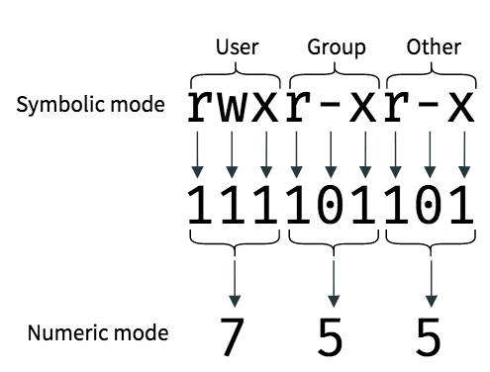

Slide 105
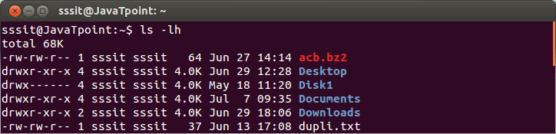
NOTE:
First letter (-) or d represents the files and directories respectively.
Now, from remaining nine letters, first triplet represents the permission for user owner. Second triplet represents the permission for group owner. Third triplet represents the permission for other .
Setting Permissions With chmod -
We can change the permissions with chmod command accordingly to your need. Below are some examples to change the permissions for different groups.
Syntax - chmod permissions filename

Slide 106
There are 2 ways to use the command –
Absolute Mode
Symbolic Mode
Absolute(Numeric) Mode - In this mode, file permissions are not represented as characters but a three-digit octal number.
Number | Permission Type | Symbol
0 | No Permission | ---
1 | Execute | --x
2 | Write | -w-
3 | Execute + Write | -wx
4 | Read | r--
5 | Read + Execute | r-x
6 | Read +Write | rw-
7 | Read + Write +Execute | rwx

Slide 107
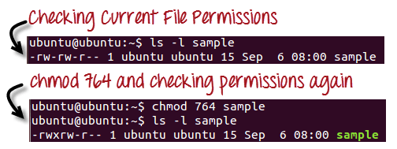
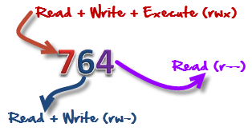
‘764’ absolute code says the following -
Owner can read, write and execute
Usergroup can read and write
World can only read
This is shown as -rwxrw-r--

Slide 108
Symbolic Mode –
In the Absolute mode, you change permissions for all 3 owners. In the symbolic mode, you can modify permissions of a specific owner. It makes use of mathematical symbols to modify the file permissions.
Operator | Description
+ | Adds a permission to a file or directory
- | Removes the permission
= | Sets the permission and overrides the permissions set earlier.
User Denotations
u | user
g | group
o | other
a | all
To add permissions to a group -
Syntax - chmod <groupName>+<permissionName> <fileName>
Example - chmod u+x file

Slide 109
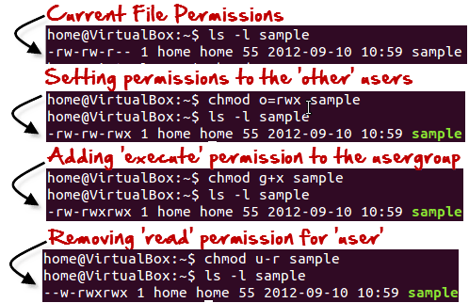

Slide 110
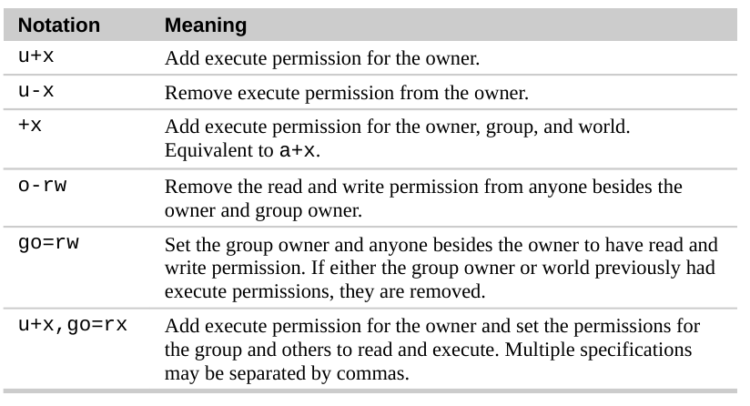

Slide 111
Change Group -
The chgrp command can be abbreviated as change group. We can change the group owner of the file using chgrp command.
Syntax - chgrp <newGroup> <filename>
How to create a new group in Linux?
The groupadd command can be used in Linux to add user groups to the system.
Syntax - groupadd <groupname>
Example - groupadd ggi
Note: If no command-line options are used, the group is created with the next available Group ID number (GID) above 499. To specify a GID, use the groupadd -g <gid> <group-name> command.
How to add existing Linux users to a group?
Use the usermod -aG <groups> <username> command.
Example - usermod -aG ggi test

Slide 112
Change Ownership -
Command chown is used to change the owner of the file.
Syntax - chown <newOwner> <fileName>
Example - chown jtp list
Command chown can also be used to change both user owner and group.
Syntax - chown <newOwner:newGroup> <fileName>
Example - chown jtp:php msg.txt
List of Special Files –
First Character | File Type
- | Normal file
d | Directory
l | Symbolic link
p | Named pipe
b | Blocked device
c | Character device
s | Socket

