Slide 1
Microsoft Sharepoint

Slide 2
What is MS Sharepoint?
Microsoft SharePoint is a browser-based collaboration, document management platform and content management system.
SharePoint is a web-based, collaborative platform that integrates with Microsoft Office. Launched in 2001.
SharePoint is primarily sold as a document management and storage system, but the product is highly configurable and usage varies substantially between organizations.
Microsoft states that SharePoint has 190 million users across 200,000 customer organizations.
After completing this tutorial, you will have a better understating of what SharePoint is and what are the high-level feature areas and functionalities of SharePoint.

Slide 3
Applications of MS Sharepoint
Enterprise content and document management
SharePoint allows for storage, retrieval, searching, archiving, tracking, management, and reporting on electronic documents and records.
Intranet and social network
A SharePoint intranet or intranet portal is a way to centralize access to enterprise information and applications. It is a tool that helps an organization manage its internal communications, applications and information more easily.
Collaborative software
SharePoint contains team collaboration groupware capabilities, including: Project scheduling (integrated with Outlook and Project), social collaboration, shared mailboxes, and project related document storage and collaboration.
File hosting service (Personal Cloud)
Custom web applications

Slide 4
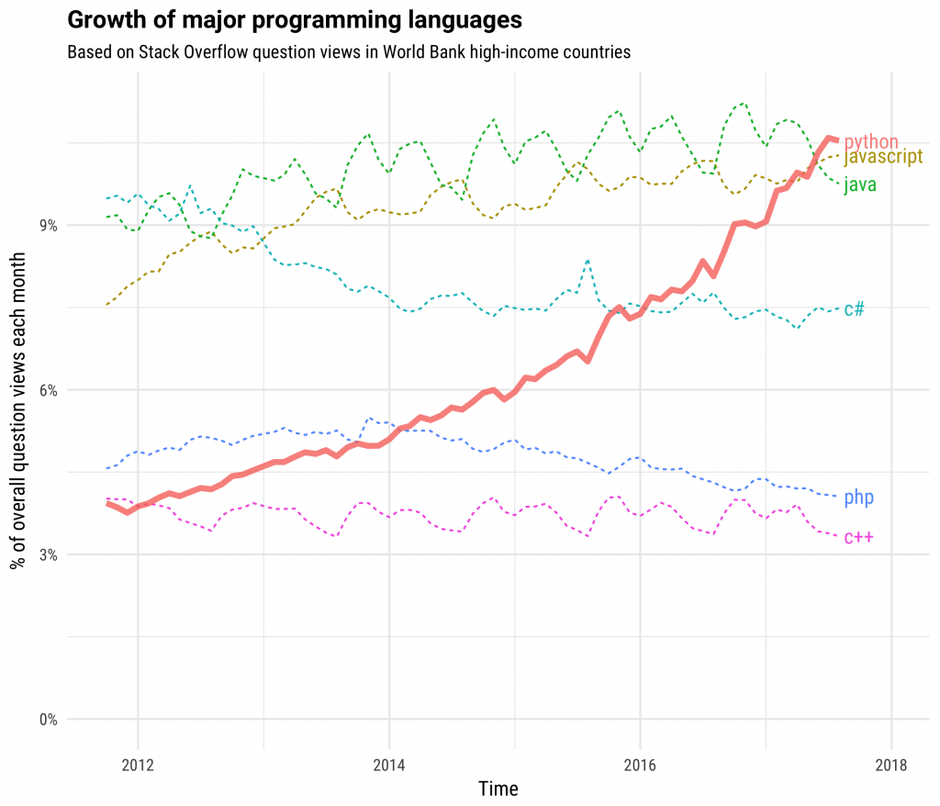
Title and Content Layout with Chart
Courtesy By - stackoverflow

Slide 5
Two Content Layout with Table
First bullet point here
Second bullet point here
Third bullet point here
Class | Group A | Group B
Class 1 | 82 | 95
Class 2 | 76 | 88
Class 3 | 84 | 90

Slide 6
Two Content Layout with SmartArt
Group A
Task 1
Task 2
Group B
Task 1
Task 2
Group C
Task 1
First bullet point here
Second bullet point here
Third bullet point here

Slide 7
Add a Slide Title - 1

Slide 8
Add a Slide Title - 2

Slide 9
Add a Slide Title - 3

Slide 11
Add a Slide Title - 4

Slide 12
Add a Slide Title - 5

