Slide 1
Lending Club Case Study Assignment
Chandramouli Das
Nabanita Paul

Slide 2
Objective
Company: Lending Club is the largest online loan marketplace, facilitating personal loans, business loans, and financing of medical procedures. Borrowers can easily access lower interest rate loans through a fast online interface.
Context: Lending Club wants to understand the driving factors behind loan default or non-default which are strong parameter of default. The company can utilize this knowledge for its portfolio and risk assessment in terms of loan issue.
Problem Statement: As a data scientist working for Lending Club analyze the dataset containing information about past loan applicants using EDA to understand how consumer attributes and loan attributes influence the tendency of default

Slide 3




Analysis Approach
Drop columns with null values, all random values or single category value
Convert values to proper int, float, date representations
Analyze variables against segments of other variables
Create derived variables
Publish insights and observations
Univariate Analysis
Segmented Univariate Analysis
Bivariate Analysis
Summarize Results
Clean Data
Do correlation analysis Check how two variables affect each other or a third variable
Analyze joint distributions
Check distributions and frequencies of various numerical and categorical variables
Create derived variables

Slide 4
Data Understanding
The dataset has 39179 rows and 111 columns.
There are many columns which consists of null value and NAN values.
The dataset has mixture of categorical and continuous data.
Some of the columns only consists of NAN values.
There are some columns which has string values also.
The columns in the dataset has duplicate values.
Our dataset needs a good amount of pre-processing.

Slide 5
Data Cleaning and Manipulation
In the first step we have dropped all the duplicate values in the dataset.
We have removed the columns that have the columns with single occurrence values.
Then we drop the columns where all values are NULL.
Then we have dropped the unnecessary columns like “id” and “url” etc.
Some of the columns consists of percentage(%) symbol. We have replaced it with (“ “) spaces.
Then we have replaced all the space values with underscore(“_”) to make one single string.
At the last we have changed different date related columns into proper date format like ‘2021-02-21’.
Now our dataset is ready for data analysis.

Slide 6
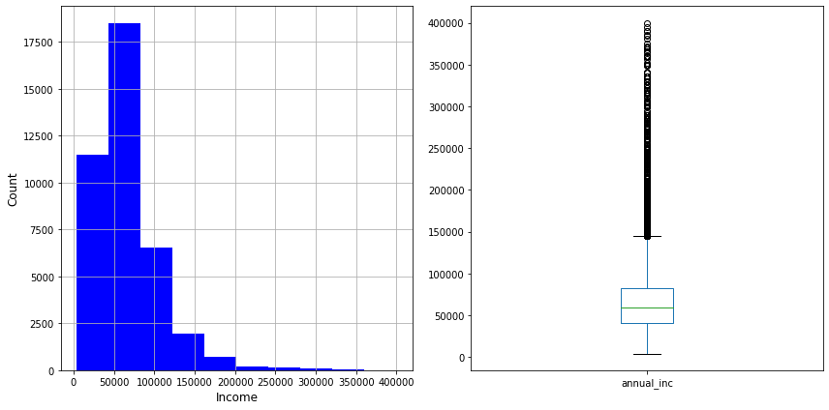
Data Analysis
At first we have created default column where we putted the value with respect to “loan_status” column.
Then we have created “issue_year” and “issue_month” column.
We plotted a Histogram and Boxplot of the column “annual_inc”.
Based on “annual_inc” we have divided the values in “low_inc”,“mid_inc” and “high_inc”category.

Slide 7
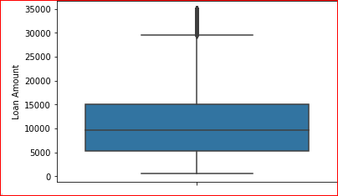
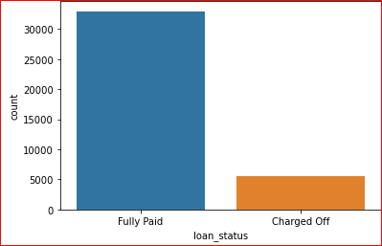
Analysis - Overall Loan Status
Total Loan Amount
Total Money Earned
Total loan amount is 35k whereas 32950 is fully paid and merely 5627 is charged off

Slide 8
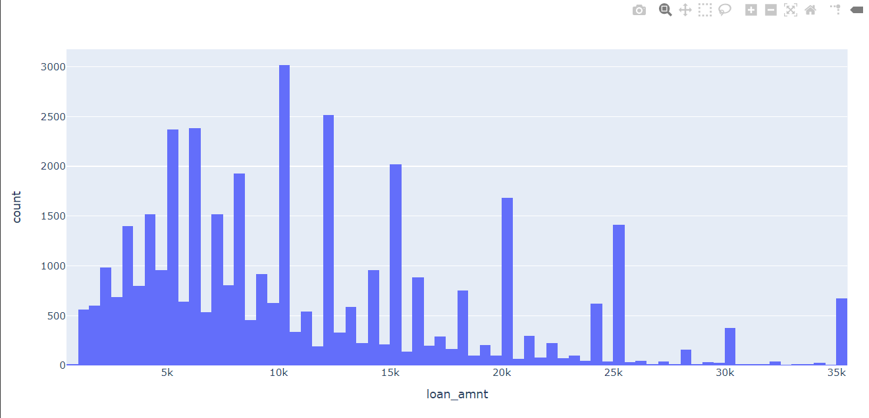
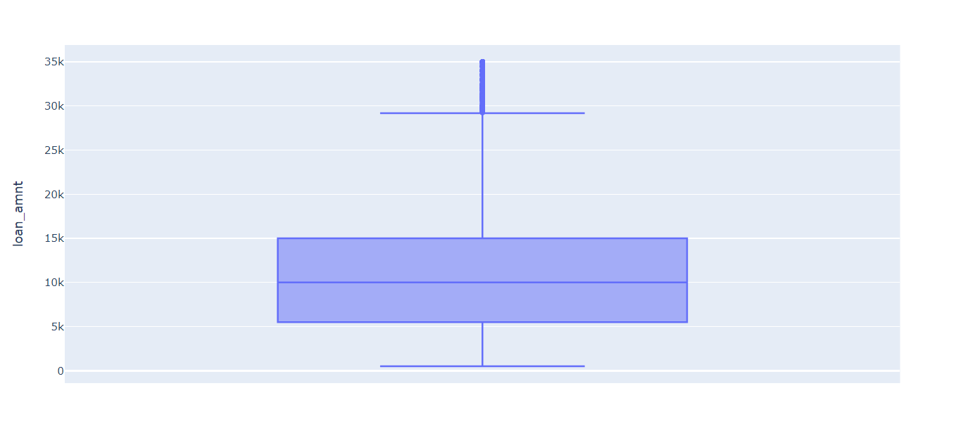
Univariate Analysis
We have plotted the loan amount requested by the borrower with respect to loan_amnt column.

Slide 9
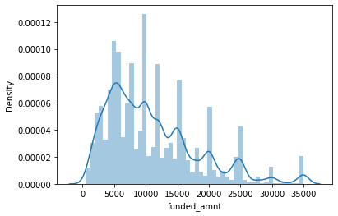
Univariate Analysis
We have plotted “funded_amnt” column to analyse.

Slide 10
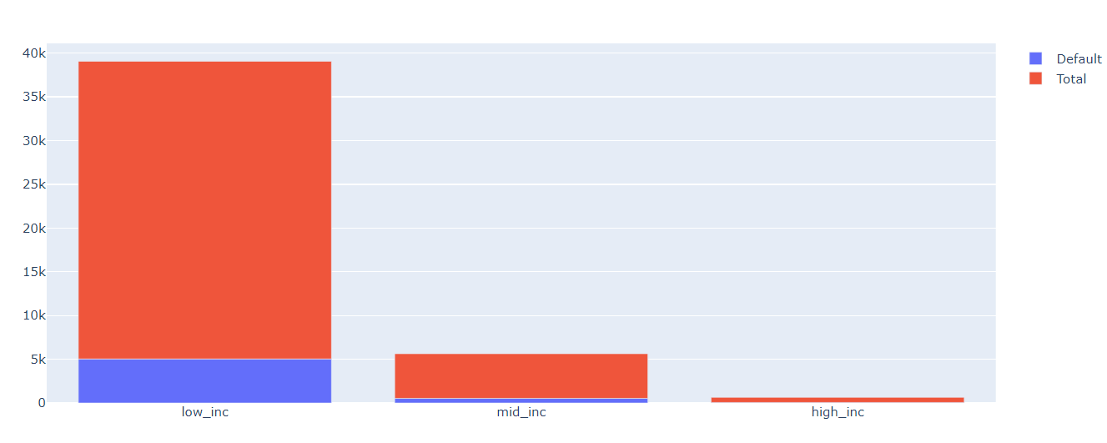
Bivariate Analysis
Plotted income with respect to category column.
Calculated the default ration in every income category

Slide 11
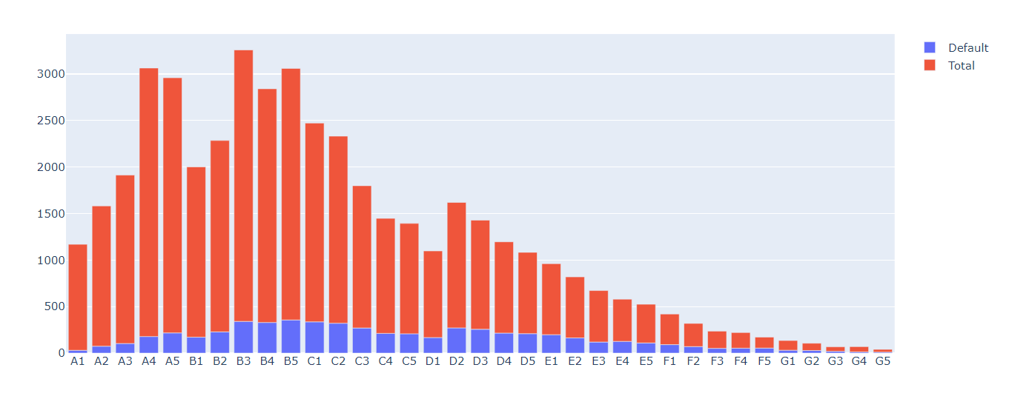
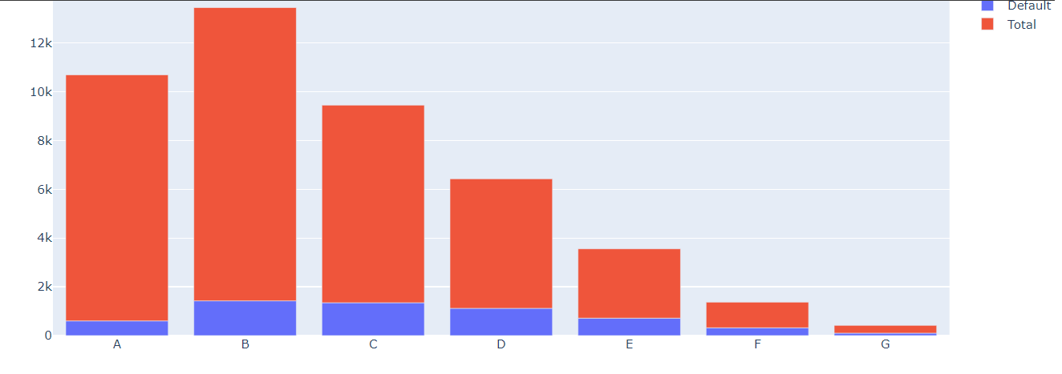
Bivariate Analysis
From the before analysis we found out that most borrowers are from low income category; only the defaulters are high for all borowers in the mid_income category.
Then we assigned grade to a borrower depending on their credit history of repayment of loan. It worked in a way like Better Grade ---> Less Interest Rates for loan.
We also divided into sub grade for better understanding.

Slide 12
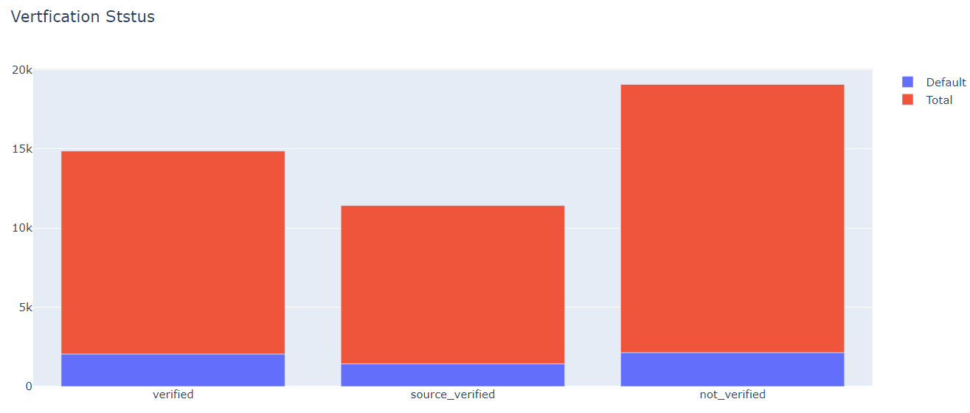
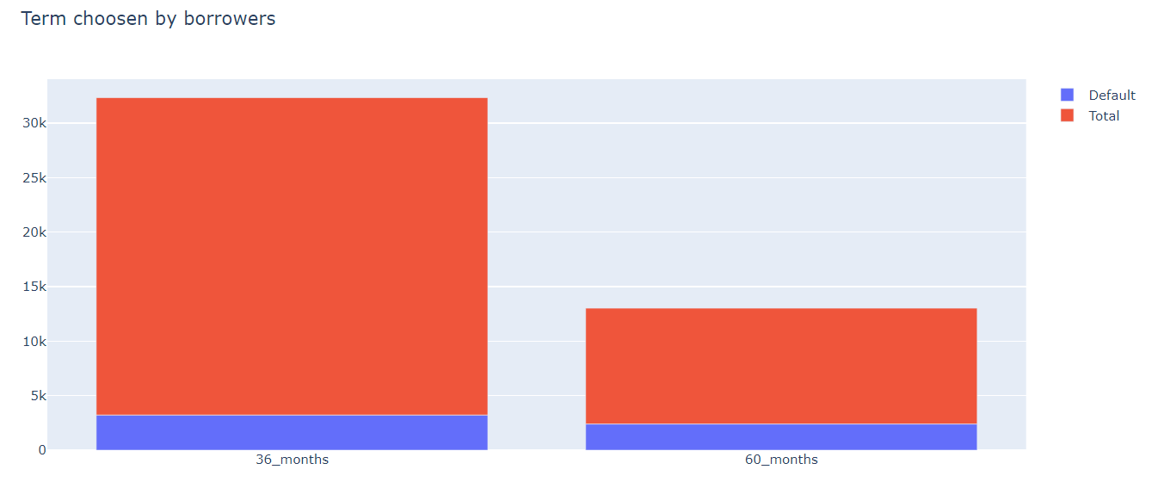
Bivariate Analysis
After that we have checked the verification status of the borrowers
We have also plotted a bar graph to check which borrower took 36_month term and who took 60_month term.

Slide 13
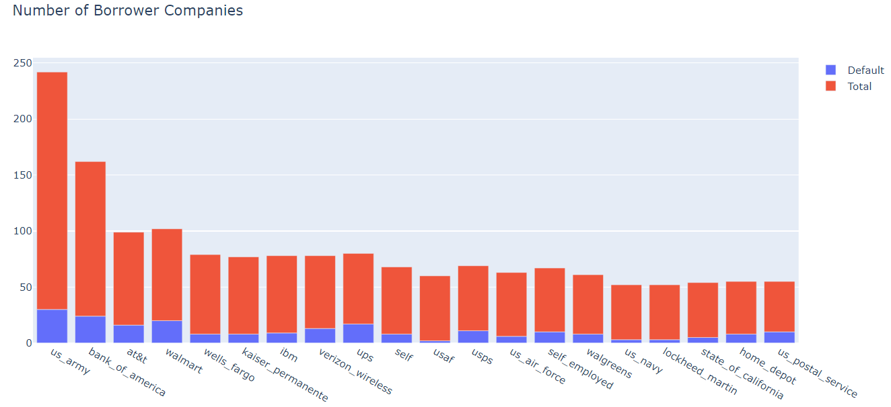
Bivariate Analysis
We have plotted a bar chart with respect to “emp_title” column which indicates company of the borrower.
After the analysis we have found out that the most number of borrowers are employed in US_ARMY.
the most number of defaulters are: UPS = 27% WALMART = 24.4% US_POSTAL = 22.22%

Slide 14
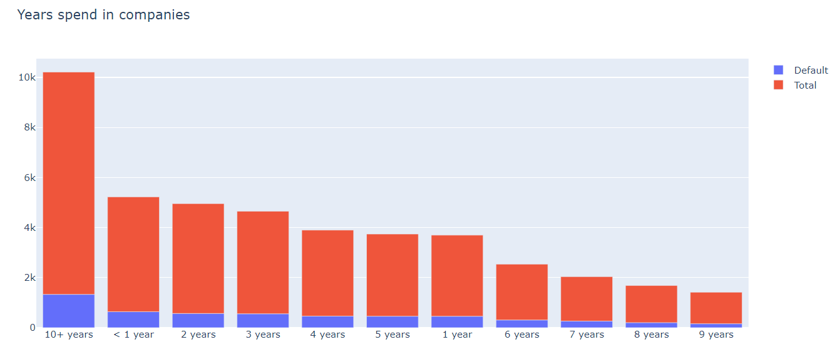
Bivariate Analysis
Then we have plotted Number of years the borrower has spent in services

Slide 15
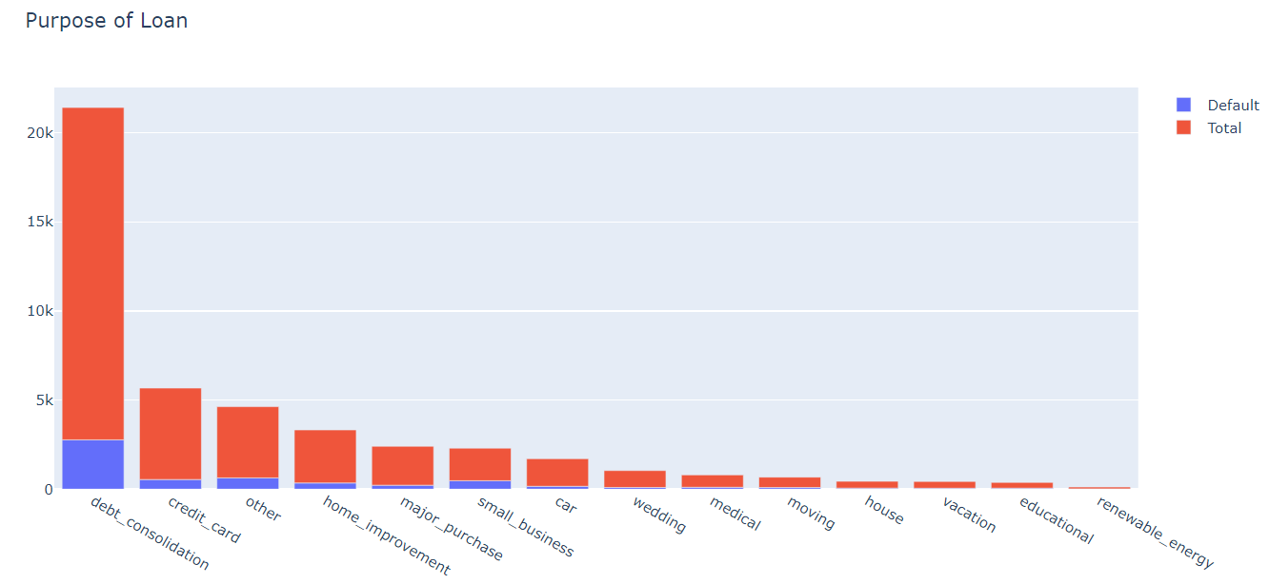
Bivariate Analysis
Here we have found out one of the most important factor that is purpose of taking loan with default rate. We got result like
"Debt consolidation" is the most common reason to take loans for the borrowers
Highest default ratio exist for the small_buisness - 26% and after that renewable_energy - 18.5%

Slide 16
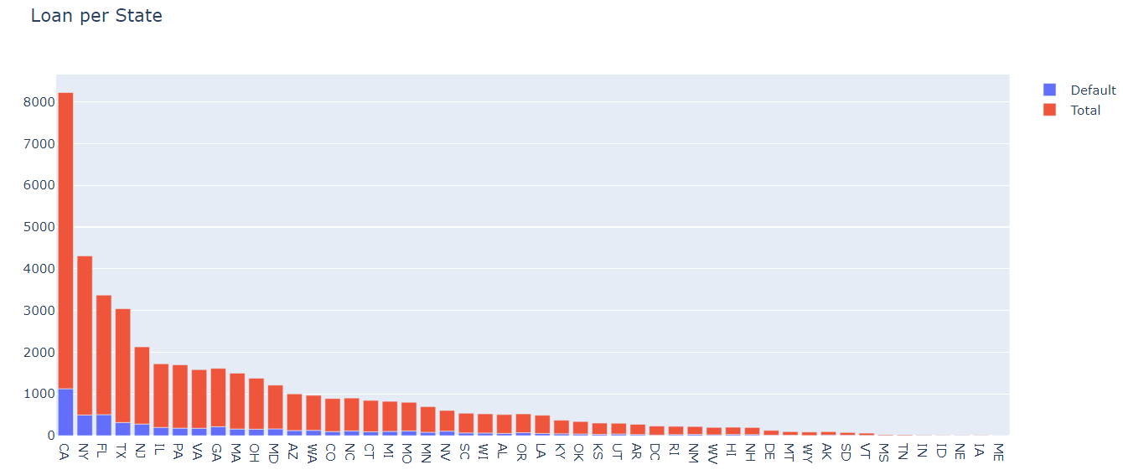
More Analysis
We have plotted bar graph as loan per state and found out that California(CA) is the state with highest number of borrowers.

Slide 17
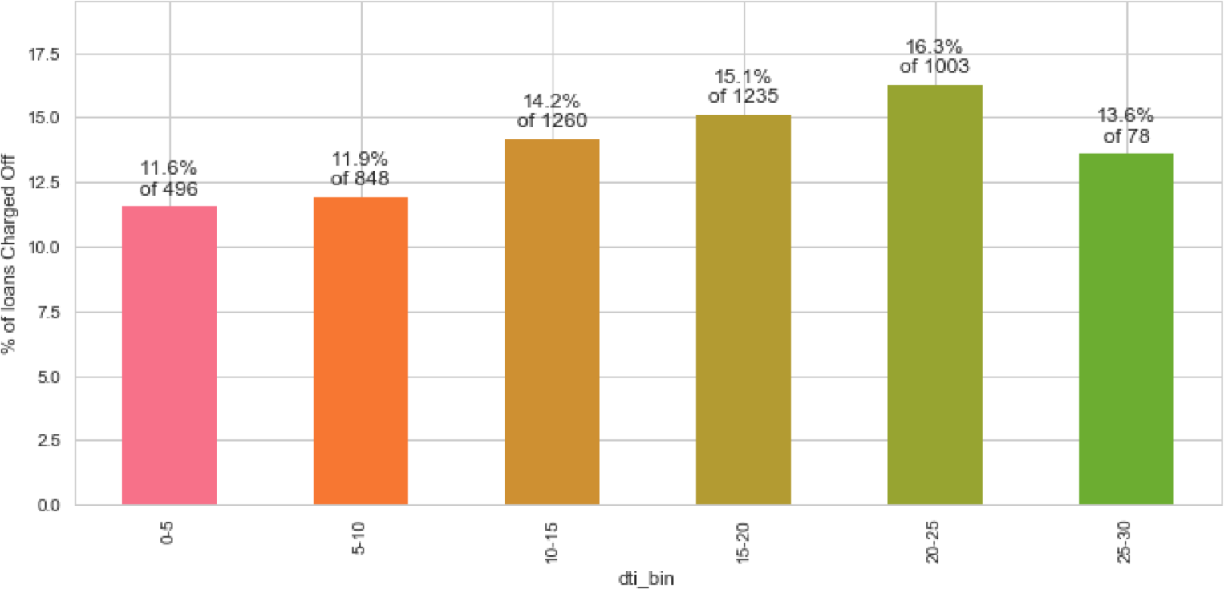
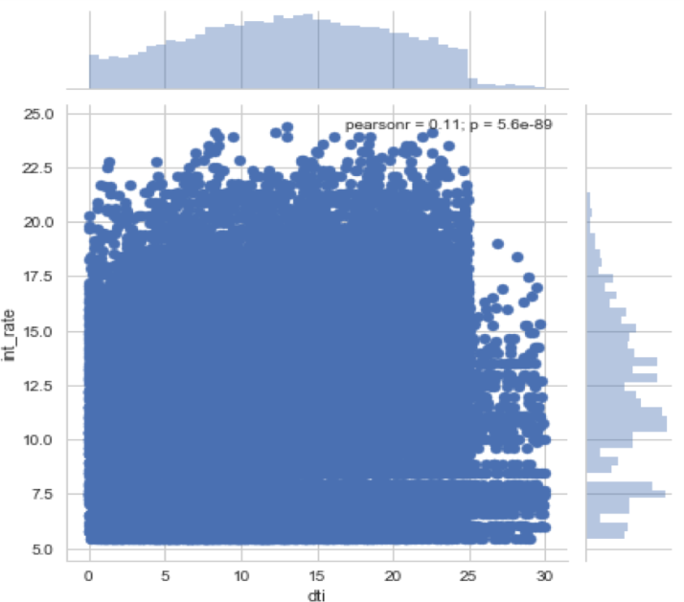
Analysis – Defaults by Debt to Income Ratio
Higher interest rates should be charged for higher dti, but we see spread across all values.
Percentage of default rises with DTI ratio.
As the DTI ratio rises above 20, the loans become risky.

Slide 18
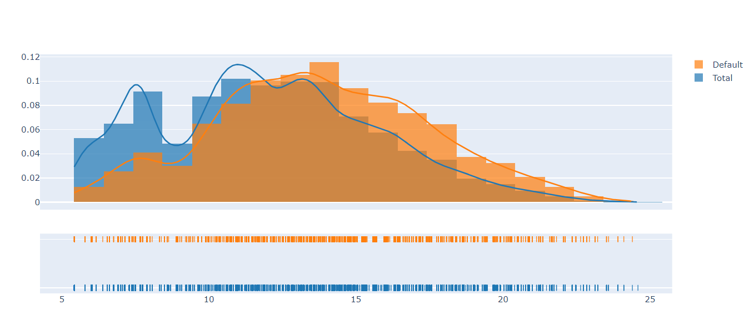
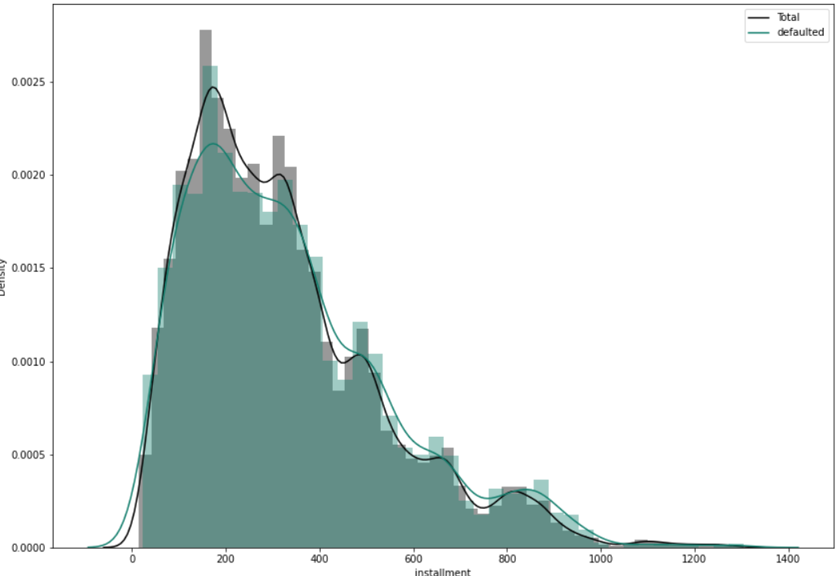
More Analysis
We have done distribution plot for installment and plotint_rate column for better analysis.

Slide 19
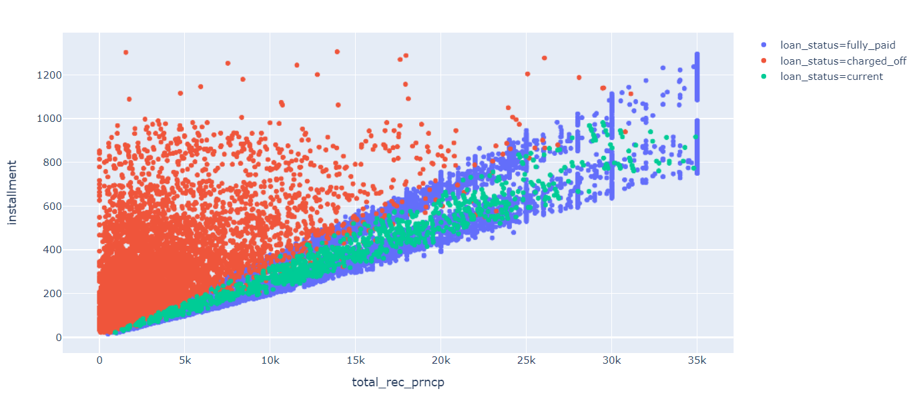
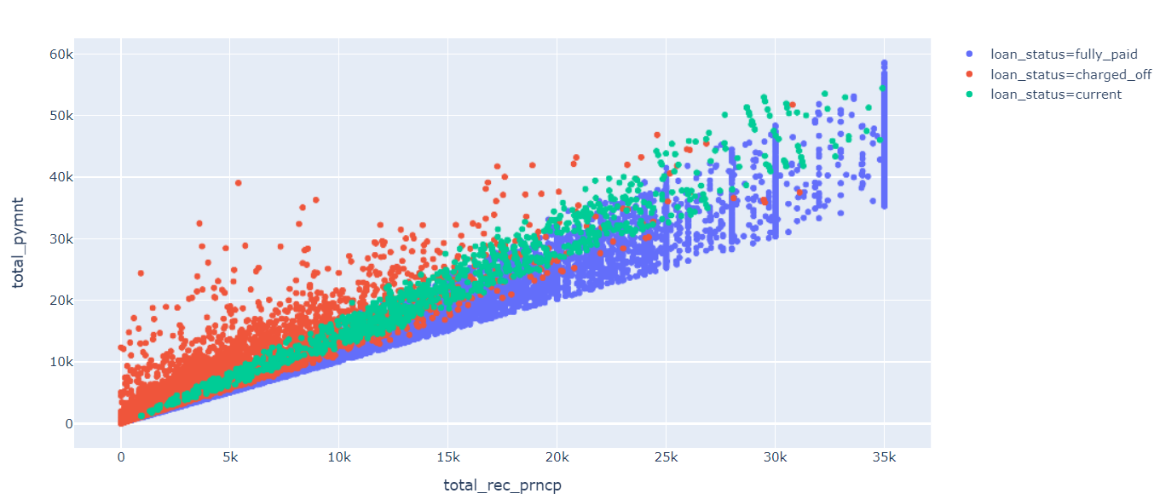
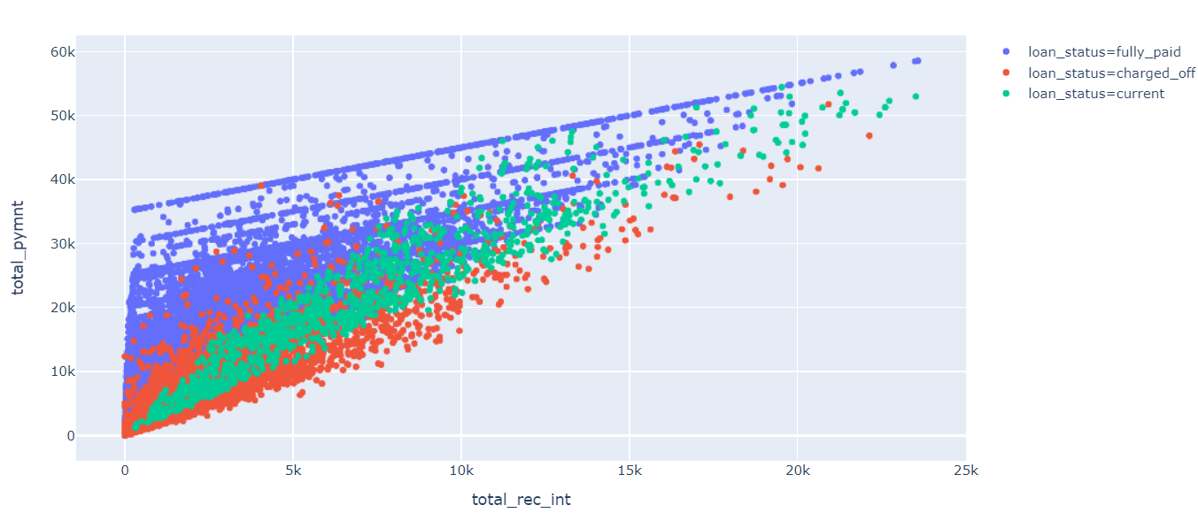
More Visualization
Then we have plotted several scatter plot with three columns, the plot was 'total_rec_prncp’ , ‘installment’ and ‘loan_status.
Second scatter plot was with 'total_rec_prncp’, 'total_pymnt’, 'loan_status’ columns.
The thired scatter plot was with 'total_rec_int', 'total_pymnt’, 'loan_status’ columns.
These are done for better visualization between the relation of these columns.

Slide 20
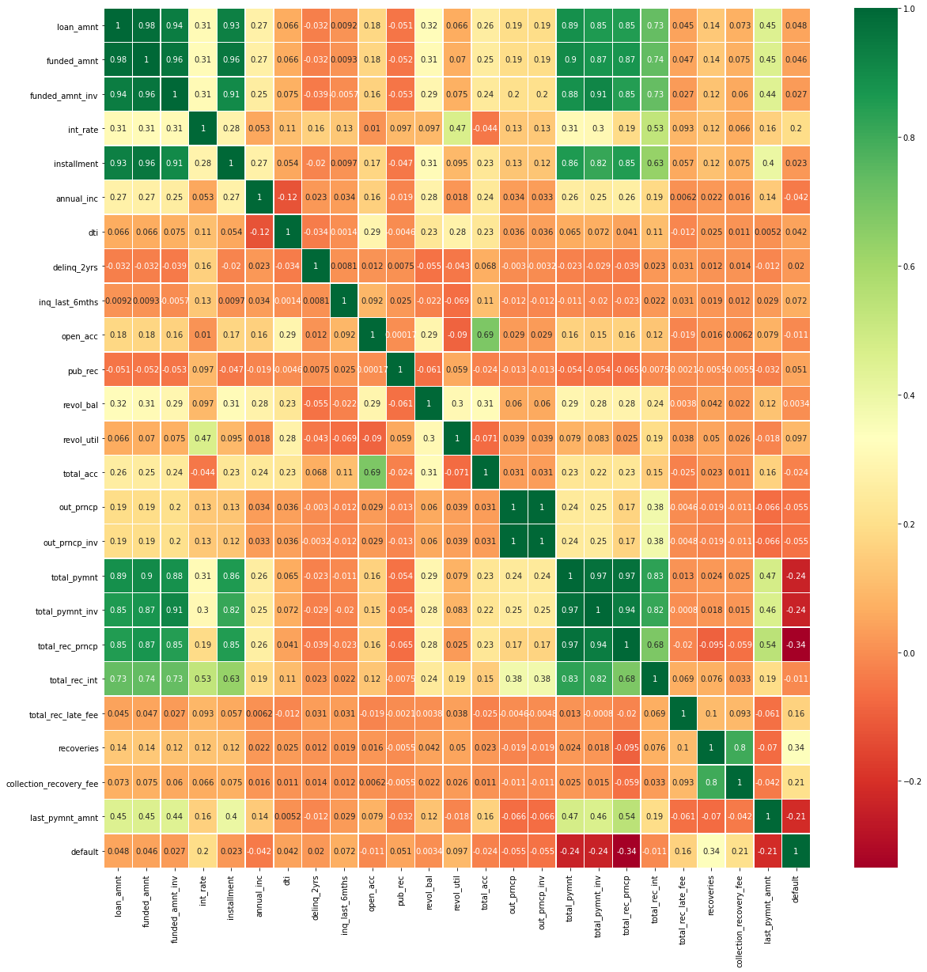
Heatmap
The final correlation is shown in the heatmap with selected columns who are highly corelated

Slide 21
Final Outcome
Income : The borrowers belongs to 'Low Income' category can make up to 85.68% of the client base of loans, which is an massive majority; 15% of these tend to default their loan. The probability of default of low income borrowers is 4% more than mid and high income. 28.5% of all low income, low grade borrowers i.e. E,F,G category tend to default.
Grade : Grade and rate of default are highly correlated. The highest default ratios are present for the three worst grades namely G: 31.96% F: 30.41% E: 25.16%
Interest Rate : There is 20% +ve correlation between interest rate and tendency to default. Interest rate is highly correlated with grade. They have strong linear relation like higher the grade, the interest rate become less. Therefore borrowers except good grade like A, B category will recieve higher interest rates which decrease their chance of paying of their loan.
Total Recurring Principal : There is a high -ve correlation (34%) between Total Reccuring Principal and tendency to default. As per effect, it can be seen that defaulters usually have higher installment charges and higher total payments for as TRP increases.
Purpose of Loan : The main purpose of loan is 'Debt Consolidation' which is around 47% and make it up the majority of borrowers. The purpose with the highest default ratio is 'Small Buisness' with a value of 26% and by 'Renewable Energy' with 18%.

Slide 22
Conclusions
We have given a loan dataset. The dataset was raw and huge. We have understood the columns of the dataset and perform data cleaning and manipulation. Then we have added data new column in the dataset for better analysis and performed univariate and bivariate analysis. We have done many analysis and the summery we have written in the outcome section. We have successfully completed EDA in our dataset and get a lot of information’s. In future we will use more advance EDA and data visualization tools to extract more information.

