Slide 1
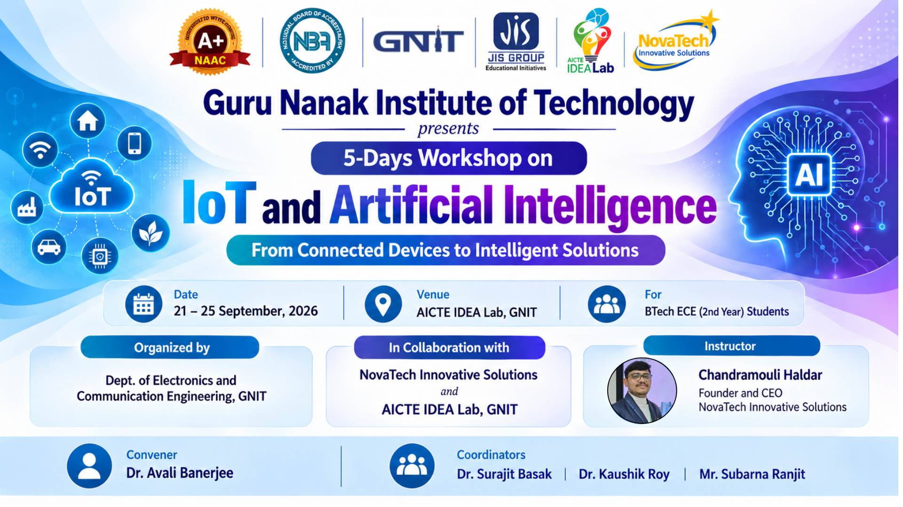

Slide 2
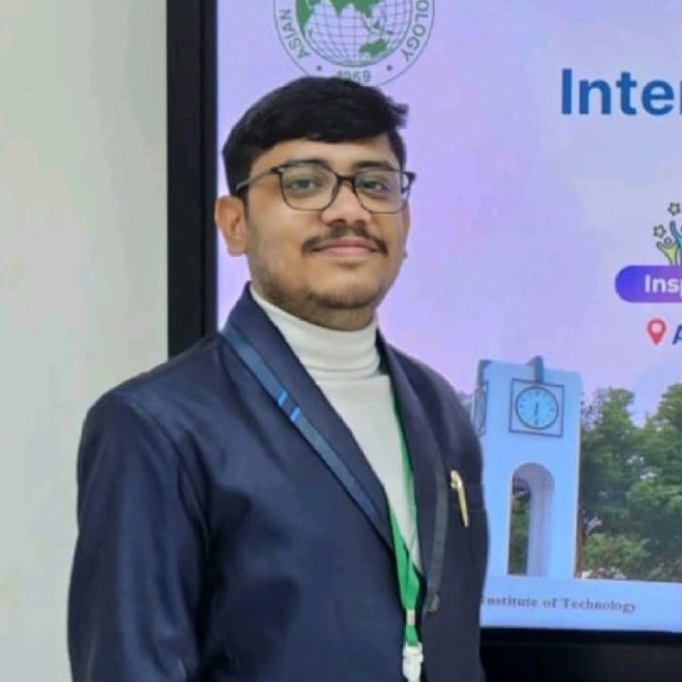
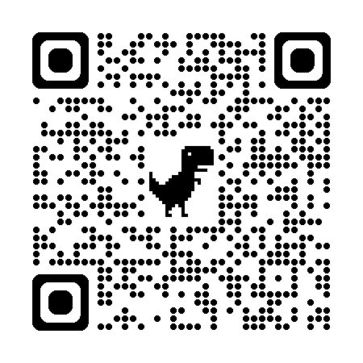
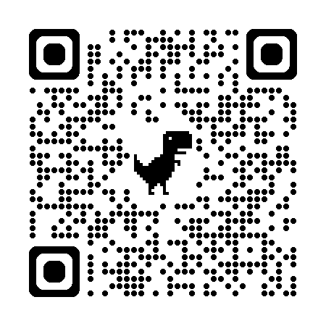
COURSE INSTRUCTOR
●
Founder & CEO
Leads NovaTech Innovative Solutions, delivering embedded, IoT and AI systems for industry and academia.
●
Education
Diploma : Electronics and Telecommunication Engineering (GNIT 2023)
B.Tech : Computer Science and Engineering (GNIT 2026)
M.Tech : Internet of Things (IIIT Sri city – Present )
●
Research Contributions
10+ Research Papers
5 Published Patents
2 Books
Chandramouli Haldar
Founder & CEO
NovaTech Innovative Solutions
●
IoT & Embedded Systems Practitioner
Hands-on experience across Arduino, ESP32, Raspberry Pi and sensor-driven product design.
IoT & AI Workshop — GNIT
2

Slide 3
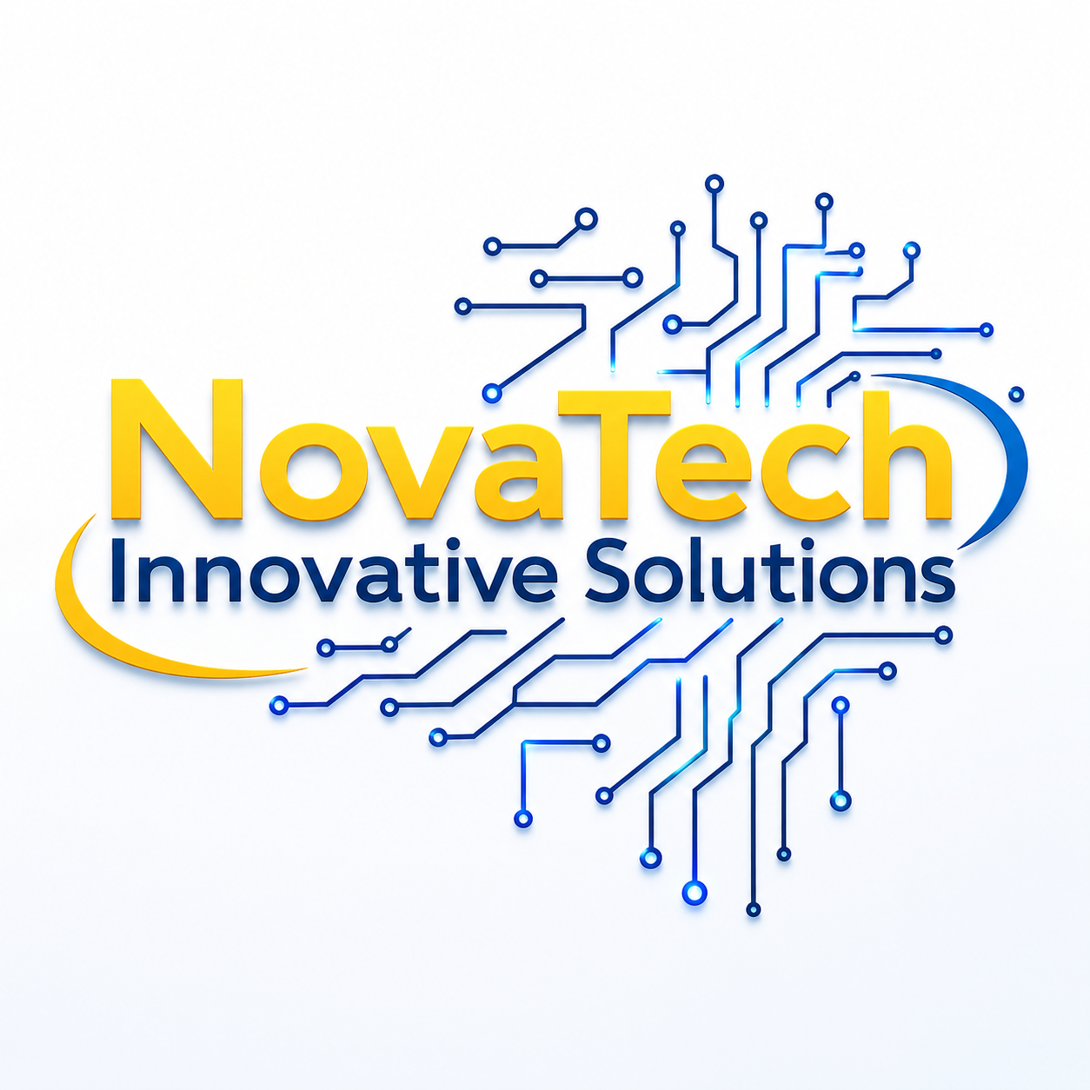
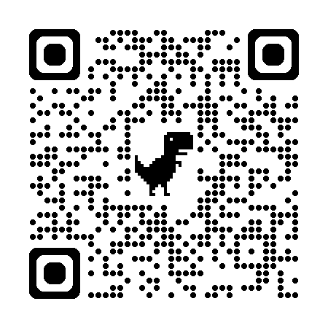
ABOUT
NovaTech Innovative Solutions
A Kolkata-based engineering start-up building the bridge between hardware and intelligence.
🔧
💻
🔬
Hardware & Embedded Solutions
Software & AI Solutions
Research & Innovation
Custom PCB, sensor and microcontroller-based product design
Applied machine learning, computer vision and automation pipelines
Academic publishing and patent-backed R&D in healthcare and edge AI
🌐
🎓
IoT & Automation
Workshops & Technical Training
Connected device networks for monitoring, control and smart systems
Hands-on curricula that take students from theory to working prototypes
IoT & AI Workshop — GNIT
4

Slide 4
ABOUT THE WORKSHOP
IoT & Artificial Intelligence
Two technologies that, together, let physical devices sense the world and act intelligently on it.
Embedded Systems
Internet of Things
OUR GOAL
1
Understand
Sensors & Actuators
Microcontrollers
2
Experiment
IoT Communication
Artificial Intelligence
3
Build
Edge AI & TinyML
Raspberry Pi
4
Innovate
✓ Learn IoT fundamentals
✓ Work with real hardware
✓ Explore how AI meets IoT
✓ Build a working practical project
IoT & AI Workshop — GNIT
5

Slide 5
ROADMAP
5-Day Roadmap
1
Day 1
Embedded Systems & IoT Basics
Foundations: what embedded systems are and how IoT connects them
2
Day 2
Sensors, Actuators & Arduino
Reading the physical world and acting back on it
3
Day 3
IoT Communication & ESP
Getting sensor data off the device and onto a network
4
Day 4
AI, Edge AI, TinyML & Raspberry Pi
Making devices intelligent, on-device or in the cloud
5
Day 5
Project Building & Presentation
Combining everything into one working prototype
IoT & AI Workshop — GNIT
6

Slide 6
DAY 1
Embedded Systems & IoT
A microcontroller is a tiny computer dedicated to one job. IoT connects many of these tiny computers so they can share what they sense.
Embedded Systems
Purpose-built computers — one program, one job, running directly on hardware with no OS overhead.
TODAY'S ACTIVITIES
•
Basic Programming (blink, read, write)
Internet of Things
Simulation-Based Practice (Tinkercad / Wokwi)
The layer that lets embedded devices talk to each other and to the cloud, turning isolated sensors into networks.
•
•
Wiring your first Arduino circuit
Arduino Basics
Open-source microcontroller platform — the easiest entry point for reading sensors and driving outputs.
•
Comparing Arduino Uno vs ESP boards
ESP Architecture
Wi-Fi-capable microcontrollers (ESP8266/ESP32) that add wireless networking on top of Arduino-style programming.
By day's end, you will have written and simulated your first embedded program.
IoT & AI Workshop — GNIT
7

Slide 7
DAY 2
Sensors & Actuators
Sensors let a device perceive the world; actuators let it respond. Together they close the loop.
SENSORS — INPUTS
ACTUATORS — OUTPUTS
Ultrasonic (HC-SR04)
Distance
Object detection, radar-style ranging
▶
LED
PIR
Motion
Human/animal presence detection
Visual signaling and status indication
▶
Relay
LDR
Light intensity
Automatic lighting, day/night switching
Switching high-power devices (motors, appliances) from a low-power signal
DHT11
Temperature & humidity
Climate and weather monitoring
▶
Servo Motor
Precise angular movement — robotics, camera gimbals
Gas (MQ-series)
Air quality / gas concentration
Leak detection, safety alerts
▶
Buzzer
IR
Reflectance / proximity
Line following, obstacle sensing
Audible alerts and notifications
Today's practice: wire each sensor to Arduino, read live values on the Serial Monitor, then trigger an actuator based on a threshold.
IoT & AI Workshop — GNIT
8

Slide 8
DAY 3
IoT Communication & Connectivity
Every protocol trades off range, power draw, and data rate differently — choosing the right one is a design decision, not a default.
PROTOCOL
RANGE
POWER USE
BEST FOR
Bluetooth
~10 m
Low
Phone pairing, short-range control
Zigbee
~10-100 m (mesh)
Very Low
Mesh sensor networks, smart home
Wi-Fi
~50 m
High
High-bandwidth data, internet-connected devices
ESP8266 / ESP32
Wi-Fi range
Low-Medium
Low-cost Wi-Fi microcontroller nodes
ESP-NOW
~100-200 m
Very Low
Fast device-to-device links without a router
Today's practice: transmit live sensor readings from an ESP32 over Wi-Fi, and compare pairing time and stability against Bluetooth.
IoT & AI Workshop — GNIT
9

Slide 9
DAY 4
AI & Machine Learning Basics & Raspberry Pi
AI is the goal — machines behaving intelligently. Machine Learning is the dominant method: teaching a system from data instead of hand-written rules.
Supervised Learning
INTRODCUTION TO THE RASPBERRY PI
Edge AI vs Cloud AI
TinyML
Unsupervised Learning
Runs full Python & OpenCV
GPIO Pins
Reinforcement Learning
AI Model Deployment
WHY PAIR AI WITH IoT?
IoT devices generate constant streams of sensor data. On their own, they can only report numbers. AI turns those numbers into decisions — detecting anomalies, predicting failures, or recognizing patterns — right where the data is collected.
AI Model Deployment
IoT & AI Workshop — GNIT
10

Slide 10
DAY 5
AI + IoT Project
Every piece from Days 1-4 comes together in one build-and-present pipeline.
1
2
3
4
Project Ideation
Hardware Integration
Sensor Data
IoT Connectivity
Pick a problem worth solving with sensors + intelligence
Wire the microcontroller, sensors and actuators together
Capture clean, reliable readings from the physical world
Get that data flowing over Wi-Fi/Bluetooth to where it's needed
5
6
7
AI / ML Integration
Prototype Development
Project Presentation
Add a model that turns raw data into a decision
Assemble a working end-to-end demo
Explain what it does, how it works, and why it matters
IoT & AI Workshop — GNIT
13

Slide 11
PROJECT IDEAS
Possible Projects
AI-Based Smart Home
Smart Agriculture
IoT Monitoring System
AI Sensor Monitoring
Sensors detect occupancy and environment; a model decides when to switch lights, fans or AC.
Soil moisture and weather sensors feed a model that recommends irrigation timing.
A network of nodes reports live status of a machine, room or process to a dashboard.
Anomaly detection flags unusual sensor readings before a failure happens.
Ultrasonic Radar
IoT Dashboard
ESP-NOW Sensor Network
A rotating ultrasonic sensor sweeps and maps nearby obstacles like a simple radar.
A live web dashboard visualizes sensor data streamed from ESP32 nodes.
Multiple ESP boards exchange data directly, without needing a Wi-Fi router.
These project themes are also represented in the workshop's proposed experiment list.
IoT & AI Workshop — GNIT
14

Slide 12
HARDWARE
Hardware We Will Use
■
■
■
■
Arduino Uno
ESP8266 NodeMCU
ESP32
Raspberry Pi
Entry-level microcontroller for wired sensor/actuator projects
Budget Wi-Fi microcontroller for simple connected devices
Dual-core Wi-Fi + Bluetooth microcontroller for richer IoT nodes
Full Linux computer for Edge AI and vision-based projects
■
■
■
Sensors
Actuators
Comm. Modules
Ultrasonic, PIR, LDR, DHT11, Gas, IR — for sensing the environment
LED, Relay, Servo, Buzzer — for acting on decisions
Wireless links (Wi-Fi/Bluetooth) tying every node together
IoT & AI Workshop — GNIT
15

Slide 13
OUTCOME
By the End of the Workshop
Understand how IoT systems are structured, end to end
Program microcontrollers confidently in C/C++
✓
✓
Interface sensors & actuators on real circuits
Choose and use the right IoT communication protocol
✓
✓
Explain how AI complements IoT and where each fits
Understand the trade-offs of Edge AI and TinyML
✓
✓
Build and present a working IoT + AI prototype
✓
IoT & AI Workshop — GNIT
17

Slide 14
Thank You
Let’s Begin the journey toward IoT.
Chandramouli Haldar
Founder & CEO, NovaTech Innovative Solutions
GNIT Alumni | M.Tech IoT — IIIT Sri City

