Slide 1
PROJECT P20
Simulating the 1D and 2D
Time-Dependent Ginzburg–Landau Equation
Governing model
∂φ/∂t = φ − φ³ + ∇²φ
real scalar • non-conserved • Model A
Numerical simulation of Model-A ordering and coarsening
Chandranil Das (261340004) · Devkinandan Sharma (261340005)
Objective
Kotak School of Sustainability
M.Tech in AI for Sustainability · IIT Kanpur
Compute domain ordering and verify the periodic finite-difference solver against analytical and numerical benchmarks.
1D
2D
No dataset
L=100, N=1024
128 × 128
Numerical IC
Source basis: the two papers supplied by Prof. Mahendra K. Verma
▶ LIVE WEB SIMULATOR
idc-p20.vercel.app
Figures and numbers use the full archived Python runs. The live app also offers shorter, labelled demonstrations.
[1] Verma et al., Phys. Rev. E 107, 034207 (2023) • [2] Yadav et al., Phys. Rev. E 110, 044130 (2024)
Notes:
Project20. Authors: Chandranil Das 261340004 and Devkinandan Sharma 261340005. Kotak School of Sustainability, M.Tech in AI for Sustainability. Sources: Verma et al. PRE107034207 (2023), Yadav et al. PRE110044130 (2024). Figures and summaries derive from results/raw NumPy archives. No external dataset.

Slide 2
MODEL + NUMERICAL SETUP
Model and finite-difference method
Dimensionless Model A, periodic central differences and forward Euler.
PHYSICS
NUMERICS
F[φ] = ∫[−φ²/2 + φ⁴/4 + |∇φ|²/2]dr
Central difference + Forward Euler + periodic boundaries
∂φ/∂t = −δF/δφ = φ − φ³ + ∇²φ
Random IC
Laplacian
TDGL RHS
Euler step
Continuous flow: dF/dt ≤ 0
φ(r,0)=δφ, δφ∈[−0.05,0.05]; zero expectation
Stable phases
φ = −1
φ = +1
Reference parameters used
φ = 0 unstable
Case
L
Grid
Δx
Δt
Δt/limit
1D
100
1024
0.0977
0.001
0.211
Infinite-line stationary wall
2D
128
128²
1
0.01
0.050
φₖ(x) = tanh[(x−x₀)/√2]
interior residual benchmark
Ordered-state linear bound: Δt ≤ Δx²/(Δx² + 2d)
[1] Verma et al., Phys. Rev. E 107, 034207 (2023) • [2] Yadav et al., Phys. Rev. E 110, 044130 (2024)
Notes:
Yadav et al. (2024) Table I and Eq35. Use unshifted GL free energy and forward-edge differences matched to the periodic nearest-neighbor stencil. The time-step bound is linear near ordered states, not unconditional nonlinear/energy stability. Noise expectation is zero, but sample means are not forced to zero. A single tanh is nonperiodic and only its interior residual is tested.

Slide 3
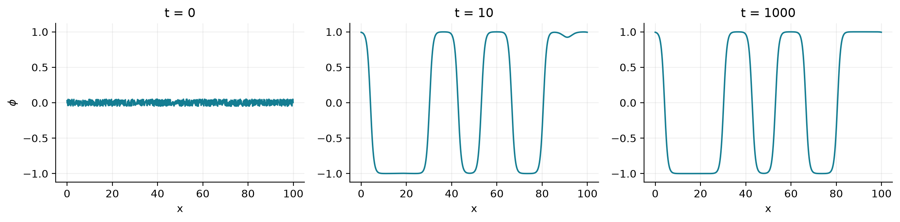
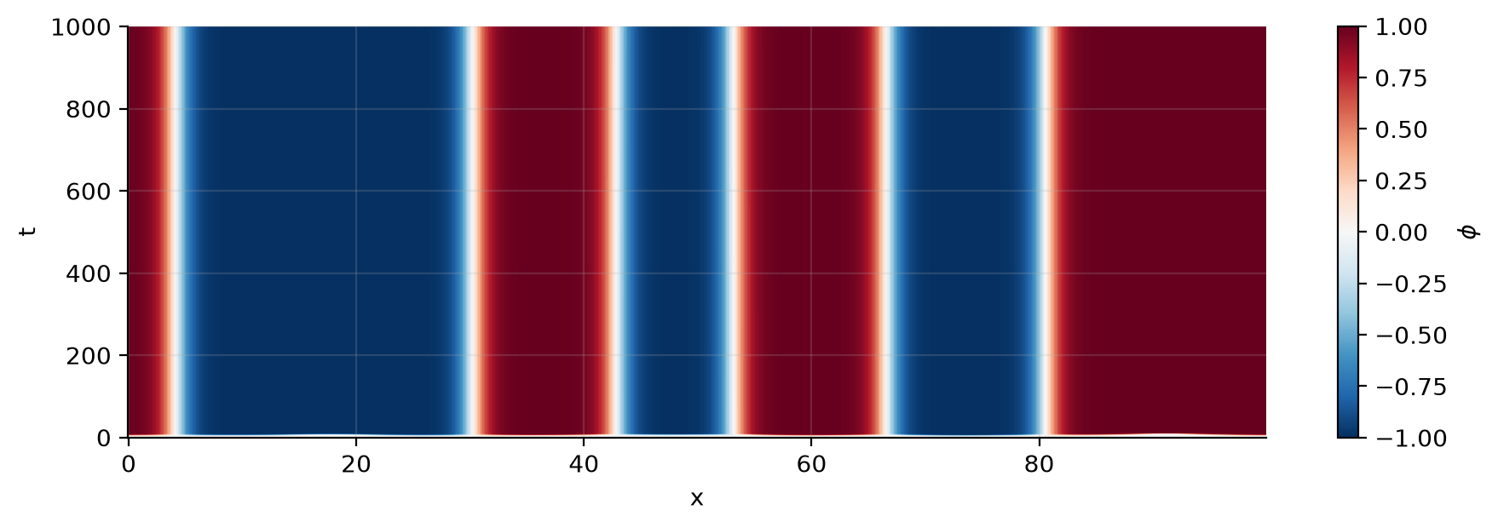
1D RESULT
1D ordering: six walls remain at t = 1000
L=100, N=1024, Δt=0.001; simulated to t=1000.
What changes with time?
t=0
small random fluctuations
t=10
rapid separation into ±1 domains
t=1000
long-lived kink–antikink walls remain
Physical interpretation
Six periodic domain walls remain at t=1000. The field has locally ordered regions but has not reached a uniform phase. Both plots show the actual archived trajectory.
0.8824
0.4152
−0.1934
⟨|φ|⟩
⟨φ²⟩/2
F/V
[1] Verma et al., Phys. Rev. E 107, 034207 (2023) • [2] Yadav et al., Phys. Rev. E 110, 044130 (2024)
Notes:
Actual tdgl_1d_random.npz, seed42 default_rng, L100 N1024 dt0.001 t_final1000. Six walls remain. Final mean_abs=0.8824038884198395, mean_square/2=0.4151693534189593, F/L=-0.19344051078645472. Both plots use this same archive, with actual time coordinates.

Slide 4
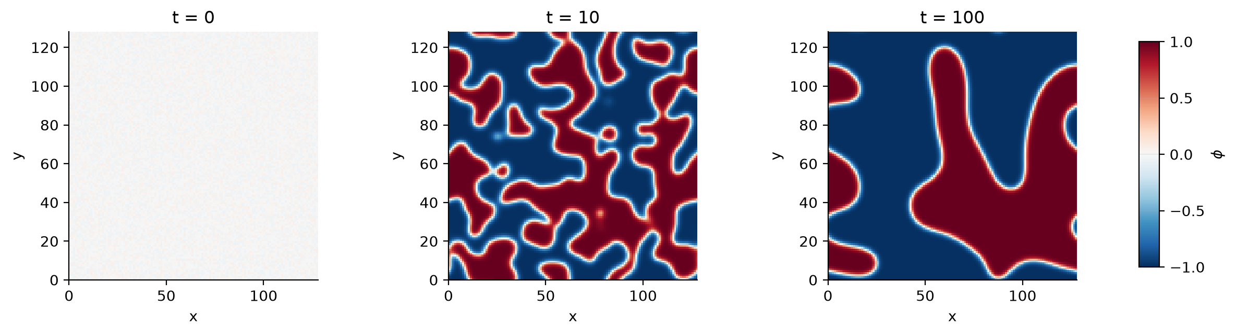
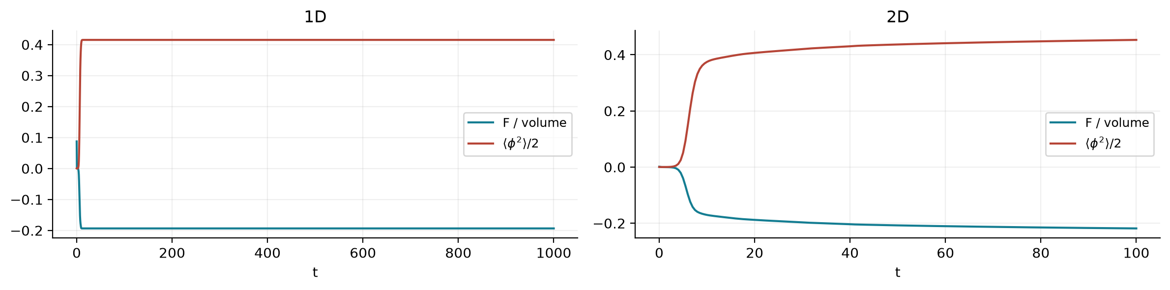
2D RESULT + RELAXATION
Curvature-driven coarsening in two dimensions
128×128 grid, Δx=1, Δt=0.01; simulated to t=100.
2D mechanism
Interfaces smooth
Small regions disappear
Coarsening morphology
No growth exponent fitted
Two quantities, opposite directions
Ginzburg–Landau free energy
F/V ↓
Ordering measure
⟨φ²⟩/2 ↑
Final 2D: ⟨|φ|⟩=0.9354
⟨φ²⟩/2=0.4530, F/V=−0.2185
[1] Verma et al., Phys. Rev. E 107, 034207 (2023) • [2] Yadav et al., Phys. Rev. E 110, 044130 (2024)
Notes:
Actual tdgl_2d_random.npz, L128 Nx=Ny128 dt.01 t_final100. Final mean_abs0.9354388494349488, mean_square/2 0.45303124816685036, F/L² -0.218481887262061. Images plot phi.T with origin lower. Bottom diagnostics show actual 1D and2D times separately. h1 is coarse relative to sqrt2 interface width. No growth exponent fitted.

Slide 5
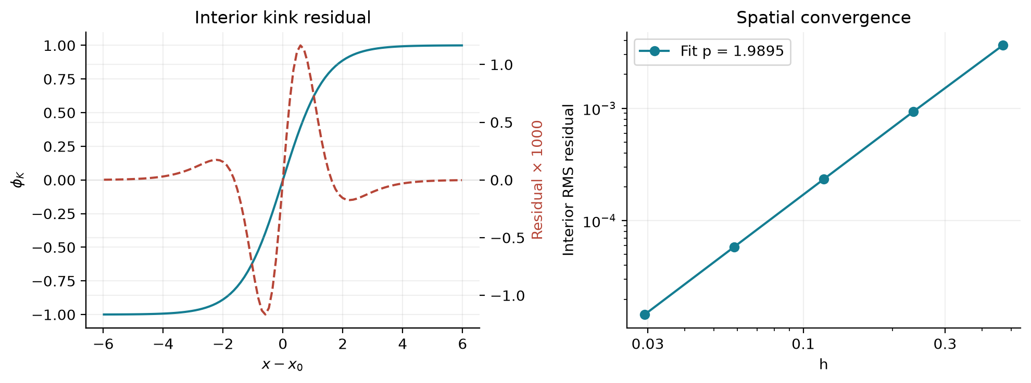
VALIDATION + CONCLUSION
Validation of the numerical solver
Analytical benchmarks, consistent energy diagnostics and independent replay.
Independent checks
✓
φ = ±1 are exact discrete fixed points
✓
small perturbation around φ = 0 grows
✓
both Δt values satisfy the linear bound
✓
1.81M steps: no energy rise > 10⁻⁹
✓
interior kink residual: p = 1.9895
✓
13 / 13 Python tests pass
What the project establishes
1D
2D
Numerics
kink–antikink domains reproduced
curvature-driven coarsening reproduced
2nd-order spatial convergence confirmed
All reported fields and metrics come from executed simulations and independent checks.
▶ LIVE WEB SIMULATOR
Limits: single random seed, finite observation times and coarse 2D interfaces. No universal growth law claimed.
idc-p20.vercel.app
[1] Verma et al., Phys. Rev. E 107, 034207 (2023) • [2] Yadav et al., Phys. Rev. E 110, 044130 (2024)
Notes:
13 Python tests pass. Kink interior RMS order1.989471479830743; maximum norm1.9664026638547067. Uniform nonlinear exact-solution temporal order0.9986015210509227 in both dimensions. Independent replay:1,000,000+10,000+800,000 steps, no energy increase above1e-9, maximum archived-field discrepancy2.4908720919203375e-12. A single isolated kink is an infinite-line analytic solution; its interior residual test does not impose periodic single-kink equilibrium. Optional nonlinear transfer analysis is not performed.

